Slide 1
OAuth2.0 and OpenID Connect
https://github.com/lbwxly/OAuthSample
Jensen Wang
Sep of 2019

Slide 2
Agenda
Traditional Form Authentication
Delegating Authenticate Problem
OAuth2.0 Overview -Authorization Code mode -Implicit mode
OpenId Connect
IdentityServer4
Auth0

Slide 3
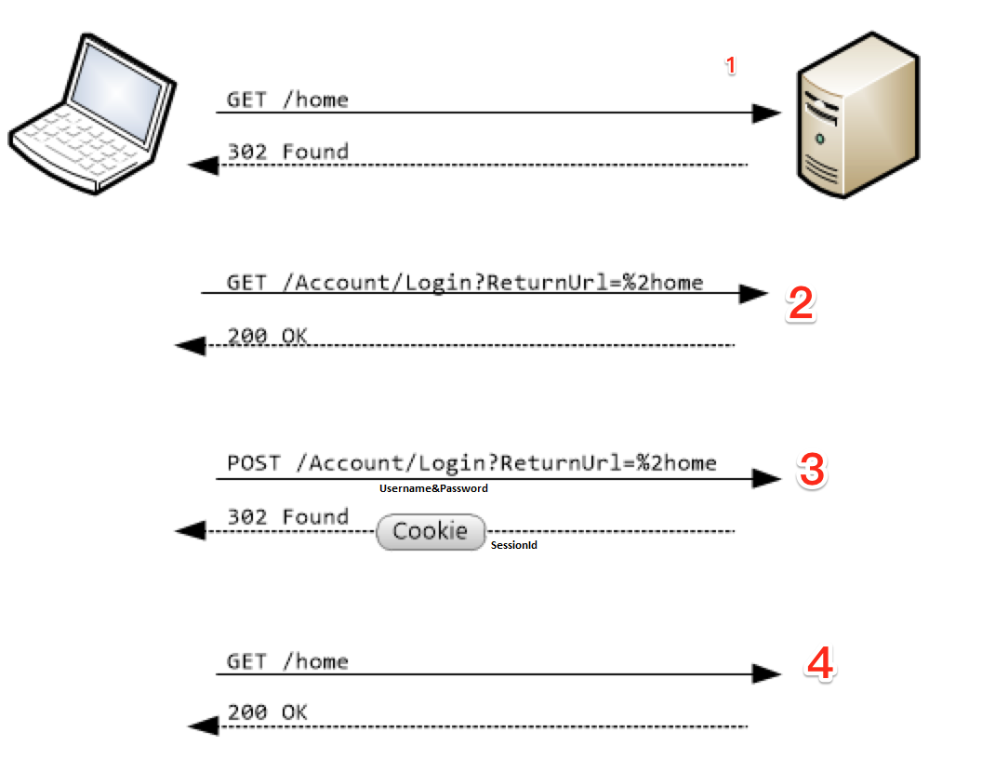
Traditional Form Authentication

Slide 4
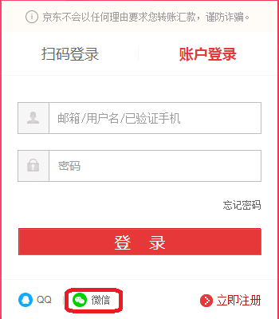
Traditional Form Authentication
Drawback
Need transfer user’s third party password(Not safe)
Need store user’s third party password(Not safe)
Grant the full control

Slide 5
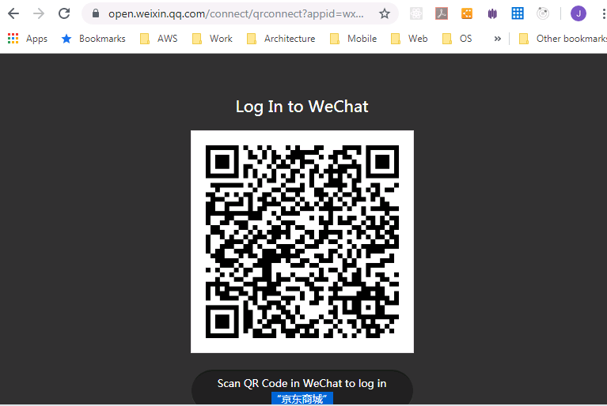
Delegating Authentication

Slide 6

OAuth
OAuth is an open standard for access delegation, commonly used as a way for Internet users to grant websites or applications access to their information on other websites but without giving them the passwords.

Slide 7
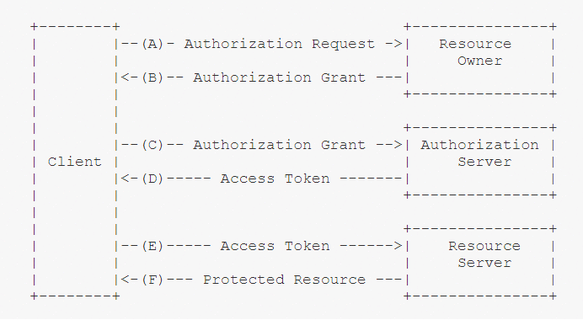
Oauth 2.0 workflow
Terminology
Authorization Server
Client
Access token(Jwt)
Resource Server
Redirect Url
Scope

Slide 8
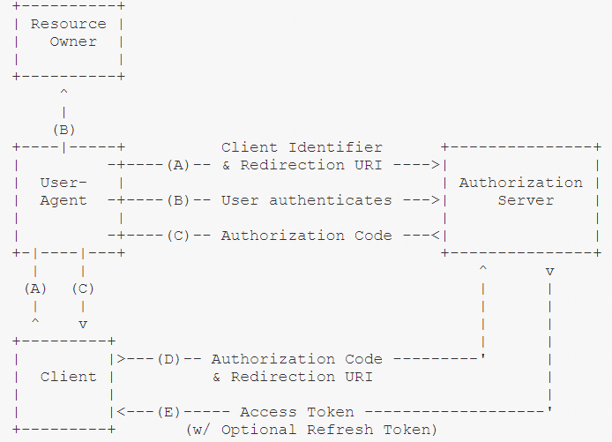
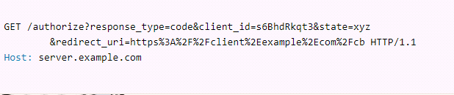
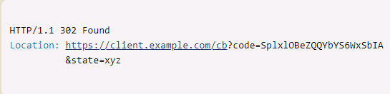
Oauth 2.0-Authorization code mode

Slide 9
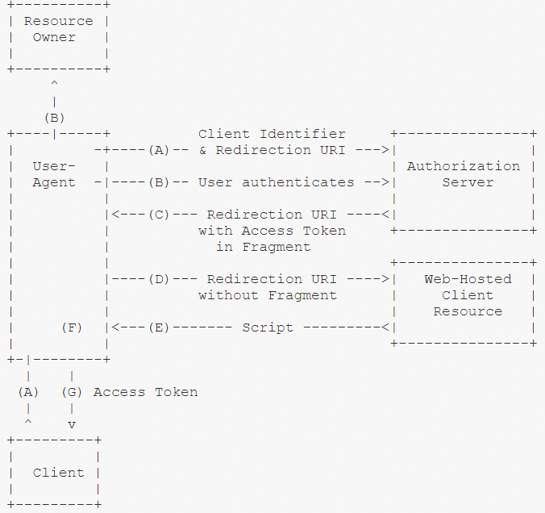
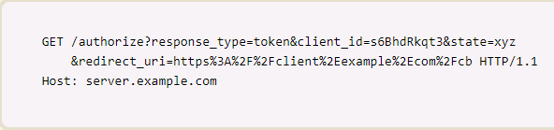
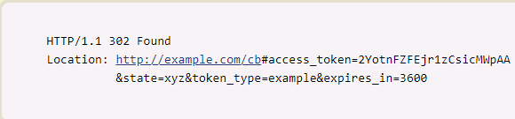
Oauth 2.0-implicit mode

Slide 10
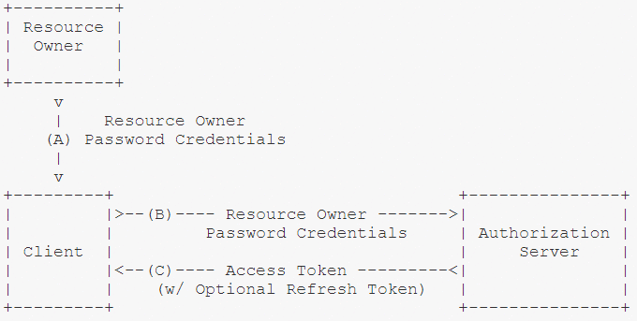
Oauth 2.0-Password mode

Slide 11
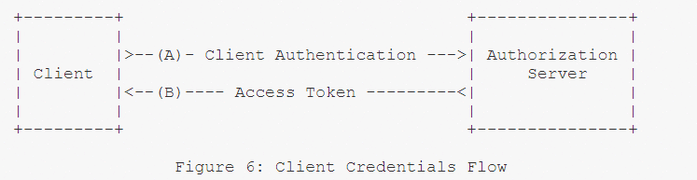
Oauth 2.0-Client credential mode

Slide 12
AccessToken-JWT(JSON Web Token)
JSON Web Token (JWT) is an open standard (RFC 7519) that defines a compact and self-contained way for securely transmitting information between parties as a JSON object.
This information can be verified and trusted because it is digitally signed. JWTs can be signed using a secret (with the HMAC algorithm) or a public/private key pair using RSA or ECDSA

Slide 13
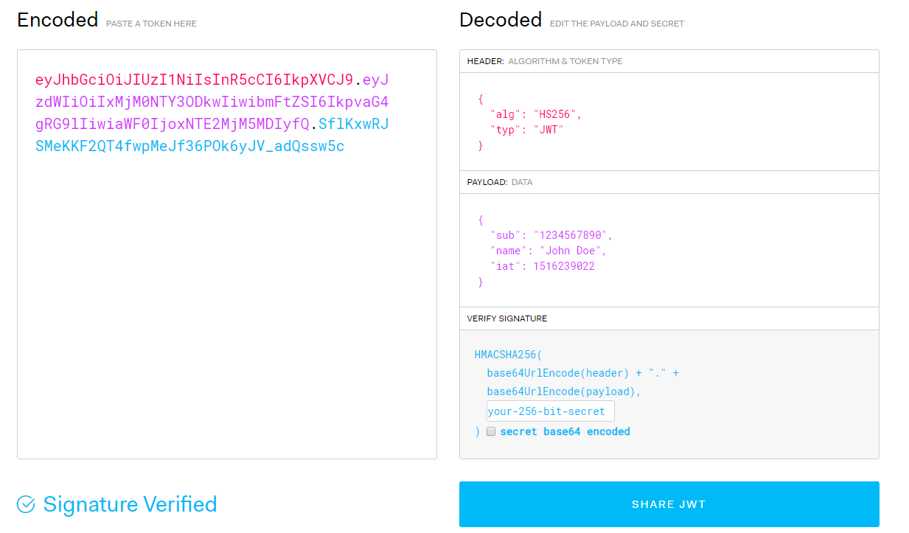
AccessToken-JWT(JSON Web Token)

Slide 14
OpenID Connect
OpenID Connect 1.0 is a simple identity layer on top of the OAuth 2.0 protocol.
It allows Clients to verify the identity of the End-User based on the authentication performed by an Authorization Server, as well as to obtain basic profile information about the End-User in an interoperable and REST-like manner.

Slide 15
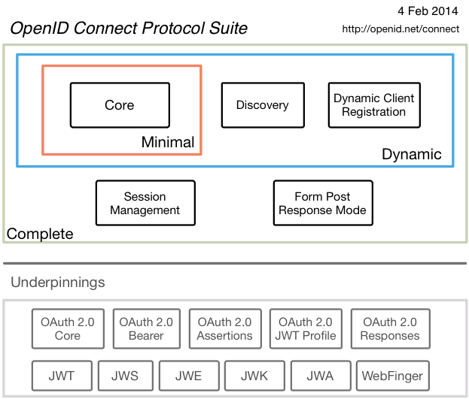
OpenID Connect

Slide 16
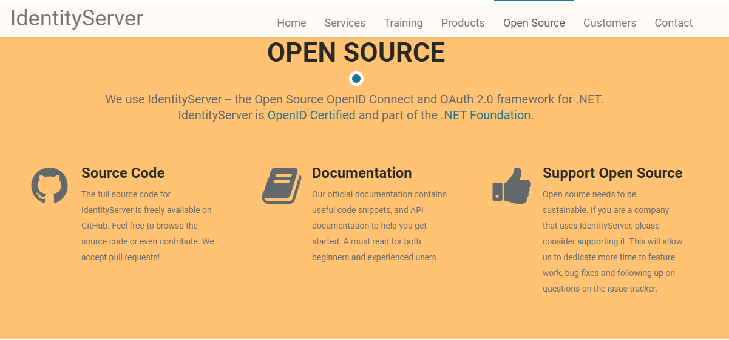
IdentityServer

Slide 17
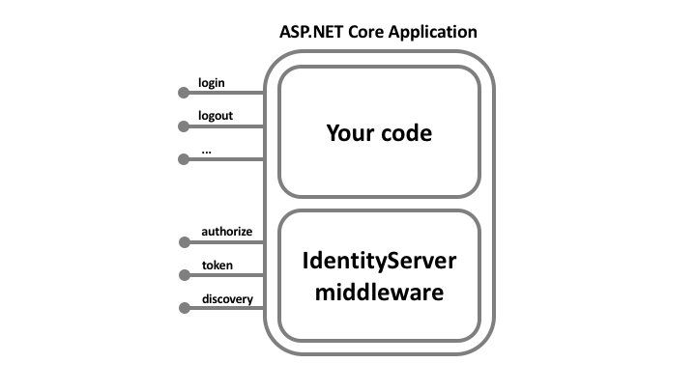
IdentityServer

Slide 18
IdentityServer-Our own Authorization Server
Authorization Server
.well-known/openid-configuration
authorize?type=code
callback?code=xxxx
Web Frontend
Web Api
GET api/now Authorization Bearer xx

Slide 19
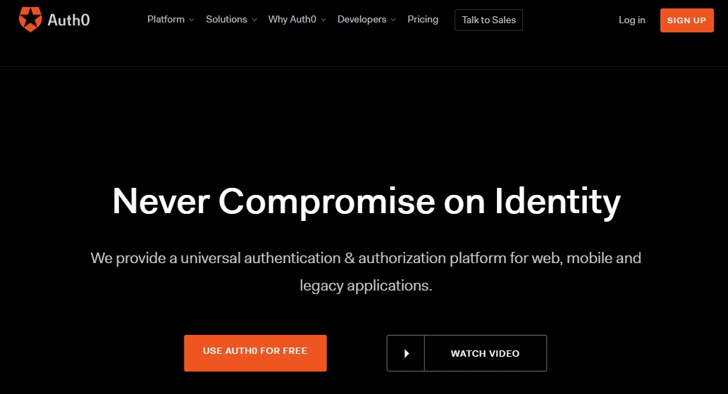
Auth0- Sass

Slide 20
Thank You!

