Slide 1
RESTful Api Introduction
https://github.com/lbwxly/Todo
Jensen Wang
April of 2019

Slide 2
Agenda
REST Architecture Introduction
ASP.NET Web API Framework -Basic Introduction -Life Cycle -Sample
Document Generator -Build in -Swagger

Slide 3
REST Architecture
Representational State Transfer(PhD paper, Roy Thomas Fielding) https://www.ics.uci.edu/~fielding/pubs/dissertation/top.htm https://www.ics.uci.edu/~fielding/pubs/dissertation/rest_arch_style.htm
Architecture style for distributed hypermedia systems
Constraints
Client-Server
Stateless
Cache
Uniform Interface
Layered System
Code-On-Demand(Optional)

Slide 4

REST Architecture-Client-Server

Slide 5
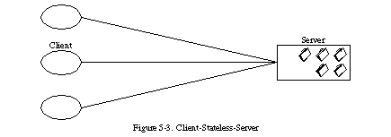
REST Architecture-Stateless

Slide 6
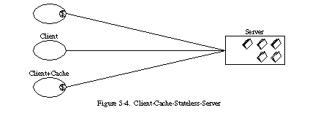
REST Architecture-Cache

Slide 7
REST Architecture-Uniform Interface
any information that can be named can be a resource
identification of resources
manipulation of resources through representations (A representation consists of data, metadata describing the data)
self-descriptive messages (Each message contains all the information necessary to complete the task)
hypermedia as the engine of application state (a REST-ful application enables the server to inform the client of the possible ways to change the state of the application via hypermedia.)

Slide 8
REST Architecture-Layered System
Doesn’t restrict to particular protocol

Slide 9
REST Architecture-Data Element
Data Element | Modern Web Examples
Resource Any information that can be named can be a resource | the intended conceptual target of a hypertext reference
Resource Identifier | URL, URN
Representation Capture the current or intended state of that resource | HTML document, JPEG image
Representation Metadata | media type, last-modified time
Resource Metadata | source link, alternates, vary
Control Data | if-modified-since, cache-control

Slide 10
REST Architecture
Doesn’t restrict to particular protocol

Slide 11
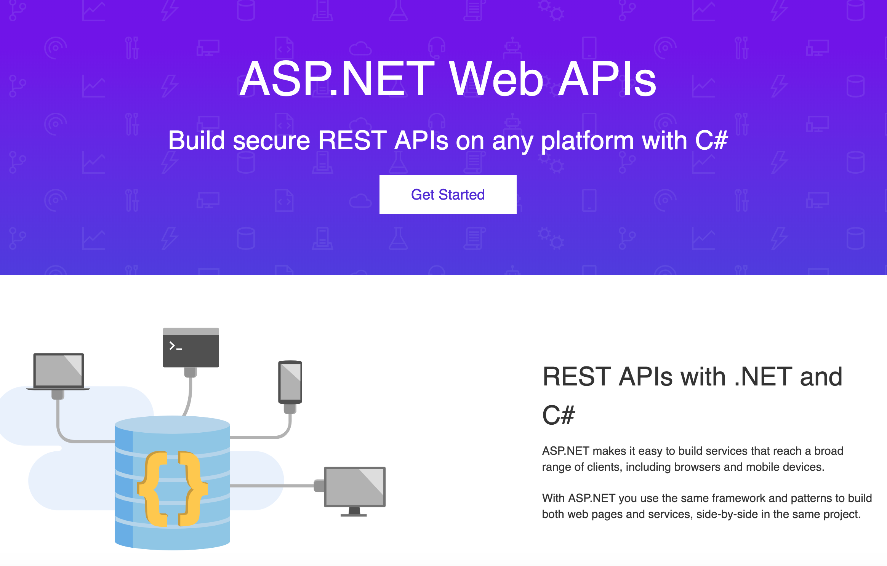
ASP.NET Web API Framework
https://dotnet.microsoft.com/apps/aspnet/apis https://docs.microsoft.com/en-us/aspnet/web-api/

Slide 12
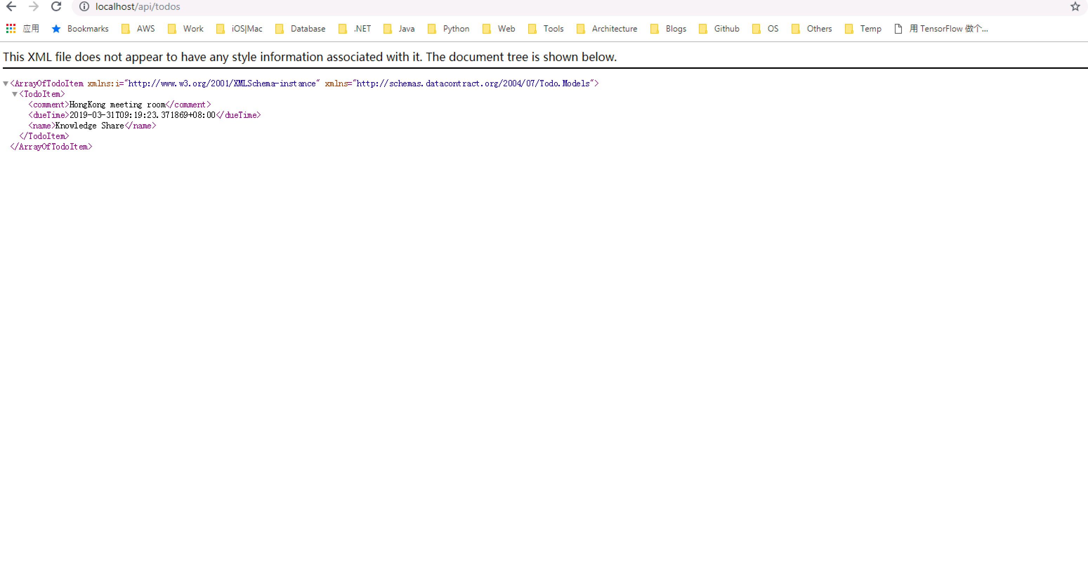
ASP.NET Web API-What does it look like?

Slide 13
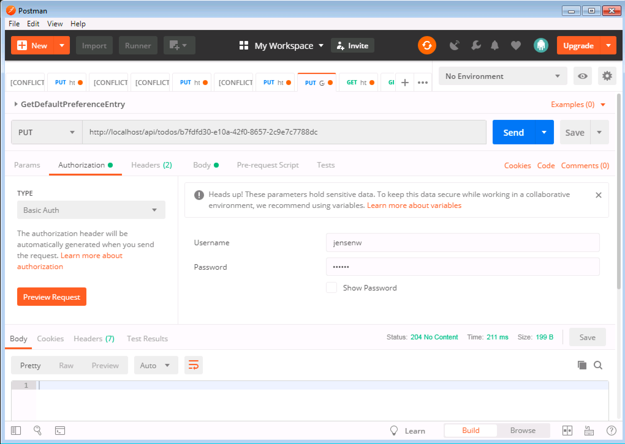
ASP.NET Web API-Access from Postman

Slide 14
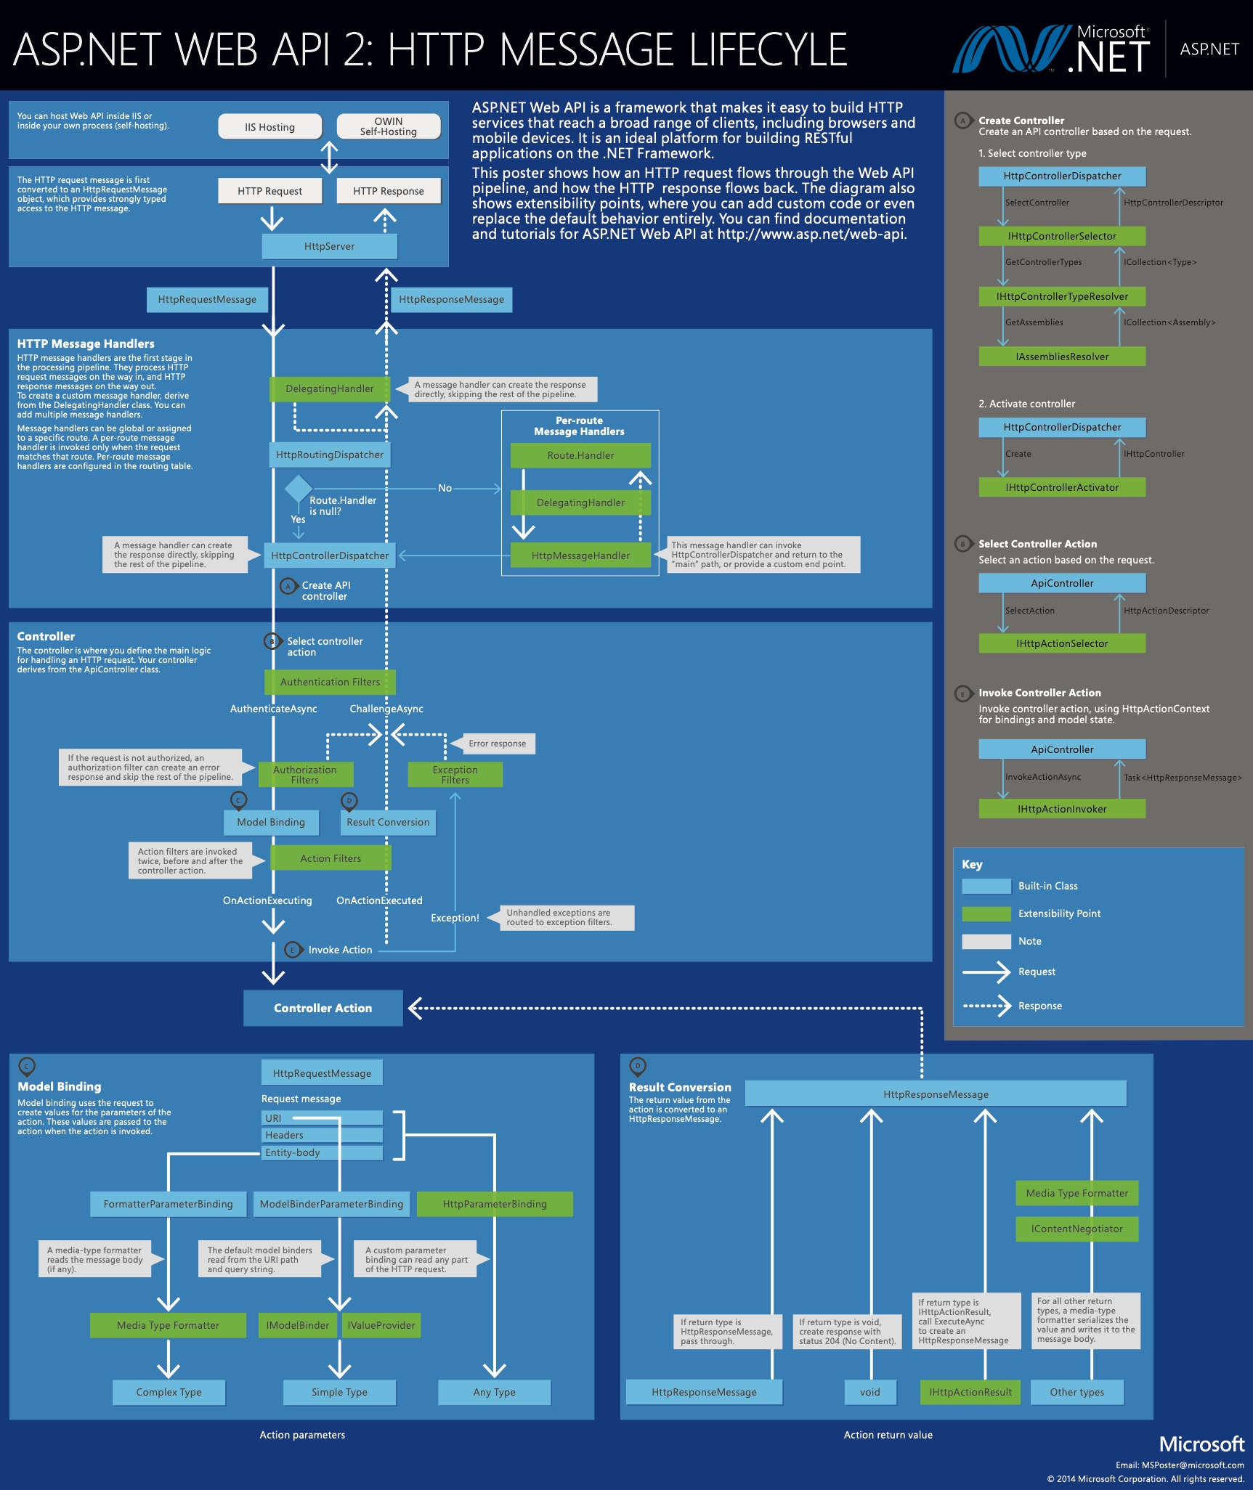
ASP.NET Web API-Request Process Pipeline

Slide 15
ASP.NET Web API-Delegating Handler
Request Monitor
Authentication Handler

Slide 16
ASP.NET Web API-Routing
Match Http Method
Match Route Template(from path of URL)
Match Action Parameter - Exclude optional parameter - All non-optional parameter are required - Match as more as possible
https://docs.microsoft.com/en-us/aspnet/web-api/overview/web-api-routing-and-actions/attribute-routing-in-web-api-2

Slide 17
ASP.NET Web API-ActionFilter
Parameter Validation Sample(GridValidation)

Slide 18
ASP.NET Web API-Model Binding
Route Table(simple type binding)
FromUri
FromBody(complex type binding)
Customized ModelBinding, DateBinder sample

Slide 19
ASP.NET Web API-Error Handling
Error handling sample

Slide 20
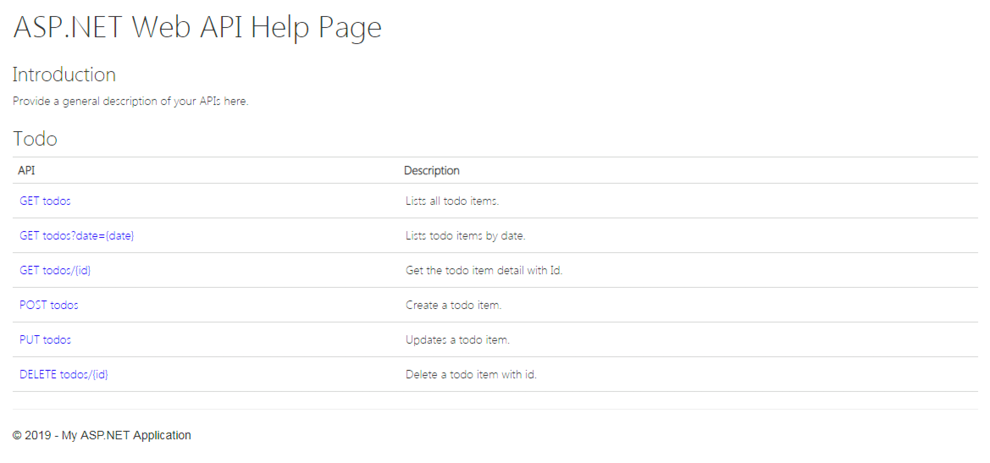
ASP.NET Web API-Buildin Document Generator

Slide 21
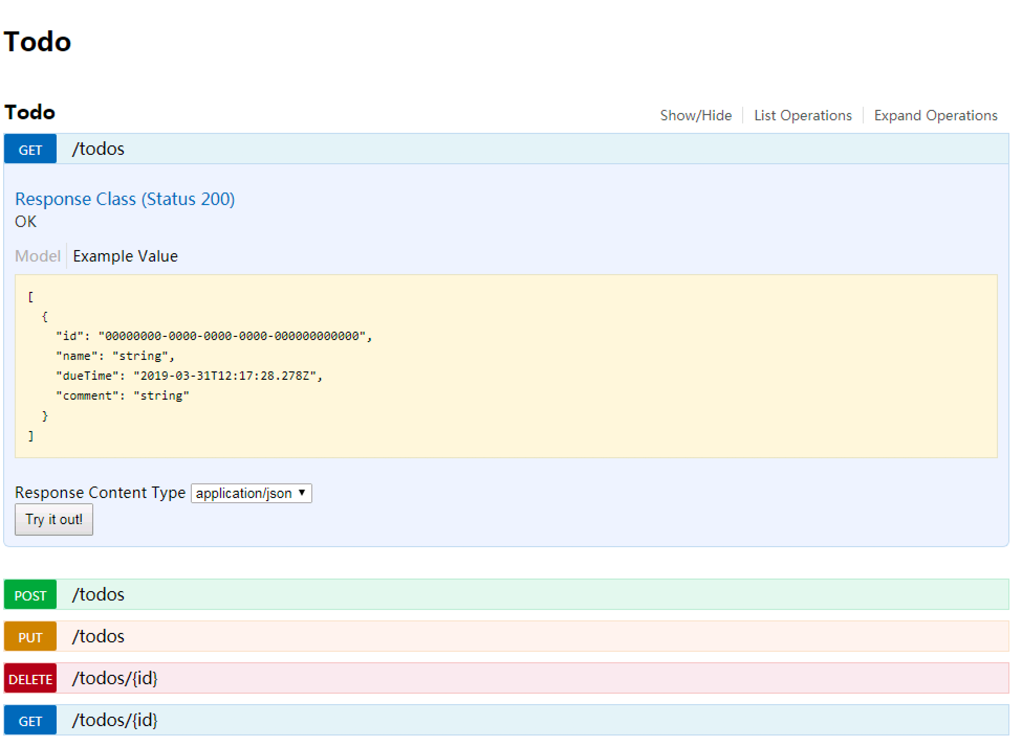
ASP.NET Web API-Swagger

Slide 22
Thank You!

