Slide 1
RESTful Api Introduction
Jensen Wang
April of 2019

Slide 2
Agenda
REST Architecture Introduction
ASP.NET Web API Framework -Basic Introduction -Life Cycle -Sample
Document Generator -Build in -Swagger
Test with Postman

Slide 3
REST Architecture
Representational State Transfer(PhD paper, Roy Thomas Fielding) https://www.ics.uci.edu/~fielding/pubs/dissertation/top.htm https://www.ics.uci.edu/~fielding/pubs/dissertation/rest_arch_style.htm
Architecture style for distributed hypermedia systems
Constraints
Client-Server
Stateless
Cache
Uniform Interface
identification of resources
manipulation of resources through representations
self-descriptive messages
hypermedia as the engine of application state
Layered System
Code-On-Demand(Optional)
Doesn’t restrict to particular protocol

Slide 4
REST Architecture-Layered System

Slide 5
REST Architecture Style
Data Element | Modern Web Examples
Resource Any information that can be named can be a resource | the intended conceptual target of a hypertext reference
Resource Identifier | URL, URN
Representation Capture the current or intended state of that resource | HTML document, JPEG image
Representation Metadata | media type, last-modified time
Resource Metadata | source link, alternates, vary
Control Data | if-modified-since, cache-control

Slide 6
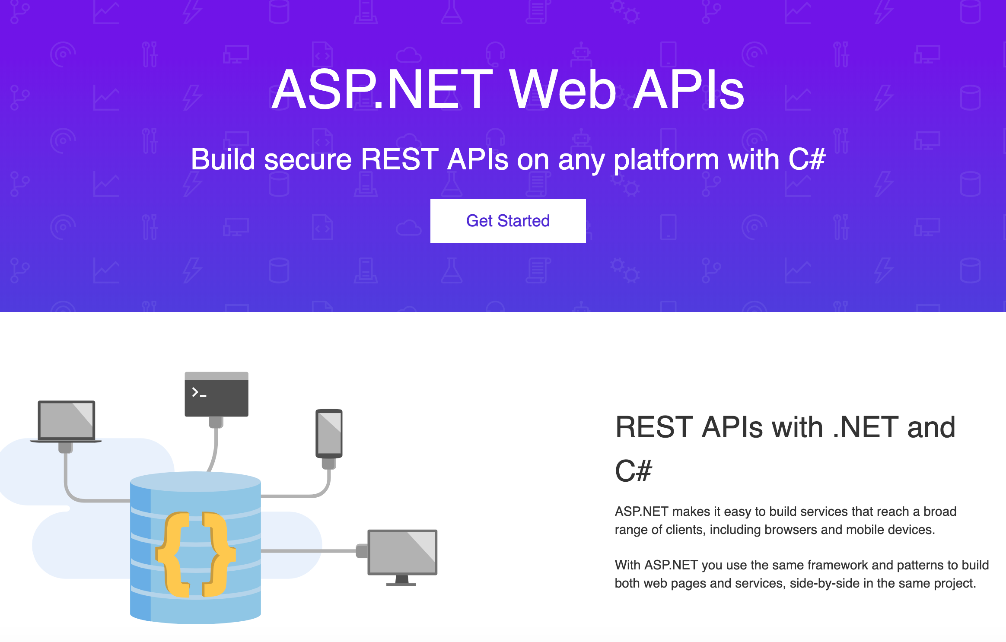
ASP.NET Web API Framework
https://dotnet.microsoft.com/apps/aspnet/apis

Slide 7
ASP.NET Web API-What does it look like?
Sample Snapshot here

Slide 8
ASP.NET Web API-Test with Postman
Sample Snapshot here

Slide 9
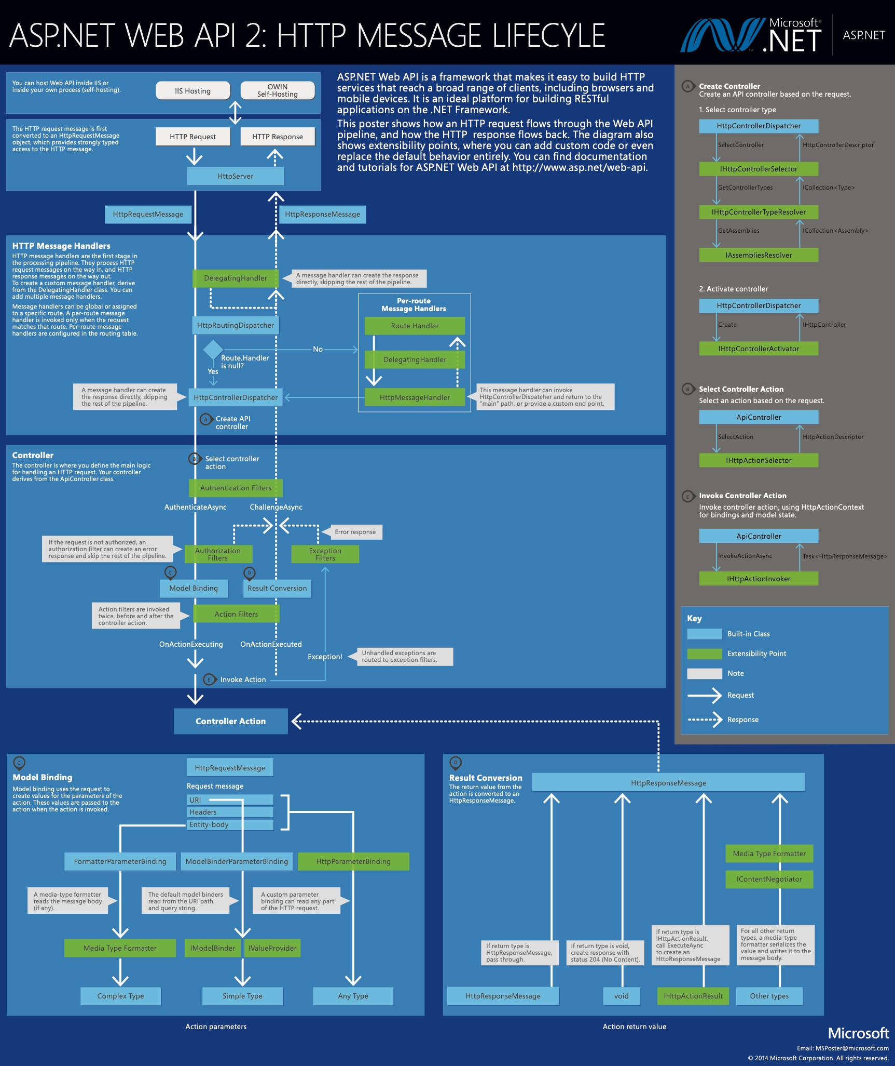
ASP.NET Web API-Request Process Pipeline

Slide 10
ASP.NET Web API-Delegating Handler
Sample Snapshot here

Slide 11
ASP.NET Web API-Routing
Sample Snapshot here

Slide 12
ASP.NET Web API-ActionFilter
Sample Snapshot here

Slide 13
ASP.NET Web API-Model Binding
Sample Snapshot here

Slide 14
ASP.NET Web API-Buildin Document Generator
Sample Snapshot here

Slide 15
ASP.NET Web API-Swagger
Sample Snapshot here

Slide 16
Thank You!

