Slide 1
RESTful Api Introduction
https://github.com/lbwxly/Todo
Jensen Wang
April of 2019

Slide 2
Agenda
REST Architecture Introduction
ASP.NET Web API Framework -Basic Introduction -Life Cycle -Sample
Document Generator -Build in -Swagger

Slide 3
REST Architecture
Representational State Transfer(PhD paper, Roy Thomas Fielding) https://www.ics.uci.edu/~fielding/pubs/dissertation/top.htm https://www.ics.uci.edu/~fielding/pubs/dissertation/rest_arch_style.htm
Architecture style for distributed hypermedia systems
Constraints
Client-Server
Stateless
Cache
Uniform Interface
Layered System
Code-On-Demand(Optional)

Slide 4

REST Architecture-Client-Server

Slide 5
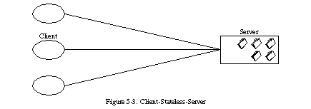
REST Architecture-Stateless

Slide 6
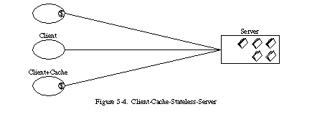
REST Architecture-Cache

Slide 7
REST Architecture-Uniform Interface
any information that can be named can be a resource
identification of resources
manipulation of resources through representations (A representation consists of data, metadata describing the data)
self-descriptive messages (Each message contains all the information necessary to complete the task)
hypermedia as the engine of application state (a REST-ful application enables the server to inform the client of the possible ways to change the state of the application via hypermedia.)
The uniform interface lets the client talk to the server in a single language, independent of the architectural backend of either. (Provide an unchanging, standardized means of communicating between the client and the server, such as using HTTP with URI resources, CRUD (Create, Read, Update, Delete), and JSON.)

Slide 8
REST Architecture-Layered System
Doesn’t restrict to particular protocol

Slide 9
REST Architecture-Data Element
Data Element | Modern Web Examples
Resource Any information that can be named can be a resource | the intended conceptual target of a hypertext reference
Resource Identifier | URL, URN
Representation Capture the current or intended state of that resource | HTML document, JPEG image
Representation Metadata | media type, last-modified time
Resource Metadata | source link, alternates, vary
Control Data | if-modified-since, cache-control

Slide 10
REST Architecture
Doesn’t restrict to particular protocol
RESTful Web Api is RESTful Api on HTTP protocol
HTTP Method | Operation
POST | Create
GET | Read
PUT | Update
DELETE | Delete

Slide 11
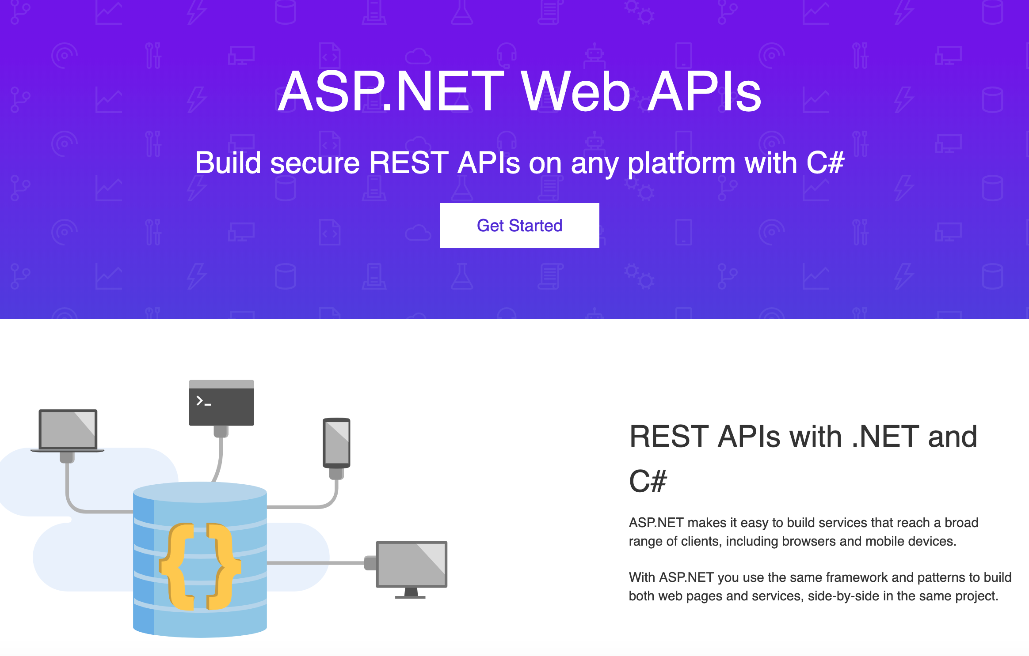
ASP.NET Web API Framework
https://dotnet.microsoft.com/apps/aspnet/apis https://docs.microsoft.com/en-us/aspnet/web-api/

Slide 12
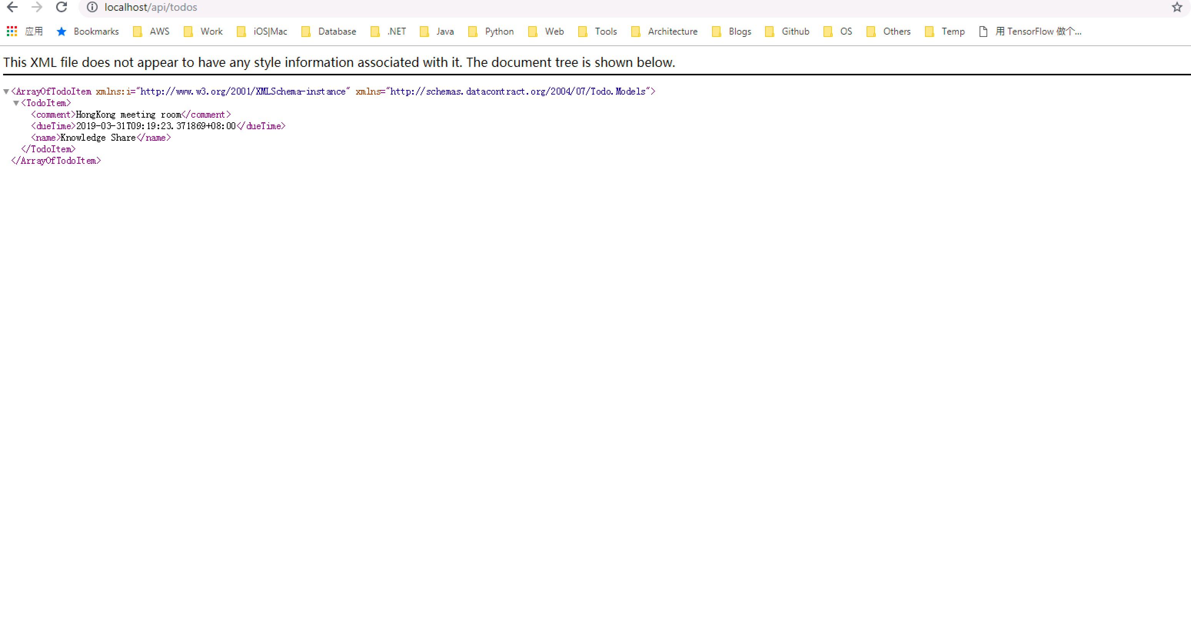
ASP.NET Web API-What does it look like?

Slide 13
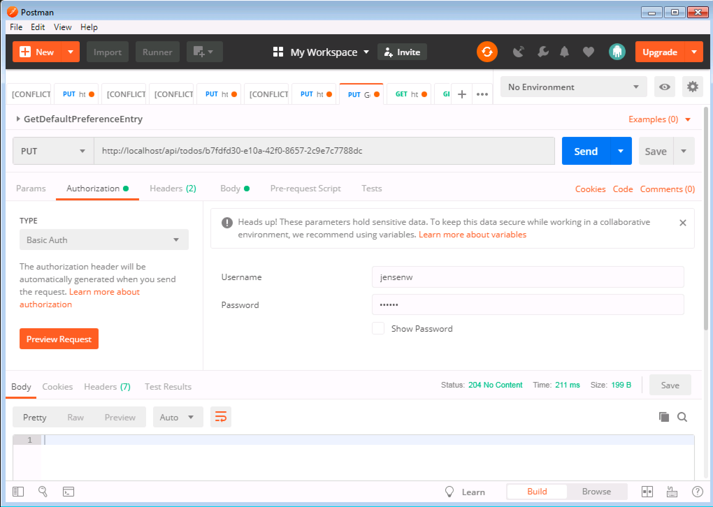
ASP.NET Web API-Access from Postman

Slide 14
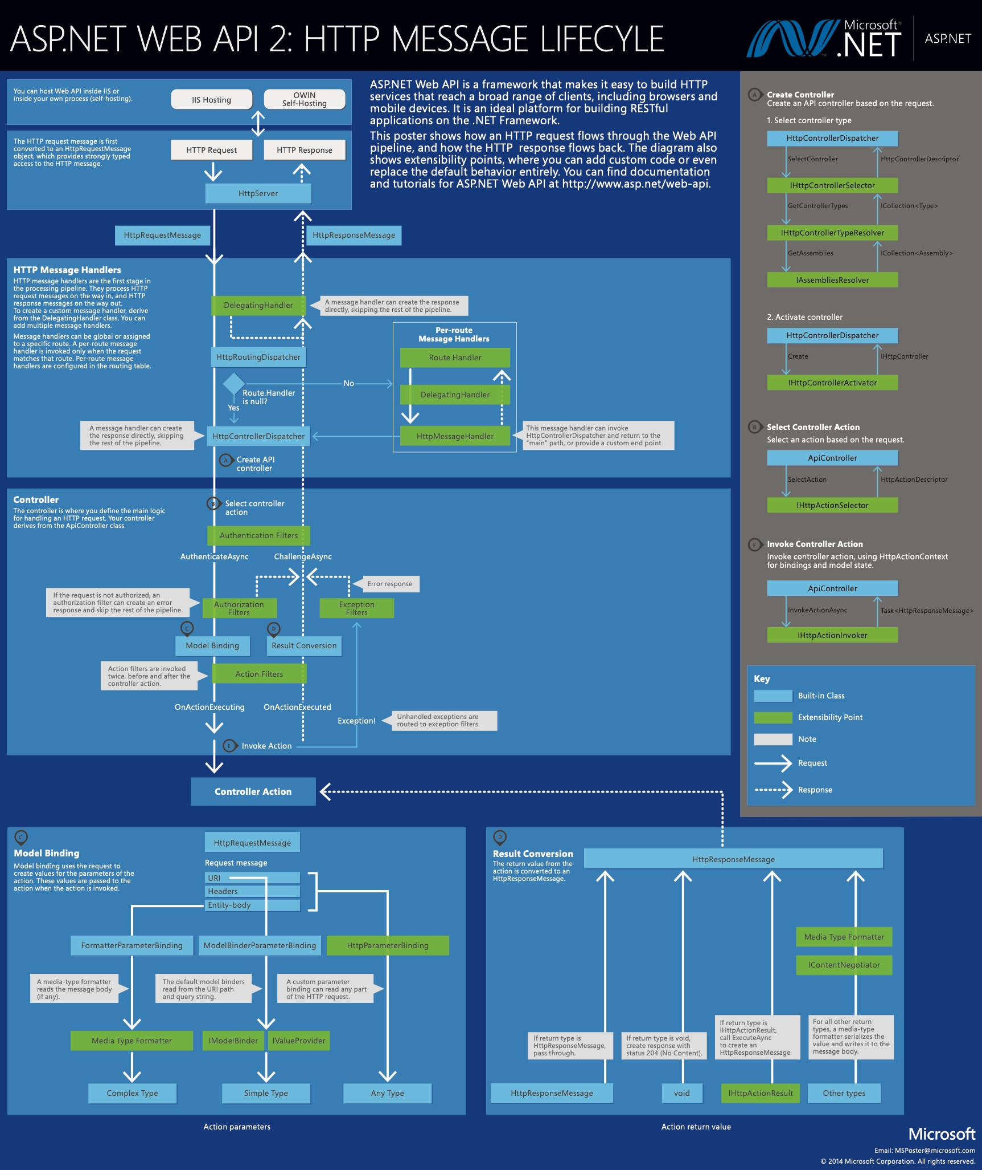
ASP.NET Web API-Request Process Pipeline

Slide 15
ASP.NET Web API-Delegating Handler
Request Monitor
Authentication Handler
https://www.cnblogs.com/Code-life/p/8376800.html (Async&Await note)

Slide 16
ASP.NET Web API-Routing
Match Http Method
Match Route Template(from path of URL)
Match Action Parameter - Exclude optional parameter - All non-optional parameter are required - Match as more as possible
https://docs.microsoft.com/en-us/aspnet/web-api/overview/web-api-routing-and-actions/attribute-routing-in-web-api-2

Slide 17
ASP.NET Web API-ActionFilter
Parameter Validation Sample(GuidValidation)

Slide 18
ASP.NET Web API-Model Binding
FromUri
FromBody(complex type binding)
Customized ModelBinding, DateBinder sample

Slide 19
ASP.NET Web API-Error Handling
Error handling sample

Slide 20
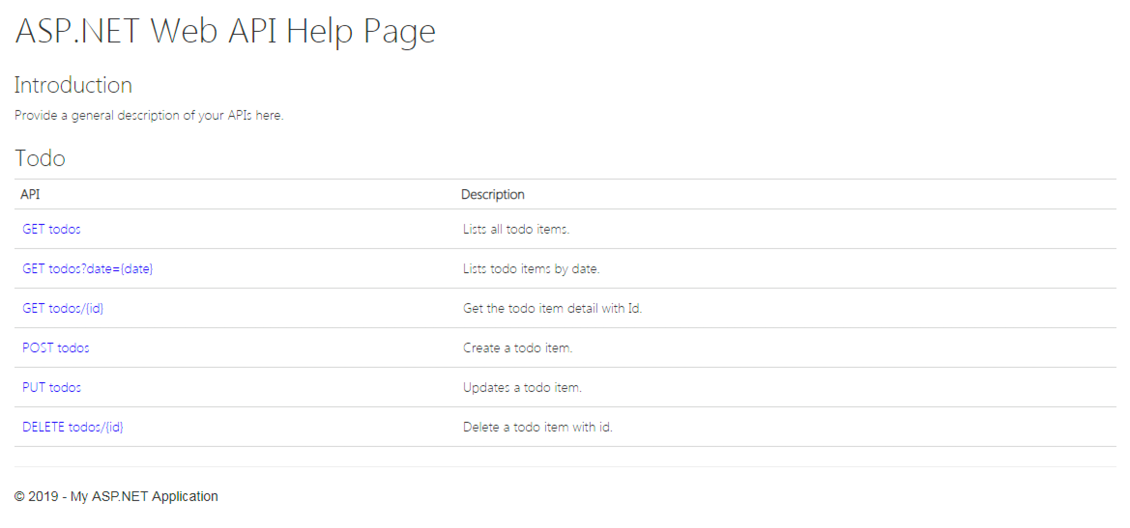
ASP.NET Web API-Buildin Document Generator

Slide 21
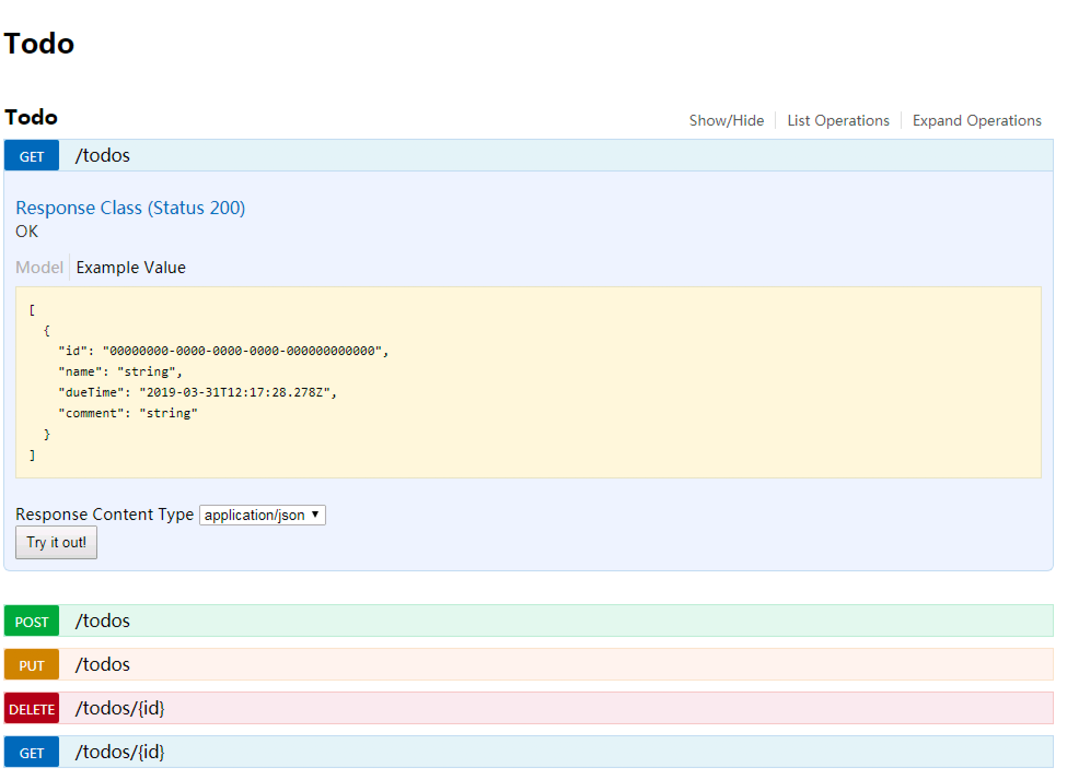
ASP.NET Web API-Swagger
http://localhost/Api/swagger

Slide 22
Thank You!

