Slide 1
Do Price and Volume Signals Predict Short-Term Stock Outperformance?
DATA 498D Capstone Project

Slide 2
Research Question
Can historical price and volume patterns predict which U.S. stocks and ETFs will rank in the top 20% of future five-day returns?
Why this matters:
Investors often use technical signals.
Many apparent market patterns are weak or unstable.
A rigorous data science workflow can test signal vs. noise.

Slide 3
Data
Kaggle Huge Stock Market Dataset:
17,078 stock and ETF price files in the downloaded archive.
Daily Open, High, Low, Close, and Volume.
Prices adjusted for dividends and splits.
Main analysis uses a liquid universe of major stocks and ETFs.
Final cleaned analysis:
1,412,252 raw rows loaded.
230 assets retained after filters.
679,803 model-ready asset-date rows.

Slide 4
Modeling Frame
We predict a cross-sectional target:
An asset is labeled positive if its future five-day return ranks in the top 20% among all assets on the same date.
Leakage controls:
Features use only information available at date t.
Future return target uses t + 5.
Train, validation, and test sets are split by time.

Slide 5
Feature Groups
Momentum: 1, 5, 21, and 63-day trailing returns.
Risk: rolling volatility and 63-day drawdown.
Volume: volume ratio and volume z-score.
Liquidity: log dollar volume.
Price behavior: daily range, gap return, open-to-close return.
Market context: SPY return and volatility when available.

Slide 6
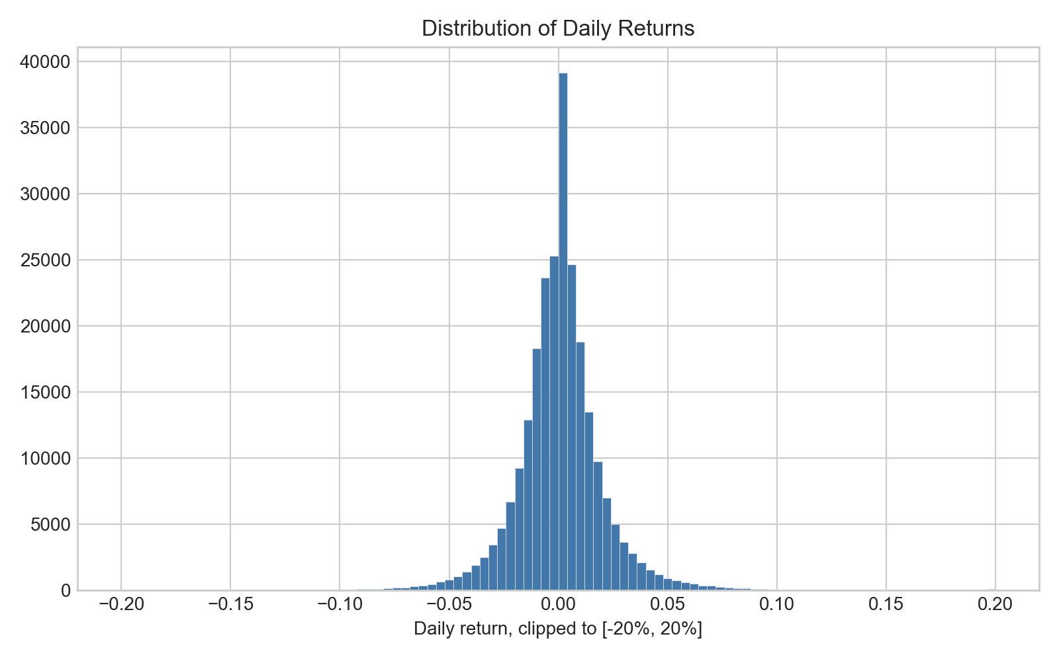
Daily Returns Are Noisy
Distribution of daily returns

Slide 7
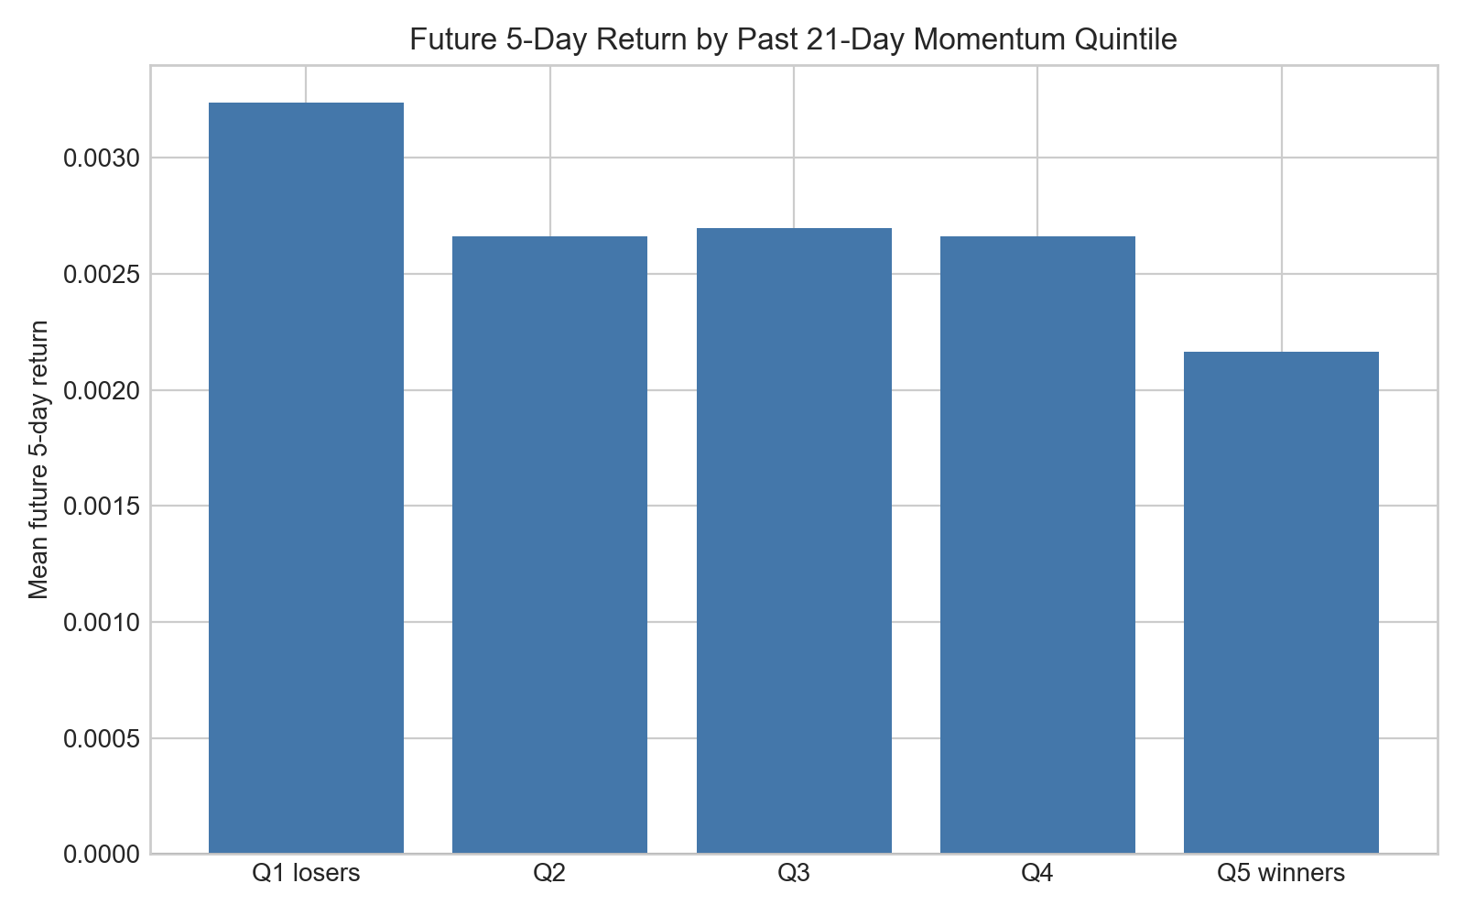
Momentum Test
The lowest past-momentum quintile had the highest average future five-day return, suggesting short-term reversal was stronger than continuation momentum in this universe.
Future return by momentum quintile

Slide 8
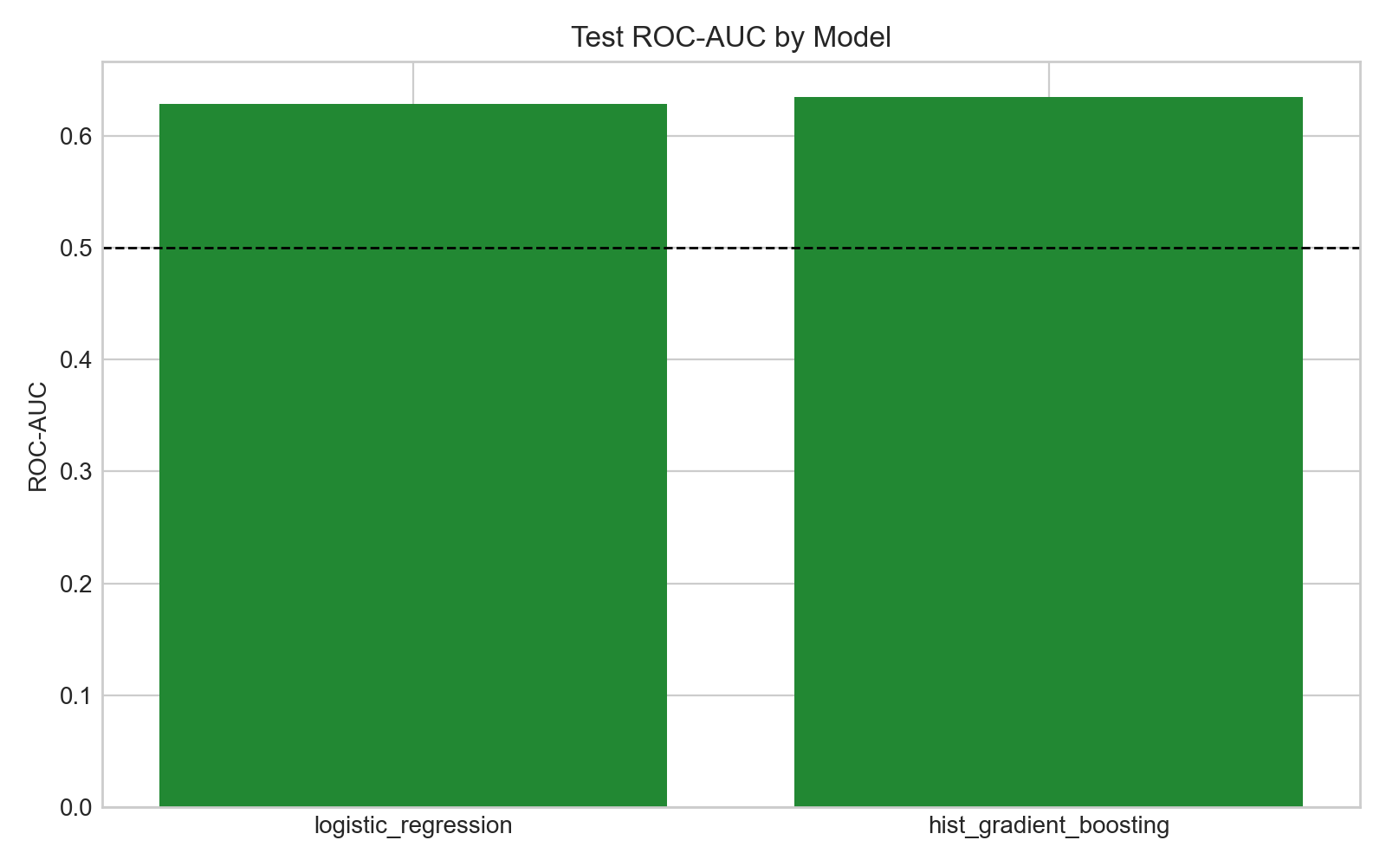
Model Results
Test ROC-AUC:
Logistic regression: 0.628
Histogram gradient boosting: 0.635
Random benchmark would be about 0.500
Model comparison

Slide 9
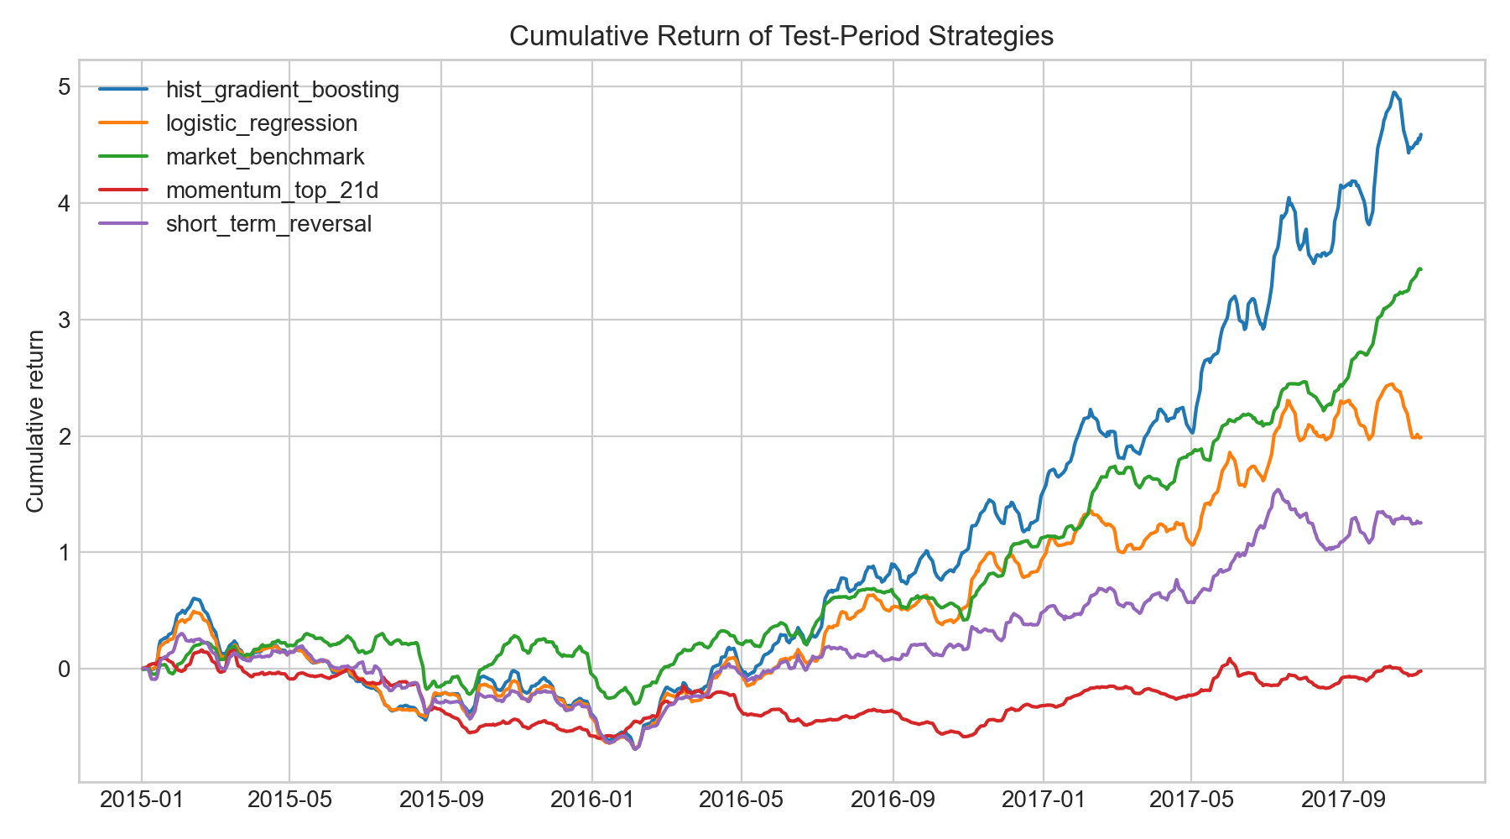
Backtest
Strategy:
Rank assets by predicted probability.
Select top 25.
Equal-weight portfolio.
Subtract 0.10% transaction cost.
Backtest cumulative returns

Slide 10
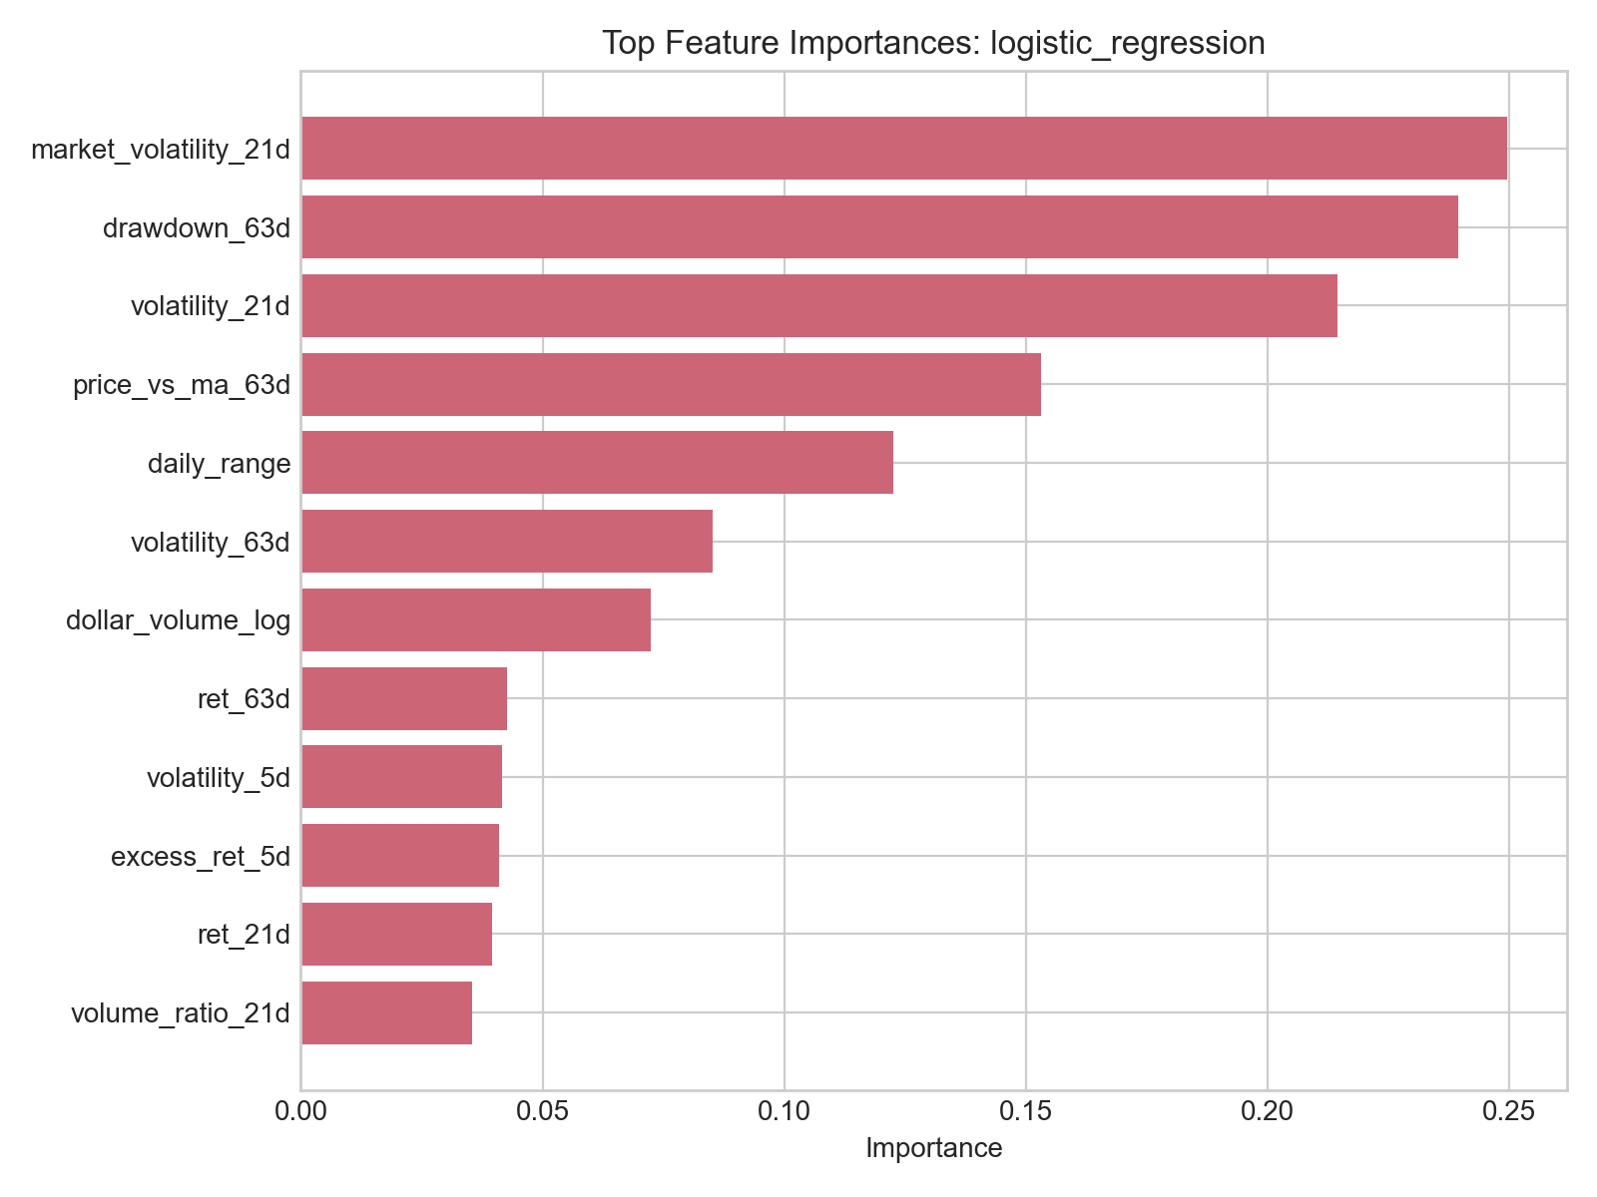
Feature Importance
The most important signals were market volatility, drawdown, rolling volatility, moving-average distance, and daily range.
Feature importance

Slide 11
Main Conclusion
Price and volume signals contain weak but measurable information about short-term relative performance.
But the project does not show an easy path to guaranteed trading profit:
Predictive signal is modest.
Active strategies had high volatility and large drawdowns.
The market benchmark had the best Sharpe ratio.
Transaction costs and risk matter.

Slide 12
Limitations and Next Steps
Limitations:
Dataset ends in 2017.
Possible survivorship bias.
No fundamentals, sectors, macro data, or news.
Simplified transaction costs.
Next steps:
Add fundamentals and sector labels.
Update through current data.
Test walk-forward retraining.
Compare stocks and ETFs separately.

