Slide 1
Robot bees as new pollination bees
Luis Bernardo Zuluaga
Manuela Zapata
Medellín, 15 de mayo 2018

Slide 2
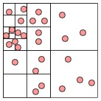
Quad Trees
Figure 1: Quad Tree of bees. A bee is a class that contains x, y coordinates.

Slide 3
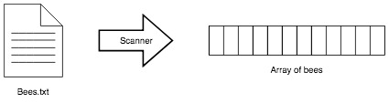
Data Structure Operations
Figure 2: Load operation of a Quad Tree

Slide 4
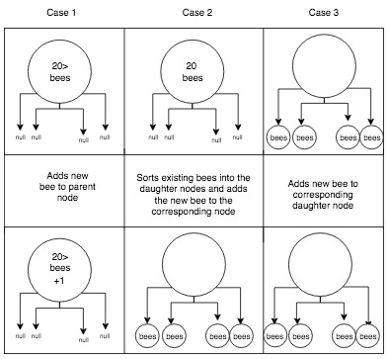
Data Structure Operations
Figure 3: Sort operation of a Quad Tree

Slide 5
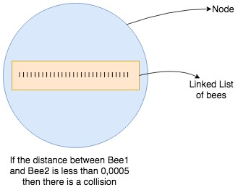
Data Structure Operations
Figure 4: Detect collision operation of a Quad Tree

Slide 6
Data Structure Operations
Method | Complexity
Add bees to list | O(n)
Sort bees into nodes | O(log4(n))
Detect collision | O(n)
Tabla 1: Cmplexity of the Quad Tree operations

Slide 7
Design Criteria of the Data Structure
Keep this title
To solve the problem, we should used, extensively, the delete operation of the first and last element.
The delete operation in a Linked List, for the first and last element, has a time complexity of O(1).
The delete operation has a memory complexity of O(1).
The delete operation of a linked list is, therefore, efficient to solve the problem.
Include your own figures and
explanations

Slide 8
Time and Memory Consumption
 | 1.000 bees | 10.000 bees | 100.000 bees
Load operation | 0.036596838 (seconds) | 0.061967095 (seconds) | 0.086280895 (seconds)
Sort operation | 0.014982947 (seconds) | 0.021908294 (seconds) | 0.01228422 (seconds)
Detect collision operation | 0.036596838 (seconds) | 0.061967095 (seconds) | 0.086280895 (seconds)
 | 1.000 bees | 10.000 bees | 100.000 bees
Load operation | 3665592 (bytes) | 3064736 (bytes) | 2446656 (bytes)
Sort operation | 166400 (bytes) | 181080 (bytes) | 183496 (bytes)
Detect collision operation | 0 (bytes) | 0 (bytes) | 0 (bytes)

Slide 9
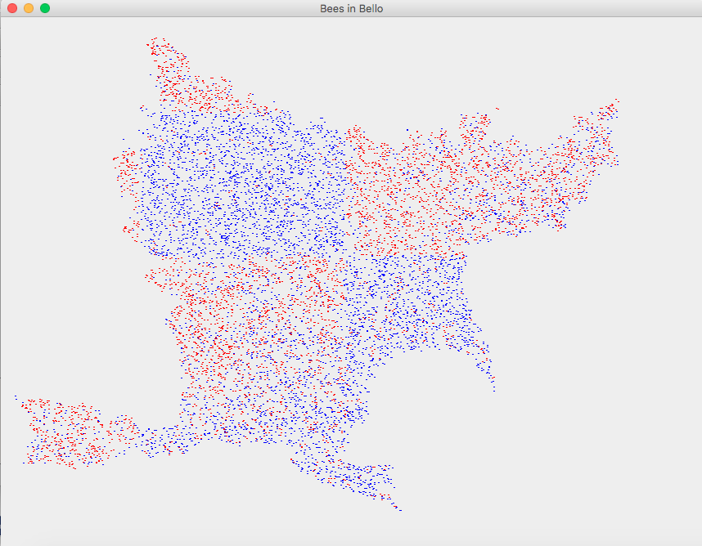
Implementation
Gráfico 4: Sistema de planificación óptima de domicilios

Slide 10
References
Onegreenplanet.org Animals and nature. Retrieved February 23, 2018. https://www.onegreenplanet.org/animalsa ndnature/the-disappearing-bees-andwhat-you-can-do-to-help/
Sos-bees.org Solutions. Retrieved February 23, 2018. http://sos-bees.org/solutions/
Euclideanspace.com Bounding boxes. Retrieved February 23, 2018 http://www.euclideanspace.com/threed/animation/collisiondetect/index.htm
Wikipedia. sweep and prune. Retrieved February 23, 2018 https://en.wikipedia.org/wiki/Sweep_and_p rune
Moodle2015-16.ua.es. Videojuegos2. Deteccion de colisiones retrieved February 23 2018 https://moodle201516.ua.es/moodle/pluginfile.php/12368/mod_resource/content/3/vii-07-colisiones.pdf
buildnewgames.com . Broad Phase Collision Detection Using Spatial Partitioning retrieved February 23, 2018 http://buildnewgames.com/broad-phasecollision-detection/

