Slide 1
Capacitated Electric Vehicle Routing Problem: Granting green deliveries
Bosse Bandowski
Luis Bernardo Zuluaga Manuela Zapata Giraldo
Medellín, October 18th

Slide 2
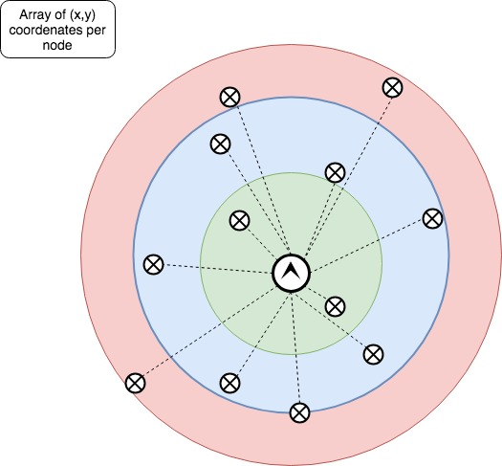

Slide 3
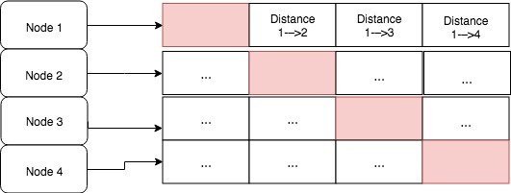
Data Structures (CN)
Figure 1: ArrayList of ArrayList. Each node can be a client, a depot or a station. The index value is the node number, and the entry value is the distance from index(node) x to index(node) y.

Slide 4
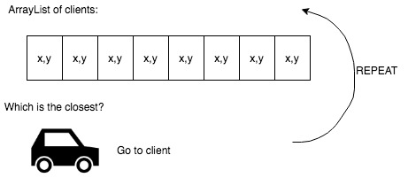
Algorithm (CN)
Figure 2: Closest neighbor algorithm representation

Slide 5
Complexity (CN)
Algorithm | Part | Method | Complexity | Asymptotic Complexity
Closest Neighbor | setup | Run.checkInput | 1 | 1
 |  | Run.readInput | n+n | 1
 |  | Run.createDistanceMatrix | n^2 | n^2
 |  | Run.createStationMatrix | n^2s | n^2s
 |  | Run.setImportantDistances | n | n
 |  | Run.orderStationsByDistanceToBase | s^2 | s^2
 |  | Run.planReturnToBase | ns | ns
 |  |  | 1+(n+n)+n^2+n^2s+n+s^2+ns | n^2s
 | planRoutes | Run.findGlobalClosestNeighbour | v | v
 |  | Vehicle.canGoToCNInTime | 1 | 1
 |  | Vehicle.returnToBase | s | s
 |  | Vehicle.canGoToCNWithFuel | 1 | 1
 |  | Vehicle.moveTo | 1 | 1
 |  | Vehicle.findClosestClient | n | n
 |  | Run.WrapUpRoutes | ns | ns
 |  |  | c(v+1+s+1+1+(vn)+ns) | cn(v+s)
Variable Definitions
n | Number of nodes
c | Number of clients
s | Number of stations
v | Number of vehicles
Table 1: Complexity analysis of the algorithm per method

Slide 6
Data Structures (VND)
Figure 2: ArrayList of ArrayList. Each node can be a client, a depot or a station. The index value is the node number, and the entry value is the distance from index(node) x to index(node) y.

Slide 7
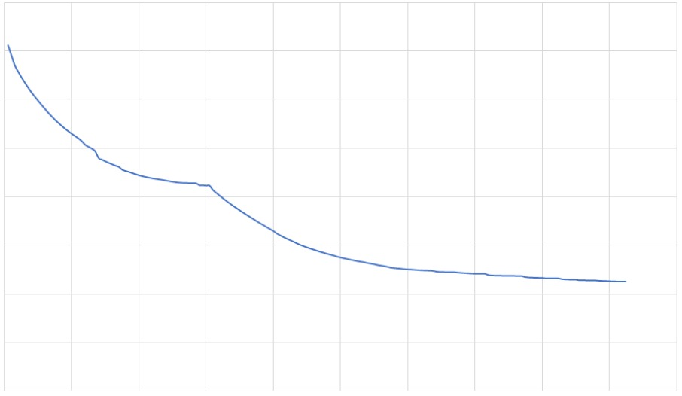
Algorithm (VND)

Slide 8
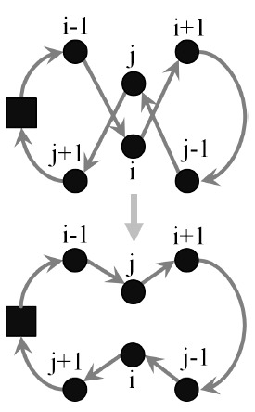
Algorithm (VND)

Slide 9
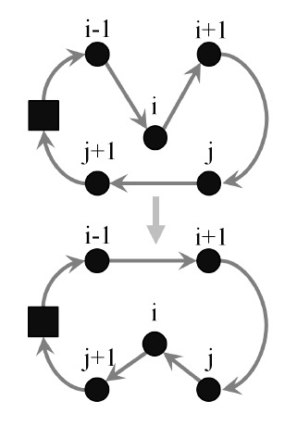
Algorithm (VND)

Slide 10
Complexity (VND)
Algorithm | Part | Method | Complexity | Asymptotic Complexity
VND | setup | changeRouteRepresentation | n+v | n+v
 |  |  | n+v | n+v
 | optimize | calculateTimeBetweenTwoNodes | 1 | 1
 |  | isFeasibleSolution | n+v | n+v
 |  | calculateObjectiveFunction | n+v | n+v
 |  | move | 1 | 1
 |  | swap | 1 | 1
 |  | reconnect | n+v+n+v | n+v
 |  |  | (n+v)(n+v)(n+3(n+v)) | (n+v)^3
Variable Definitions
n | Number of nodes
c | Number of clients
s | Number of stations
v | Number of vehicles
Table 2: Complexity analysis of the algorithm per method

Slide 11
Time and Memory Consumption for both algorithms
Execution time
 | Dataset 1 | Dataset 2 | Dataset 3 | Dataset 4
Setup | 0.2495s | 0.2595s | 0.31562s | 0.3145s
CN | 0.0214s | 0.0272s | 0.0309s | 0.0367s
VND | 0.0047s | 0.0047s | 0.0068s | 0.0057s
Memory consumption
 | Dataset 1 | Dataset 2 | Dataset 3 | Dataset 4
Setup | 15 MB | 15 MB | 17 MB | 17 MB
CN | 111 MB | 111 MB | 108 MB | 108 MB
VND | 17 MB | 17 MB | 19 MB | 19 MB

Slide 12
Total complexity
n^2s+cn(v+s)+n+v+((n+v)^3)*i
where I is the number of iterations that can be performed before the stop criteria is fulfilled (t>30s)

Slide 13
Algorithm analysis
The results show that the VND algorithm approach is much faster, but has a higher memory consumption. However, given that time is the top priority, we have concluded that VND is the best algorithm to solve this problem.

Slide 14
Thank you

