Slide 1




MODULE 3.1 · EDGE AI WORKSHOP
Efficient Inference
for Edge AI
Quantization · Pruning · Knowledge Distillation
MobileNetV2 · CIFAR-10 · PyTorch
Pre-workshop knowledge check

Slide 2





AGENDA
What we'll cover today
01
Why efficient inference matters
Edge constraints: compute, memory, power, latency
02
Quantization
FP32 → INT8 mapping, PTQ vs QAT, calibration
03
Pruning
Magnitude-based, structured vs unstructured, fine-tuning
04
Knowledge Distillation
Teacher–student, soft targets, temperature, alpha
05
Wrap-up
Comparing three techniques.
AGENDA 2 / 30

Slide 3
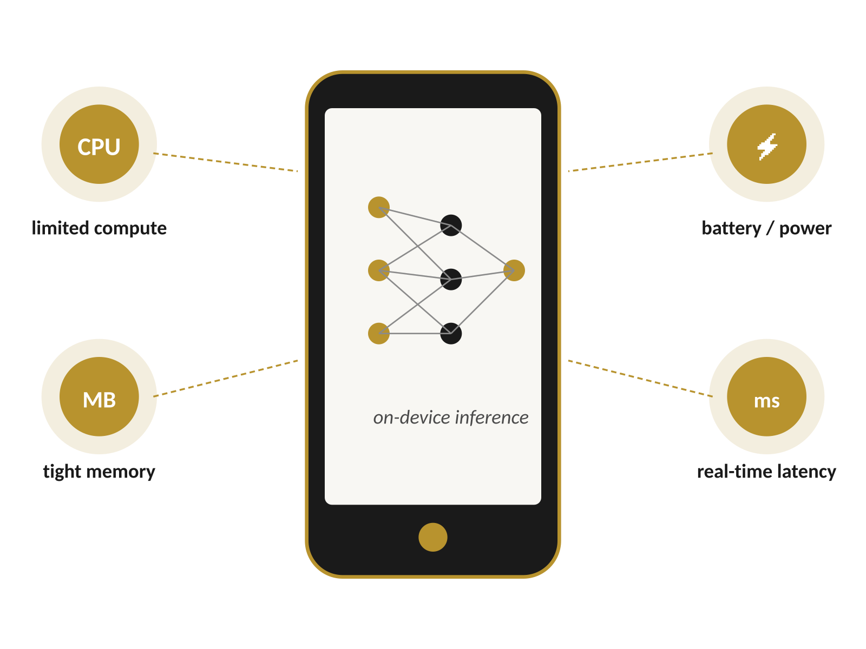




PART 1 · MOTIVATION
Why efficient inference?
Edge AI Constraints
Limited compute
Mobile CPUs, small GPUs, NPUs
Limited memory & storage
Megabytes, not gigabytes
Power & battery
Energy budget per inference matters
Real-time latency
Predictable, low-latency requirements
Constraint envelope shapes every modeling decision on edge hardware.
PART 1 · MOTIVATION 3 / 30

Slide 4
PART 1 · MOTIVATION
Baseline deep models don't fit
Typical CNN baseline
~25 M
Millions of parameters in FP32 weights
High memory bandwidth and large activations
Higher latency per forward pass
Not ideal for on-device or embedded deployment
parameters in a typical CNN
~98 MB
weight storage at FP32 (4 B/weight)
10–100×
more bandwidth than INT8 needs
PART 1 · MOTIVATION 4 / 30

Slide 5
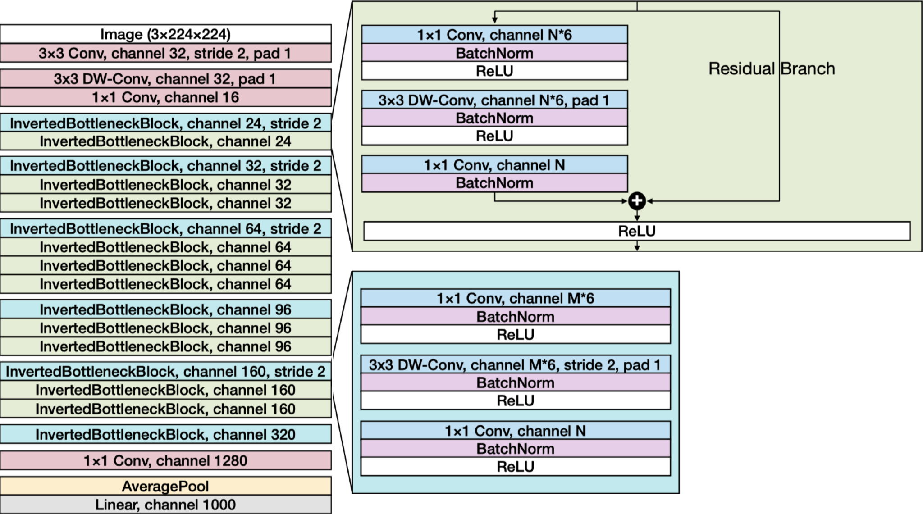
PART 1 · MOTIVATION
Why MobileNetV2 as our base?
Architecture designed for mobile / edge deployment
Uses depthwise-separable convolutions for efficiency
Strong accuracy–efficiency trade-off out of the box
Excellent base model to compress further (Q · P · KD)
standard convolution cost: D² x M x N x H x W
Depthwise-separabel cost: D² x M x H x W plus M x N x H x W
Adapted from Howard et al., "MobileNets," arXiv:1704.04861 (2017); Sandler et al., "MobileNetV2," CVPR 2018.
PART 1 · MOTIVATION 5 / 30

Slide 6
PART 1 · MOTIVATION
Three axes of model optimization
Quantization
Pruning
Knowledge Distillation
Reduce numeric precision
Remove unnecessary weights
Train smaller models from larger ones
Map FP32 weights & activations to INT8 (or lower).
Zero out small-magnitude weights or whole channels.
Student mimics a teacher's soft probability targets.
Combine in real deployments → Distill, then prune, then quantize
PART 1 · MOTIVATION 6 / 30

Slide 7
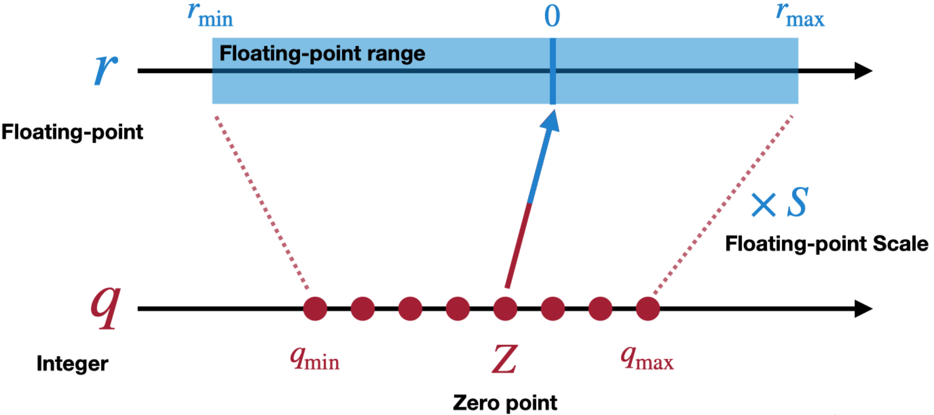
PART 2 · QUANTIZATION
What is quantization?
Map high-precision values (FP32) → low-precision (e.g., INT8)
Applies to both weights and activations
Represent continuous values using fewer bits
q = round(x / s) + z
scale s and zero-point z calibrate the mapping range
PART 2 · QUANTIZATION 7 / 30

Slide 8

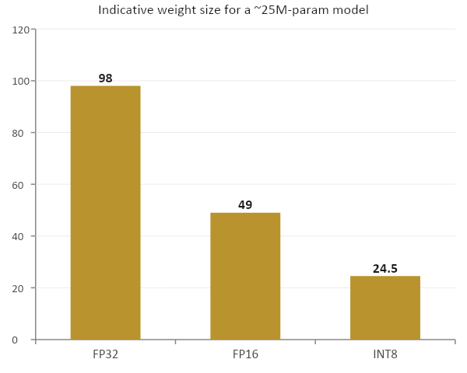

PART 2 · QUANTIZATION
Why quantize?
Params /M
Smaller models
FP32 (4 B) → INT8 (1 B), roughly 4× smaller weights
Faster inference
Less memory bandwidth, integer ops on accelerators
Lower energy
Less data movement, fewer joules per inference
Indicative; actual gain depends on layer types and hardware support.
PART 2 · QUANTIZATION 8 / 30

Slide 9
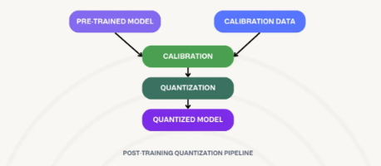
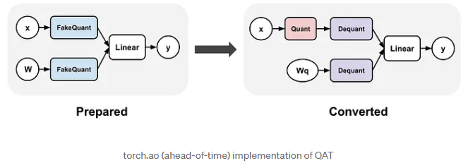
PART 2 · QUANTIZATION
Types of quantization
Post-Training Quantization (PTQ)
Quantization-Aware Training (QAT)
Quantize a pretrained model — no retraining
Simulate quantization during training
Apply after training
Needs calibration data for activation ranges
Fast and convenient
May lose accuracy on sensitive layers
Inserts fake-quant nodes in the graph
Model learns to be robust to INT8 noise
Usually best accuracy
More training cost & infrastructure
Granularity: Per-tensor (one scale for the whole tensor) vs Per-channel (a scale per output channel — finer control, common for conv weights)
PART 2 · QUANTIZATION 9 / 30

Slide 10

PART 2 · QUANTIZATION
Trade-offs & pitfalls
Sensitive layers
Activation outliers
First and last layers are often the most fragile — sometimes left in higher precision.
Long-tail values cause saturation and precision loss; calibration matters.
Hardware dependence
Acceptable accuracy drop
Real speedups require INT8-capable hardware (NPU, AVX-VNNI, ARM NEON).
Tolerance is application-specific — 0.1 % matters for some tasks, not others.
Always benchmark on the actual target device — speedup is not always model-size reduction.
PART 2 · QUANTIZATION 12 / 30

Slide 11
PART 2 · QUANTIZATION
Notebook 1 highlights
Setup
What you'll do
Model: MobileNetV2 adapted for CIFAR-10
First conv adjusted for 32×32 input
Classifier head: 1000 → 10 classes
Approach: Post-Training Quantization in PyTorch
Load and adapt MobileNetV2 to CIFAR-10
Run baseline (FP32) evaluation
Apply PTQ using PyTorch APIs
Compare accuracy, size, inference time
Visualize weight distributions pre/post
Build summary table of trade-offs
Metrics we report
Accuracy
before / after quantization
Model size (MB)
weight footprint on disk / memory
Inference time
per image and per batch
PART 2 · QUANTIZATION 13 / 30

Slide 12
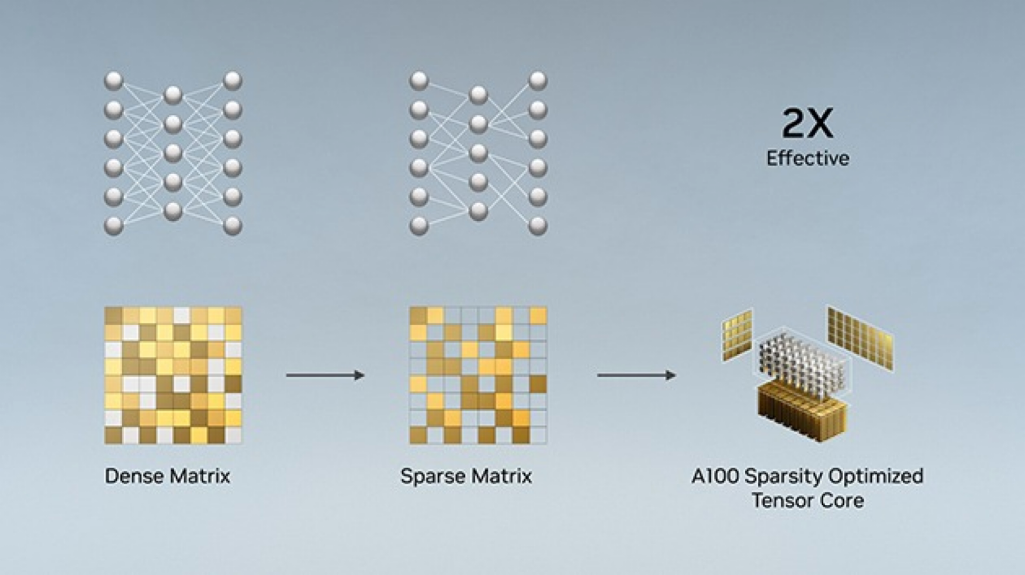
PART 3 · PRUNING
What is pruning?
Remove weights or structures from a trained network
Goal: increase sparsity, reduce computation
Many weights are close to zero — their contribution is small
Zero them out → smaller, sparser model
Sparsity
fraction of zeros in weight tensors
higher sparsity → fewer multiplies, smaller storage
PART 3 · PRUNING 14 / 30

Slide 13
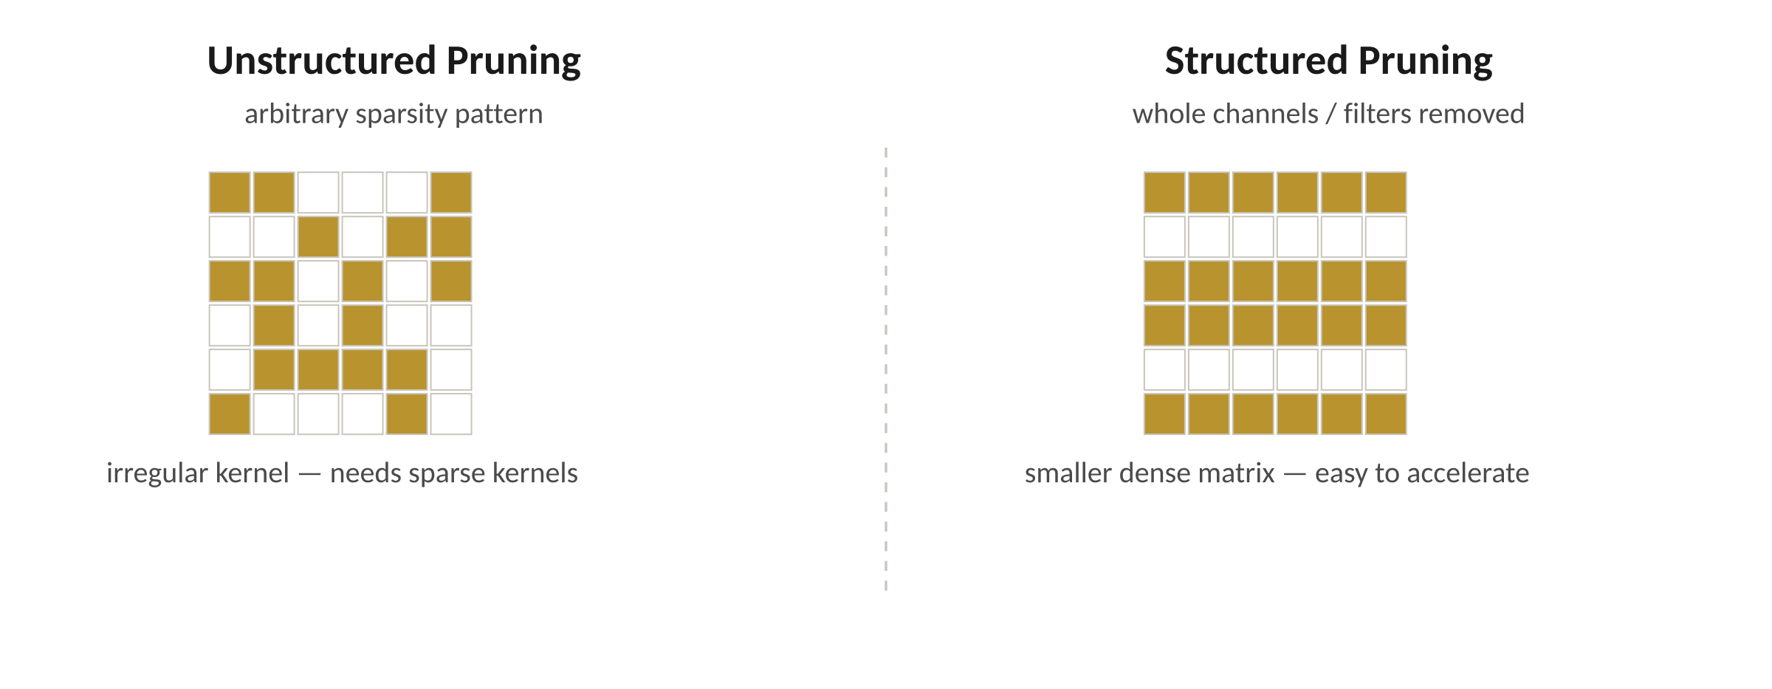
PART 3 · PRUNING
Types of pruning
Unstructured
Structured
Remove individual weights by magnitude. Arbitrary sparsity pattern. Hardware speedups depend on sparse kernels.
Remove channels, filters, or whole blocks. Smaller dense matrices — easy to accelerate on standard hardware.
Global vs layer-wise: global uses one threshold across the whole model; layer-wise picks a threshold per layer.
PART 3 · PRUNING 15 / 30

Slide 14
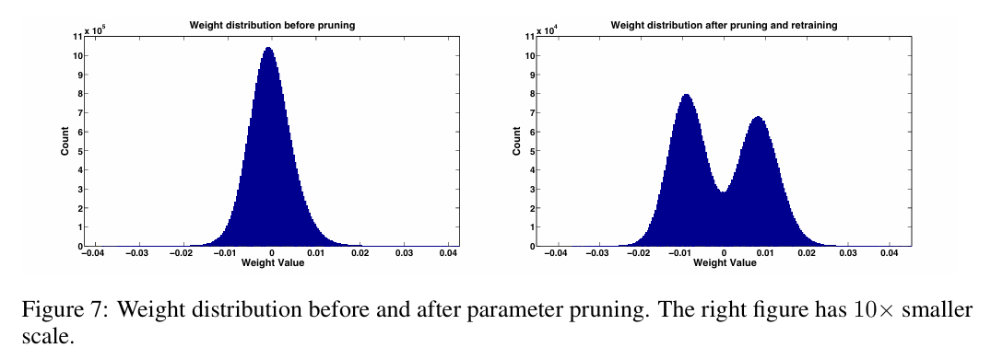

PART 3 · PRUNING
Magnitude-based pruning (our focus)
Rank weights by absolute value |w|
Zero out the smallest fraction (e.g., 30 / 50 / 70 / 90 %)
Very simple and widely used heuristic
Works especially well on over-parameterized networks
Magnitude pruning was popularized for deep nets by Han et al., "Learning both Weights and Connections," NeurIPS 2015.
Reference: arXiv:1506.02626
PART 3 · PRUNING 16 / 30

Slide 15
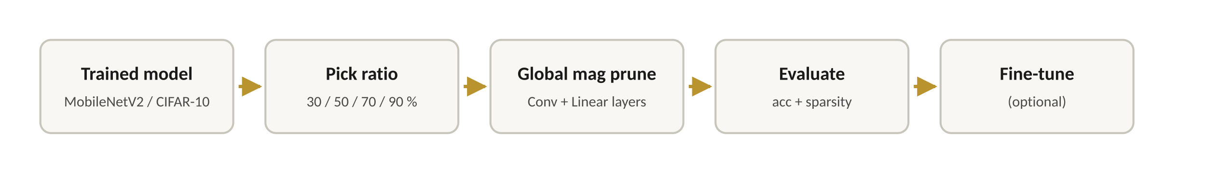
PART 3 · PRUNING
Pruning in this workshop
What we apply
Metrics
Start from a trained model
Choose pruning ratios: 30, 50, 70, 90 %
Apply global magnitude-based pruning to Conv / Linear layers
Evaluate accuracy after pruning
Optionally fine-tune to recover accuracy
Parameters / sparsity
fraction of zeros after pruning
Accuracy vs sparsity
curve across the four ratios
Inference time
if measured on the target device
PART 3 · PRUNING 17 / 30

Slide 16
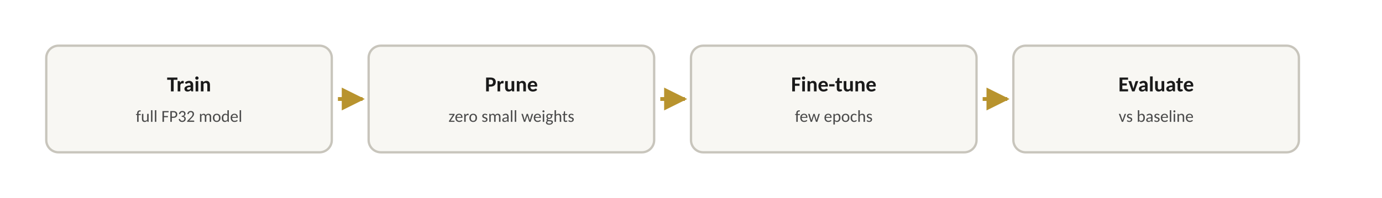
PART 3 · PRUNING
Fine-tuning after pruning
Why fine-tune?
Pruning modifies the network's effective structure
Remaining weights need to adapt to fill the gap
A few extra epochs typically recover most of the lost accuracy
Expected pattern
Moderate pruning (30–50 %): small accuracy drop, easily recovered · Aggressive pruning (70–90 %): bigger drop, instability risk
PART 3 · PRUNING 18/ 30

Slide 17
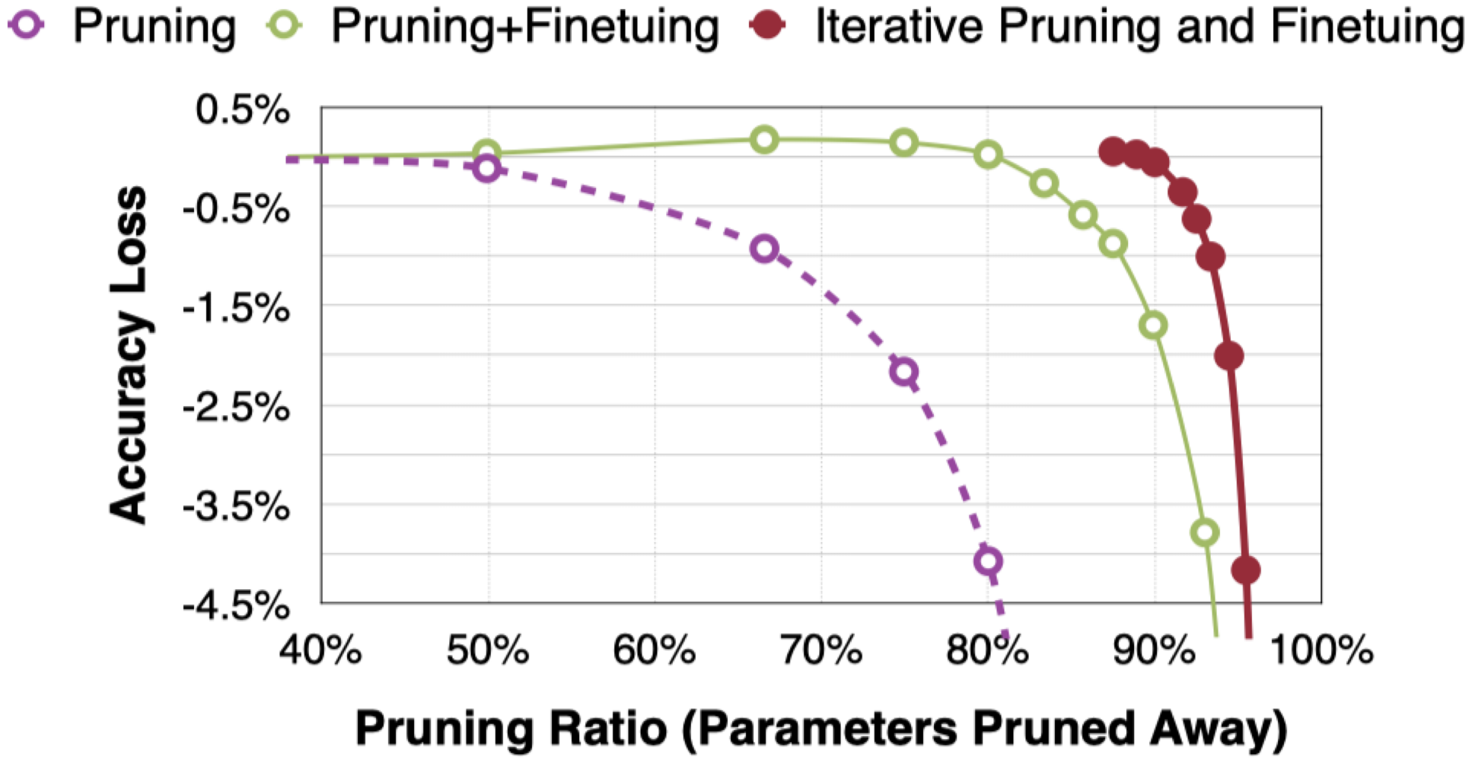
PART 3 · PRUNING
Pruning — visualization & analysis
Layer-wise sparsity — which layers got pruned more?
Where does accuracy collapse?
Early vs late layers: which is more sensitive?
Effect of fine-tuning vs raw pruning
Things to look for
PART 3 · PRUNING 19 / 30

Slide 18
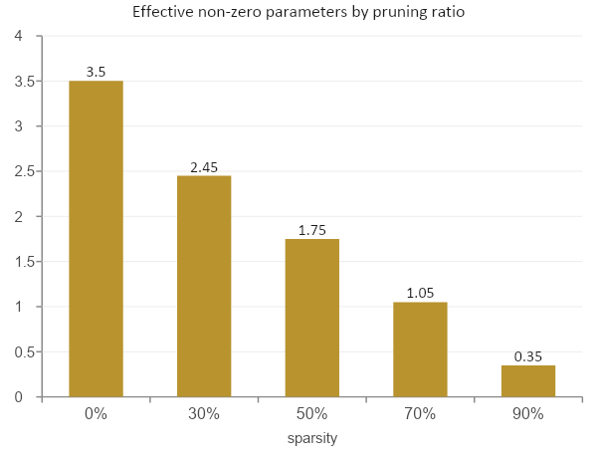
PART 3 · PRUNING
Notebook 2 highlights
Use PyTorch torch.nn.utils.prune utilities
Apply global magnitude-based pruning to MobileNetV2
Try multiple sparsity ratios
Optionally remove pruning reparameterization to save true sparse weights
Evaluate accuracy, sparsity, and (optionally) inference time
What you'll do
Effective parameter count assumes magnitude pruning on a ~3.5M MobileNetV2-CIFAR variant.
PART 3 · PRUNING 20 / 30

Slide 19
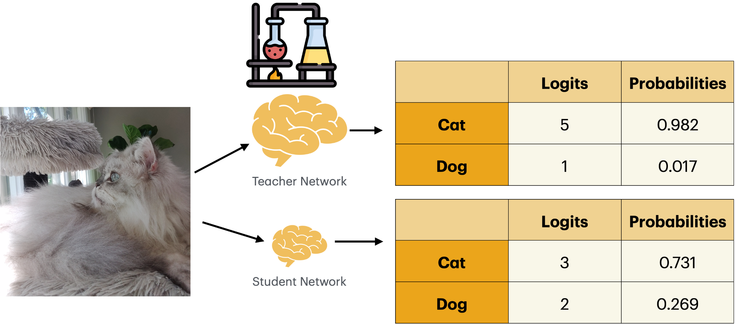
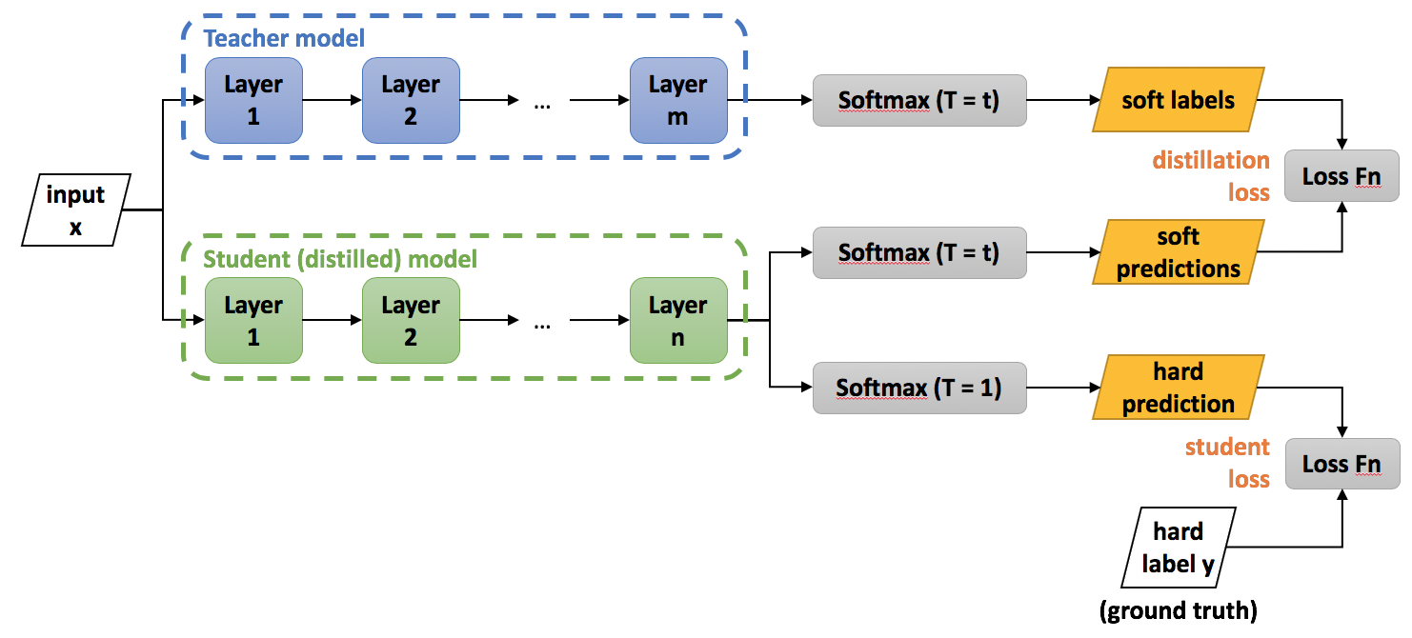
PART 4 · KNOWLEDGE DISTILLATION
What is knowledge distillation?
Train a small student model to imitate a large teacher
Teacher provides rich, soft probability distributions
Student learns from soft targets, not only hard labels
Goal: near-teacher performance at much lower complexity
Adapted from Hinton, Vinyals, Dean, "Distilling the Knowledge in a Neural Network," NeurIPS Workshop 2014.
PART 4 · KNOWLEDGE DISTILLATION 21 / 30

Slide 20
PART 4 · KNOWLEDGE DISTILLATION
Teacher–student setup in this workshop
Teacher
Student
Enhanced MobileNetV2
Compact MobileNetV2
~4.2 M
~1.8 M
parameters
parameters
Extra classifier capacity
Higher accuracy on CIFAR-10
Frozen during distillation
Fewer feature layers
Designed for edge deployment
Trained with combined loss
Dataset: CIFAR-10 · Compression ratio: ~2.3× smaller student vs teacher
PART 4 · KNOWLEDGE DISTILLATION 22 / 30

Slide 21
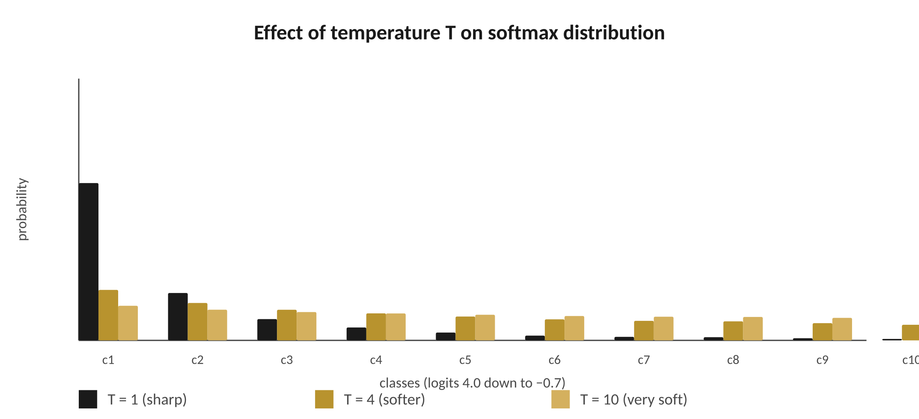
PART 4 · KNOWLEDGE DISTILLATION
Distillation mechanics
Loss formulation
Soft targets (with temperature T):
Combined loss:
T² scales the soft loss to keep gradients comparable across temperatures.
Higher T spreads probability mass across classes — the "dark knowledge" the student learns from.
PART 4 · KNOWLEDGE DISTILLATION 23 / 30

Slide 22
PART 4 · KNOWLEDGE DISTILLATION
Key hyperparameters
T
α
Temperature
Alpha
Controls softness of the probability distribution
Balances ground truth vs teacher's soft targets
Higher T → softer → more "dark knowledge"
Too low: behaves like hard targets
Too high: distribution flattens, signal lost
Common range: 2 – 10
α near 0: trust the teacher
α near 1: ignore distillation
α near 0.5: balanced training
Common range: 0.1 – 0.9
Sweep both T and α — small changes can shift student accuracy by several percent.
PART 4 · KNOWLEDGE DISTILLATION 24 / 30

Slide 23
PART 4 · KNOWLEDGE DISTILLATION
Benefits of knowledge distillation
~2×
~2×
+ x %
smaller student model
faster inference
accuracy uplift
Compact MobileNetV2 vs enhanced teacher
Fewer multiplies per forward pass
vs same-size model trained without a teacher
Especially useful when…
Deploying to many edge devices
Memory, bandwidth, and energy budgets are tight
A strong, larger teacher already exists in production
You need a small dense model — not a sparse one — for hardware reasons
+ x % uplift is illustrative — Notebook 3 measures the actual gain on CIFAR-10.
PART 4 · KNOWLEDGE DISTILLATION 25 / 30

Slide 24
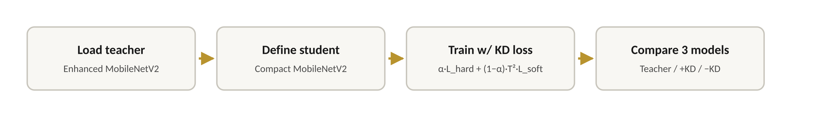
PART 4 · KNOWLEDGE DISTILLATION
Knowledge distillation in this workshop
Teacher
Student + KD
Student − KD
baseline accuracy
trained with soft targets
trained on hard labels only
compare ↓
compare ↓
compare ↓
Analysis
Effect of T and α on student accuracy
Performance vs model size — does the gap close as the student grows?
PART 4 · KNOWLEDGE DISTILLATION 26 / 30

Slide 25
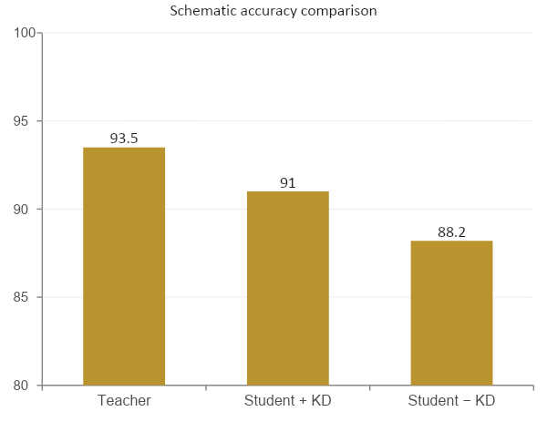
PART 4 · KNOWLEDGE DISTILLATION
Notebook 3 highlights
What you'll do
Implement the distillation loss function
Build the training loop for the student model
Compare accuracy: teacher vs student (+/− KD)
Compare parameter counts and inference time
Hands-on: try different T and α
Experiment with different student sizes
Schematic numbers; Notebook 3 reports the measured values on CIFAR-10.
PART 4 · KNOWLEDGE DISTILLATION 27 / 30

Slide 26
PART 5 · PUTTING IT ALL TOGETHER
Comparing the three techniques
Quantization
Pruning
Knowledge Distillation
Pros
Pros
Pros
Large size reduction
Faster inference
PTQ requires no retraining
Reduces parameter count
Conceptually simple
Composable with quant / KD
Small dense models
Easy to deploy
Strong performance
Cons
Cons
Cons
Accuracy loss possible
Needs hardware support
Sparse speedups depend on kernels
Can hurt accuracy at high sparsity
Needs a teacher model
Extra training cost
Most production deployments combine all three.
PART 5 · WRAP-UP 28 / 30

Slide 27
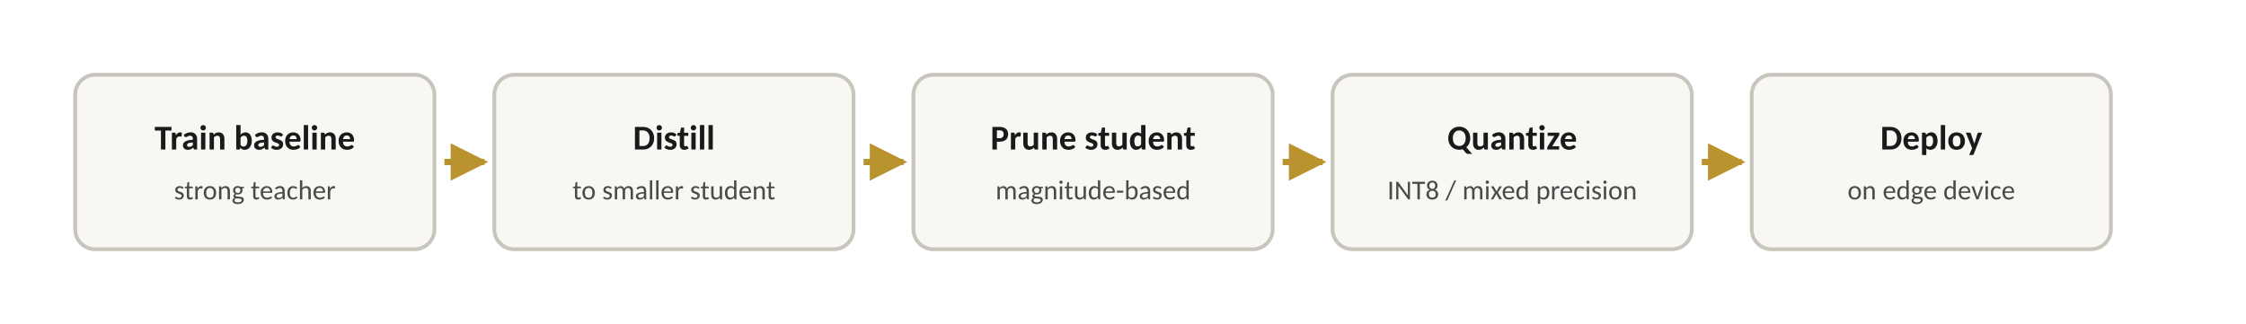


PART 5 · PUTTING IT ALL TOGETHER
Typical edge deployment strategy
Evaluate at every stage
Accuracy
Latency
vs baseline on real validation data
per-batch and per-image on the target device
Model size
Energy
weights and activation buffers
joules per inference where measurable
Order is a guideline; sometimes prune-then-distill or quantize-then-prune fits the constraints better.
PART 5 · WRAP-UP 29 / 30

Slide 28
PART 5 · PUTTING IT ALL TOGETHER
Mapping theory to the notebooks
NOTEBOOK
NOTEBOOK
NOTEBOOK
1
2
3
Quantization
Pruning
Knowledge Distillation
Implement PTQ on MobileNetV2. Evaluate size and accuracy impact.
Apply magnitude-based pruning. Explore sparsity vs accuracy trade-offs.
Train a student with distillation. Compare to teacher and non-distilled student.
PART 5 · WRAP-UP 30 / 30

Slide 29
Acknowledgements
NSF NAIRR-Nat AI Research Resource (NAIRR) Awards OAC-2528533 and OAC-2528534
National Artificial Intelligence Research Resource (NAIRR) Pilot allocation NAIRR250048
Jetstream2 cloud resource supported by the NSF (award NSF-OAC 2005506) at Indiana University
Call to action for cybersecurity faculty and SFS PIs
Adopt one workshop module in a course or REU/SFS training
Send participants to the March 2026 series (virtual)
Co-develop a case study using your datasets or agency partners
Share feedback on the highest-value modules to prioritize packaging
Any opinions, finding, and conclusions or recommendations expressed in this material are those of the author(s) and do no necessarily reflect the views of the National Science Foundation.
Contact: fu@oakland.edu | jdai@wpi.edu
Contact: fu@oakland.edu | jdai@wpi.edu
Notes:
Close by asking the room which module they would adopt first, and what barrier (accounts, time, staffing, compute) is most acute.
https://access-ci.org/

Slide 30

THE END
Questions?
Post-workshop knowledge check
01
02
03
Try different T and α in distillation
Combine pruning + quantization
Think about your own deployment scenario
Module 3.1 · Efficient Inference for Edge AI · Oakland University

Slide 31

Workshop Survey

