Slide 1
False Sharing — Demo & Mitigation
Timing and memory-layout charts included

Slide 2
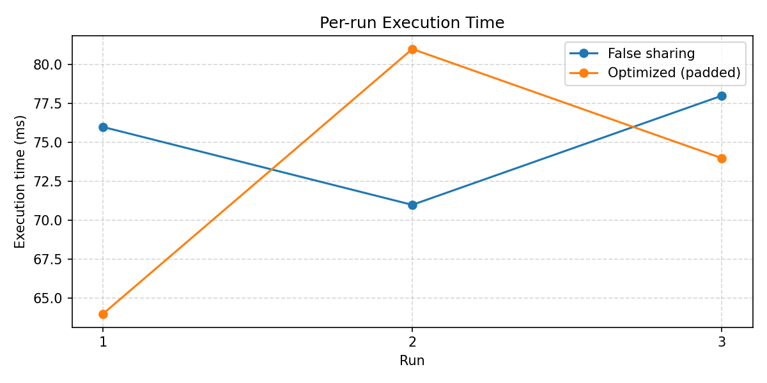
Per-run Timing

Slide 3
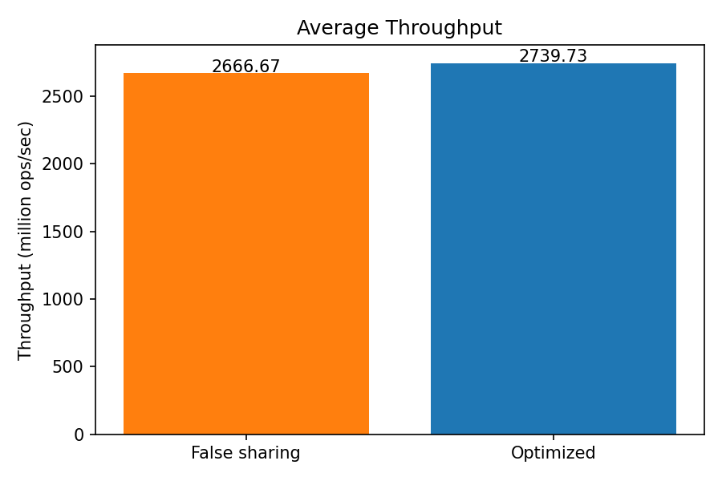
Average Throughput

Slide 4
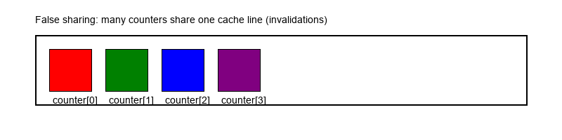
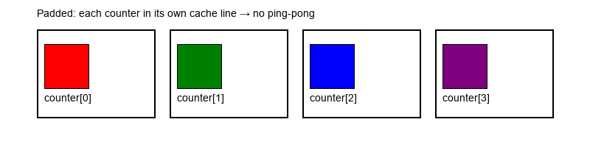
Illustration: False Sharing vs Padded

Slide 5
Summary & Recommendations
Results summary:
Avg speedup (padding): 1.03x (~2.7% reduction)
Recommendations: use padding, thread pinning, and larger workloads

