Slide 1

Java Problem Repository
&
Education Platform
Software Plan
DeltaTech - Software Plan Presentation 9/23/2013

Slide 2

Client:
Dr. Darren Lim
  Associate Professor of Computer Science
DeltaTech - Software Plan Presentation

Slide 3

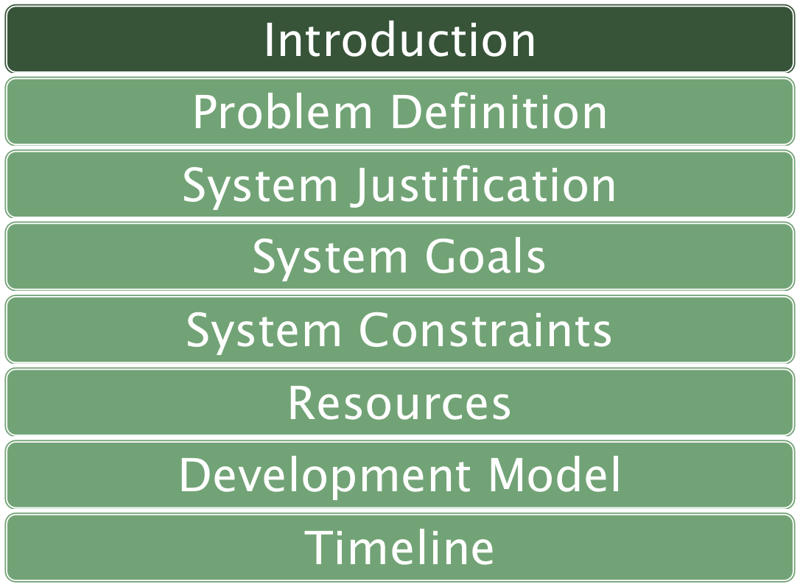
DeltaTech - Software Plan Presentation

Slide 4

Luke Greiner – Team Leader
Denis Kalic – Developer & Co-Webmaster
Abigail McCarthy – Technical Documenter
Robert Tateo – System Administrator
Nguyen Truong – Developer
Patrick White - Webmaster
DeltaTech - Software Plan Presentation

Slide 5
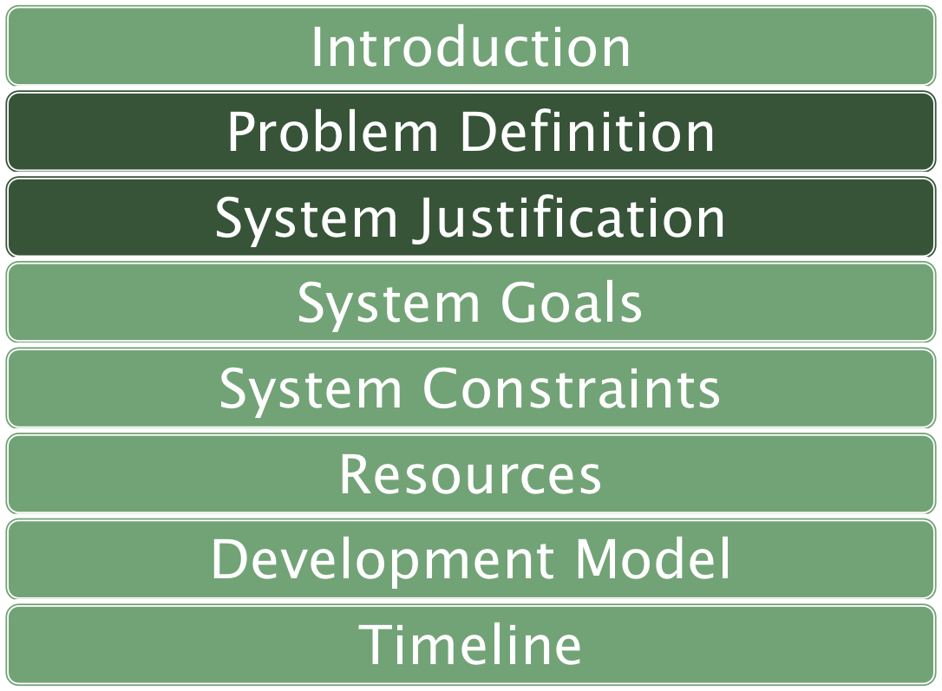
DeltaTech - Software Plan Presentation

Slide 6

Unique login credentials
Create, reuse, and maintain
Immediate compilation and feedback
DeltaTech - Software Plan Presentation

Slide 7

Unique accounts
  Students
  Faculty
  Administrator
Create, reuse, and maintain
Immediate compilation and feedback
Course groups
DeltaTech - Software Plan Presentation

Slide 8
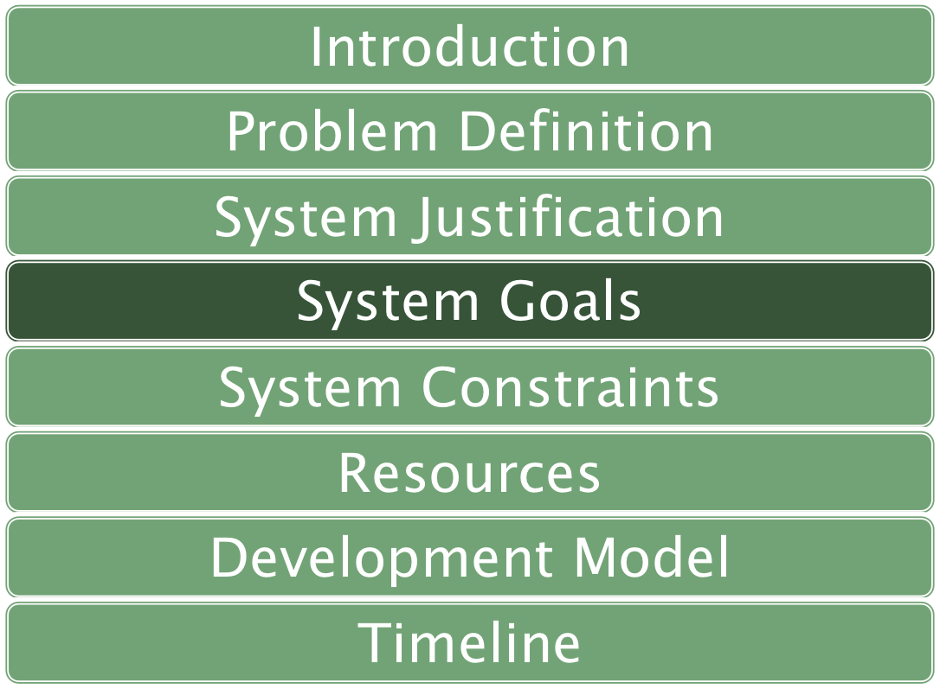
DeltaTech - Software Plan Presentation

Slide 9

Web-based assignment system
Maintained by computer science faculty
Each student has individual login
Student’s assignments administered by respective professors
Student solutions compiled when finished
Solutions run against predetermined test cases
DeltaTech - Software Plan Presentation

Slide 10
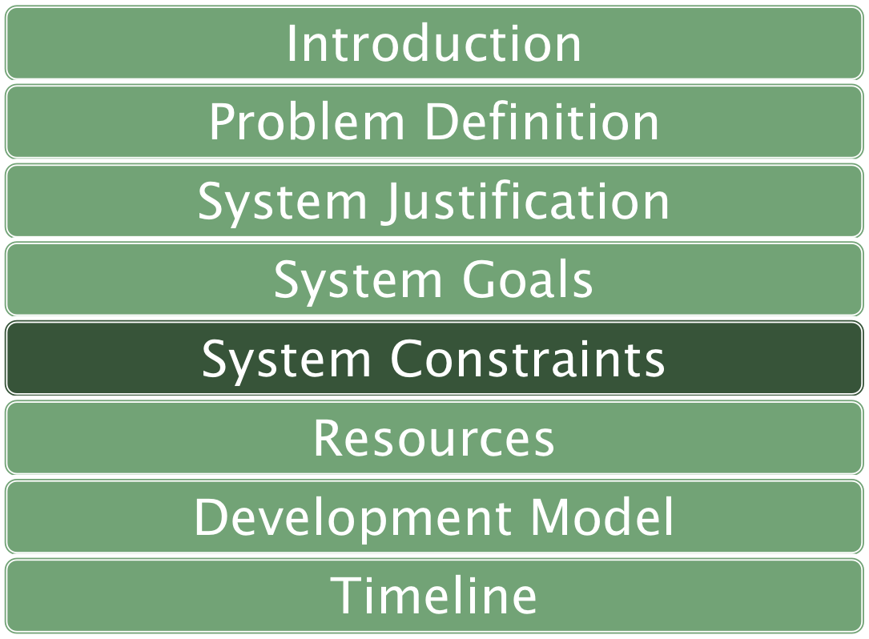
DeltaTech - Software Plan Presentation

Slide 11

Latest Compatible Web Browsers
  Google Chrome, Mozilla Firefox, Microsoft Internet Explorer, Apple Safari
One Input Language for Compiler
  Java™ Programming Language
Runtime < 1 second
DeltaTech - Software Plan Presentation

Slide 12
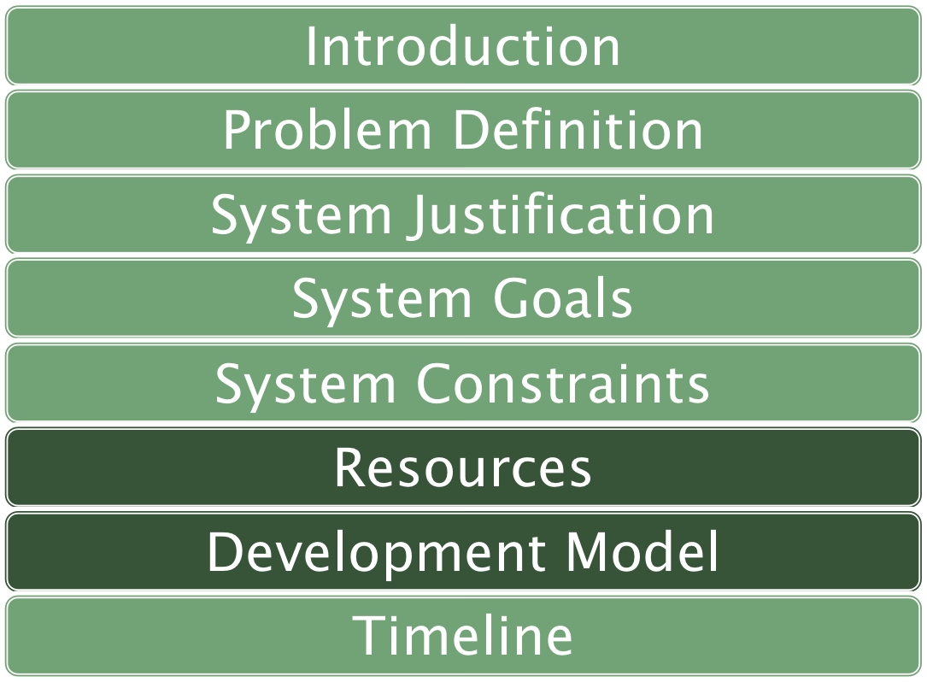
DeltaTech - Software Plan Presentation

Slide 13

Development Environments:
  Windows
    Application development
  Mac
    Application development
  Server
    Database
    Website
    Web applet
DeltaTech - Software Plan Presentation

Slide 14
Windows
  Vista Enterprise service pack 2
  Dell Optiplex 720 (E7500)
  Intel Core 2 duo CPU
  Speed 2.93 GHz
  Memory (RAM) 4.00 GB
  32bit operating system
DeltaTech - Software Plan Presentation

Slide 15
Mac
  Apple Mac OS X Lion Version 10.7.5
  iMac 21.5 mid 2011
  Intel Core i5
  Speed: 2.5 GHz
  Memory (RAM) 4.00 GB
DeltaTech - Software Plan Presentation

Slide 16
Server
  Operating System: CentOS 5.2, Kernel 2.6.18-92e15
  Server Name: oraserv.cs.siena.edu
  CPU Type: Intel Xeon
  Speed 2.66 GHz
  Memory: 8GB Memory
DeltaTech - Software Plan Presentation

Slide 17

Software Plan
Requirements
Specification
Developing And Testing
Preliminary
Design
Detailed
Design
Acceptance
Test
DeltaTech - Software Plan Presentation

Slide 18
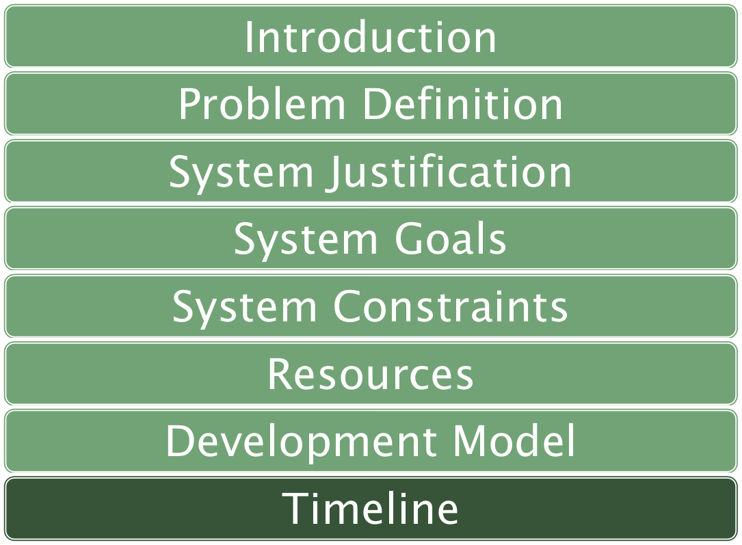
DeltaTech - Software Plan Presentation

Slide 19

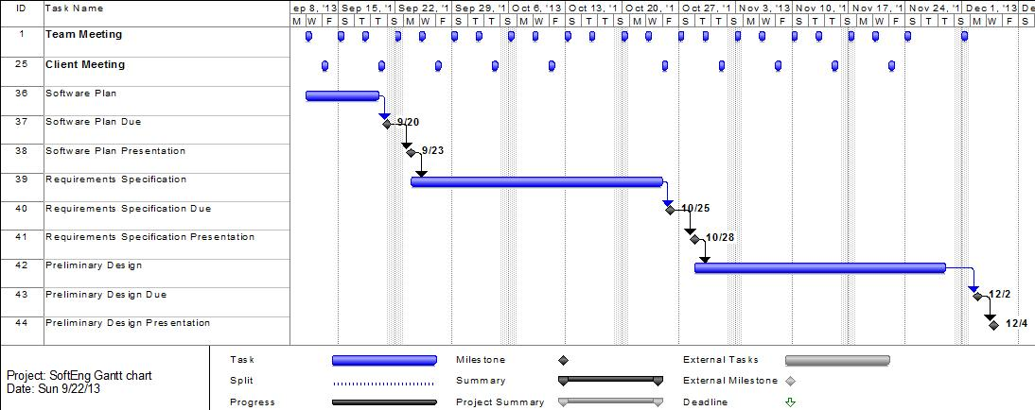
DeltaTech - Software Plan Presentation

Slide 20

Questions?
DeltaTech - Software Plan Presentation

