Slide 1

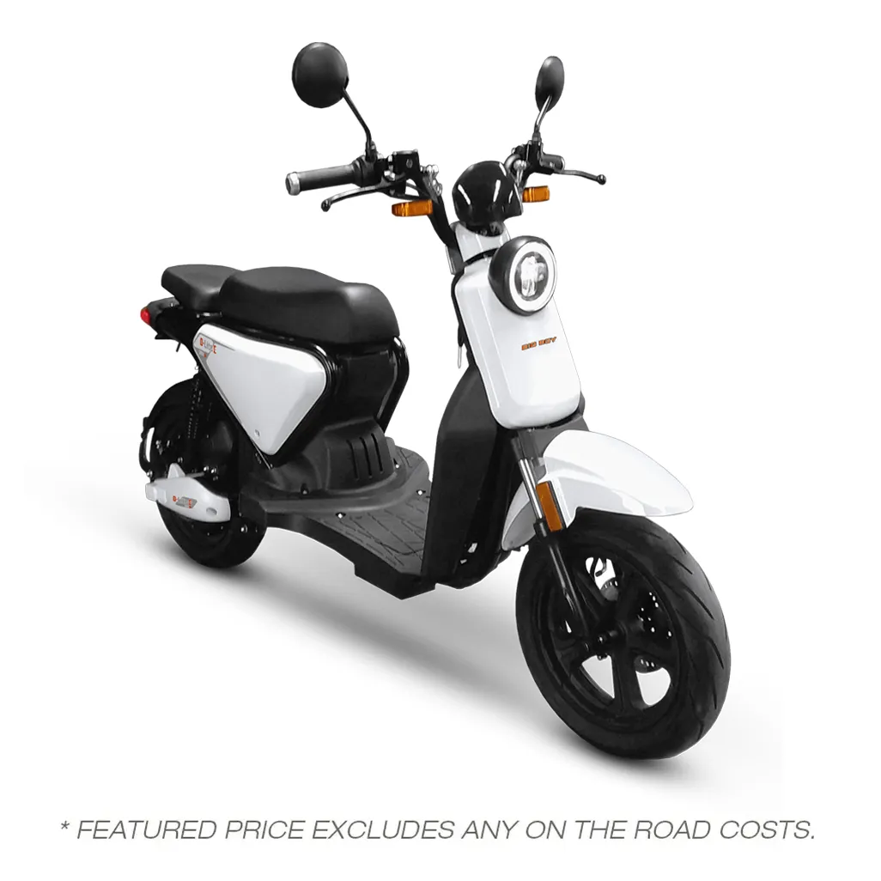
CHECKERS PILOT
Solar-Powered
Delivery Fleet Pilot
A 90-day test proposal to reduce delivery fuel exposure, build operating resilience, and validate e-mobility economics using the Big Boy D-Lite E 3000W platform.
Prepared for enterprise delivery operations innovation in South Africa
Prepared by: Independent fleet integration partner - Milano SA (Pty) Ltd
Date: 12 March 2026
Vehicle + Charging + Service
One operating model. Three moving parts integrated.
Notes:
[Sources] - Big Boy D-Lite E 3000W product imagery and product page: https://www.samotorcycles.co.za/big-boy-d-lite-e-3000w - Slide narrative and proposal framing are original work product.

Slide 2
Why Checkers should test this now
The opportunity is not theoretical: the delivery engine is already large and fuel remains a live operating variable.
Sixty60 is scaling fast
Customer promise is speed
Fuel is still volatile
Shoprite reported Sixty60 sales of R11.9bn for the half year, up 34.6% year on year.
Checkers publicly promises “fast & reliable delivery in as little as 60 minutes.”
March 2026 inland 95 petrol: R20.30/L
Any fleet solution must preserve the customer promise while reducing cost and risk.
Every stop-start scooter route compounds fuel exposure, especially at scale and during peak demand windows.
A fast-growing demand engine puts pressure on delivery unit economics, route density, and fleet uptime.
Strategic reading
Operating cost per bike
Uptime under real conditions
Scale-readiness
Checkers does not need a full fleet conversion to learn something meaningful. It needs a controlled pilot on selected routes that measures three executive-level outputs:
Can electric lower route cost without harming service speed?
Can charging, maintenance and rider workflow stay reliable?
Can the model expand from 10 bikes to a province-wide fleet?
Notes:
[Sources] - Checkers Sixty60 home page (delivery promise): https://www.checkers.co.za/ - Shoprite 2026 Interim Results Presentation (Sixty60 H1 sales and growth): https://www.shopriteholdings.co.za/docs/interim-results-presentation-2026.pdf - March 2026 petrol price reporting: https://www.thesouthafrican.com/news/here-are-the-official-petrol-and-diesel-prices-for-march-2026/

Slide 3
Illustrative route economics
This is the slide that matters most to an operator: even a modest cost delta per bike compounds quickly.
Scenario assumption
Indicative monthly operating cost per unit
80 km/day • 26 operating days/month • stop-start urban route • internal benchmark model for pilot screening
≈ R1,600 saved per bike / month
Before lease structuring and before pilot-specific service costs are negotiated.
10-bike pilot
≈ R16k monthly OPEX delta
50-bike cluster
≈ R80k monthly OPEX delta
100-bike scale case
≈ R160k monthly OPEX delta
What Checkers is really buying with the pilot
A low-cost way to measure if part of the fleet can be insulated from fuel volatility without compromising the delivery promise.
Notes:
[Sources] - Vehicle battery capacity and recharge timing sourced from Big Boy D-Lite E 3000W spec sheet and product page. - Fuel price anchor sourced from March 2026 petrol pricing report: https://www.thesouthafrican.com/news/here-are-the-official-petrol-and-diesel-prices-for-march-2026/ - Route economics, maintenance assumptions and scale-case calculations are internal illustrative estimates for pilot evaluation only; they must be validated against real Checkers route data.

Slide 4
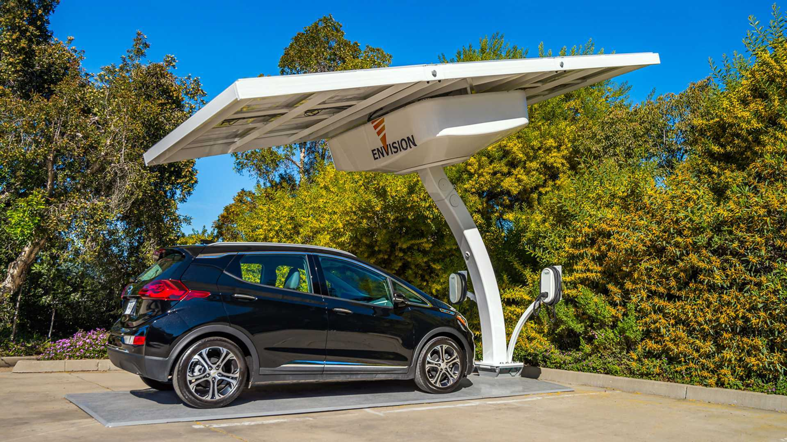
The operating model
The pitch is not “buy a bike.” The pitch is a controlled operating system: vehicle, charging and service bundled around one pilot.
3. Service layer
Fleet deployment and route selection
Maintenance coordination and spares planning
Pilot dashboard: cost, uptime, charging, rider feedback
1. Vehicle layer
2. Charging layer
Big Boy D-Lite E 3000W selected for commercial fit, low entry price, local dealer support and urban route compatibility.
Solar-assisted or grid-backed depot charging delivered by a certified local installer under partner management.
Single point of accountability for pilot reporting
Core point for Checkers:
LOCAL
COMMERCIAL
EV
SOLAR
DEPOT
You test one accountable partner, not three disconnected vendors.
Notes:
[Sources] - Big Boy D-Lite E 3000W product imagery and product page: https://www.samotorcycles.co.za/big-boy-d-lite-e-3000w - Solar charging imagery: https://insideevs.com/news/410026/envision-solar-ev-arc-off-grid-charging/ - Operating model, partner structure and service design are original recommendations.

Slide 5
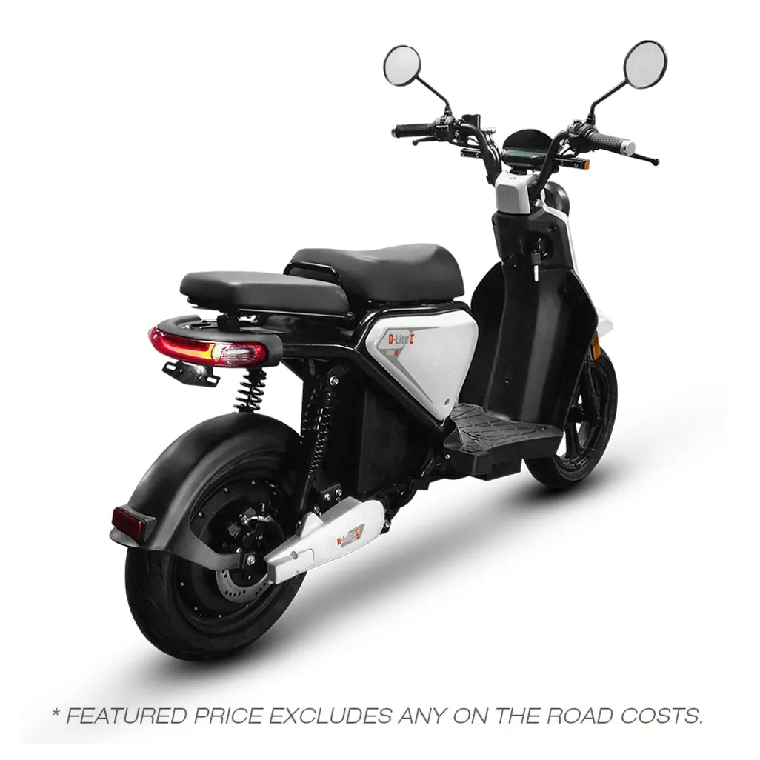
Why the D-Lite E is a credible pilot vehicle
The first test does not need the perfect future bike. It needs a low-risk, locally supportable platform with enough range to prove or disprove the operating case.
Top speed
Range
70 km/h
90–100 km @ 70 km/h
up to 130 km @ 45 km/h
Recharge
Torque
5–6 hours
140 Nm
Big Boy D-Lite E 3000W
Retail price anchor: R34,999
Commercial positioning: business deliveries, local commuting, security and patrol
Battery
Payload
72V 45Ah lithium
110 kg max load
Why this matters for the pilot
Local dealer availability lowers procurement friction and makes the first test easier to start.
Pilot interpretation
This vehicle is good enough to validate economics, rider workflow, charging logic and service support before you discuss a broader enterprise fleet configuration.
Notes:
[Sources] - Big Boy D-Lite E 3000W product page: https://www.samotorcycles.co.za/big-boy-d-lite-e-3000w - Big Boy D-Lite E 3000W specification PDF: https://content.storefront7.co.za/stores/za.co.storefront7.samotorcycles/products/d-lite-e-3000w/documents/big-boy-d-lite-e-3000w-specs.pdf

Slide 6
90-day pilot proposal for Checkers
Keep the test small, measurable and operationally boring. The goal is not hype. The goal is credible data.
1
Weeks 1–2
2
Weeks 3–6
3
Weeks 7–10
4
Weeks 11–12
Deployment setup
Live operations
Optimization
Executive review
Confirm store cluster, route design, riders, maintenance path and charging depot.
Run 10 bikes on selected routes and track service speed, range, energy and downtime.
Adjust route assignment, charging windows, rider practices and spares management.
Compare cost and service data against the fuel baseline and decide: stop, extend or scale.
Pilot success metrics
Decision gate at day 90
Cost per operating bike per month
On-time delivery performance vs. baseline
If economics hold and service levels remain intact, move to a second-phase fleet cluster with better procurement terms and a formal service agreement.
Average daily range and recharge behavior
Mechanical downtime and battery-related events
Rider feedback and route suitability by store cluster
Notes:
[Sources] - Pilot structure, timing and success criteria are original recommendations.

Slide 7
What could go wrong — and how the pilot controls it
Executives say yes when the test is structured to answer the hard questions upfront.
Risk
Why it matters
Pilot control
Executive read-through
Range under real load
Bike underperforms on heavier or longer routes.
Start with route classes inside a conservative daily range envelope and capture real-world usage before scale.
Pilot absorbs the uncertainty before scale.
Charging downtime
Poor charging discipline creates missed availability.
Use depot charging windows, backup grid option, and a simple charging roster from day one.
Pilot absorbs the uncertainty before scale.
Maintenance response
A single bike failure hurts confidence in the whole pilot.
Agree service turnaround and spares availability with Big Boy before deployment.
Pilot absorbs the uncertainty before scale.
Rider adoption
Riders may resist workflow changes or charging routines.
Train on rider workflow, assign champion riders, and collect weekly feedback.
Pilot absorbs the uncertainty before scale.
Pilot economics disappoint
Savings may not justify a broader rollout.
That is exactly what the 90-day pilot is designed to prove or reject early.
A disciplined “no” is still a good outcome.
Notes:
[Sources] - Risk framework and control design are original recommendations.

Slide 8
The ask to Checkers
This is intentionally simple: approve a low-risk test with a tight scope, defined measures and a hard decision gate.
We are asking for three things only.
1. Pilot sponsorship
A single internal owner from operations or on-demand delivery to coordinate route access, baseline metrics and review cadence.
Why an executive can say “let’s test this”
No full-fleet commitment required
2. Limited route access
One store cluster or micro-region where 10 bikes can be tested without changing the broader operating model.
Pilot is reversible if the numbers fail
Brand upside: visible sustainability action
3. Data cooperation
Fuel baseline, route volume, service timing and rider feedback needed to judge the pilot honestly.
Operational upside: potential fuel insulation
Scale case only happens if the pilot proves itself
Recommended decision
Approve a 90-day pilot and judge the result on cost, uptime and service impact — not on theory.
Notes:
[Sources] - Proposal structure and executive decision framing are original recommendations.

Slide 9
Why Big Boy should support the rollout
You are not approaching Big Boy as a retail buyer. You are approaching them as a fleet channel.
What you ask Big Boy for
Fleet pricing
A bulk price that creates room for a lease or managed-service model.
Demo / pilot support
Priority allocation for 10 pilot bikes and pre-agreed parts availability.
Service SLA
Named service contact, response times and spares pathway during the pilot.
What Big Boy gets
Brand cooperation
Permission to position Big Boy as the vehicle platform in enterprise pitches.
Corporate fleet volume instead of one-off retail sales
A live enterprise use case for the D-Lite E
Scale trigger
Improved terms if the pilot converts into a larger fleet contract.
Visibility into a national growth channel
Feedback loop to improve future fleet specification
Notes:
[Sources] - Big Boy D-Lite E product page and imagery: https://www.samotorcycles.co.za/big-boy-d-lite-e-3000w - Partnership rationale and request structure are original recommendations.

Slide 10
Exact Big Boy negotiation structure
Do not ask for “support.” Ask for specific terms tied to a measurable fleet opportunity.
1. Open with volume logic
“I am not here to buy one scooter. I am building a fleet channel into enterprise delivery operations.”
2. Ask for pilot economics
Target a pilot price below retail, ideally with room for service margin and demo flexibility.
3. Tie support to conversion
“If the pilot converts, you become the preferred vehicle platform for the next rollout phase.”
4. Negotiate service before price
Price matters, but uptime will kill the deal faster than a weak discount. Get service response commitments in writing.
5. Secure scale ratchets
Ask for improved pricing bands at 10, 50 and 100 bikes so the economics improve as rollout expands.
Target term sheet for the first meeting: fleet price band • pilot allocation • spares commitment • named service contact • scale discounts • co-branding permission
Notes:
[Sources] - Negotiation structure, sequencing and draft term logic are original recommendations.

Slide 11
Use this talk track with Big Boy
The objective is to sound commercial, not speculative. Lead with demand, then ask for terms.
“I am building a managed e-delivery pilot for enterprise clients. The first target is a controlled 90-day test, not a retail sale.”
“I want Big Boy as the vehicle platform because the D-Lite E gives me a local, commercially positioned EV with a realistic entry price.”
“To make this work, I need fleet pricing, service responsiveness, parts availability and clear expansion terms if the pilot converts.”
“If I win the client and the pilot expands, Big Boy becomes the preferred supplier for the next rollout phase. If the pilot fails, we both learn cheaply.”
“I am not asking you to take all the risk. I am asking you to help me build a fleet channel you do not currently own.”
Close the meeting with a concrete ask
“If I send you a simple pilot term sheet this week, can you revert with fleet pricing, pilot support terms and service coverage within five working days?”
Notes:
[Sources] - Negotiation talk track is original work product.

Slide 12

Recommended next moves
1
2
3
Lock the Big Boy meeting
Refine the pilot economics
Pitch for the test — not the rollout
Get price, service and pilot support terms on the table.
Tailor the model to one real Checkers route cluster.
Ask Checkers for a 90-day controlled pilot, not a national commitment.
The objective is simple: create enough proof for a rational executive to say “let’s test this.”
Prepared as a founder-facing pitch draft. Validate all economics with live route data before external use.
Notes:
[Sources] - Closing recommendations and sequence are original recommendations.

