Slide 1
Differential, Instrumentation & Bridge
Amplifiers
YR3-BE3-HBINST
Dept. of Bioengineering
E.M.Drakakis

Slide 2
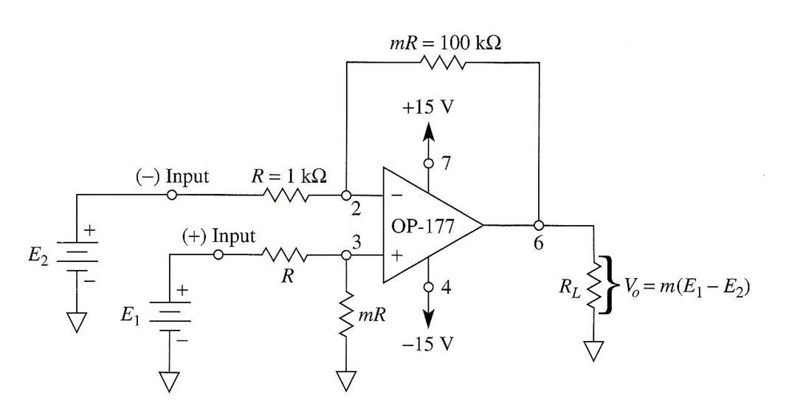
BASIC DIFFERENTIAL AMPLIFIER (SUBTRACTOR CIRCUIT)
V_{o}= mE₁ –mE₂ = m (E₁-E₂)
Notes:
Interest of using amplifiers:

Slide 3
V_{o}= mE₁ –mE₂ = m (E₁-E₂)
Output = m x (DIFFERENCE of Inputs)
m is termed “differential gain” & depends on resistor ratios

Slide 4
Subtractor’s Basic Relation (Derivation- Fill in)

Slide 5
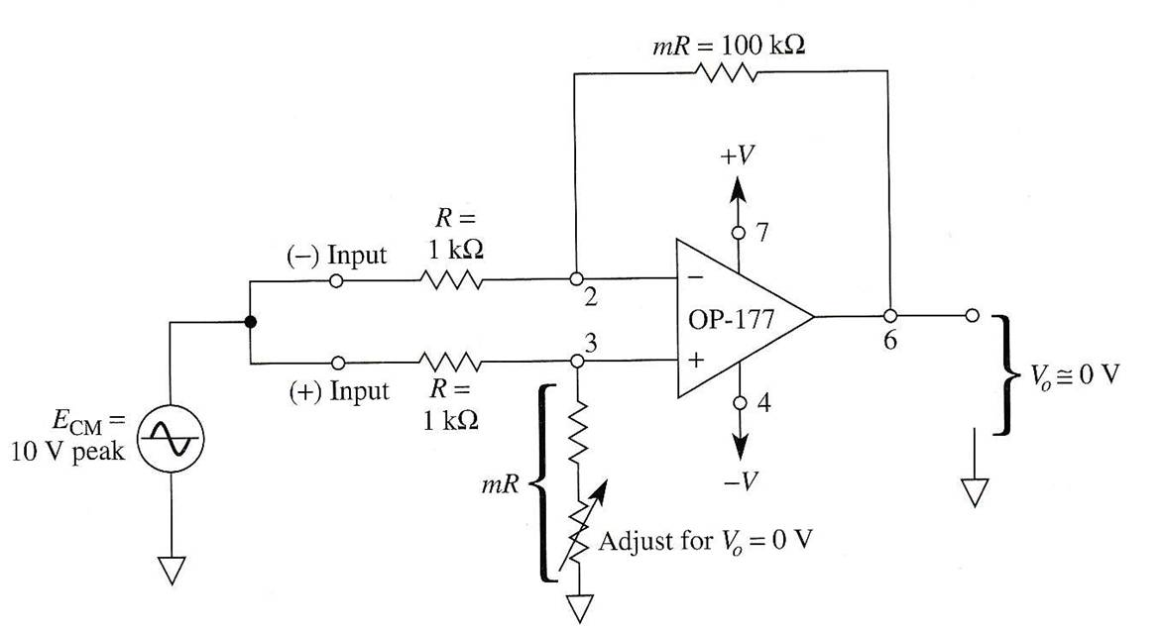
Common Mode Rejection (Ratio)
What is the value of the subtractor circuit output voltage when both inputs have a common value?

Slide 6
BOTTOMLINE
Vout = A_{d} . (E₁-E₂) + A_{c} . [ (E₁+E₂)/2 ]
Ad: Differential Gain
Ac: Common-mode Gain
E₁-E₂: Differential Input
(E₁+E₂)/2: Common Mode Input
We want the amplifier to:
AMPLIFY THE DIFFERENCE of the two input signals
REJECT THEIR COMMON-MODE SIGNAL
have HIGH A_{d}
have LOW A_{c}
have high CMRR= 20 log (Ad/Ac)
Notes:
Common Mode Rejection Ratio = CMRR

Slide 7
Problem!
What about Resistor Mismatch?
How well should the resistors be
matched so that CMRR becomes very high?

Slide 8
EFFECT OF RESISTOR MISMATCH ON THE SUBTRACTOR CIRCUIT OPERATION (Derivation-Fill In)

Slide 9
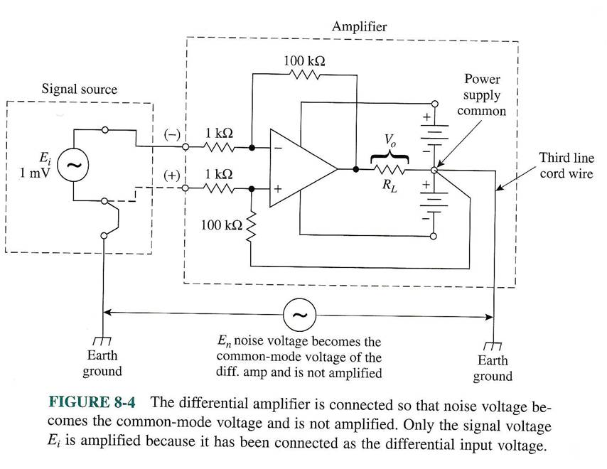
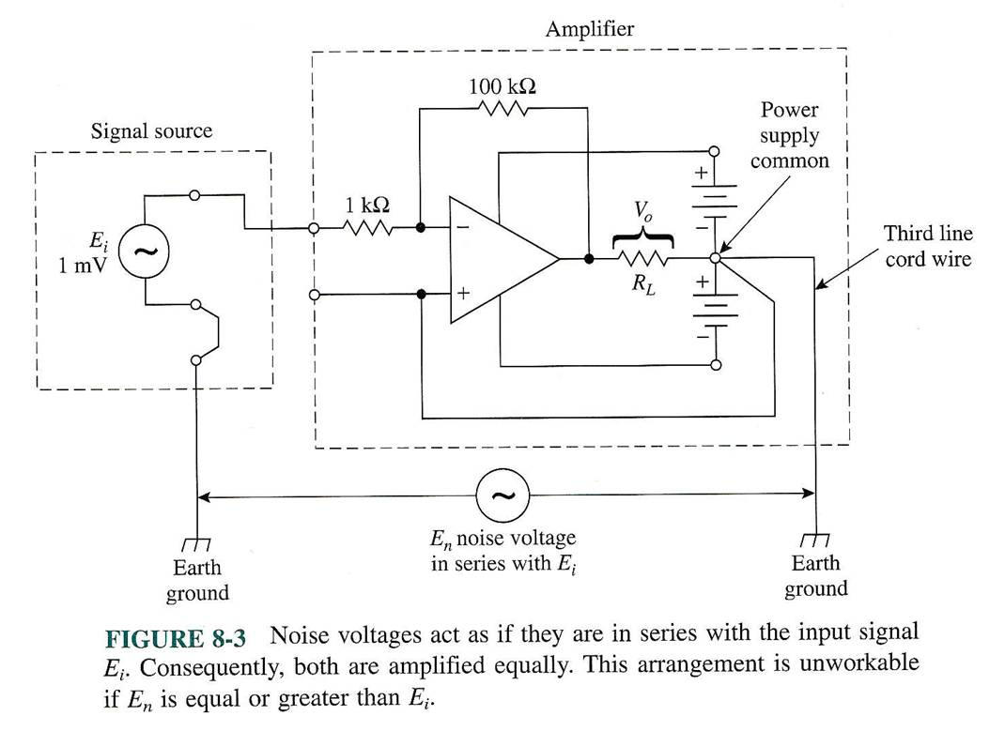
Single-input vs. Differential-input
Measurement
Notes:
Noise due to parasitic voltage due to spatial separation of inputs

Slide 10
Problem!
We need increased R_{in}
We need adjustable G_{(ain)}

Slide 11
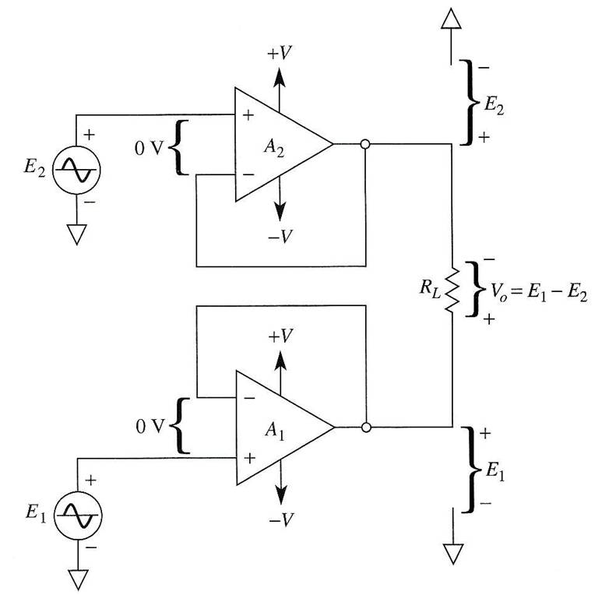
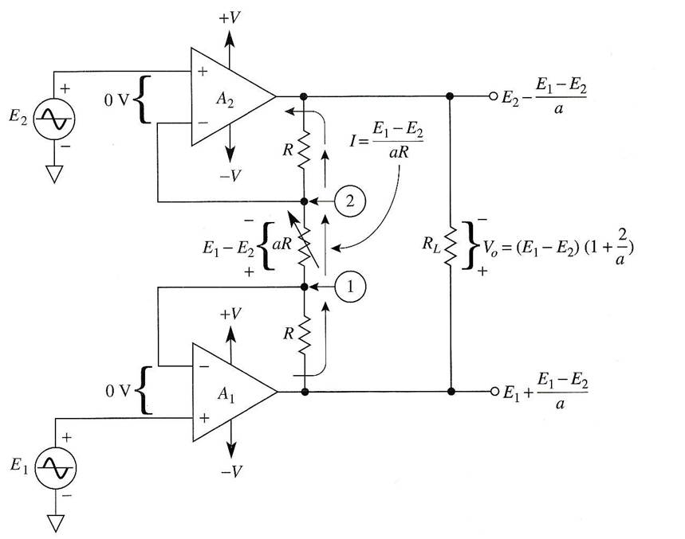
Solution
Introduction of buffers
Notes:
By introducing buffers(voltage folloewrs) we are increasing the input impedance

Slide 12
Adjustable Gain (Derivation- Fill in)

Slide 13
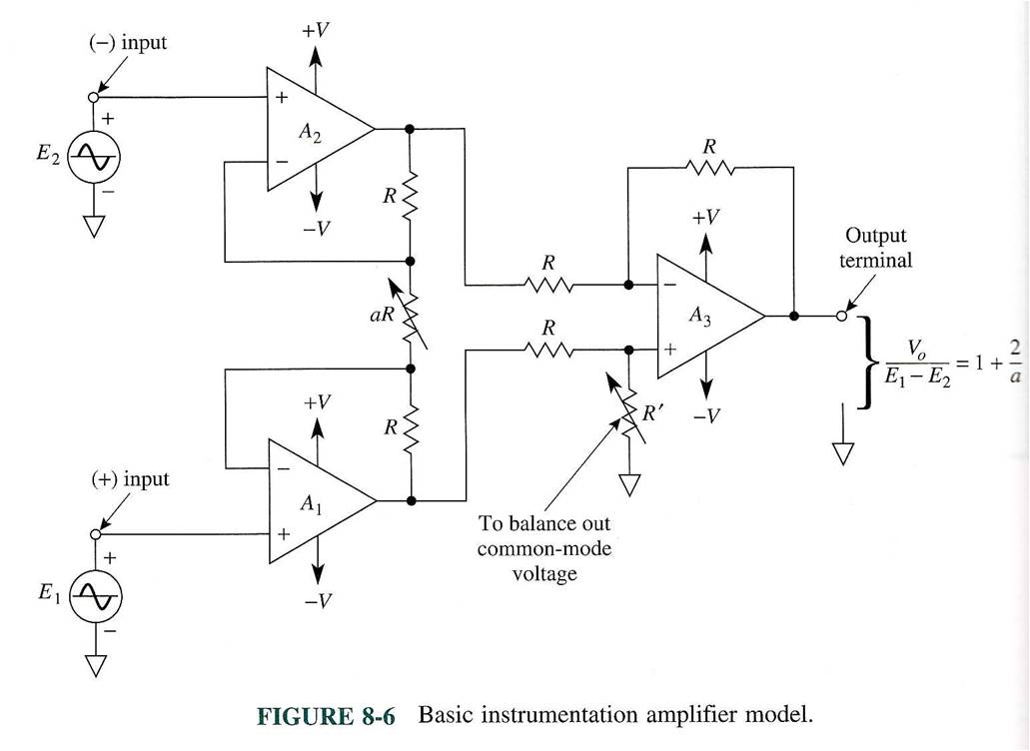
BASIC INSTRUMENTATION AMPLIFIER (IA)
Buffered Diff.Input-to-Diff.output
With Adjustable Gain Block
Subtractor Block

Slide 14
Basic Calculations for IA (Fill in)

Slide 15
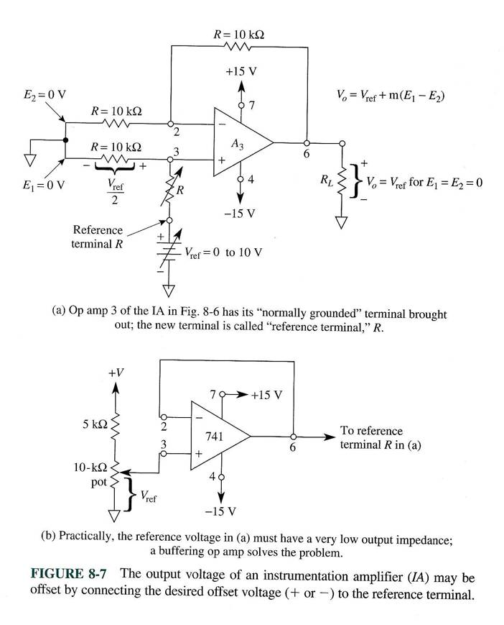
Referencing the Output Voltage
Notes:
Vref raises signal do a desired DC level

Slide 16
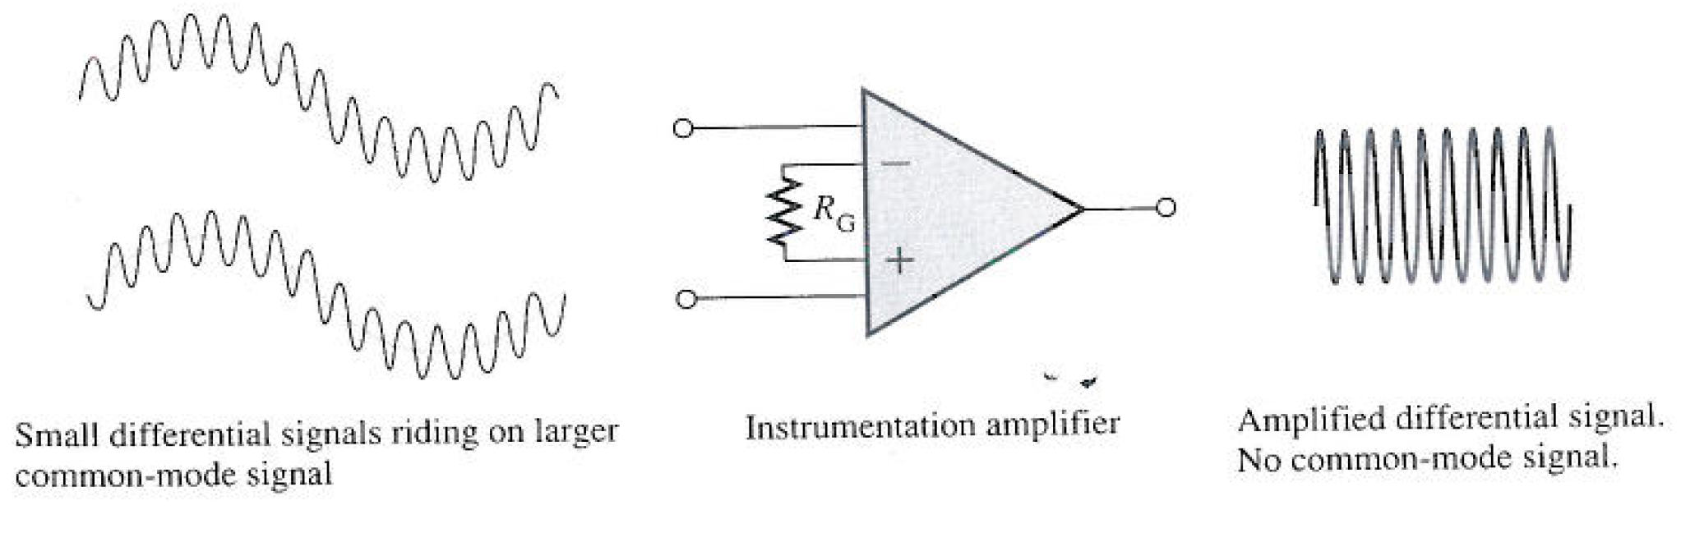
Measuring with the IA
“Large” common-mode
signals
“Small” differential
Signals (of interest)
Amplified Diff. Input;
“common-mode” signal
has been rejected

Slide 17
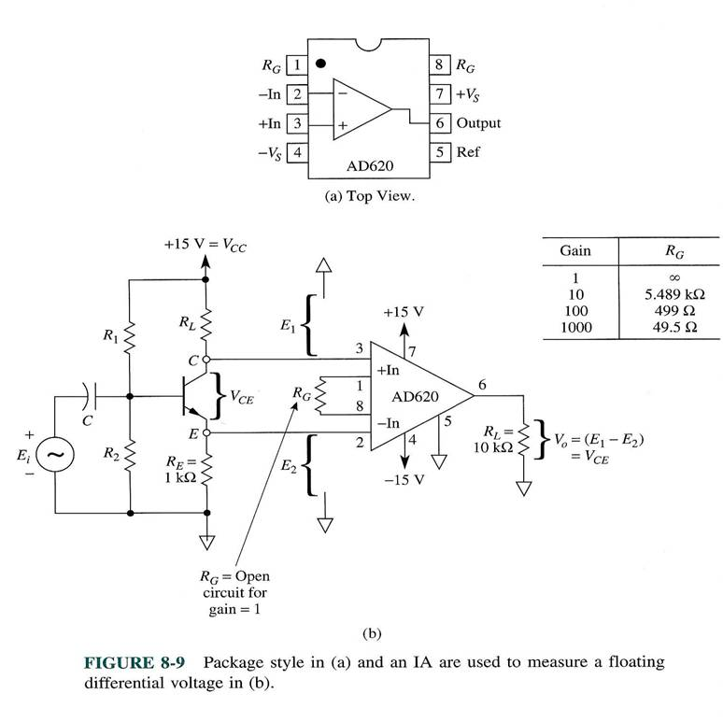
IA-based measurement example: differential voltage measurement

Slide 18
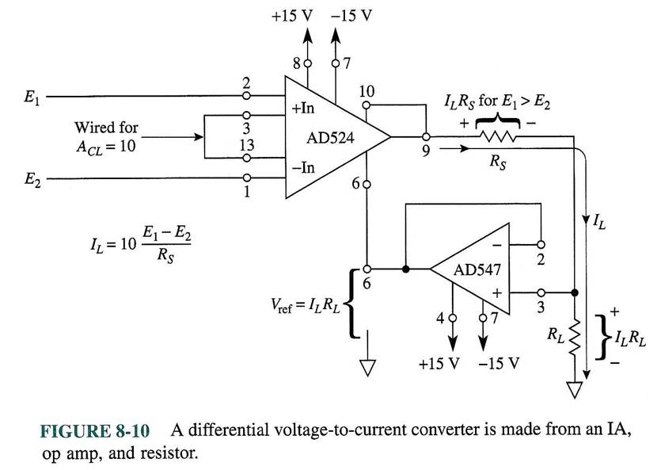
IA-based Differential V-to-I converter

Slide 19
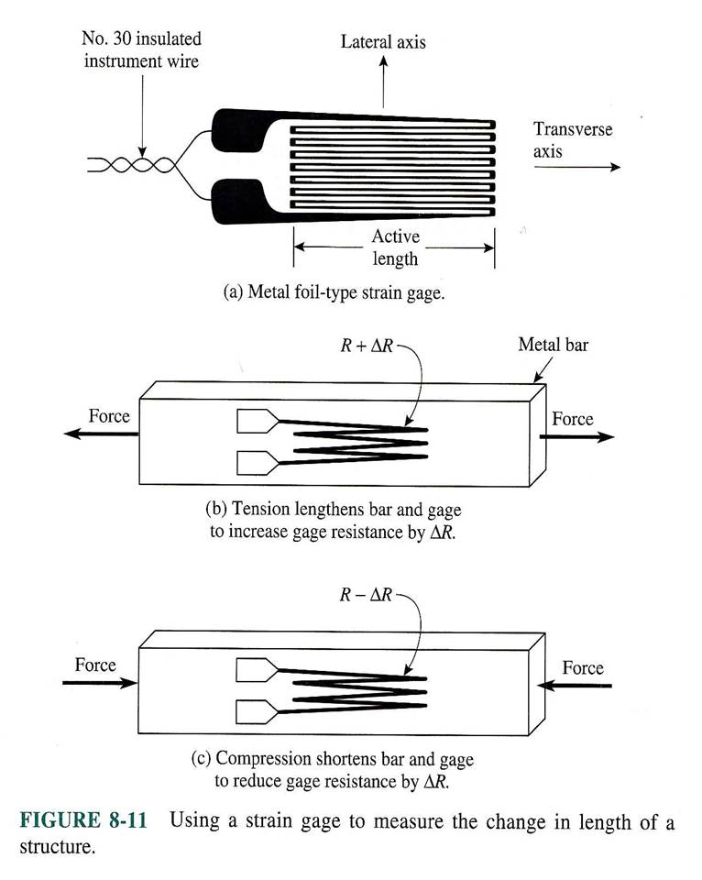
The IA as a signal conditioning circuit: strain gage measurements
LECTURE FINISHED HERE
GF= [(ΔR/R) / (ΔL/L)] (Ω/m)
Notes:
LECTURE FINISHED HERE

Slide 20
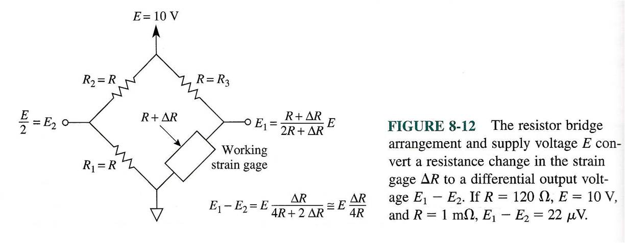
Basic Resistance Bridge

Slide 21
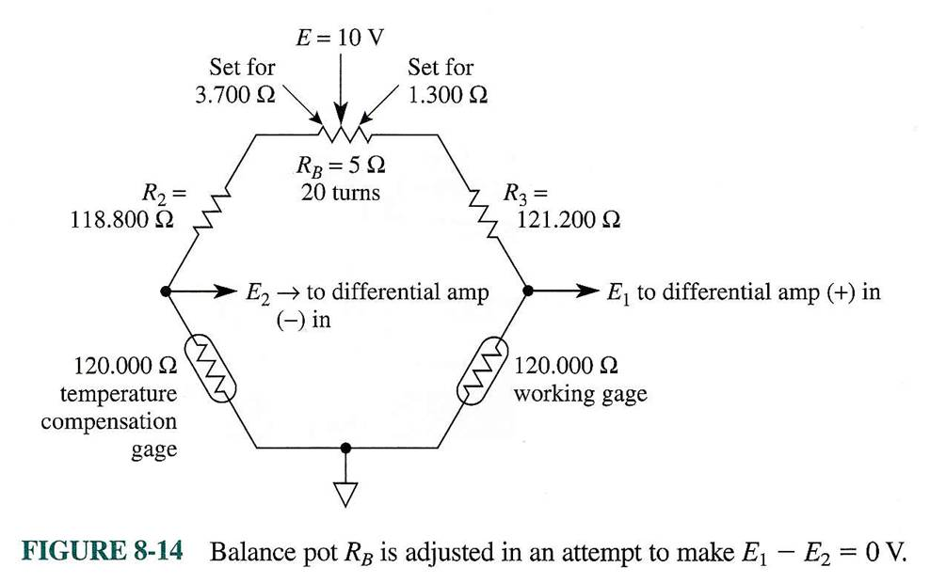
Balancing a Resistance Bridge

Slide 22
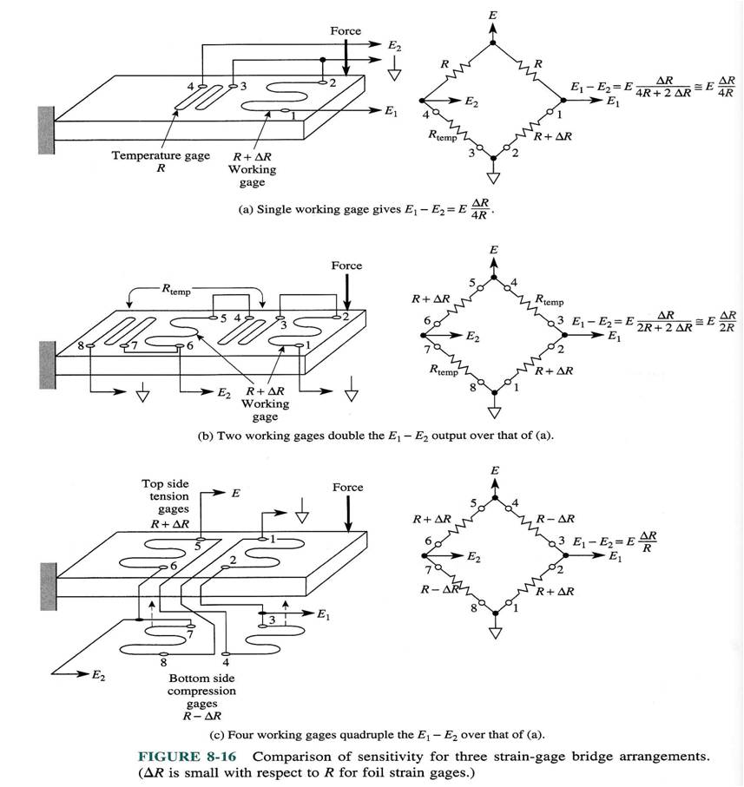
Sensitivity of Resistor Bridges

Slide 23
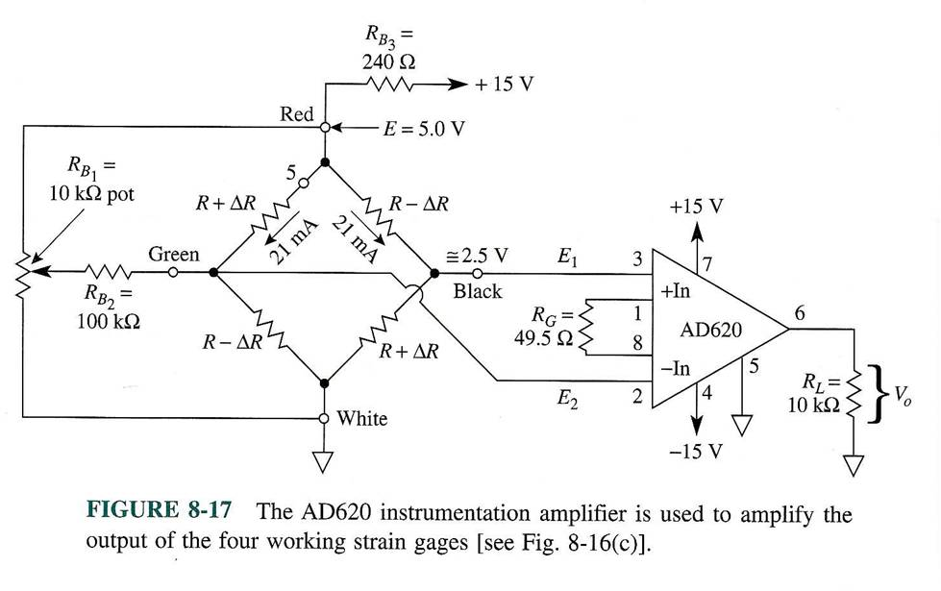
Bridge Measurements with IA

