Slide 1
Basic Non-Linear Circuits
YR3-BE3-HBINST
Dept. of Bioengineering
E.M.Drakakis

Slide 2
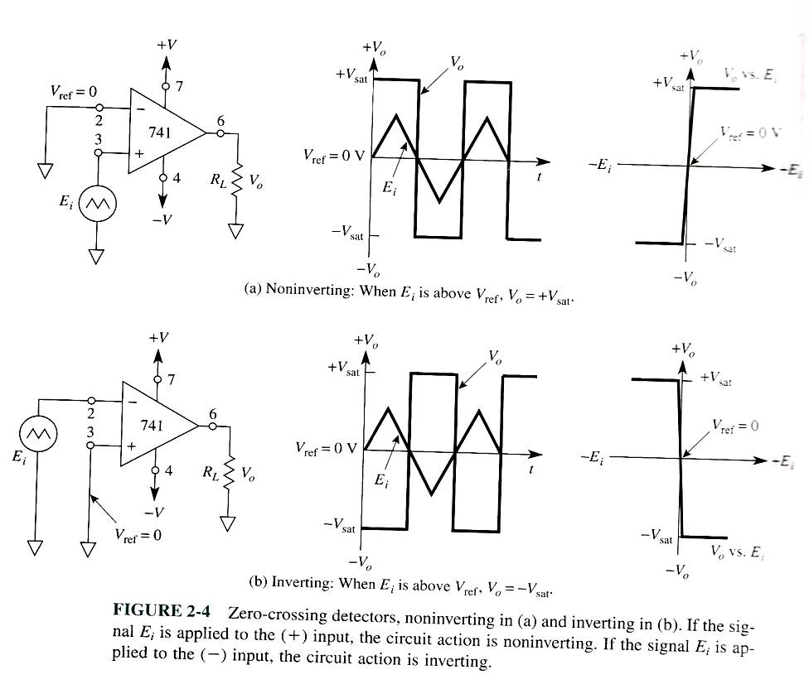
Zero Crossing Detectors
Notes:
The most straight forward cicrucit. Detects wgen input is etiher ppositive or negative, o.e when it crosses zero.
Circuits here work in open-loop operation, not connection between output and input terminals.

Slide 3
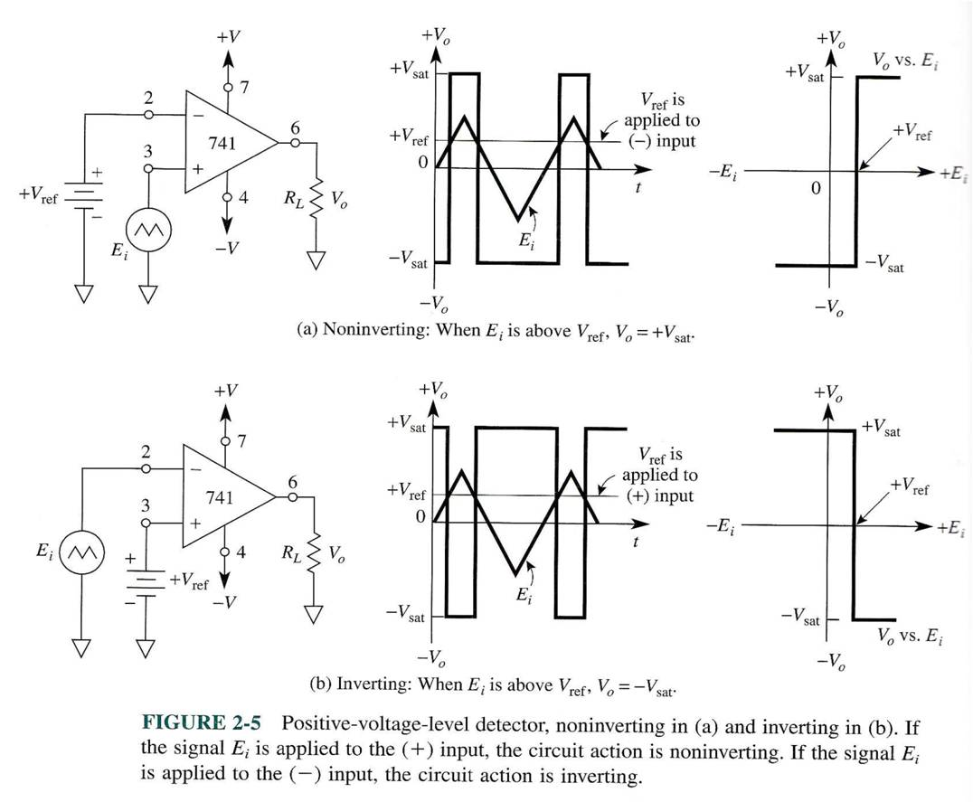
+ve Voltage Level Detector

Slide 4
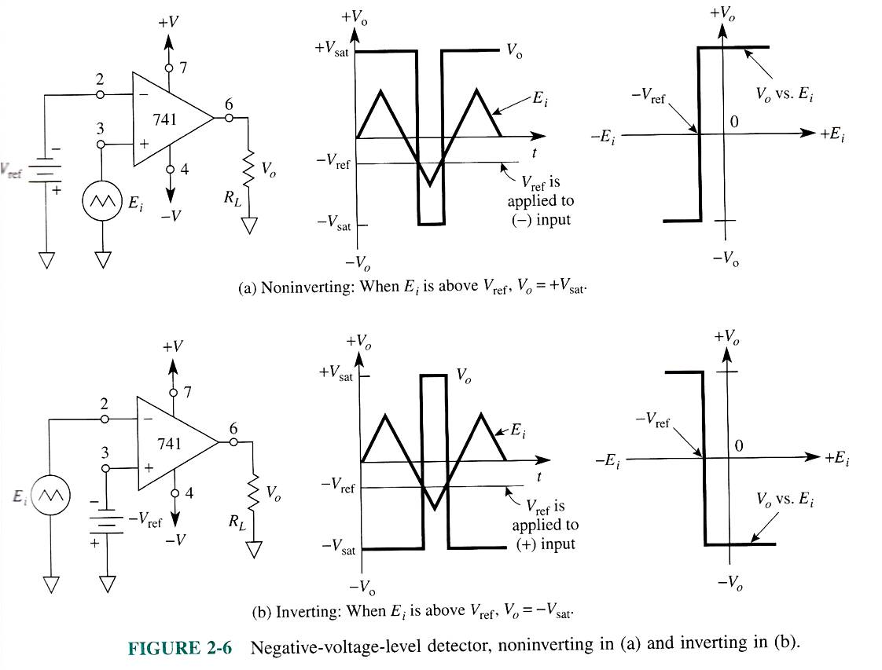
-ve Voltage Level Detector

Slide 5
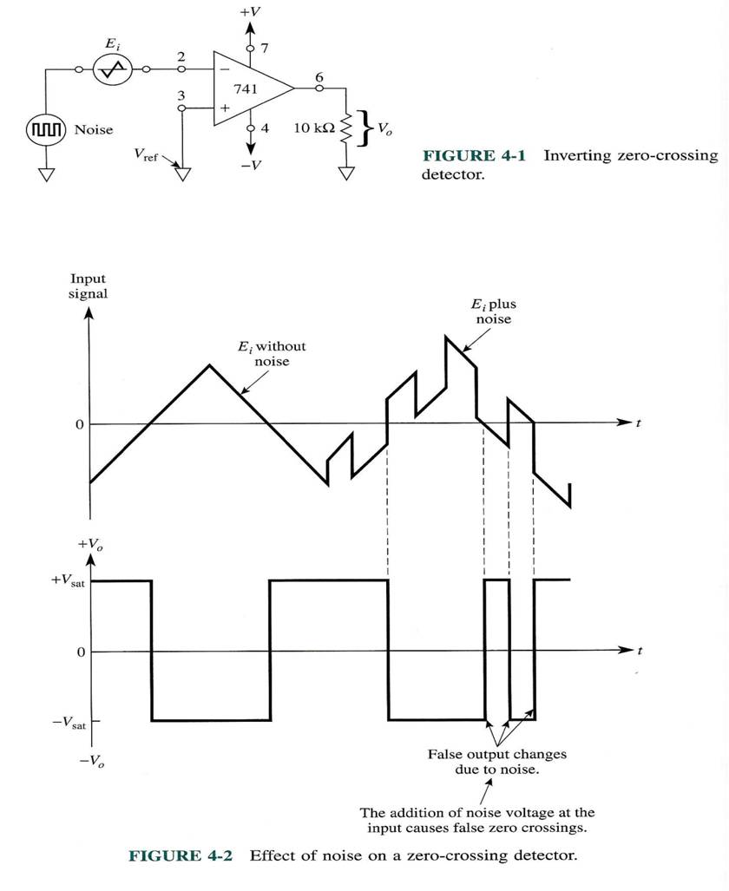
Problem! effect of noise
Notes:
Never used in a straight forward manner

Slide 6
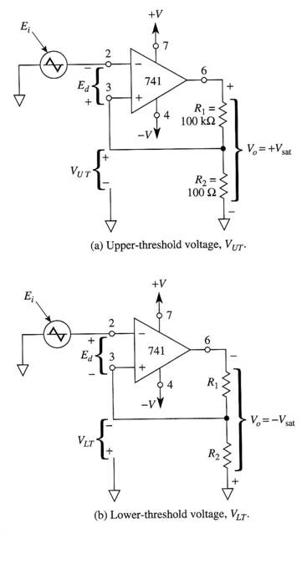
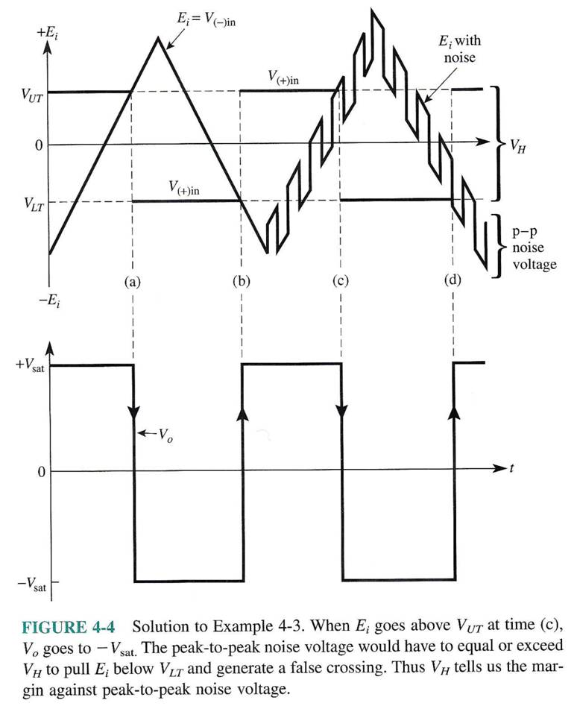
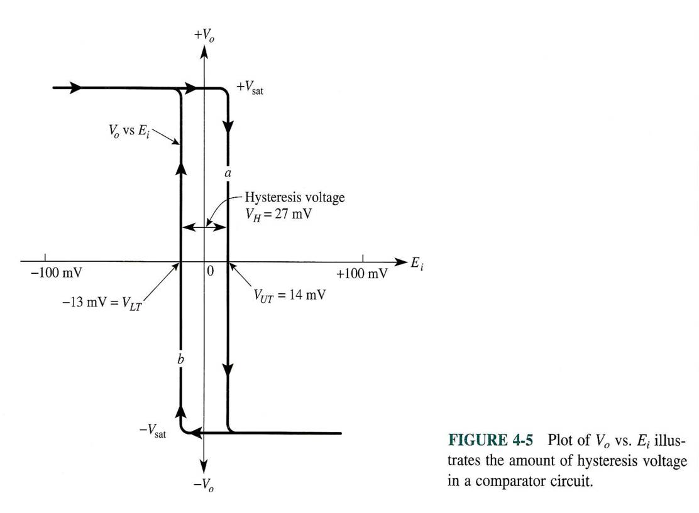
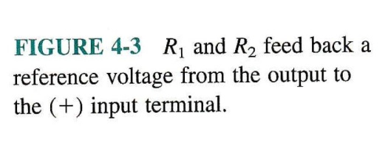
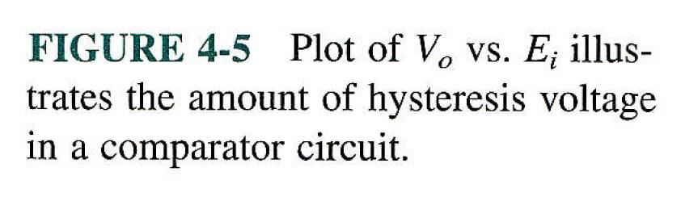
Solution: +ve feedback!
Notes:
Vout changes state when the input is higher than the higher threshold or lower than low threshold.
It’s only one circuit not two.

Slide 7
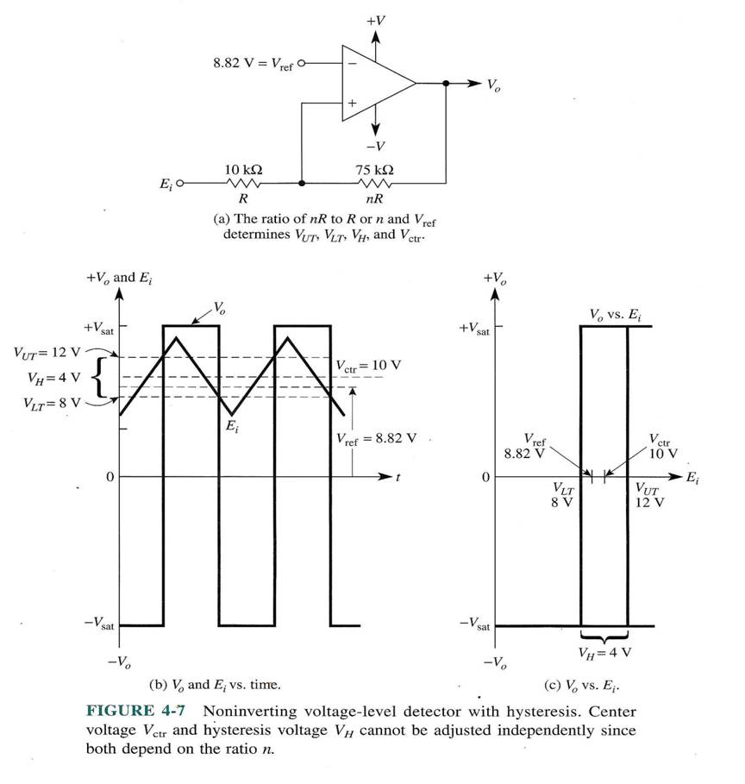
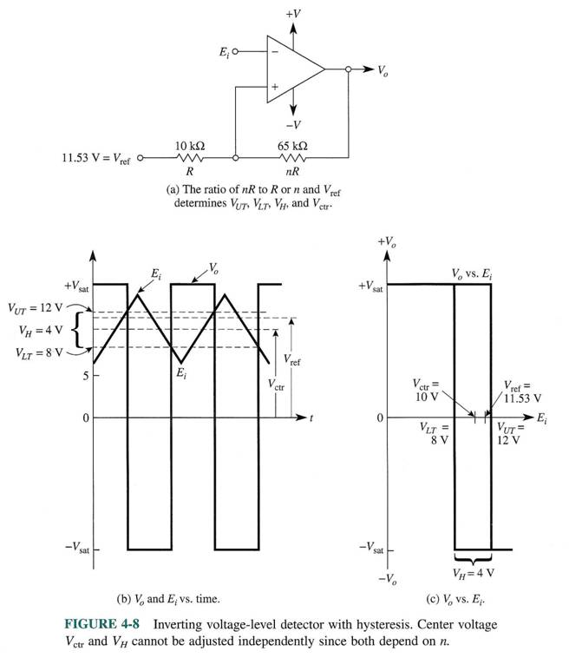
Voltage-Level Detectors with Hysteresis

Slide 8
Determine V_{UT}
(fill in)

Slide 9
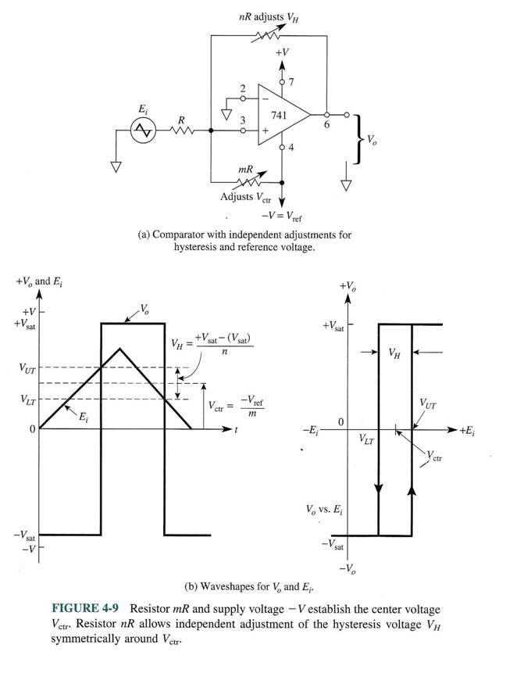
Voltage-Level Detectors with independent
adjustment of hysteresis and center voltage

Slide 10
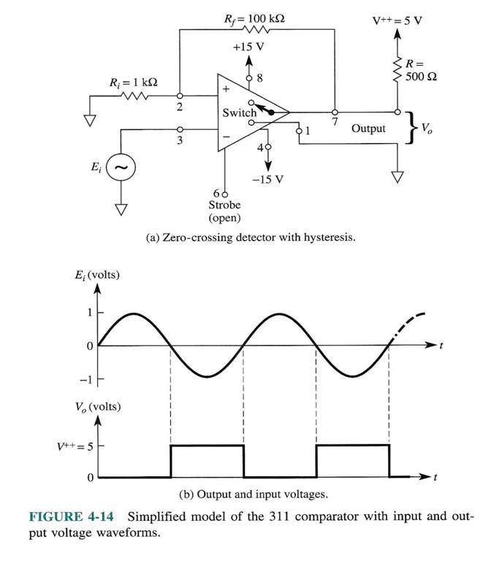
EKG Detector –I

Slide 11
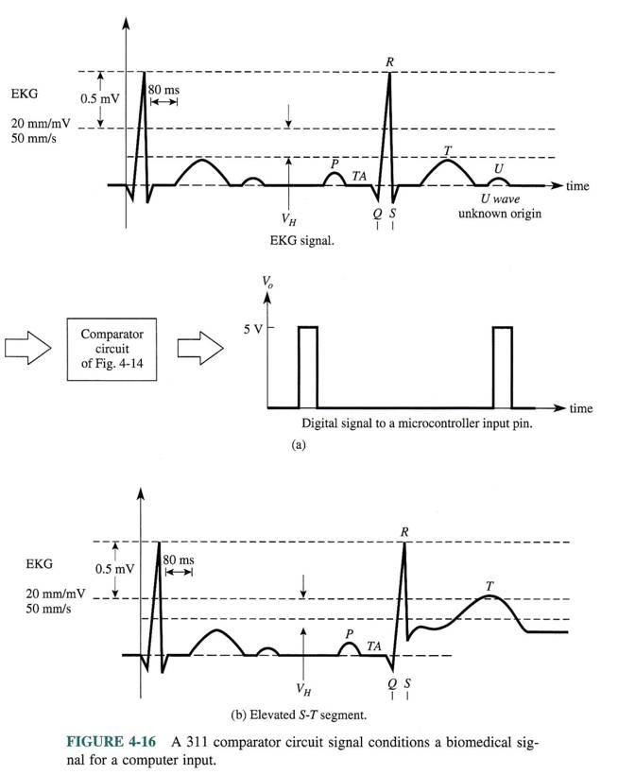
EKG Detector –II

Slide 12
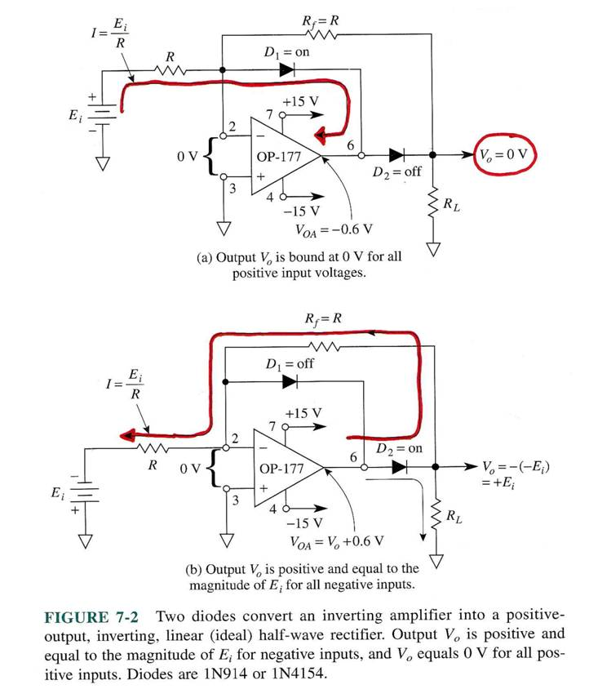
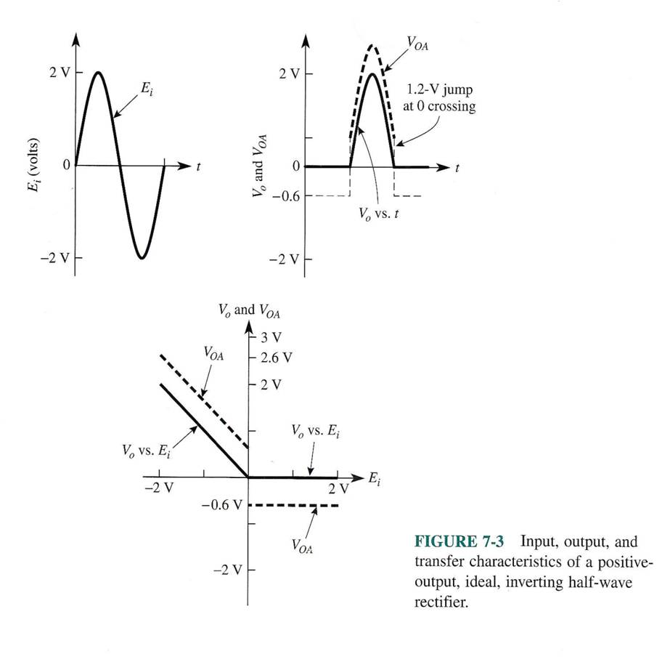
Inverting Half-Wave Rectifier: +ve output

Slide 13
Basic HWR Operational Relations
(Derivation-Fill in)

Slide 14
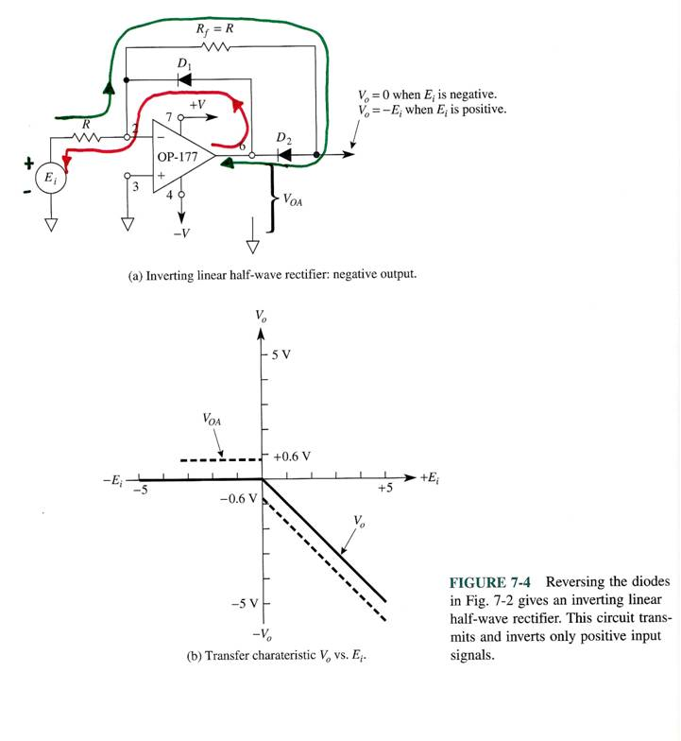
Inverting Half-Wave Rectifier: -ve output

Slide 15
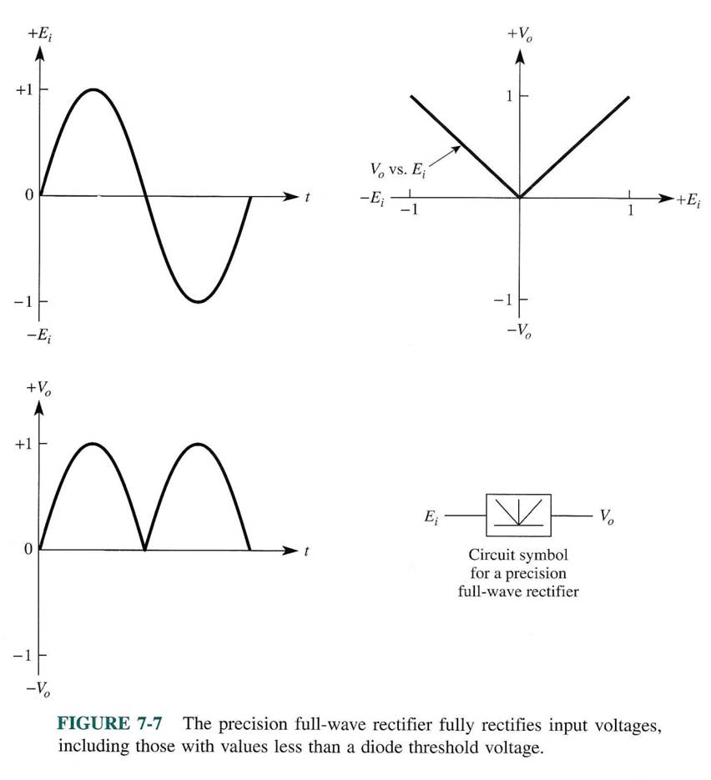
Precision Full Wave Rectifier
(Absolute Value Circuit)

Slide 16
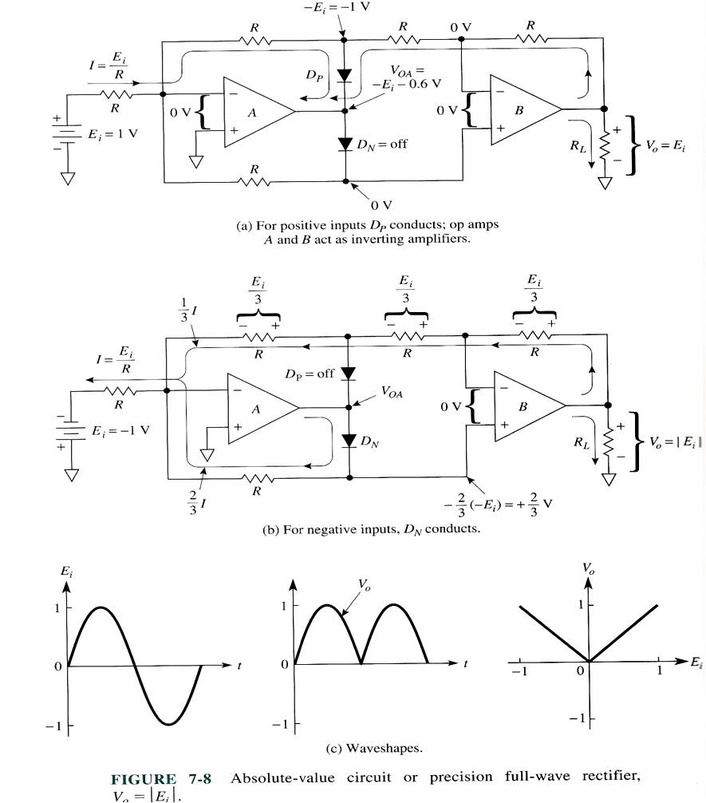
Practical FWR

Slide 17
FWR Basic Operational Relations
(Derivation-Fill in)

Slide 18
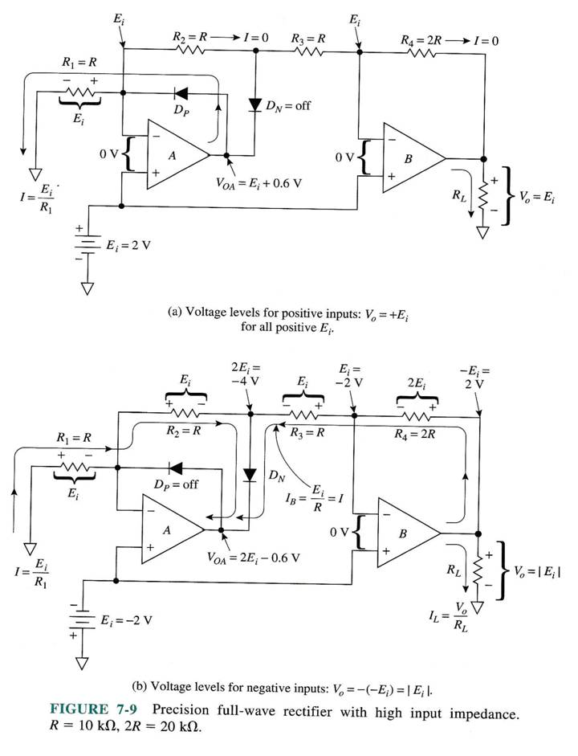
Practical FWR with high R_{in}

Slide 19
High-R_{in} Basic FWR Operational Relations
(Derivation-Fill in)

Slide 20
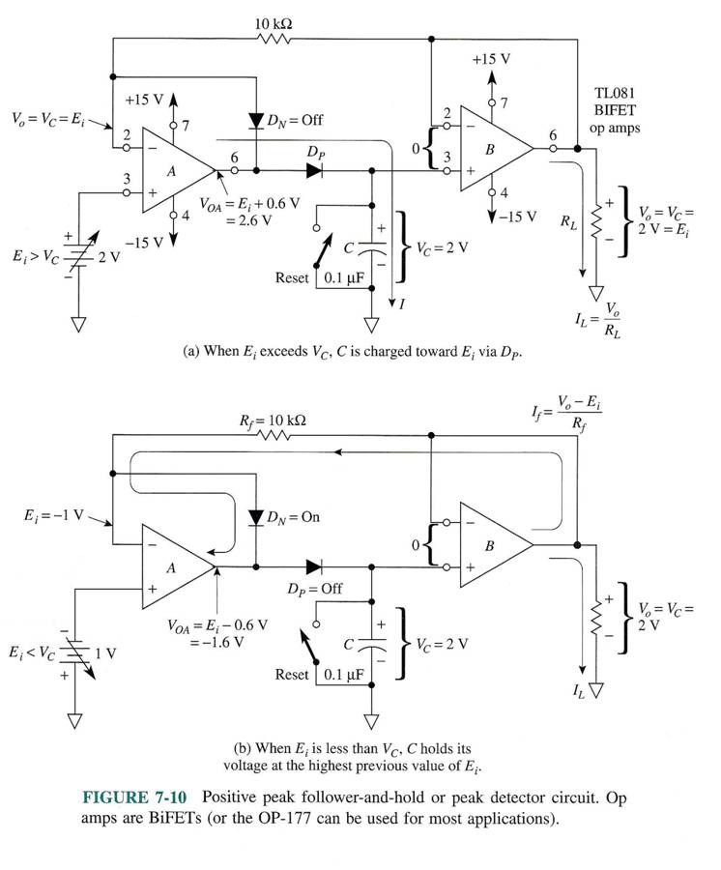
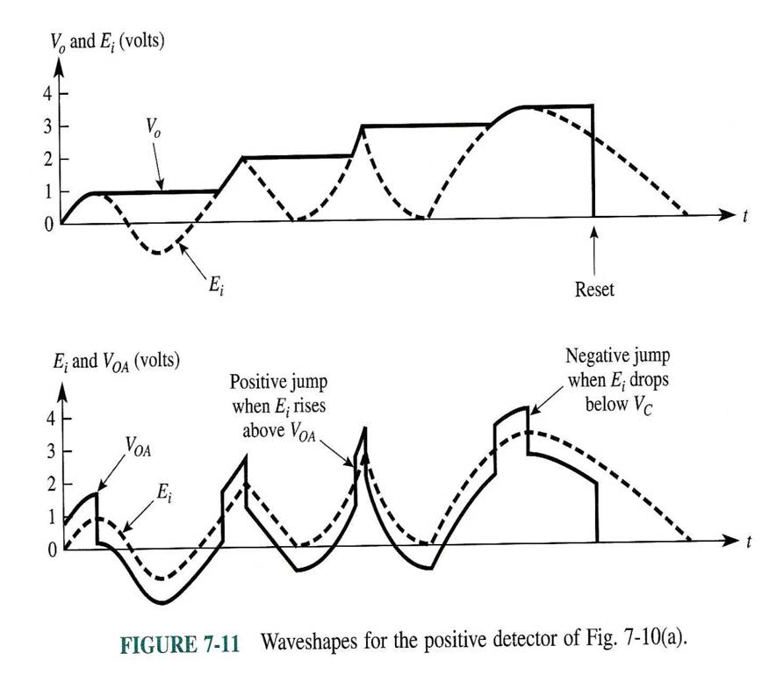
Peak Detector

Slide 21
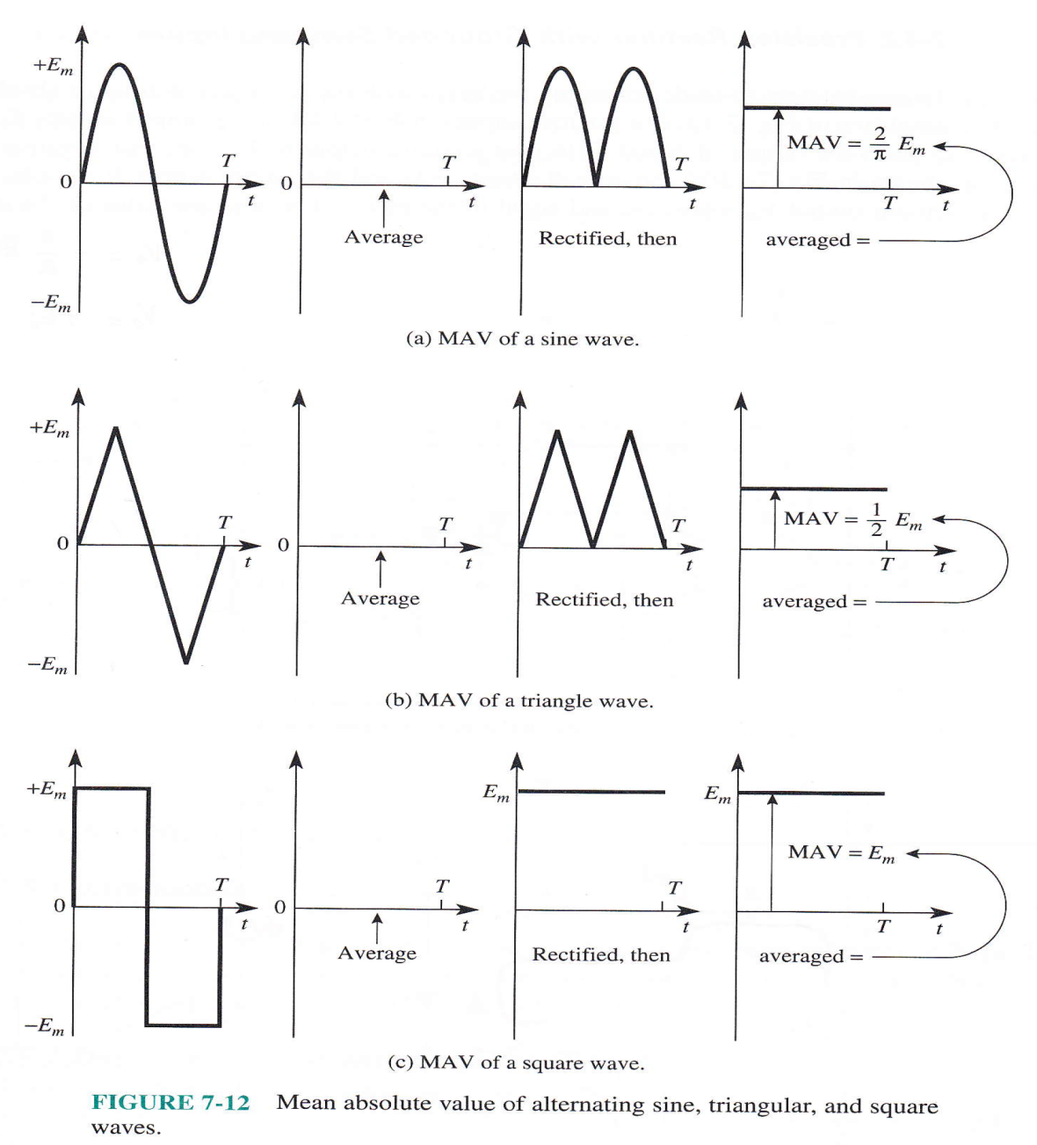
AC-DC Converter
(Mean Absolute Value-MAV Circuit)

Slide 22
Circuits for Cochlear Implant Example
(Derivation-Fill in)

Slide 23
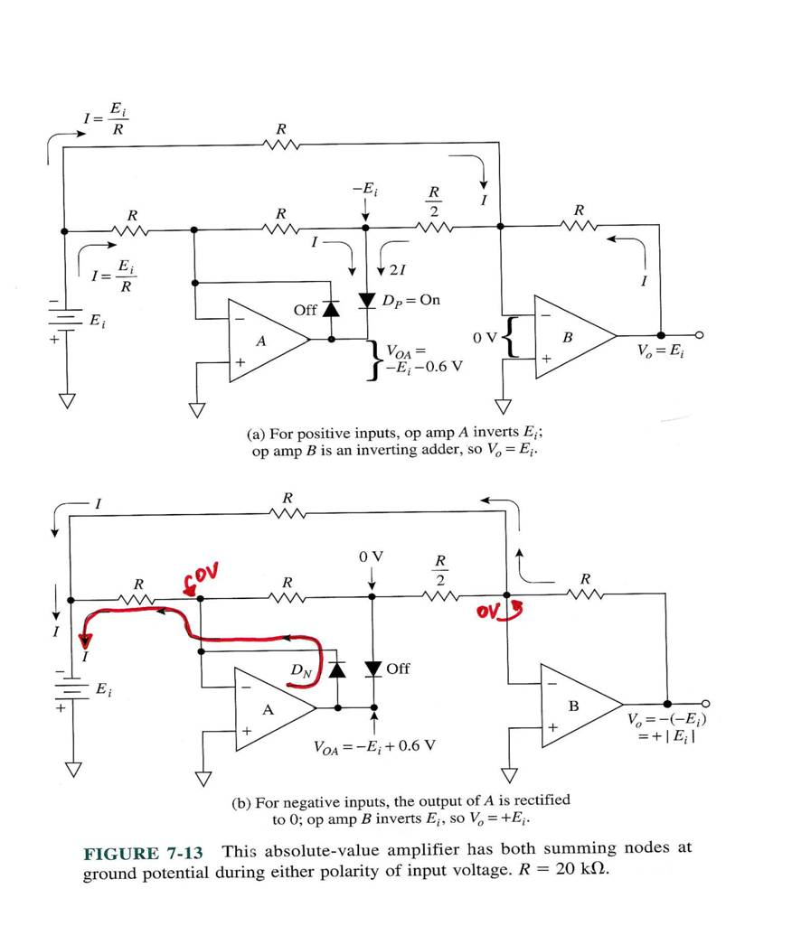
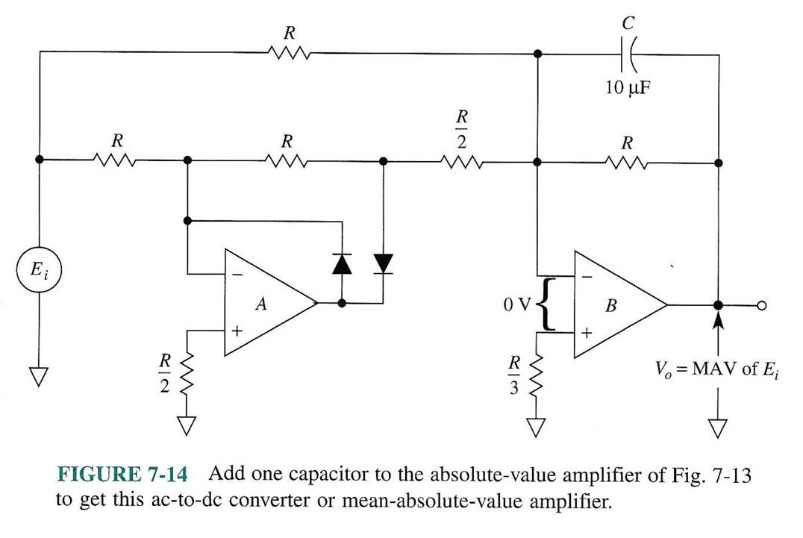
Precision Rectifier with GND-ed Summing Inputs

Slide 24
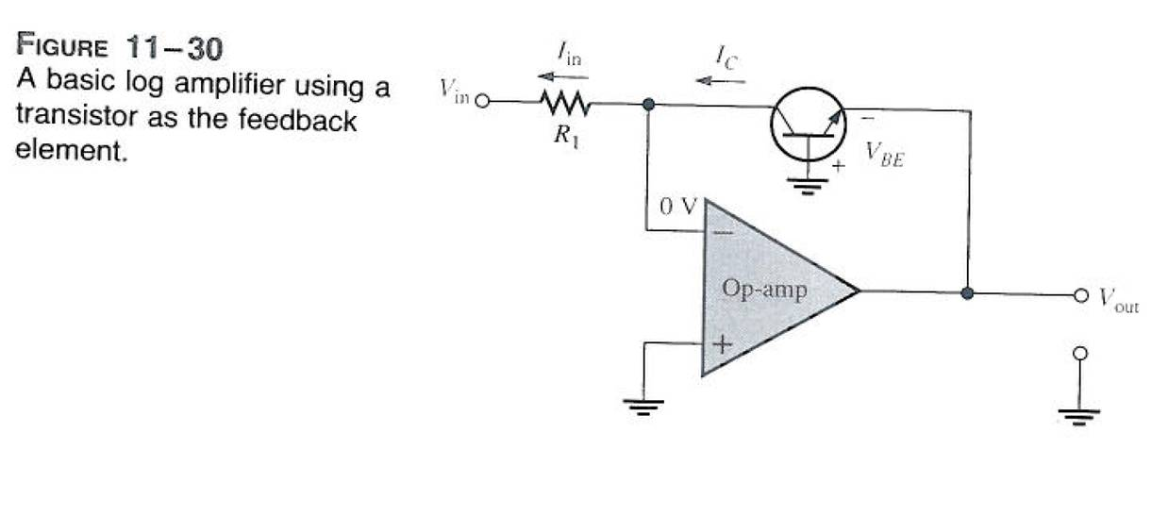
LOG- Amplifier
V_{out}=…

Slide 25
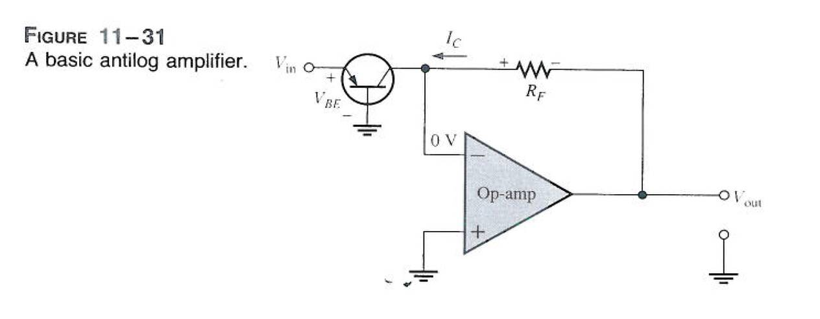
ANTILOG Amplifier
V_{out}=…

Slide 26
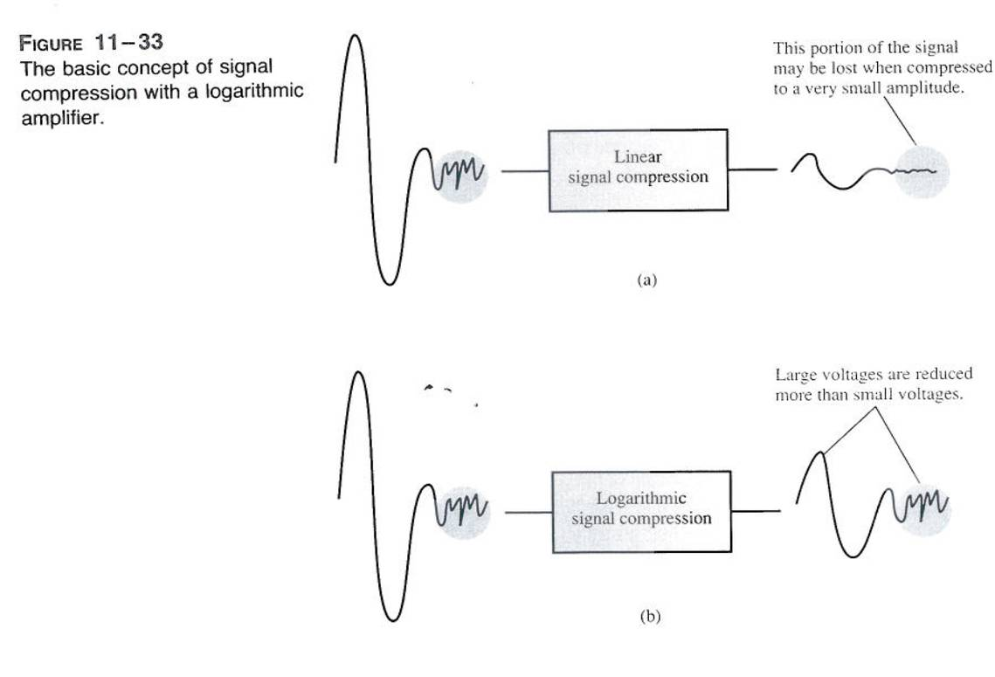
LOG Compression

Slide 27
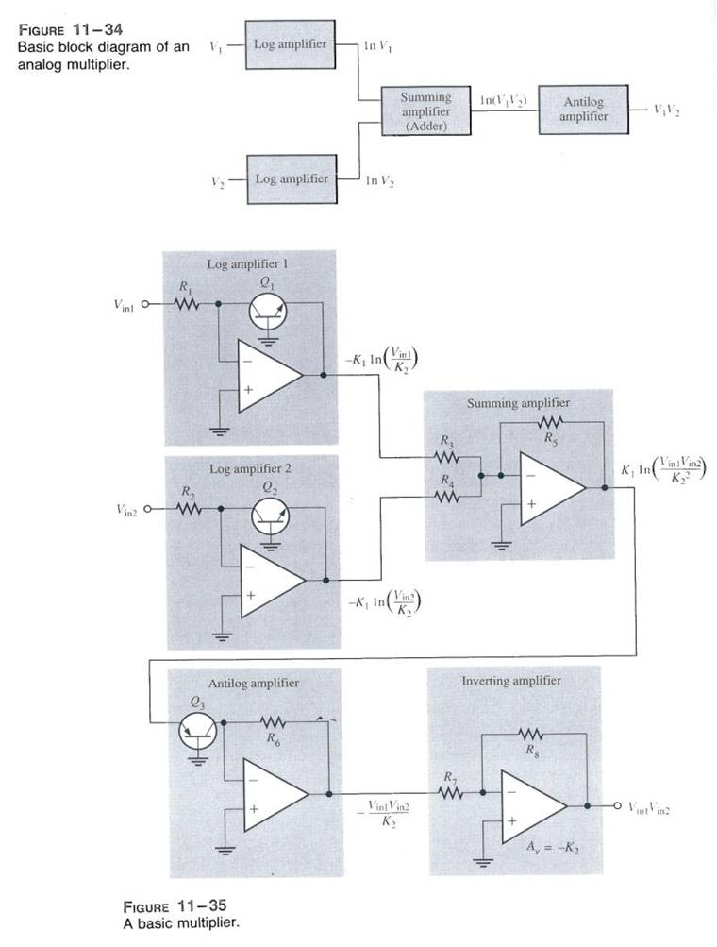
LOG-based Multiplier

Slide 28
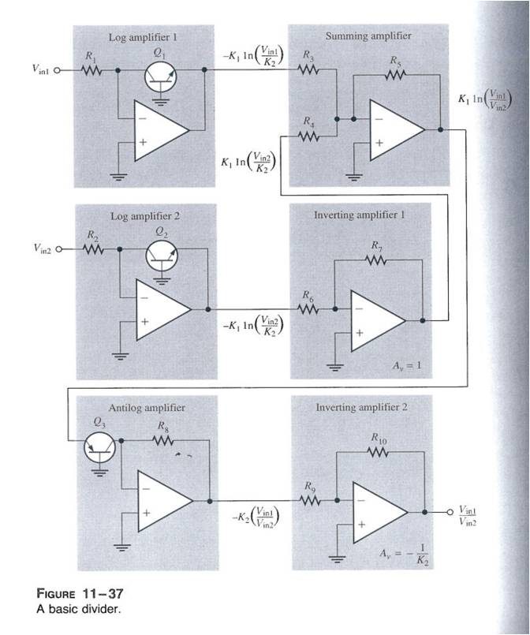
LOG-based Divider

