Slide 1
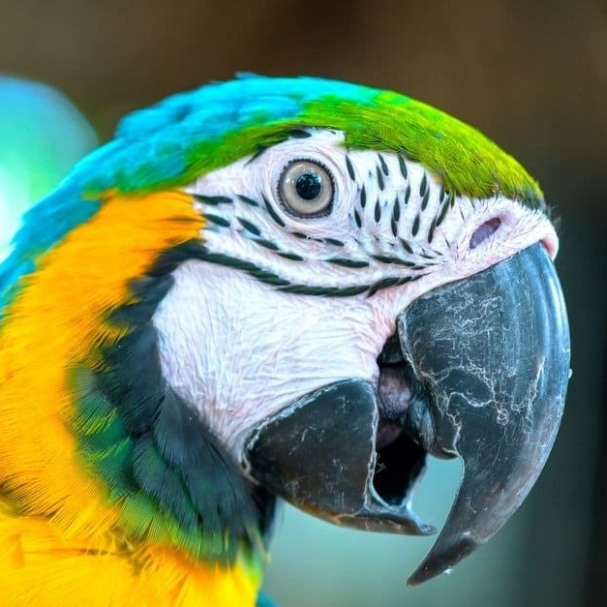
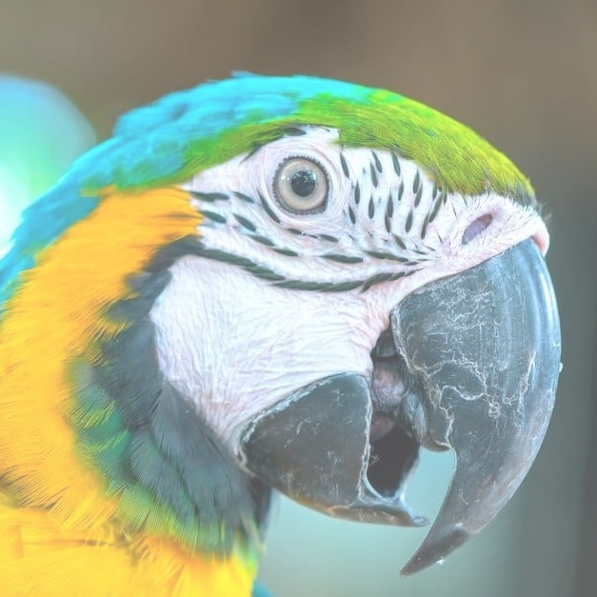
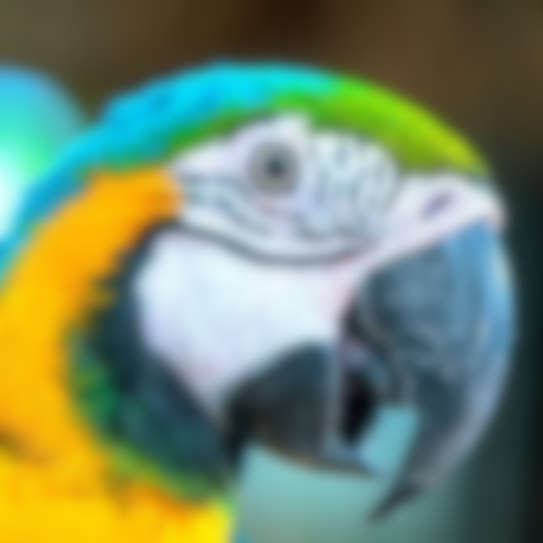
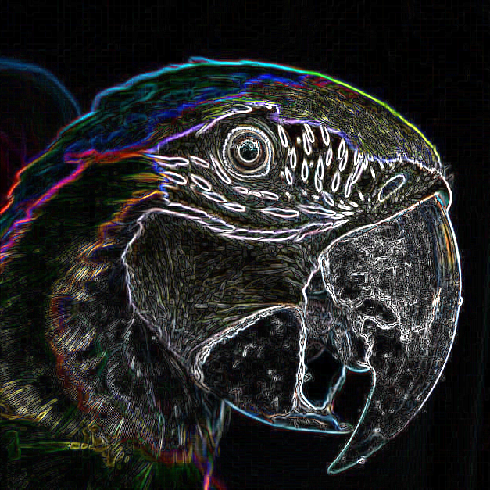
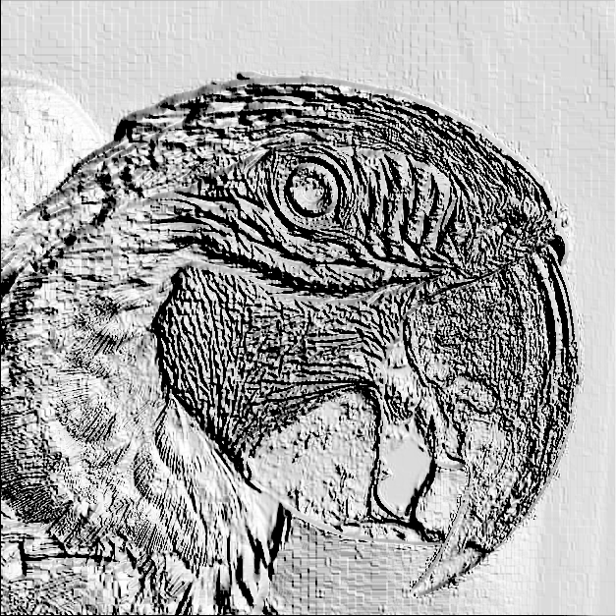
You have probably seen image filters before.
Can you match the name of each image filter to the output?
1
2
3
4
Emboss
Blur
Edge detect
Brighten

Slide 2
你可能见过图像滤镜。
你能把每个图像滤镜的名称和输出匹配吗？
1
2
3
4
Emboss - 压花
Blur - 模糊
Edge detect - 边缘检测
Brighten - 明亮

Slide 3
2 June 2026
Convolutions

Slide 4


Suppose that we want to store an image in a computer.
In this lesson, we will just consider black and white images.
0 | 0 | 1 | 1 | 1 | 1 | 0 | 0
0 | 1 | 1 | 1 | 0 | 1 | 1 | 0
1 | 1 | 1 | 1 | 1 | 1 | 1 | 1
1 | 1 | 1 | 1 | 1 | 0 | 0 | 0
1 | 1 | 1 | 1 | 1 | 0 | 0 | 0
1 | 1 | 1 | 1 | 1 | 1 | 1 | 1
0 | 1 | 1 | 1 | 0 | 1 | 1 | 0
0 | 0 | 1 | 1 | 1 | 1 | 0 | 0
First, we convert the image to pixels.
Each pixel is stored as 0 (white) or 1 (black).
We can also store grey values as numbers between 0 and 1.

Slide 5
假设我们想在计算机中存储一张图像。
本课我们只考虑黑白图像。
0 | 0 | 1 | 1 | 1 | 1 | 0 | 0
0 | 1 | 1 | 1 | 0 | 1 | 1 | 0
1 | 1 | 1 | 1 | 1 | 1 | 1 | 1
1 | 1 | 1 | 1 | 1 | 0 | 0 | 0
1 | 1 | 1 | 1 | 1 | 0 | 0 | 0
1 | 1 | 1 | 1 | 1 | 1 | 1 | 1
0 | 1 | 1 | 1 | 0 | 1 | 1 | 0
0 | 0 | 1 | 1 | 1 | 1 | 0 | 0
首先，我们将图像转换为像素。
每个像素被存储为0（白色）或1（黑色）。
我们也可以将灰色值存储为0到1之间的数字。

Slide 6

Now we can make a simple filter using an image convolution
A convolution matrix is a 3×3 grid of numbers like this.
0.06 | 0.13 | 0.06
0.13 | 0.24 | 0.13
0.06 | 0.13 | 0.06
Open up lesson 260201 on the website
Enter this convolution matrix onto the page.
Click the Apply Filter button to see the effect.
Think back to the starter. What type of filter is this?

Slide 7
现在我们可以用图像卷积做一个简单的滤波器
卷积矩阵是一个3×3的数字网格，类似这样的。
0.06 | 0.13 | 0.06
0.13 | 0.24 | 0.13
0.06 | 0.13 | 0.06
在网站上打开课程260201
将这个卷积矩阵输入到页面上。
点击“Apply Filter”按钮查看效果。
回想一下导入。这是什么类型的过滤器？

Slide 8
A convolution works on each 3×3 square of pixels in the image
Each pixel is multiplied by the matching number in the convolution matrix.
The top left pixel is multiplied by the top left number in the matrix.
The bottom right pixel is multiplied by the bottom right number in the matrix.
We add these together to get the final pixel value:
0 | 0 | 1 | 1 | 1 | 1 | 0 | 0
0 | 1 | 1 | 1 | 0 | 1 | 1 | 0
1 | 1 | 1 | 1 | 1 | 1 | 1 | 1
1 | 1 | 1 | 1 | 1 | 0 | 0 | 0
1 | 1 | 1 | 1 | 1 | 0 | 0 | 0
1 | 1 | 1 | 1 | 1 | 1 | 1 | 1
0 | 1 | 1 | 1 | 0 | 1 | 1 | 0
0 | 0 | 1 | 1 | 1 | 1 | 0 | 0
0.06 | 0.12 | 0.06
0.12 | 0.24 | 0.12
0.06 | 0.12 | 0.06
Note:
If the final value is > 1, we just store 1.
If the final value is < 0, we just store 0.
3×0.06
2×0.12
1×0.24
0.66

Slide 9
卷积作用于图像中每个3×3像素方格
每个像素乘以卷积矩阵中的匹配数。
左上像素乘以矩阵中的左上角数字
右下角像素乘以矩阵中的右下角数字。
我们将这些元素相加得到最终的像素值：
0 | 0 | 1 | 1 | 1 | 1 | 0 | 0
0 | 1 | 1 | 1 | 0 | 1 | 1 | 0
1 | 1 | 1 | 1 | 1 | 1 | 1 | 1
1 | 1 | 1 | 1 | 1 | 0 | 0 | 0
1 | 1 | 1 | 1 | 1 | 0 | 0 | 0
1 | 1 | 1 | 1 | 1 | 1 | 1 | 1
0 | 1 | 1 | 1 | 0 | 1 | 1 | 0
0 | 0 | 1 | 1 | 1 | 1 | 0 | 0
0.06 | 0.12 | 0.06
0.12 | 0.24 | 0.12
0.06 | 0.12 | 0.06
注：
如果最终值>1，
我们只需存储1。
如果最终值<0
我们只需存储0。
3×0.06
2×0.12
1×0.24
0.66

Slide 10
0 | 0 | 0
0 | 1.5 | 0
0 | 0 | 0
Can you guess the effect of this convolution matrix?
0 | 1 | 0
1 | -4 | 1
0 | 1 | 0
What about this one?
Take a guess, then enter the values onto the web page to check.

Slide 11
Because convolutions need a 3×3 box of pixels to work,
one question is what to do at the edges.
No pixels to use here!
0 | 0 | 1 | 1 | 1 | 1 | 0 | 0
0 | 1 | 1 | 1 | 0 | 1 | 1 | 0
1 | 1 | 1 | 1 | 1 | 1 | 1 | 1
1 | 1 | 1 | 1 | 1 | 0 | 0 | 0
1 | 1 | 1 | 1 | 1 | 0 | 0 | 0
1 | 1 | 1 | 1 | 1 | 1 | 1 | 1
0 | 1 | 1 | 1 | 0 | 1 | 1 | 0
0 | 0 | 1 | 1 | 1 | 1 | 0 | 0
A common solution is just to ignore the edges.
This means that after the convolution, the image is a bit smaller.
For example, a 100×100 image would become 98×98 pixels.

Slide 12
因为卷积需要一个3×3像素的盒子才能工作，
一个问题是边缘该怎么办。
这里没有像素可用！
0 | 0 | 1 | 1 | 1 | 1 | 0 | 0
0 | 1 | 1 | 1 | 0 | 1 | 1 | 0
1 | 1 | 1 | 1 | 1 | 1 | 1 | 1
1 | 1 | 1 | 1 | 1 | 0 | 0 | 0
1 | 1 | 1 | 1 | 1 | 0 | 0 | 0
1 | 1 | 1 | 1 | 1 | 1 | 1 | 1
0 | 1 | 1 | 1 | 0 | 1 | 1 | 0
0 | 0 | 1 | 1 | 1 | 1 | 0 | 0
一个常见的解决办法就是忽略边缘。
这意味着卷积后，图像会稍微变小。
例如，一张100×100像素的图像会变成98×98像素。

Slide 13
Questions for you to investigate:
Do the numbers in the convolution matrix always have to add up to 1? 卷积矩阵中的数字总是必须加起来为1吗？
In what situations can we take an image which has been filtered and work backwards to get the original? 在什么情况下，我们可以将经过滤镜处理的图像倒推得到原始图像？
Why could convolutions be useful for compressing data? 为什么卷积对数据压缩有用？
Why could convolutions be useful for AI image recognition? 为什么卷积对人工智能图像识别有用？

