Slide 1
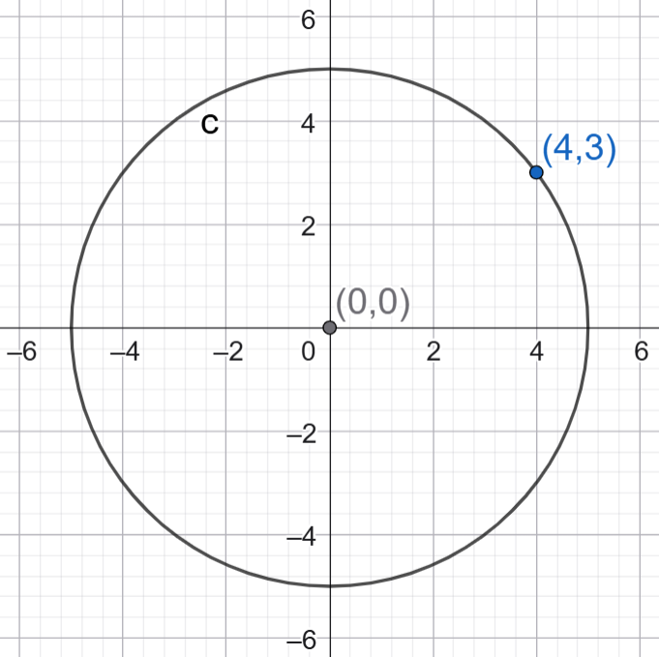
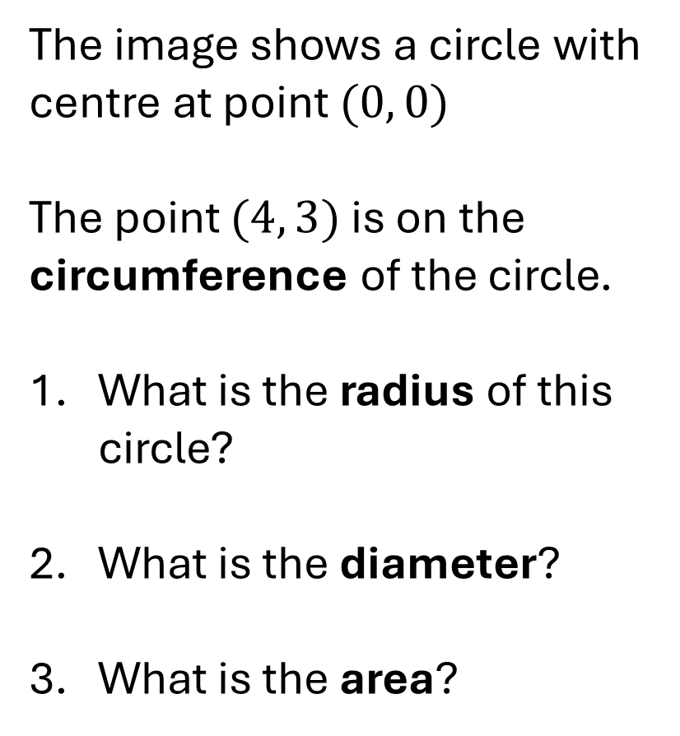
The image shows a circle with centre at point $(0, 0)$
The point $(4, 3)$ is on the circumference of the circle.
What is the radius of this circle?
What is the diameter?
What is the area?

Slide 2
图像显示一个圆，
中心为点（0， 0）
点（4， 3）位于圆周上。
这个圆的半径是多少？
直径是多少？
那是哪个地区？

Slide 3
2 June 2026
Rasterising Circles

Slide 4
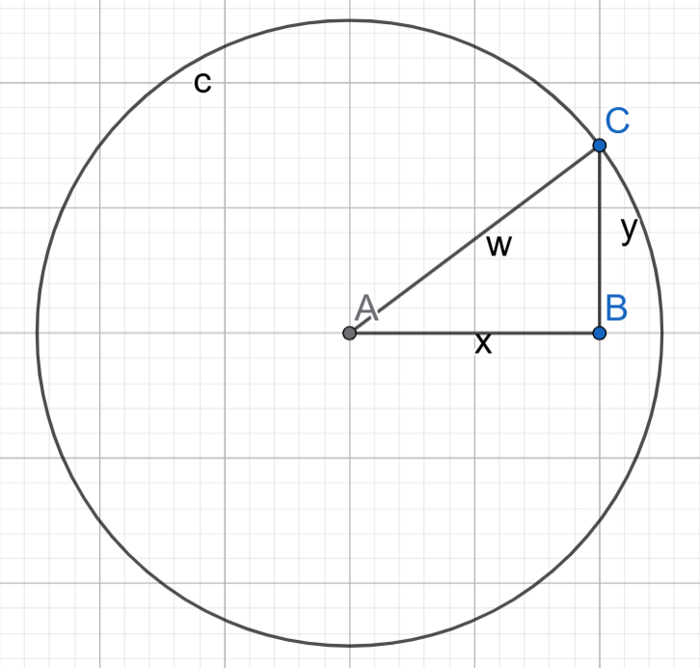
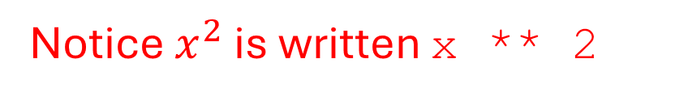
Every point on the circumference of a circle is exactly one radius length away from the centre of the circle.
We can measure the distance from the centre using Pythagoras.
Mathematical notation:
$$w=\sqrt{x^{2}+y^{2}}$$
Python code:
w = sqrt(x ** 2 + y ** 2)
Notice $x^{2}$ is written x ** 2

Slide 5
圆周上的每个点距离圆心恰好一个半径长度。
我们可以用毕达哥拉斯来测量距离中心的距离。
数学记号法:
$$w=\sqrt{x^{2}+y^{2}}$$
Python 代码：
w = sqrt(x ** 2 + y ** 2)
Notice $x^{2}$ is written x ** 2

Slide 6
Now consider this Python program to display a solid circle:
1 | radius = 20
2 | for y in range(minY, maxY):
3 | for x in range(minX, maxX):
4 | w = sqrt(x ** 2 + y ** 2)
5 | if w < radius:
6 | plot(x, y)
Line 2 considers every possible integer value on the y-axis.
Line 3 considers every possible integer value on the x-axis.
Line 5 checks if the pixel at (x, y) is inside the circle.
Line 6 fills in the pixel at that location.

Slide 7
现在考虑这个Python程序，显示一个实心圆：
1 | radius = 20
2 | for y in range(minY, maxY):
3 | for x in range(minX, maxX):
4 | w = sqrt(x ** 2 + y ** 2)
5 | if w < radius:
6 | plot(x, y)
第2行考虑y轴上所有可能的整数值。 第3行考虑了x轴上所有可能的整数值。 第5行检查（x, y）处的像素是否在圆圈内。 第6行填充该位置的像素。

Slide 8
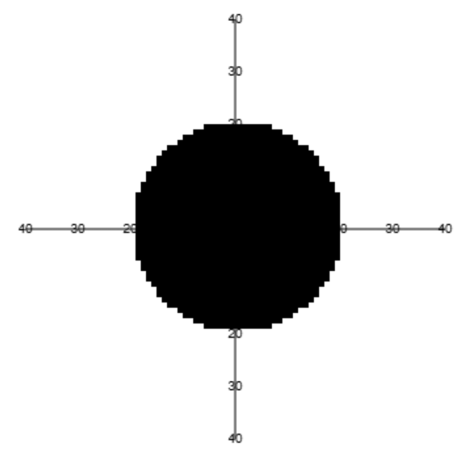
To run the program, open up lesson 260602 on the website.
The result looks like this.
Because pixels are not infinitely small, the edge of the circle is not smooth.
We can only approximate a circle with pixels.
Converting a mathematical shape to pixels is called rasterisation.

Slide 9
要运行该程序，请在网站上打开课程260602。
结果如下。
由于像素不是无限小的，圆的边缘并不光滑。
我们只能用像素近似一个圆。
将数学形状转换为像素称为rasterisation。

Slide 10
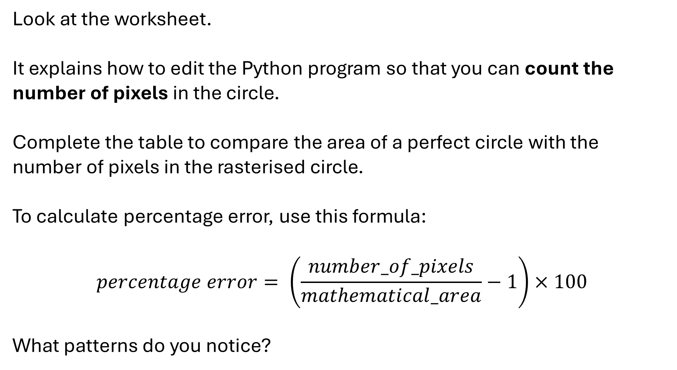
Look at the worksheet.
It explains how to edit the Python program so that you can count the number of pixels in the circle.
Complete the table to compare the area of a perfect circle with the number of pixels in the rasterised circle.
To calculate percentage error, use this formula:
$$percentage error= \left(\frac{number_of_pixels}{mathematical_area}−1\right)×100$$
What patterns do you notice?

Slide 11
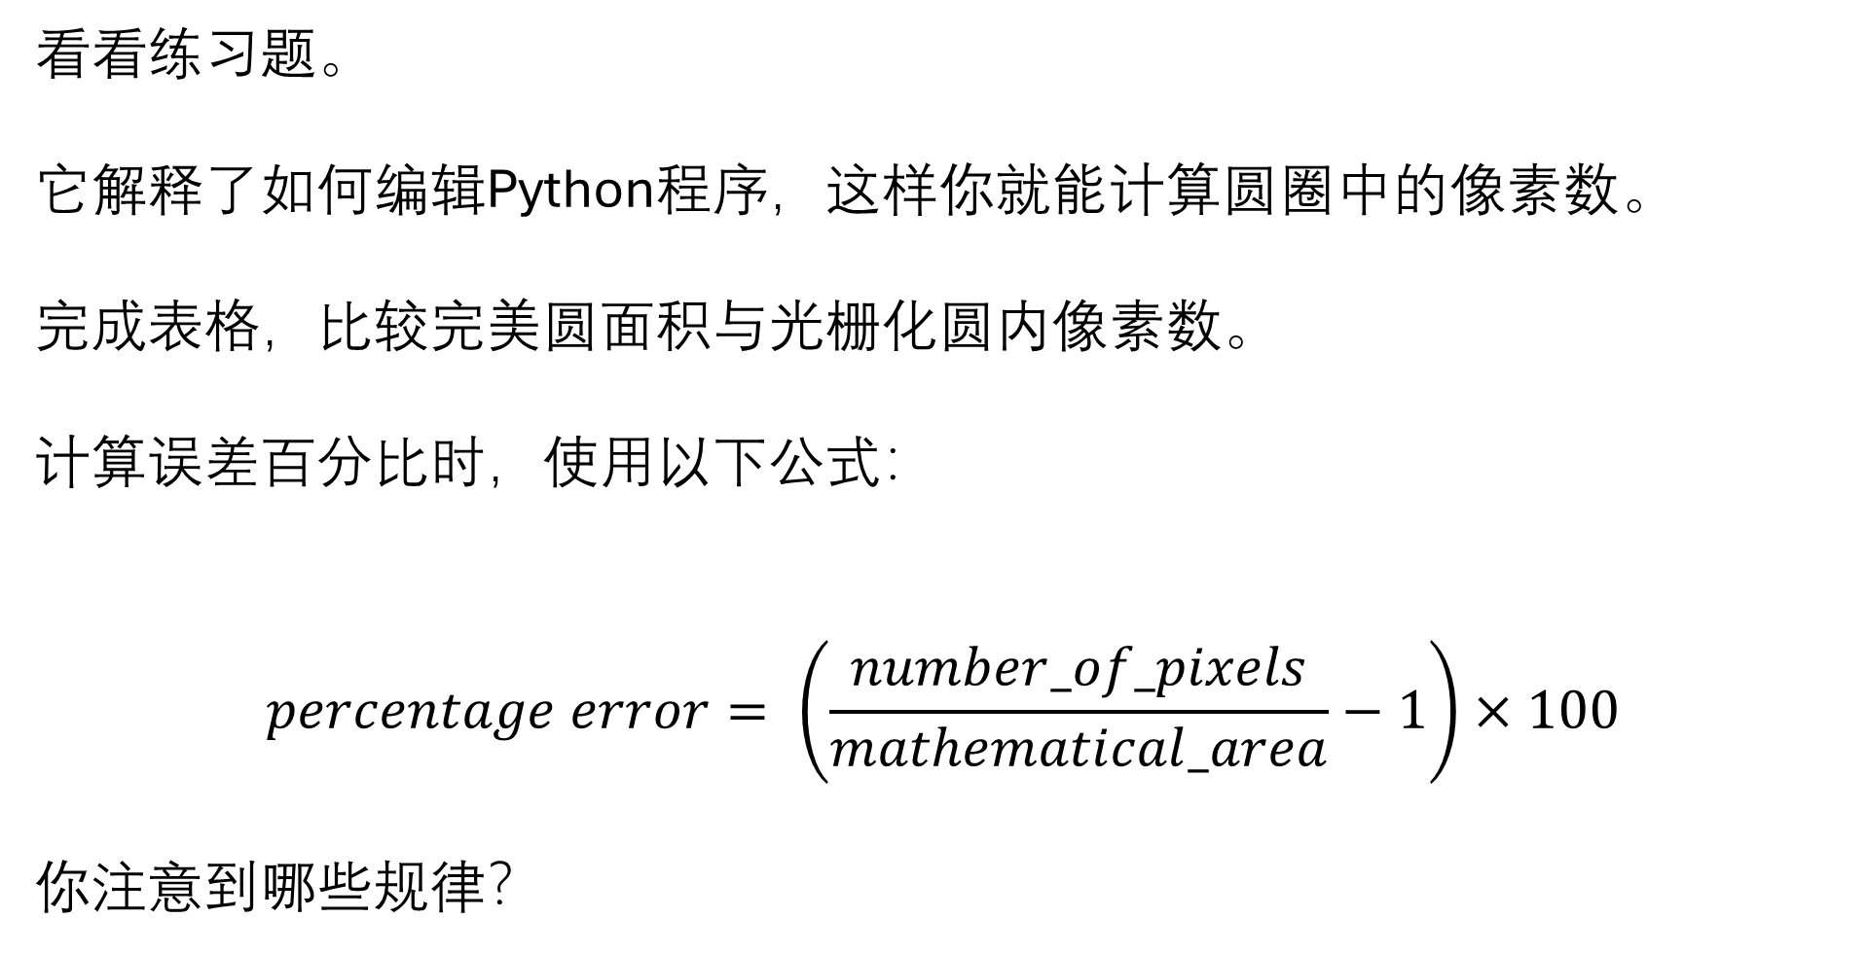
看看练习题。
它解释了如何编辑Python程序，这样你就能计算圆圈中的像素数。
完成表格，比较完美圆面积与光栅化圆内像素数。
计算误差百分比时，使用以下公式：
$$percentage error= \left(\frac{number_of_pixels}{mathematical_area}−1\right)×100$$
你注意到哪些规律？

Slide 12
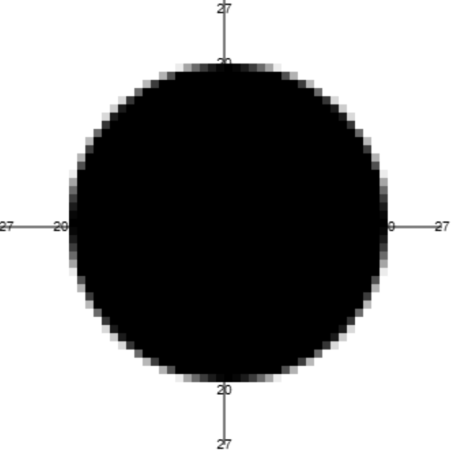
Extension For Advanced Students
To create more accurate graphics, a common technique in rasterising is to use different shades of colour for pixels which are on the boundary.
You can change the shade of a pixel by using the ink(x) command, where x is a number between 0 and 1.

Slide 13
Extension For Advanced Students
为了制作更准确的图形，rasterising常用的技术是对边界上的像素使用不同色调。
你可以用 ink(x) 命令来改变像素的色调，其中 x 是 0 和 1 之间的数字。

