Slide 1
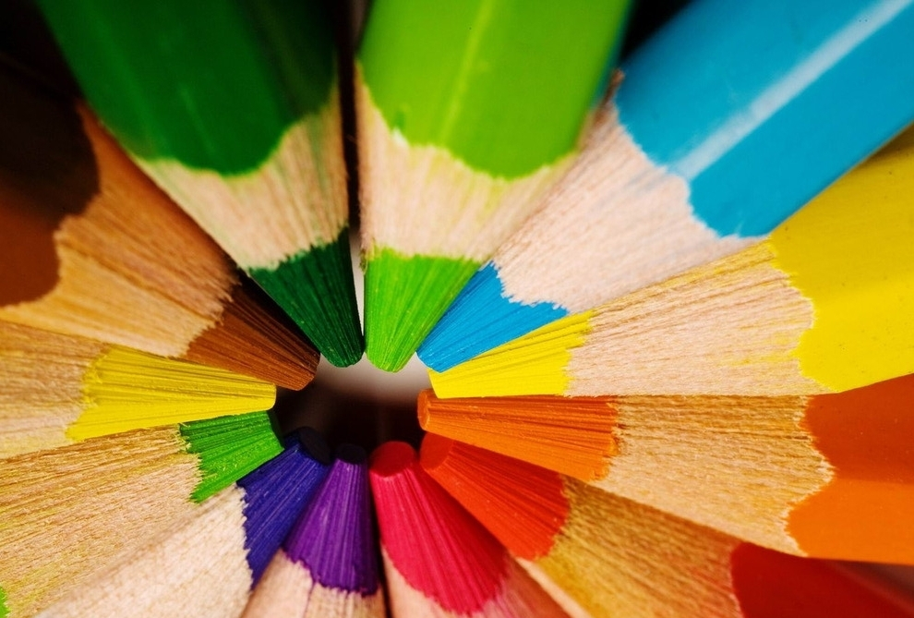
Every colour that we see can be made by mixing just three primary colours together.
What are those three colours?
A
Red, Yellow and Blue
B
Red, Green and Blue.
C
Cyan, Magenta and Yellow.

Slide 2
我们看到的每一种颜色，只需混合三种原色即可制成。
那三种颜色是什么？
A
红、黄、蓝
B
红色、绿色、蓝色。
C
青色、品红色、黄色。

Slide 3
9 June 2026
Representing Colour

Slide 4
In fact, the answer depends on the situation!
This system is used by painters. It’s not scientific but it’s practical for art and design.
In this lesson, we will focus on RGB colour.
A
Red, Yellow and Blue
This system, called additive colour, is accurate for screens and other devices that emit light.
B
Red, Green and Blue.
This system, called subtractive colour, is accurate for printing on surfaces that reflect light.
C
Cyan, Magenta and Yellow.

Slide 5
事实上，答案取决于具体情况！
这种系统被画家使用。这不是科学的，但对艺术和设计来说很实用。
A
红、黄、蓝
这种系统称为加色法，适用于屏幕和其他发光设备。
B
红色、绿色、蓝色
C
这种称为减色系统的系统，适用于在反射光线的表面上印刷。
青色、品红色、黄色

Slide 6
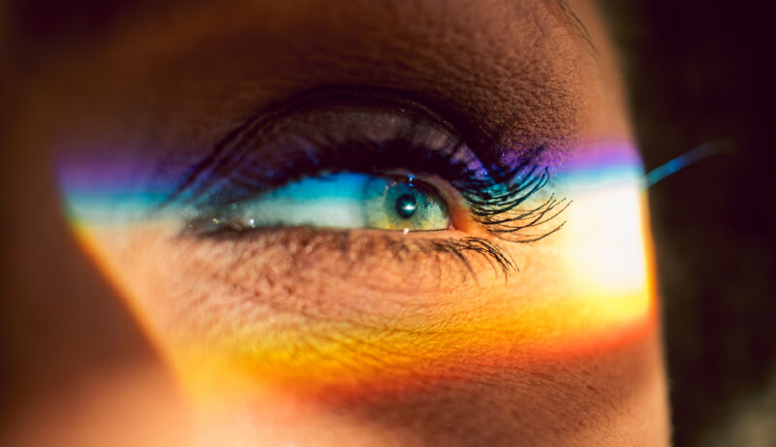
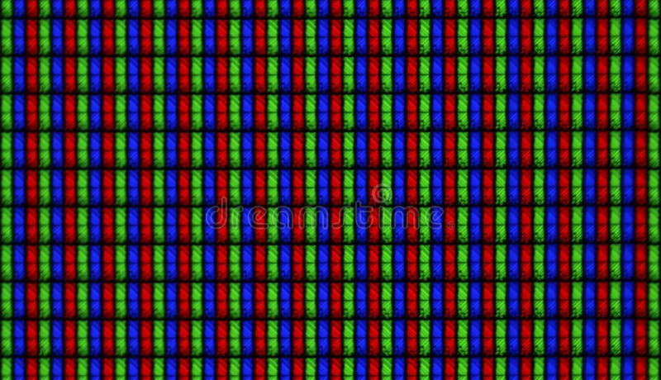
If we look at a colour screen under a microscope, we can see that it is made of tiny red, green and blue lights.
Most computer software uses a byte to measure how much red, green and blue are in a colour.
Remember, a byte can store any value from 0 to 255.

Slide 7
如果我们在显微镜下观察彩色屏幕，可以看到它由微小的红、绿、蓝光组成。
大多数计算机软件使用字节来测量颜色中红色、绿色和蓝色的比例。
记住，一个字节可以存储0到255之间的任意值。

Slide 8
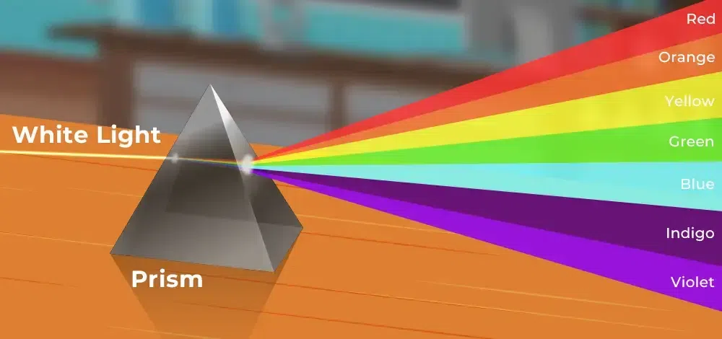
So we can write the colour red as:
(255, 0, 0)
Maximum amount of red.
No green or blue light.
(0, 255, 0)
Similarly, the colour green would be:
(0, 0, 255)
And the colour blue would be:
(255, 255, 0)
What about this colour?

Slide 9
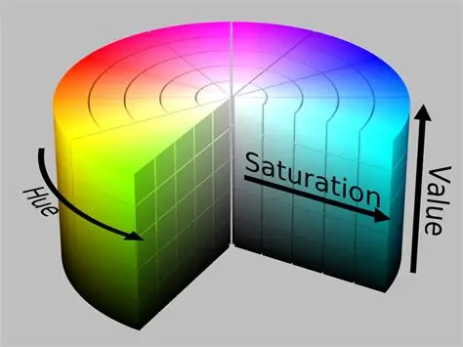
RGB is not the only colour system in use for computing.
For digital art and design, the HSV colour system is very popular.
Investigate the HSV colour system.
How does HSV colour work?
Why is it useful for artists and designers?
Does every RGB colour match exactly one HSV colour? Does every HSV colour match exactly one RGB colour?

Slide 10
RGB并不是计算中唯一的彩色系统。
在数字艺术和设计领域，HSV彩色系统非常受欢迎。
调查HSV的颜色系统。
HSV颜色是如何工作的？
为什么它对艺术家和设计师有用？
每个RGB颜色是否都恰好对应一种HSV颜色？ 每个HSV颜色是否都恰好匹配一种RGB颜色？

Slide 11
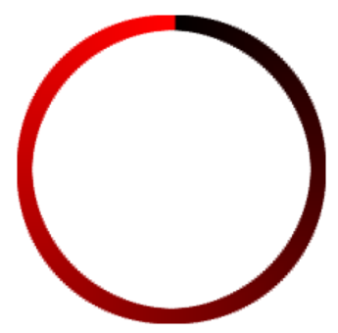
This circle displays every possible shade of red.
However, it is not a smooth gradient.
There is a discontinuity at the top, from bright red to black.
Is it possible to display every shade of red in a smooth colour circle, without any discontinuity?
Is it possible to display a smooth colour circle with every shade of red and green combined?
Is it possible to display a smooth colour circle with every possible colour?

Slide 12
这个圆圈展示了所有可能的红色调。 然而，这并不是平滑的梯度。 顶部有不连续的部分，从鲜红到黑色。
是否有可能将所有红色调都显示成平滑的色圈，且没有任何不连续？
有没有可能用各种红色和绿色的色调来显示一个平滑的色圈？
有没有可能用所有可能的颜色显示一个平滑的色圈？

