Slide 1

EVERSCALE ACADADEMY WORKSHOP #6

Slide 2
PLAN
Explore and Deploy the MultiSig Wallet and Application in DeBot
*Deploy Multisig Wallet
*Multisig DeBot Usage

Slide 3
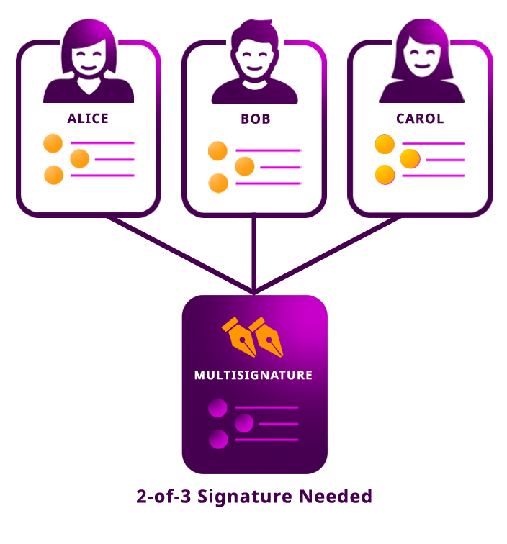
Multi-signature Wallets

Slide 4
Wallet Characteristics
Multi-signature wallets can have up to 32 custodians.
By default they can queue up to 5 transactions from each single custodian to be confirmed by other custodians.
Default transaction lifetime is 1 hour.
Minimal amount that can be transferred is 0.001 token.

Slide 5
Create Wallet
Create wallet seed phrase
Generate deployment key pair file with wallet private/public keys based on the wallet seed phrase
Generate wallet address based on the wallet seed phrase
Send some tokens to the wallet address
Deploy wallet (set custodians)

Slide 6
PRACTICAL DEMONSTRATION

Slide 7
Questions?

