Slide 1
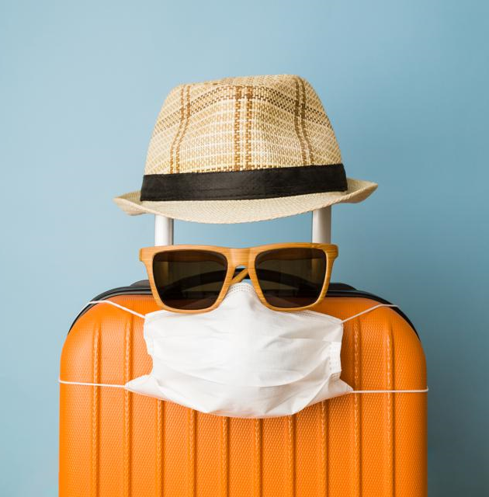
MASK FREE ADVENTURES

Slide 2
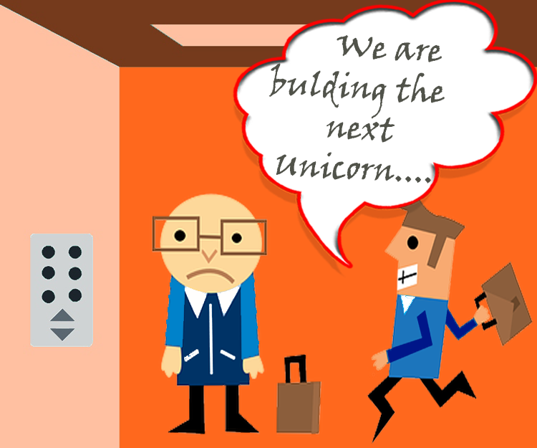
WHAT- App that gives you live COVID-19 statistics for a particular state and national parks available for that state. WHO - Travelers looking to travel nationally. WHY - The pandemic gives you limited options, so this app gives you safe alternative to travel and enjoy outdoors.
The Coding Covids - 2020
Notes:
Elevator pitch

Slide 3


We enjoy traveling and spending time outdoors
Our app was created with the intention to inform the adventures about what states are open for visitors and what outdoor parks are available because of COVID-19 restrictions.
User Story
AS a traveler
I WANT to see COVID-19 statistics and optional national parks to visit. So THAT I can determine whether or not I want to travel to set destination.
Notes:
Concept What is your user story? What was your motivation for development

Slide 4







Technologies
jQuery.
Visual Studios
AJAX Foundation HTML/CSS/JS Framework. The COVID Tracking Project Data API. National Park Service Data API.
Breakdown of tasks and roles
Farrah- Modal, Luis- js/jQuery, Danielli- PM/CSS
Challenges
Working remotely was challenging when having to consolidate each others portion of the work.
Relying on GitHub to push and pull code for the first time was a hurdle.
We struggled to properly display the modal, but then Dan was of great help.
Successes
Working as a group and being able to rely on each other and trust that each was going to put the effort in.
The Coding Covids - 2020
Notes:
Process: What were the technologies used? How were tasks and roles broken down and assigned? What challenges did you encounter? What were your successes?

Slide 5
Demo https://elli360.github.io/MaskFreeAdventures/
The Coding Covids - 2020
Notes:
5 minute

Slide 6
Directions for Future Development
Expand search ability and data results to travel from other states.
Add other types of popular parks/outdoor locations to visit.
Provide small summaries about the destinations in results.
Include symbols to display boasted amenities.
Give options to sort or filter search results by certain park amenities such as camping, kayaking, bathrooms or handicap accessibility.
Provide review ratings from a source such as Yelp.
The Coding Covids - 2020
Notes:
1 minute

Slide 7
Links
https://elli360.github.io/MaskFreeAdventures/
https://github.com/Elli360/MaskFreeAdventures
The Coding Covids - 2020

