Slide 1
Laser Light Show
ELEC 391 – Group B1

Slide 2
Simulink Model

Slide 3
The Process
Find Motor Parameters
Encoder PCB
System Setup
Controller Code

Slide 4
Motor Parameters
R, L (8.4 $Ω$ , 1.12mH)
R, L (8.4 Ω , 1.12mH)
Measured using multimeter
$$Kτ$$
Kτ
J
B
Torque determined from conservation of power
Calculated from mechanical time constant
Kv
Back EMF calculated from KVL
Kinetic friction from $\frac{torque}{friction}$ at no load conditions
Kinetic friction from 𝑡𝑜𝑟𝑞𝑢𝑒/𝑓𝑟𝑖𝑐𝑡𝑖𝑜𝑛 at no load conditions
Resistance and Impedance
Torque Constant
Rotor Inertia
Back EMF
Kinetic Friction

Slide 5

Checking Motor Parameters

Slide 6
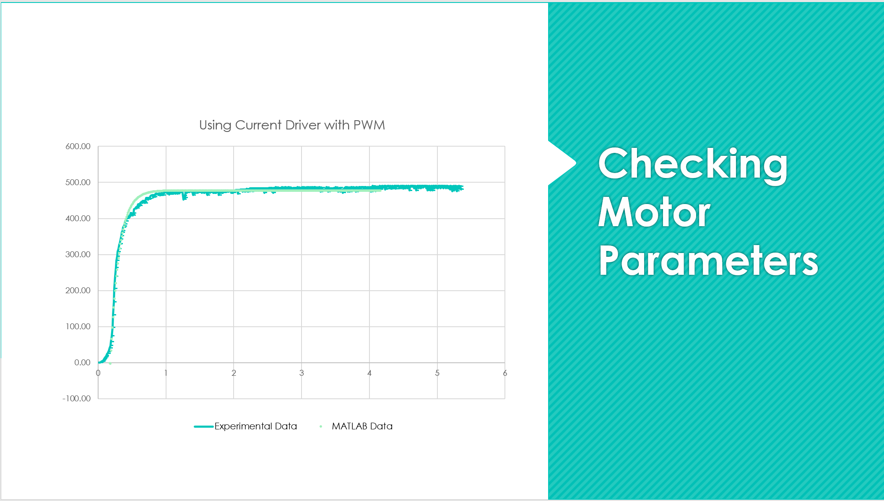

Slide 7
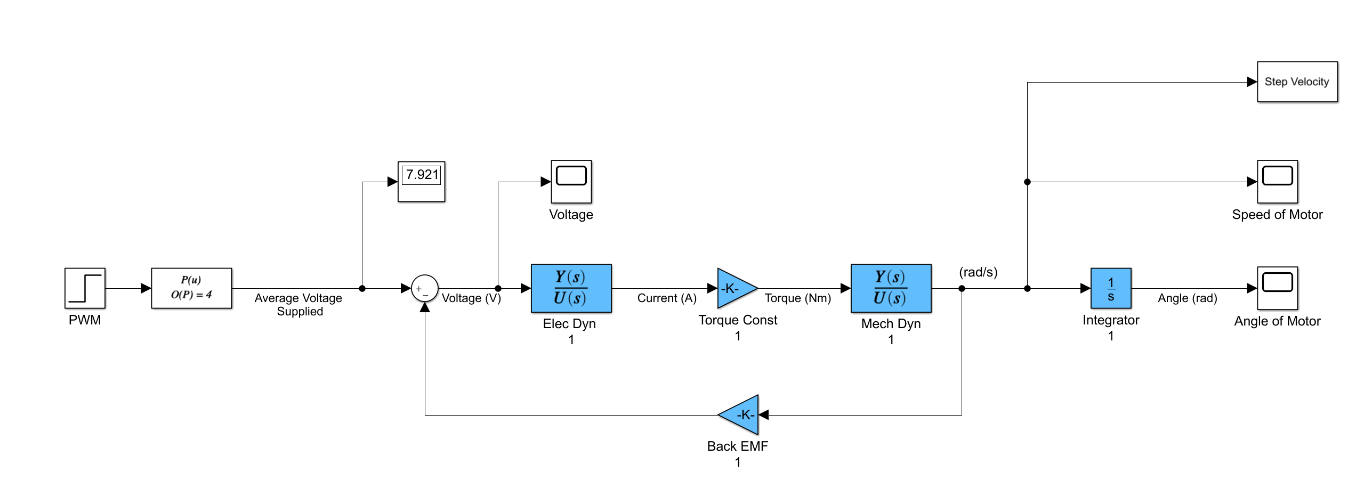
Simulink Model of Motor

Slide 8
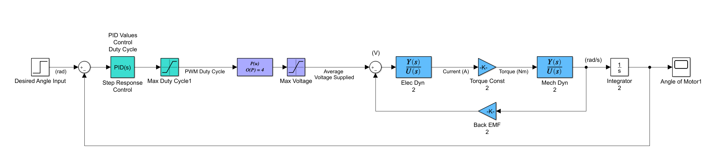
Simulink Model with PID Control

Slide 9
Controller Logic – Reading Position
On Encoder A Interrupt
On Encoder B Interrupt
State 01
State 11
A ^ B
Read Encoder B
Position++
Position--
A ^ B
State 00
State 10
Read Encoder A
Position++
Position--
Increment
End
End
State
<A> <B>
Decrement

Slide 10
Initial Control
-7493
-8
0
Insert Root Locus Here

Slide 11
Simulink Model

Slide 12
Next Steps

