Slide 1
Laser Light Show
ELEC 391 – Group B1 ( Control )

Slide 2

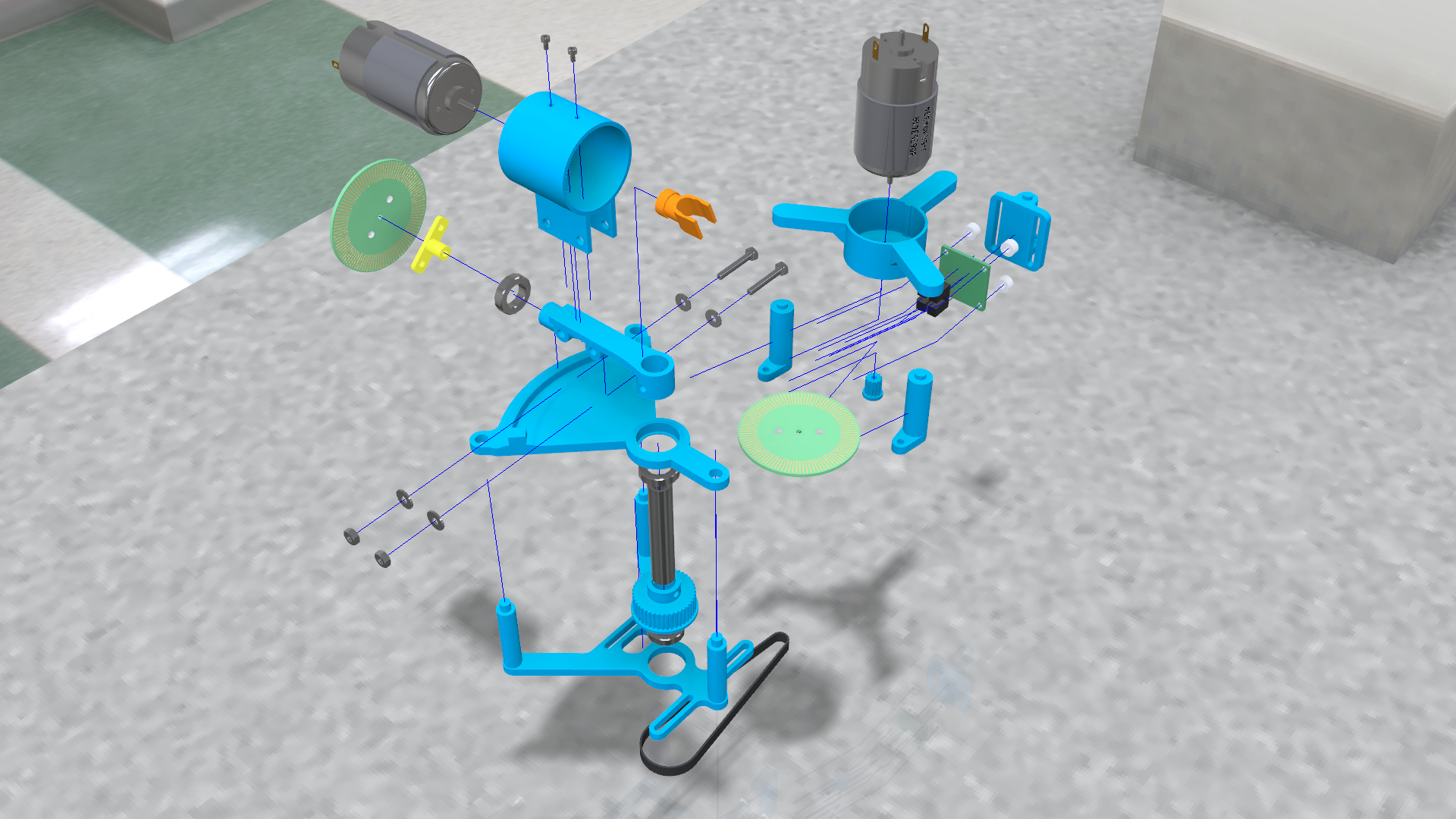
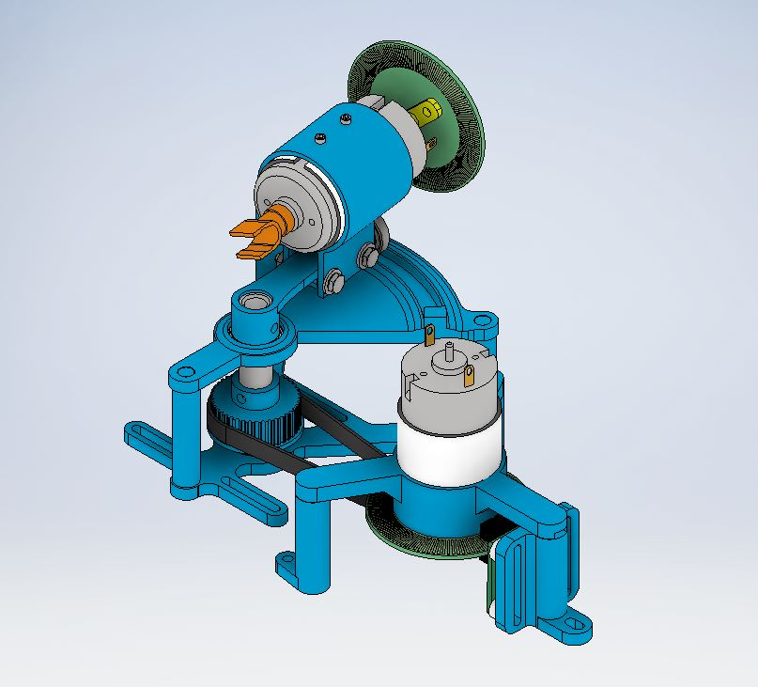
Simulink Model

Slide 3
RCGs
Requirements
PID Values Obtained
Encoder Detects Position and Direction
Constraints
Max Memory / Speed of Microcontroller
Max Motor Current ( < 1A )
Goals
Rise Time ( < 0.017 s )
Overshoot ( < 10 % )
Functioning Microcontroller
No Breadboards
Max Encoder Resolution ( 400 pulses )
Simulink Model of Motor Within 5 % Error

Slide 4
The Process
Find Motor Parameters
Encoder PCB
System Setup
Controller Code

Slide 5
Motor Parameters
R, L (8.4 $Ω$ , 1.12mH)
R, L (8.4 Ω , 1.12mH)
Measured using multimeter
$Kτ$ ( 23.54 $\frac{mNm}{A}$ )
Kτ ( 23.54 mNm/A )
J ( $5.93×{10}^{−6}$ $kg m^{2}$ )
J ( 5.93×〖10〗^(−6) kg m^2 )
B ( 4.964 $×{10}^{−6}$ $\frac{kg m^{2}}{s}$ )
B ( 4.964 ×〖10〗^(−6) (kg m^2)/s )
Torque determined from conservation of power
Calculated from mechanical time constant
Kv ( 628.5 $\frac{RPM}{V}$ )
Kv ( 628.5 RPM/V )
Back EMF calculated from KVL
Kinetic friction from $\frac{torque}{friction}$ at no load conditions
Kinetic friction from 𝑡𝑜𝑟𝑞𝑢𝑒/𝑓𝑟𝑖𝑐𝑡𝑖𝑜𝑛 at no load conditions
Resistance and Impedance
Torque Constant
Rotor Inertia
Back EMF
Kinetic Friction

Slide 6
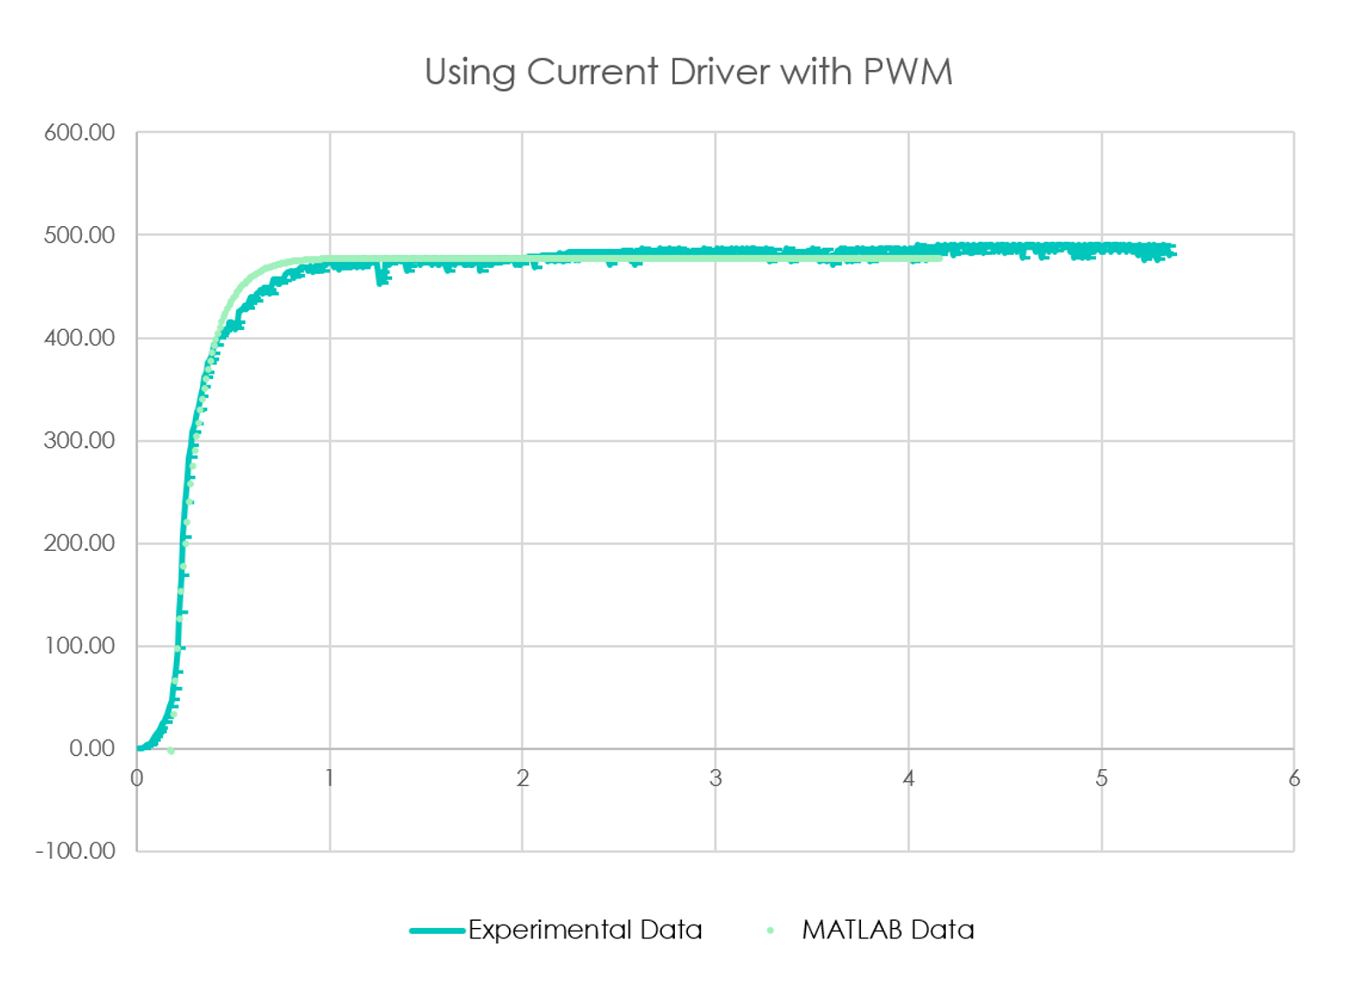
Checking Motor Parameters

Slide 7
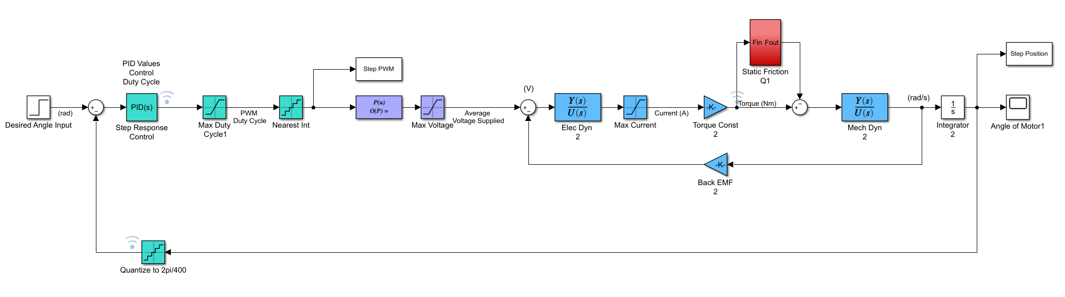
Closed Loop Simulink Model
Model Behaviour for Low PWM Values
PWM Value between
0 - 255
Maps PWM to Average Voltage
Quantizes Angle to Encoder Resolution
Rounds PWM to Integer
Motor Transfer Function

Slide 8
Controller Logic – Reading Position
On Encoder A Interrupt
On Encoder B Interrupt
State 01
State 11
A ^ B
Read Encoder B
Position++
Position--
A ^ B
State 00
State 10
Read Encoder A
Position++
Position--
Increment
End
End
State
<A> <B>
Decrement

Slide 9
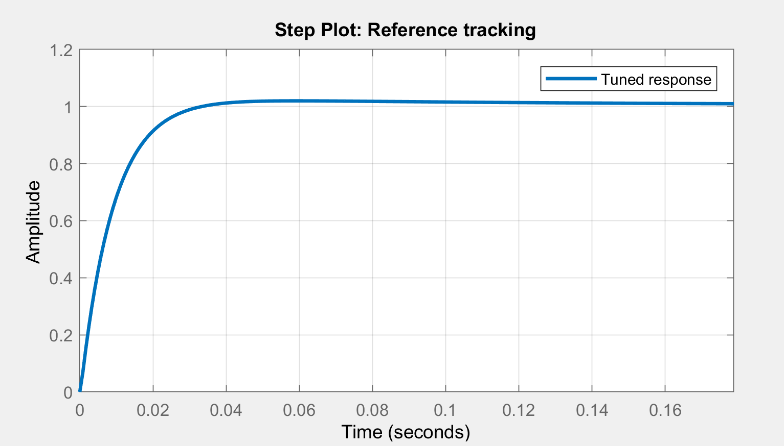
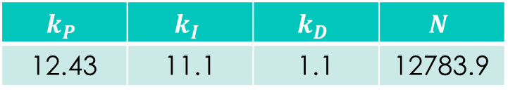
Initial Control
Aim for fastest rise time and smallest overshoot
Ensure system is stable
Overshoot
Rise Time
Settle Time
Control Frequency
$$k_{P}$$ | $$k_{I}$$ | $$k_{D}$$ | $$N$$
12.43 | 11.1 | 1.1 | 12783.9

Slide 10
Controller Logic – PID Control
Proportional
Subtract current position from desired position for error value
Multiply by proportional gain
Integral
Keep sum of error values at small intervals
Multiply by integral gain
Derivative
Save position value every millisecond for velocity
Multiply velocity by derivative gain (negative)
Reset sum for each new coordinate

Slide 11
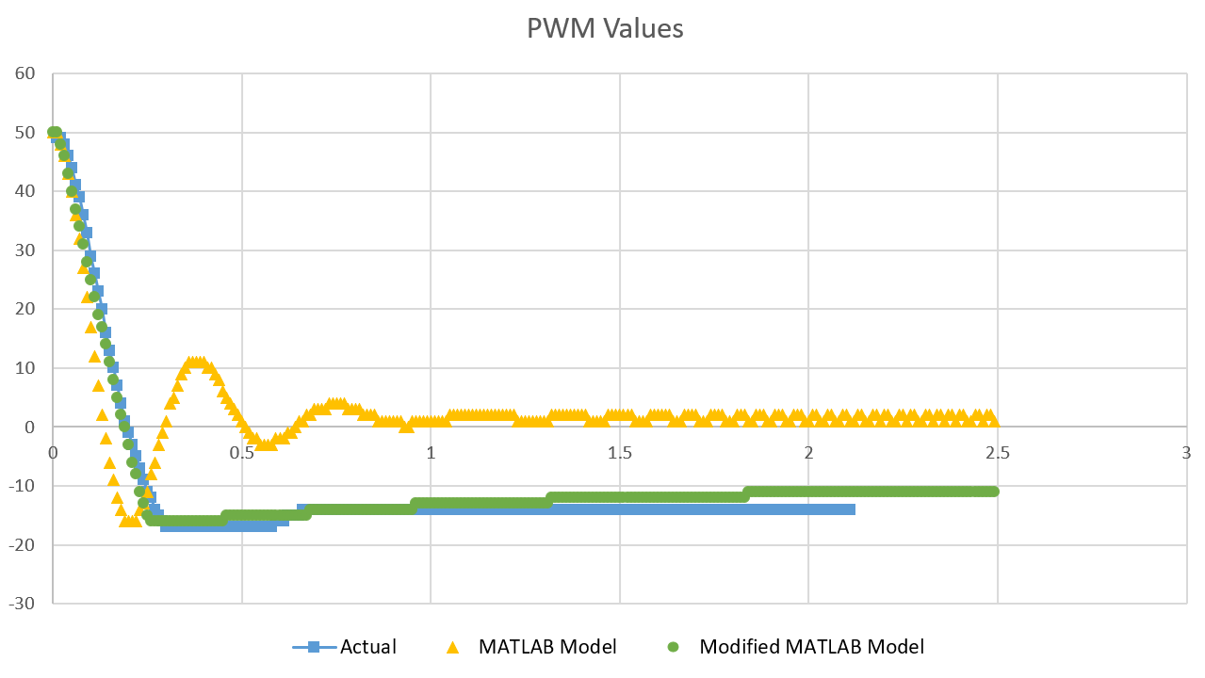
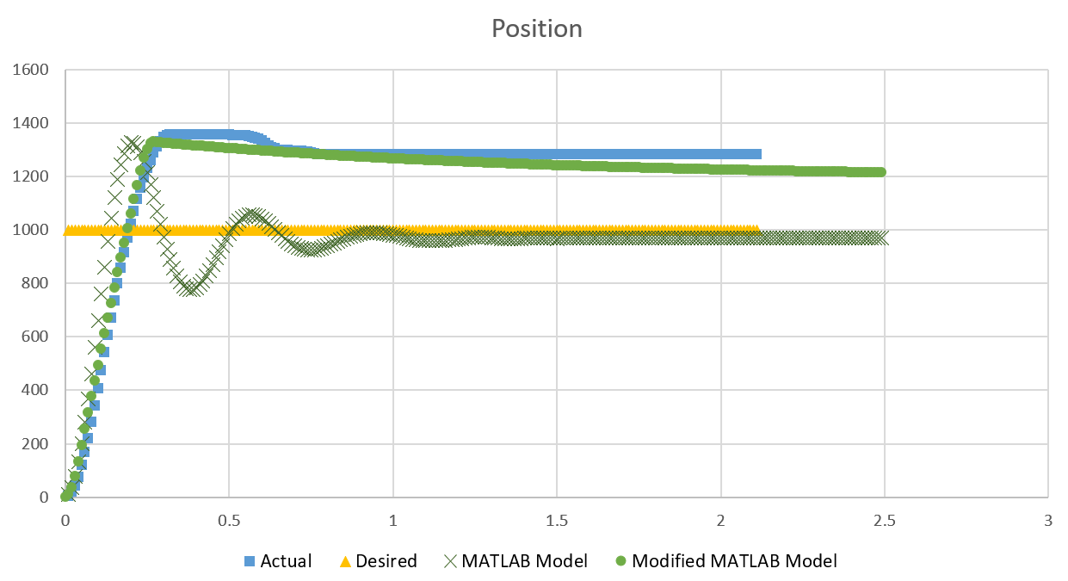
P Control
Modified MATLAB Model accounts for values of PWM less than 30 being too low to overcome cogging and static friction

Slide 12
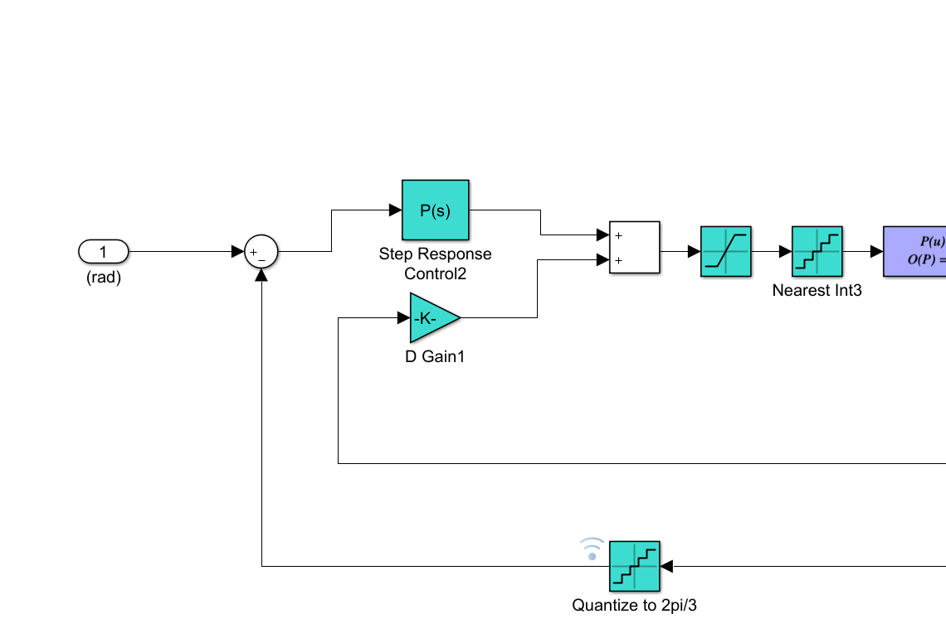
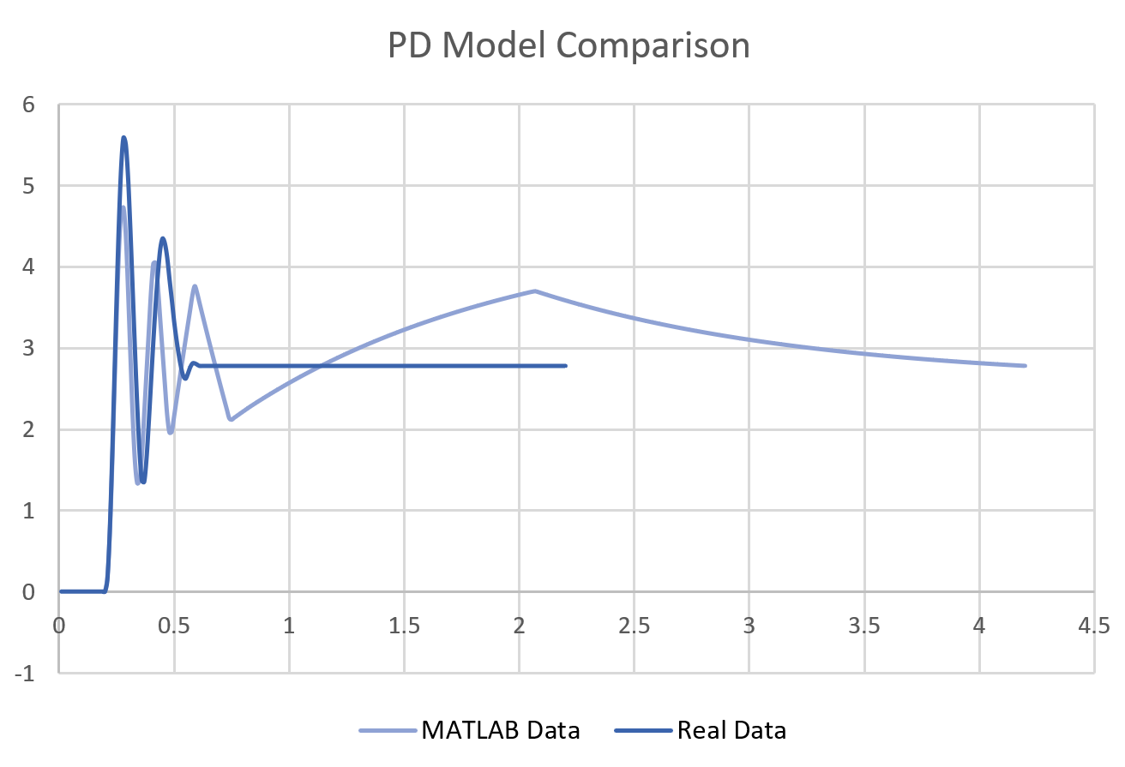
PD Control
Simulink model adjusted for derivative control on current velocity instead of rate of error change.
This results in a negative derivative gain.

Slide 13
Performance
Overshoot | ~ 5 %
Rise Time | ~ 0.13 s
Settle Time | ~ 0.3 s
Control Frequency | ??

Slide 14

SYSTEM
INSERT IMAGE OF CAD MODEL FOR SYSTEM

Slide 15
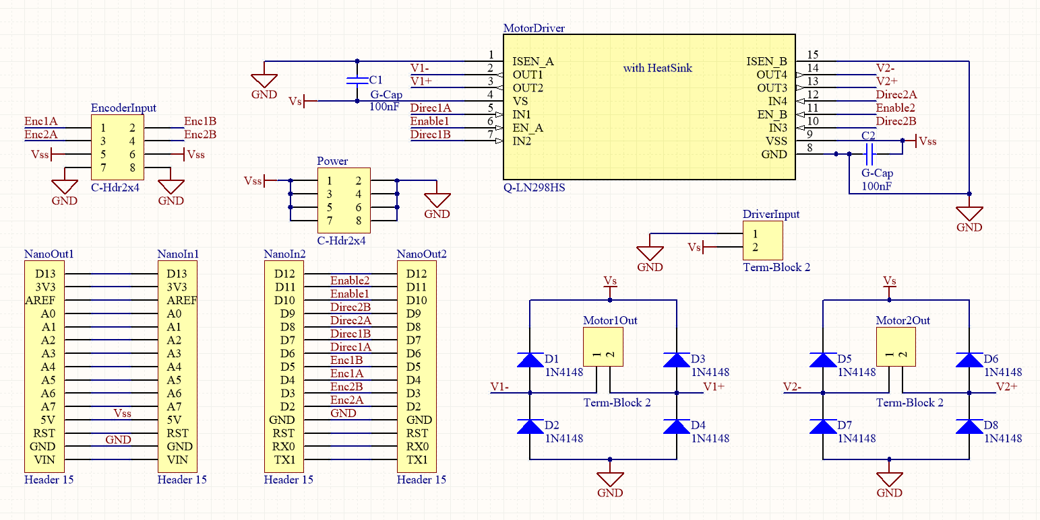
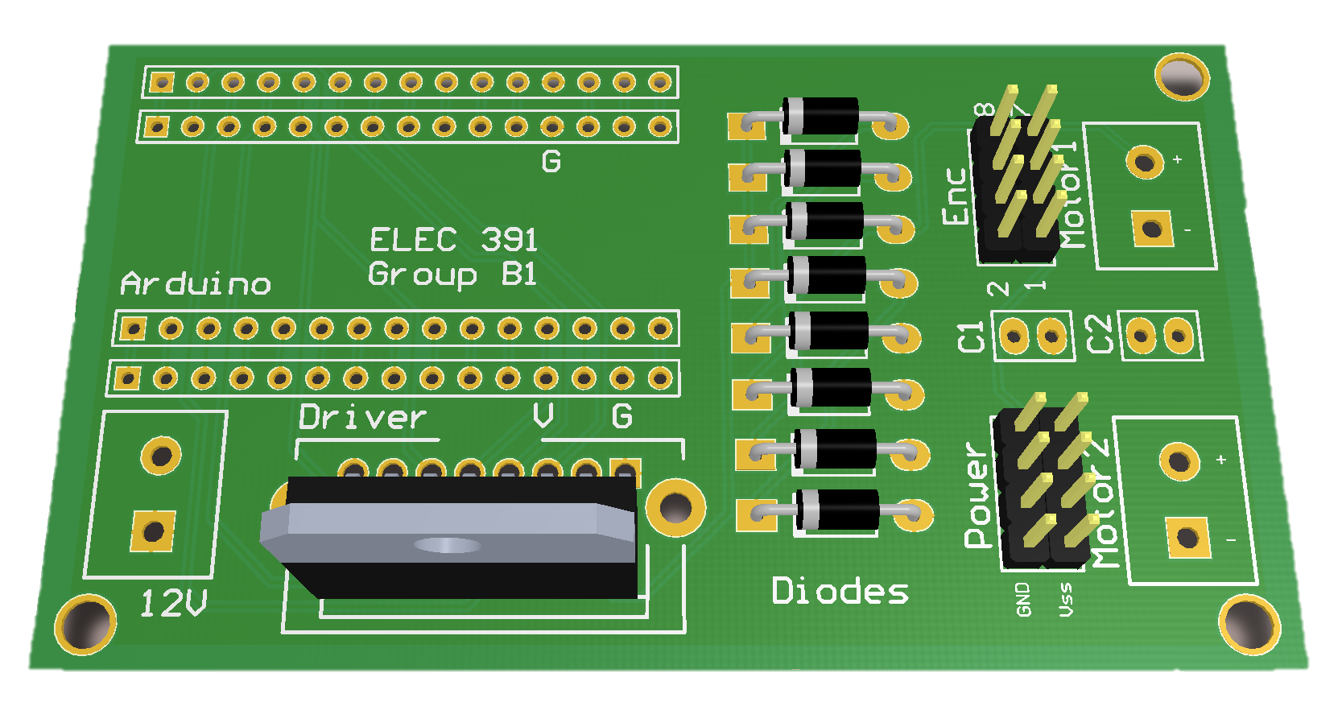
System PCB
Current Driver
Pins from Encoder
Extra 5V Pins
12V Input Pins
Arduino Base
Diode Bridge

Slide 16
Homing
dfsa

Slide 17




Mapping
1
2
-0.7, 0.6
0.8, -0.2
To Controller
Map desired laser path to list of coordinates
Inverse kinematics are applied to obtain angles
Angles are converted to encoder positions
Time vector is generated based on length of each line segment
3
4
Points:
< n pulses >
Time:
< relative length>
-0.7, 0.6
$$θ1$$
$$θ2$$
0.8, -0.2
$$θ1$$
$θ1$ = 7 pulses

Slide 18
Next Steps - Integration
Measure new motor parameters
Adjust system integration design
Improve gear ratios
Retune PIDs

Slide 19
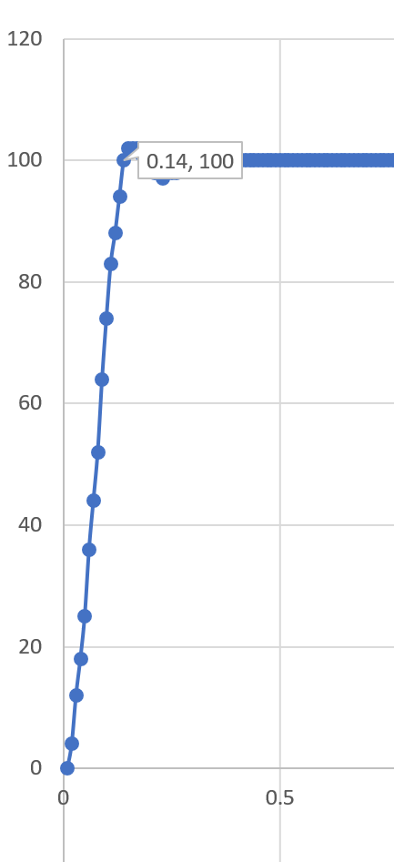
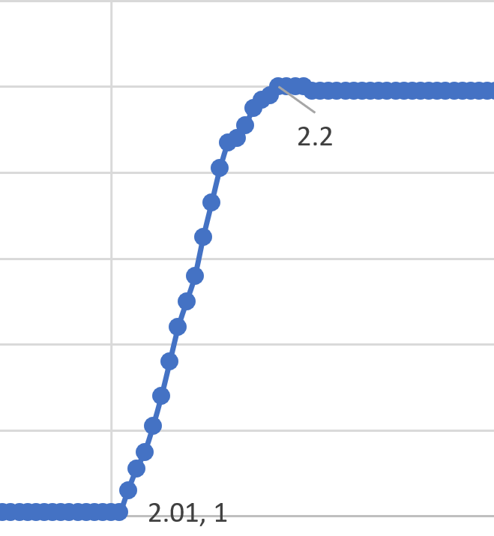
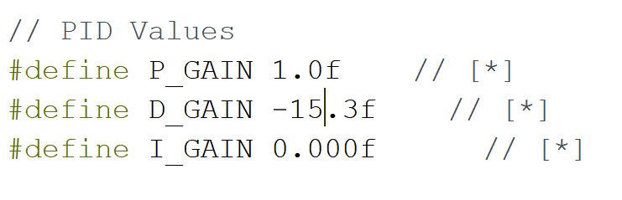
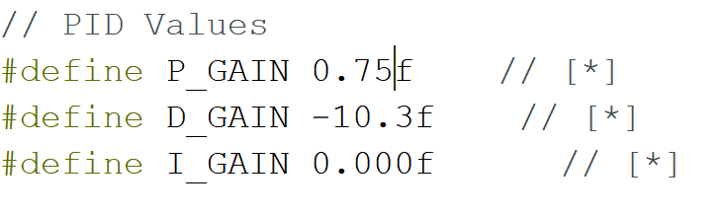
Garbage Slide

