Slide 1
Laser Light Show
ELEC 391 – Group B1 ( Control )

Slide 2
Simulink Model
INSERT IMAGE OF WHAT WE’RE DEMOING

Slide 3
RCGs
Requirements
PID Values Obtained
Encoder Detects Position and Direction
Constraints
Max Memory / Speed of Microcontroller
Max Motor Current ( < 1A )
Goals
Rise Time ( < 0.017 s )
Overshoot ( < 10 % )
Functioning Microcontroller
No Breadboards
Max Encoder Resolution ( 400 pulses )
Simulink Model of Motor Within 5 % Error

Slide 4
The Process
Find Motor Parameters
Encoder PCB
System Setup
Controller Code

Slide 5
Motor Parameters
R, L (8.4 $Ω$ , 1.12mH)
R, L (8.4 Ω , 1.12mH)
Measured using multimeter
$$Kτ$$
Kτ
J
B
Torque determined from conservation of power
Calculated from mechanical time constant
Kv
Back EMF calculated from KVL
Kinetic friction from $\frac{torque}{friction}$ at no load conditions
Kinetic friction from 𝑡𝑜𝑟𝑞𝑢𝑒/𝑓𝑟𝑖𝑐𝑡𝑖𝑜𝑛 at no load conditions
Resistance and Impedance
Torque Constant
Rotor Inertia
Back EMF
Kinetic Friction

Slide 6

Checking Motor Parameters

Slide 7
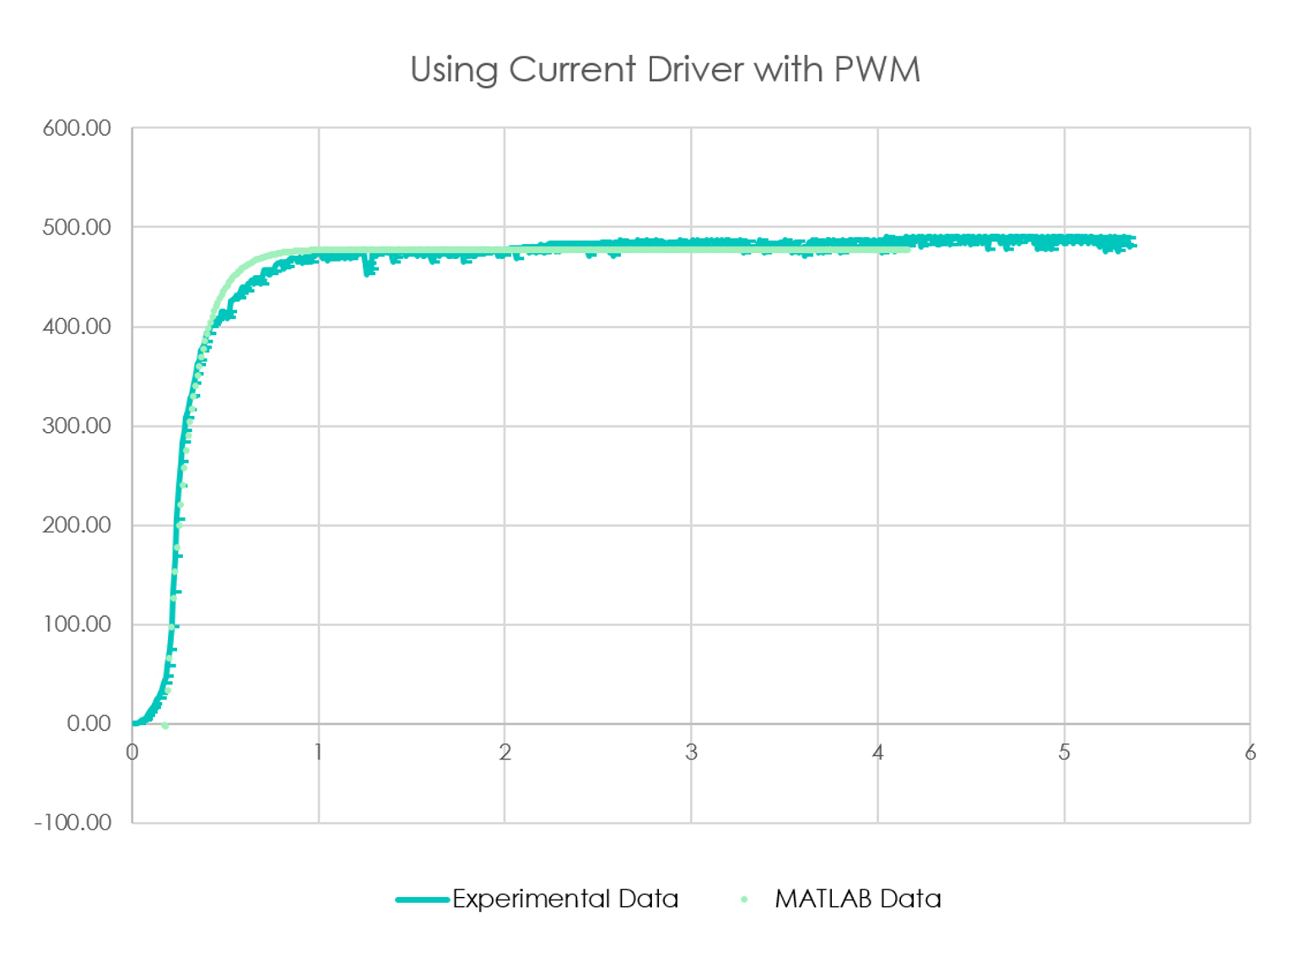
Checking Motor Parameters

Slide 8
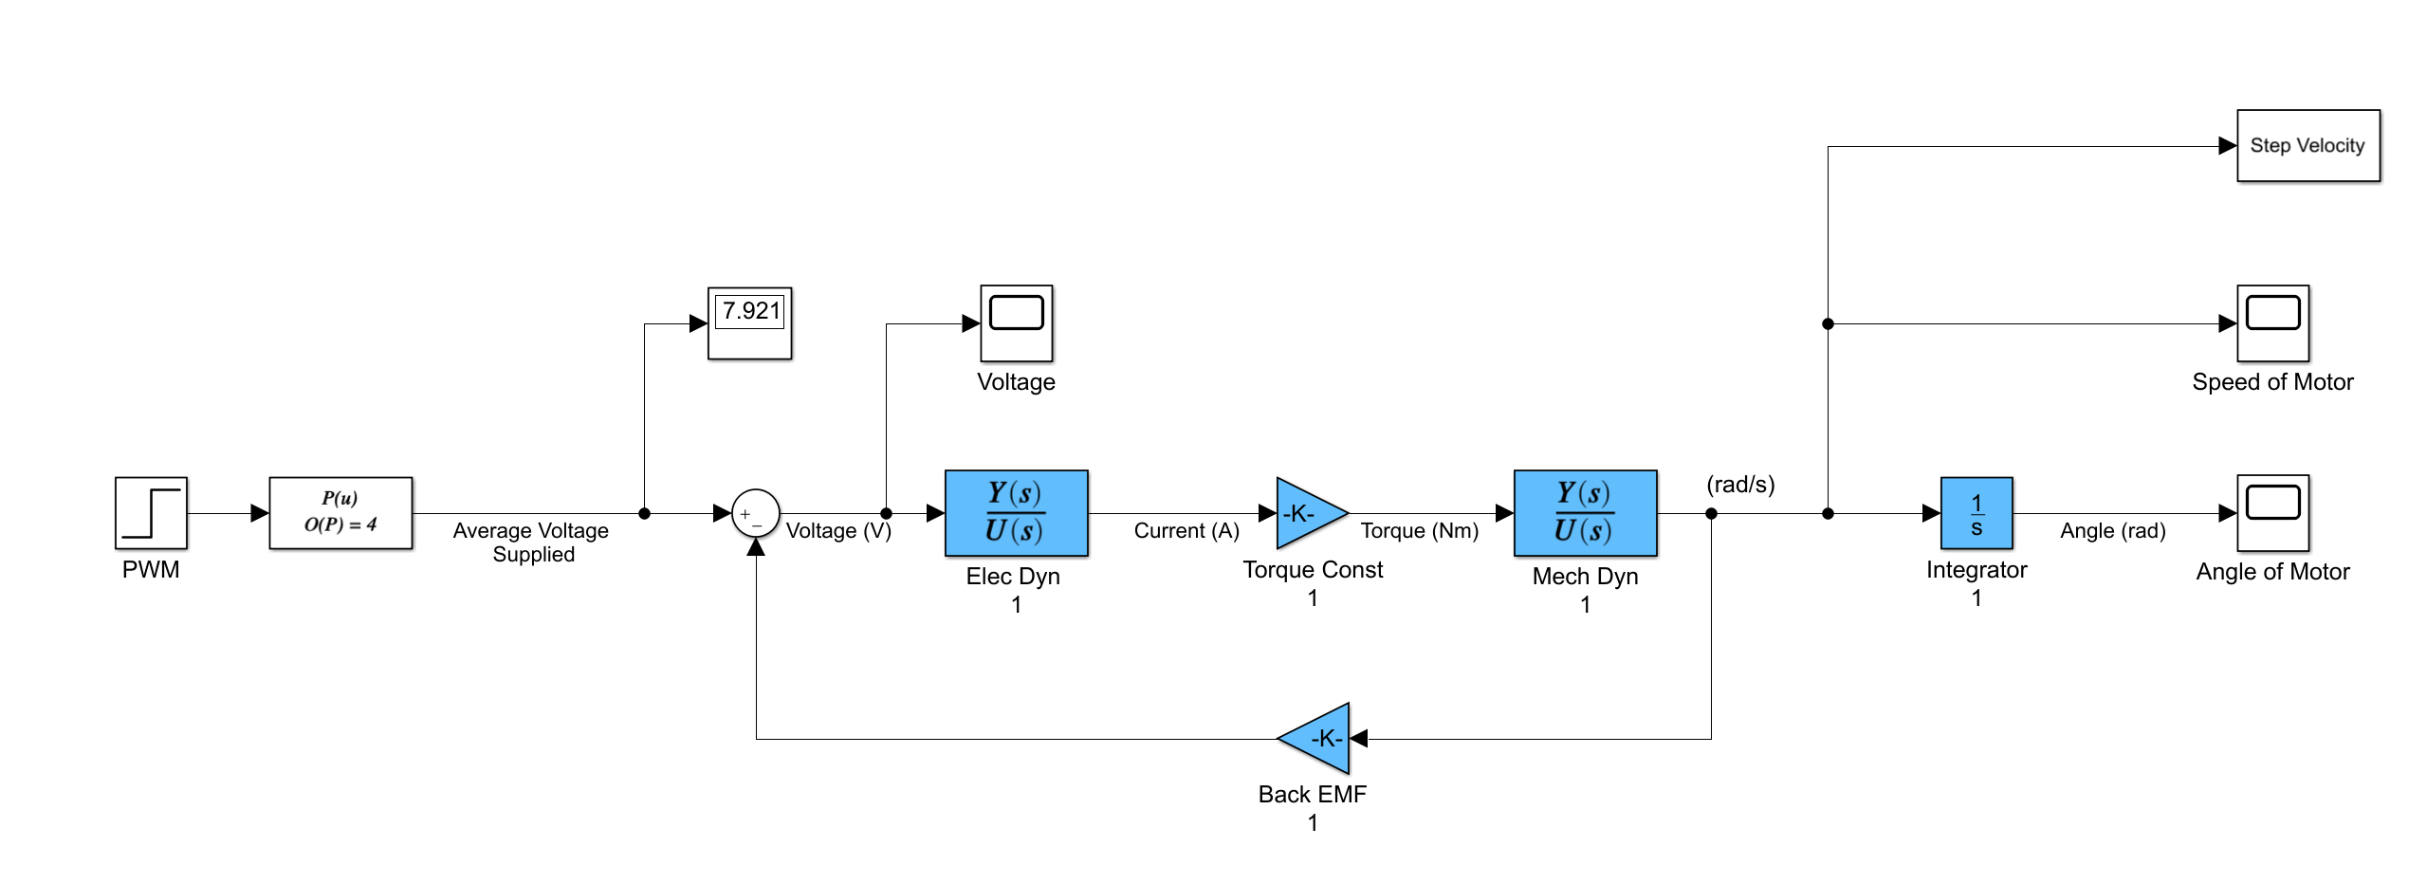
Simulink Model of Motor

Slide 9
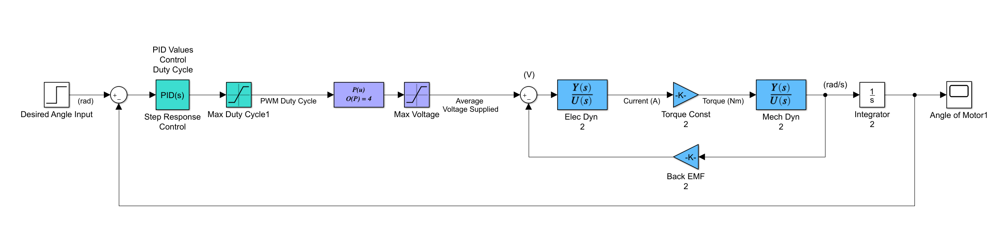
Simulink Model with PID Control

Slide 10
Controller Logic – Reading Position
On Encoder A Interrupt
On Encoder B Interrupt
State 01
State 11
A ^ B
Read Encoder B
Position++
Position--
A ^ B
State 00
State 10
Read Encoder A
Position++
Position--
Increment
End
End
State
<A> <B>
Decrement

Slide 11
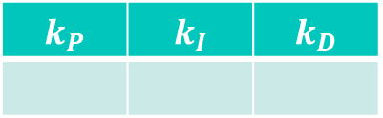

Initial Control
$$k_{P}$$ | $$k_{I}$$ | $$k_{D}$$
Choose initial PID values to cancel pole at -8 and 0
Choose initial $K_{D}$ for critically damped response
* not to scale *
-7493
-8
0

Slide 12
Controller Logic – P, I Control

Slide 13
Controller Logic – D Control

Slide 14
Performance
Overshoot
Rise Time
Settle Time
Control Frequency
INSERT CL TUNED RESPONSE HERE

Slide 15

SYSTEM
INSERT IMAGE OF CAD MODEL FOR SYSTEM

Slide 16




Mapping
1
2
-0.7, 0.6
0.8, -0.2
To Controller
Map desired laser path to list of coordinates
Inverse kinematics are applied to obtain angles
Angles are converted to encoder positions
Time vector is generated based on length of each line segment
3
4
Points:
< n pulses >
Time:
< relative length>
-0.7, 0.6
$$θ1$$
$$θ2$$
0.8, -0.2
$$θ1$$
$θ1$ = 7 pulses

Slide 17
Next Steps - Integration
Measure new motor parameters
Adjust system integration design
Improve gear ratios
Retune PIDs

