Slide 1
Building Your First Game in Unity: "Roll-a-Ball"
https://learn.unity.com/project/roll-a-ball-tutorial
www.github.com/lcanner/rtfn

Slide 2
Overview
Unity: a cross-platform game engine that individuals can use FOR FREE to build 2D, 3D, AR and VR games (among other things...)
Our goal: to create a simple game called Roll-a-Ball using the Unity interface and C# scripts.
Roll-a-Ball: a game in which the player rolls a ball across a flat surface with the goal of collecting floating objects.
Notes:
Optional: show intro video from Unity tutorial - https://youtu.be/RFlh8pTf4DU

Slide 3
Overview: Steps
Create and set up a new project in Unity
Add initial game objects:
Plane (playing surface)
Player (ball)
Create materials to customize the color of the game objects
Build a script that turns user input (pressing keys) into action (moving the ball)
Set up camera and play area
Add/customize collectible objects
Display score and other text ("You win!")
Profit. (Probably not but maybe.)

Slide 4
1. Create and set up new Unity project
Open Unity
File>New Project
Give it a name and choose a destination (a place on the computer where you want the game to be saved)
Select "3D project"
You now have a new project with a new empty scene
Project window – open Assets folder, right-click on Scenes folder and add an underscore so it reads "_Scenes". This will keep it at the top of the list alphabetically. Rename sample scene "MiniGame".

Slide 5
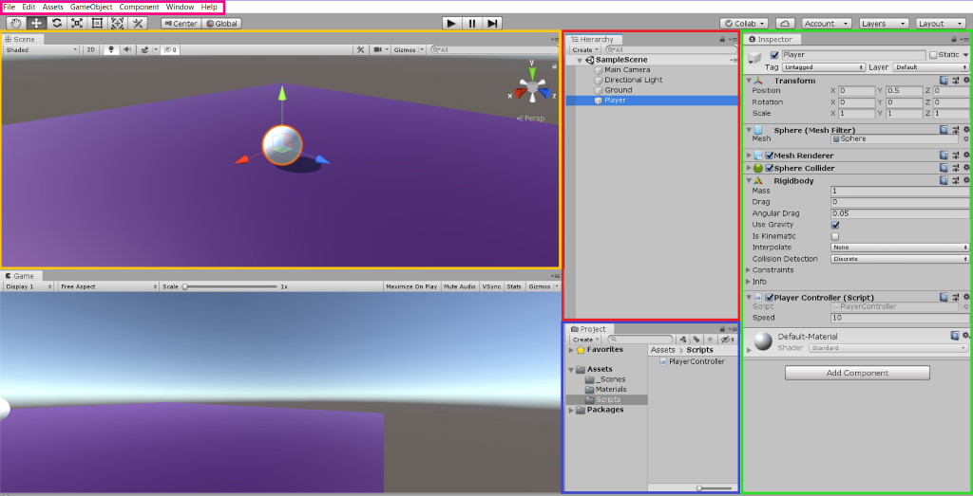
Unity Interface
Hierarchy view
Inspector view
Project view
Scene view
Menu toolbar

Slide 6
2. Add Game Object (plane/Ground)
Add a plane to the scene
Menu toolbar – click on GameObject > 3D Object > Plane
Rename the game object "Ground"
Hierarchy window – right-click on "Plane" > rename "Ground"
Make sure that the object is at location (0, 0, 0) in the scene
Inspector window – click on gear icon next to Transform > Reset
Resize the plane and get rid of the gridlines
Inspector window – Transform > Scale > (2, 1, 2)
Scene view – Click Gizmos, uncheck "show grid" box
Notes:
Optional:
Scene view: Gizmos>uncheck "Show Grid" (we don't need gridlines in this project)
Inspector window: Transform>Scale> x=2, y=1, z=2, doubles the size of the plane

Slide 7
2. Add Game Object, Continued (sphere/Player)
Add a sphere to the scene
Menu toolbar – GameObject > 3D Object > Sphere
Rename the game object "Player"
Hierarchy window – right-click on "Sphere" > rename "Player"
Make sure that the object is at location (0, .5, 0) in the scene
Inspector window – Transform > Position, set values for x, y, z coordinates

Slide 8
3. Create materials to change color of game objects
Create a new folder to hold any materials you add
Project window – Create > Folder, name folder "Materials" (inside of Assets folder)
Add your first material
Project window – select Materials folder, Create > Material, name it "Background"
Inspector view – click in color selector box labeled Albedo, select a color
Apply the material to the Ground
Click on the material in the Project window and drag it onto the Ground object in the Scene view or Hierarchy window
(Optional) Repeat with a second material for the Player object

Slide 9
3b. Change direction of light source
Transform rotation of Main Camera (this places the light in a better position for our game)
Hierarchy window – Select "Main Camera" > Transform > Rotation > y=60

Slide 10
4. Add Player movement
Apply laws of physics to your Player object
Hierarchy window – click on Player object
Menu toolbar – Component > Physics > Rigidbody
Create and attach a C# script
Project window – Create > Folder, name folder "Scripts" (in the Assets folder)
Hierarchy window – click on Player object
Inspector window – Add component > New Script > name script "PlayerController"
Project window – drag PlayerController script into Scripts folder
Open script to edit in Visual Studio
Project window – double click on PlayerController script
Notes:
Ask: What do we want the player to do? Tutorial: "We want to have the Sphere roll around on the game area, bump into walls, stay on the ground and not fly off into space. We want to be able to collide with our collectible GameObjects and pick them up when we do."
This requires (1) physics, (2) instructions on how to respond to user input like pressing arrow keys, and (3) instructions on how to interact with other objects like walls and collectibles.

Slide 11
4. Add Player movement continued (scripting)
Replace the sample code with the PlayerController script from GitHub
Notes on coding:
Variables are used to represent and store numbers, words, or objects that we want to access throughout our script.
Ex. speed (a number), rb (a Rigidbody object), moveHorizontal (a number), moveVertical (a number), movement (a vector)
Methods are actions; we create a series of steps that we want to happen each time the method is "called"
Ex. Start(), FixedUpdate(), Rigidbody.AddForce()

Slide 12
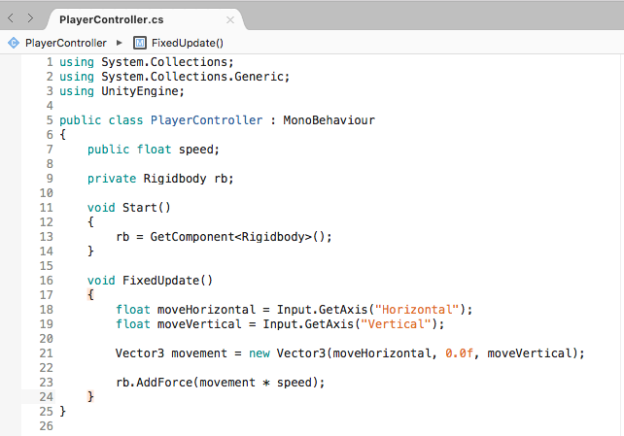
4. Add Player movement continued (scripting)
Replace with this -->
Notes on coding:
Variables are used to represent and store numbers, words, or objects that we want to access throughout our script.
Ex. speed (a number), rb (a Rigidbody object), moveHorizontal (a number), moveVertical (a number), movement (a vector)
Methods are actions; we create a series of steps that we want to happen each time the method is "called"
Ex. Start(), FixedUpdate(), Rigidbody.AddForce()
Notes:
*This is the script from Unity (at the end of the "Moving the Player" step of the tutorial)
Emphasize that punctuation, capitalization, and spacing ARE important!!

Slide 13
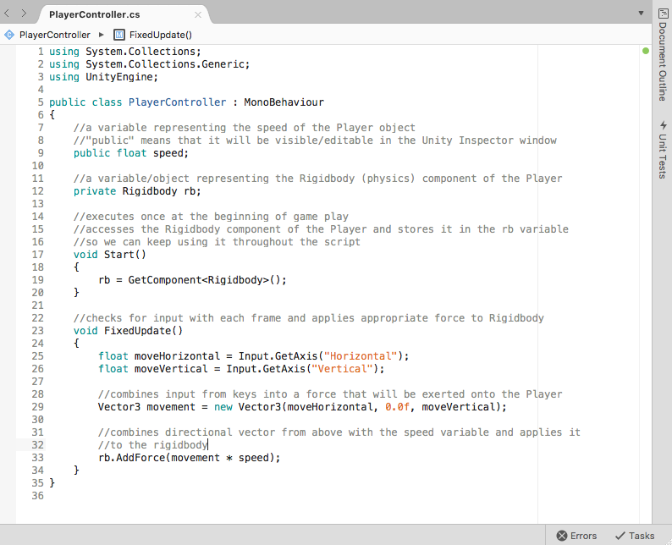
Notes:
With comments to explain script

Slide 14
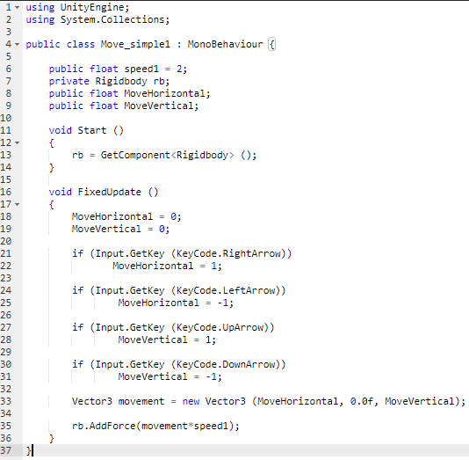
Notes:
Alternative script from Dale

Slide 15
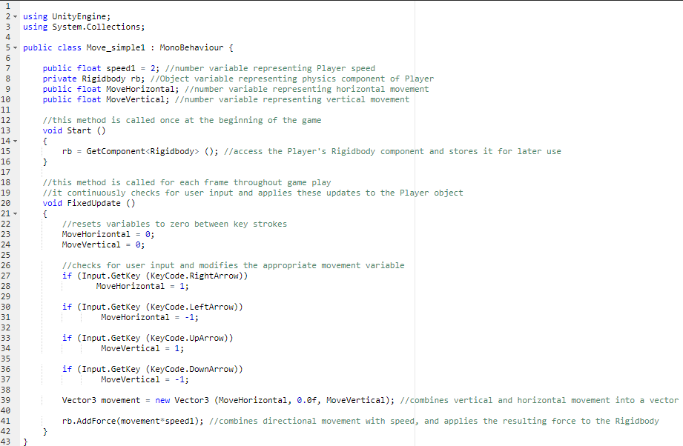
Notes:
Dale's code with comments

Slide 16
4. Player movement- test script
Now that you have added this script, a "Speed" variable should be available. Test it out by increasing the speed.
Inspector window – Player > Player Controller Script component > Speed = 10
Play the game!
Press Play button above Scene view
Use arrow keys to control your Player object
Exit the game!
Press the play button again to switch from play mode back to editor mode (otherwise your changes will not be saved)

Slide 17
5. Attach Camera to Player
Move & rotate the camera
Hierarchy window – Select Main Camera
Inspector window – Transform > Position > x= 0 y=10 z=-10
Inspector window – Transform > Rotation > x=45 y=10 z=0
Add script
Inspector window – Add Component > New script > name it "CameraController"
Project window – Assets > click and drag "CameraController" into Scripts folder
Double click to open and paste CameraController code from Github
Attach Player to script
Hierarchy window – Select Main Camera, note Camera Controller script in Inspector window
Click and drag Player from Hierarchy window into player field in Inspector window>Camera Controller script component
Notes:
We want the camera to follow the player object as it moves around the plane. This will require some position and rotation transformations, as well as an additional script.

Slide 18
5b. Set up play area (add walls)
Create an "empty" object to hold/group 4 wall objects
Menu toolbar – GameObject > Create Empty
Hierarchy window – right-click Empty, rename "Walls"
Reset transform stats for "Walls" (centers object on plane)
Inspector window – gear icon > reset
Add a 3D Cube object to represent our west wall
Menu toolbar – GameObject > 3D Object > Cube
Hierarchy window – right-click Cube, rename "West Wall"
Hierarchy window – click and drag West Wall into Walls object
Transform position & scale
Inspector window – Position: (-10, 0, 0), Scale: (0.5, 2, 20.5)

Slide 19
5b. Add walls
Duplicate to create additional walls
Hierarchy window – Select "West Wall"
Menu toolbar– Edit > Duplicate
Rename & Transform accordingly:
"East Wall" Position: (10, 0, 0)
"North Wall" Position: (0, 0, 10), Rotation: (0, 90, 0)
"South Wall" Position: (0, 0, -10), Rotation: (0, 90, 0)
Make sure all walls are grouped inside the Walls object

Slide 20
6. Add "Collectible" object
Create a cube named "Pick Up"
Menu toolbar – GameObject > 3D Object > Cube
Reset transform stats: Inspector window – gear icon > reset
Temporarily hide Player object
Hierarchy window – Select Player object
Inspector window – uncheck "active" box at the top of the window
Transform the Pick Up object's position, size, and rotation
Inspector window – Transform > Position: (0, 0.5, 0) Scale: (0.5, 0.5, 0.5) Rotation: (45, 45, 45)
Add rotation script
Inspector window – Scroll to bottom, Add Component > New script > name it "Rotator"
Project window – Drag Rotator script into Scripts folder, open script, paste Rotator script from Github

Slide 21
6. Add "Collectible" object - continued
Create a "Prefab" subfolder in the "Assets" folder
Project window – Select Assets folder, click Create > Folder, name it "Prefabs"
Click and drag Pick Up object from the Hierarchy window to the Prefabs folder in the Project window
Create an empty "Pick Ups" object to hold all the collectibles
Menu toolbar – GameObject > Create Empty, name it "Pick Ups"
Reset transform stats: Inspector window – gear icon > reset
Hierarchy window – click and drag the single Pick Up object into Pick Ups empty object
Change view to see/place collectibles easily
Scene view – click green Y button on the compass gizmo
Zoom out until the entire Ground object can be seen
Change the Scene view from "local" to "global" (tab found between Menu Toolbar and Scene view)

Slide 22
6. Add more collectibles
Duplicate your Pick Up object
Hierarchy window – Select Pick Up
Menu toolbar – Edit > Duplicate
Scene view – click and drag duplicate to desired location on the Ground
Repeat until you have the desired number of collectible objects
Create a new material and apply it to your collectibles
Project window – Select Materials > Background
Menu toolbar – Edit > Duplicate, rename new material "Pick Up"
Inspector window – Use the color selector (albedo) to choose a color
Project window – click and drag Pick Up material onto the Pick Up prefab object
Bring back the Player object
Hierarchy window – Select Player object
Inspector window – check "active" box at the top of the window

Slide 23
6. Make Pick Up objects collectible
Update the PlayerController script
Hierarchy window – Select Player object
Inspector window – find Player Controller script component, click gear icon > Edit Script
Paste "PlayerController - Collecting the PickUp Objects" from Github
Add a tag to the Pick Up prefab
Project window – Select Pick Up Prefab, open it, click Tag Menu > Add Tag
Click + to add a tag, name it "Pick Up"
Select the Tag Menu again, click "Pick Up" tag
Make the pick up objects "collectible"
Project window – Select Pick Up prefab
Inspector window – Find "box collider" component, check "is trigger" box
Inspector window – Add Component > Physics > Rigidbody, check "use gravity" and "is kinematic"

Slide 24
7. Display score text
Modify Player Controller script again
Hierarchy window – Select Player object
Inspector window – locate Player Controller script component, click the gear icon > Edit Script, paste "PlayerController – Displaying the Score and Text" code from Github
Locate "if (count >= 12)" on line 47 and change the 12 to match the number of collectible objects in your game
Add a visible text element to the game
Menu toolbar – GameObject > UI > Text
Hierarchy window – in new "Canvas" folder, right click on "Text" and rename to "Count Text"
Hierarchy window – Select Count Text
Inspector window – Change color by clicking on the color component

Slide 25
7. Display score text - continued
Anchor the Count Text element to the top left corner of the play view
Inspector window – Rect Transfrom > Anchor Menu
Hold Shift + Alt keys, select top-left alignment
Inspector window – Rect Transform > x = 20, y = -20
Inspector window – Find Text (script) component, type "Count: " in text box
Link Count Text element to Player Controller script
Hierarchy window – Select Player object
Hierarchy window – click and drag Count Text UI element into Count Text field of Player Controller Script (inspector window)

Slide 26
7b. Add win text
Create another UI Text element named "Win Text"
Menu toolbar – GameObject > UI > Text, name it "Win Text"
Inspector window – Change the color, increase font size to 24, change Rect Transform position to (0, 75)
Inspector window – find Text(script) section, enter "Win text" in text field (lowercase t – case sensitive)
Attach Win Text component to PlayerController script
Hierarchy window – Select Player
Hierarchy window – Click and drag Win Text UI element to (Inspector window) Win Text field of Player Controller script
Test it out!!

Slide 27
8. Profit! (Or at least share your game with friends)
"Build" your game
File > Build Settings
Select "PC, Mac & Linux Standalone" as the platform
Project window – click and drag "MiniGame" scene from _Scenes folder to "Scenes in Build" window
Click Build button
Click "new folder" button and name the folder "Builds"
Enter the name "Roll a Ball" in the "Save As" field and click save
Navigate to the Builds folder on your computer and open the newly created Roll a Ball application.

