Slide 1
COVID in the US
Analysis by Data Dinos
Kieran McAleer, Dan Jahnsen, Aksheta Jain, Lily Carbonara, Kyle Terramoccia
Notes:
Lily

Slide 2
Our Motivation
COVID has dominated the headlines of 2020
and candidly our lives for the last 9 months
Terrible as the pandemic has been, it has also yielded a treasure trove of data
Each state has managed the pandemic differently, and is comprised of different constituents
Are there any themes to the ongoing infections? Trends between states?
Notes:
Lily

Slide 3
Hypothesis & Questions
COVID has unequally impacted different parts of the US. We seek to determine how COVID infections have been distributed across the country and identify any trends in this distribution.
Our specific questions…
What is the distribution of COVID across the US by state?
What correlation is there between number of COVID Cases and…
State Median Income?
Population Density?
State median age?
Notes:
Lily

Slide 4





Data Sources & Limitations
Limitations & Considerations:
Analysis only includes data as of 12/18/2020
Any corrections/additions to the data after 12/18/2020 are not included
Positive/negative stats consider unique individuals only, while total test results includes multiple tests per individual
Census data is based on the 2019 Community Survey
Notes:
Lily

Slide 5
Process
Collected the data from our sources
COVID data was stored as a CSV
Census data was pulled from the API
State Capital locations was pulled from Gmaps
When running code, you will need your API key for US Census and gmaps
Created a single, clean data frame comprised only of…
Most recent COVID data for each state
Median Income and age per state
State size, population and population density
Notes:
Kyle

Slide 6
Process
Mapped COVID cases across the US
Generated a Pie Chart of US COVID cases
Scatter plotted COVID data against key metrics
Median Income Per State
Population Density per State
Median Age per State
Conducted a linear regression for each key metric
Notes:
Kyle

Slide 7
Our Analysis

Slide 8
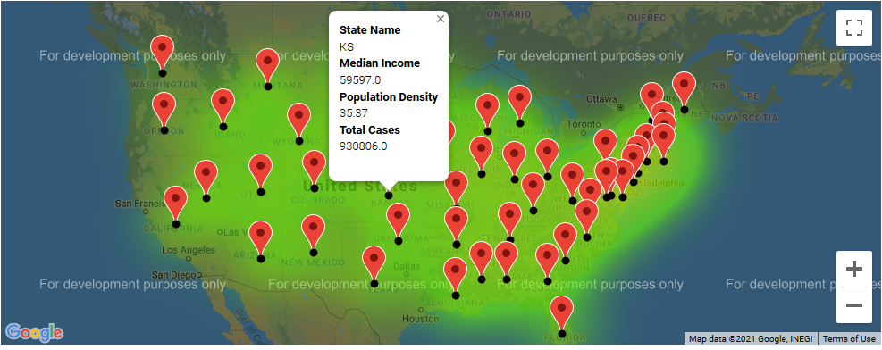
Analysis: COVID Cases across the US
Notes:
Kieran

Slide 9
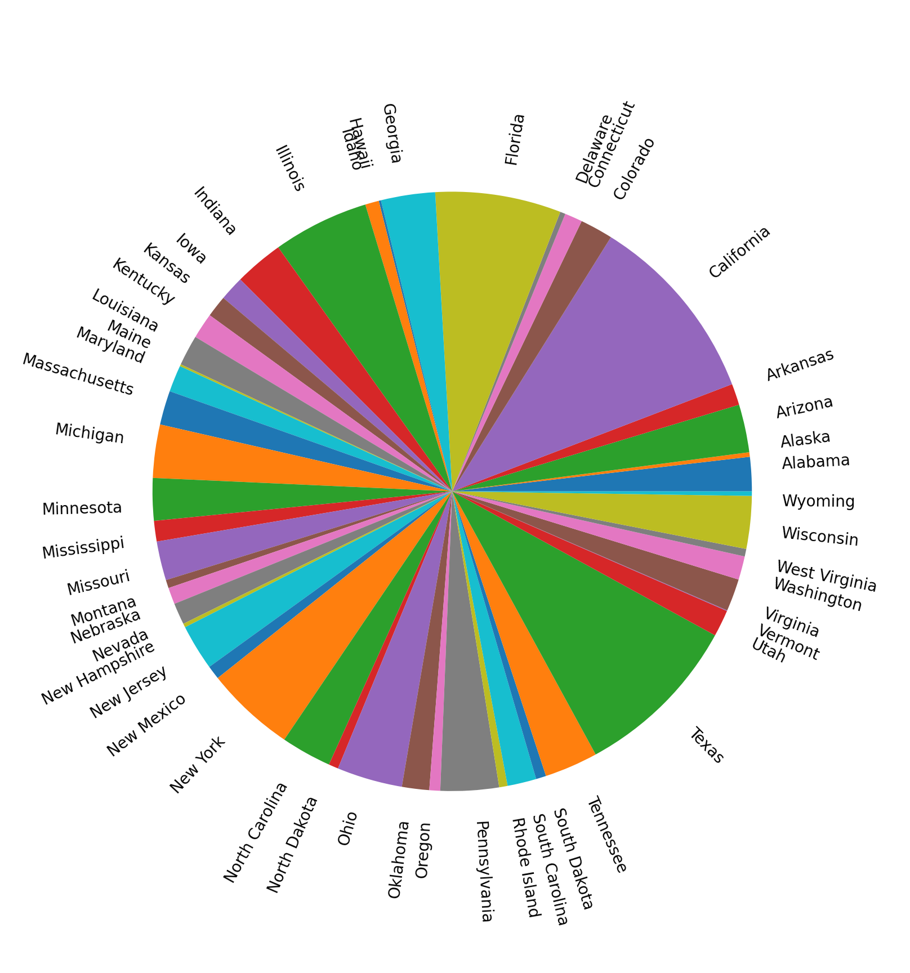
Analysis: COVID Cases per State
Notes:
Aki

Slide 10
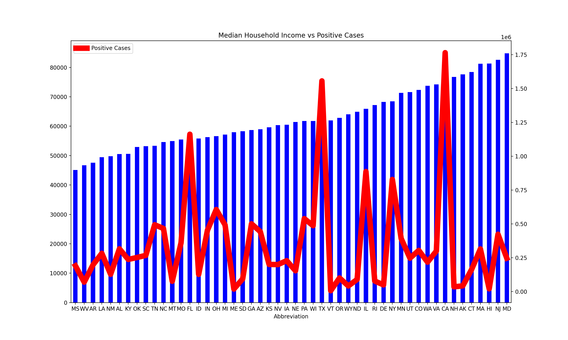
Analysis: Median Income v Positive Cases

Slide 11
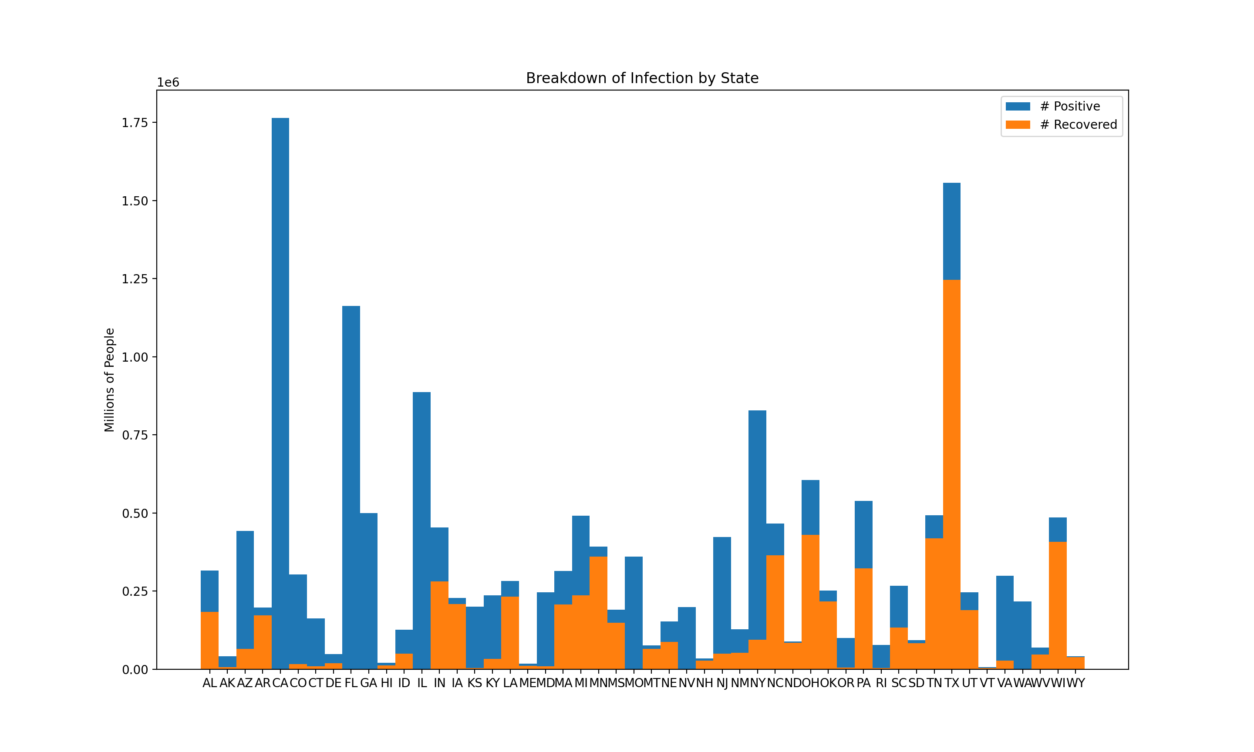
Analysis: Positive Cases v. Recoveries

Slide 12
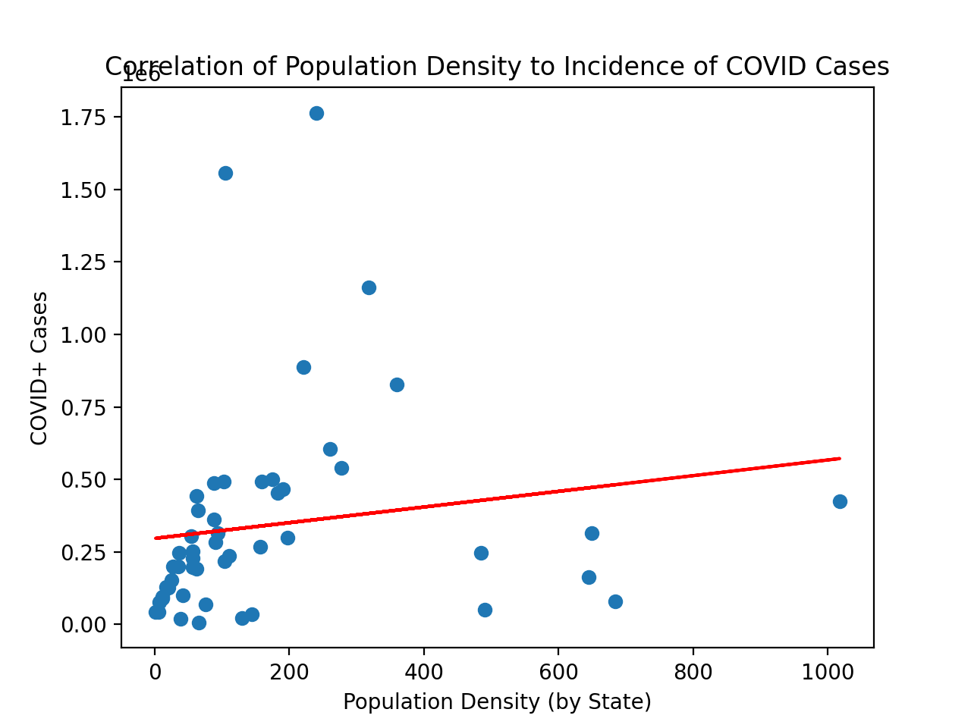
Analysis: COVID v. Population Density
Notes:
Aki

Slide 13
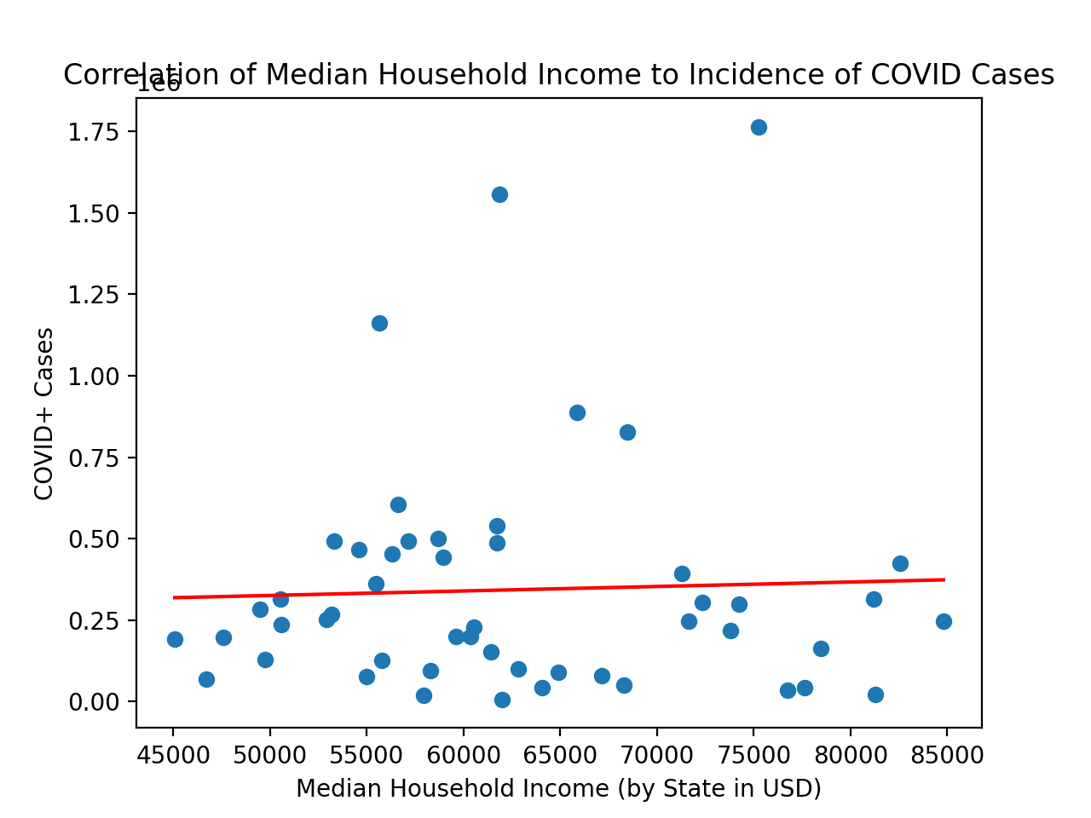
Analysis: COVID v. Median Income
Notes:
Aki

Slide 14
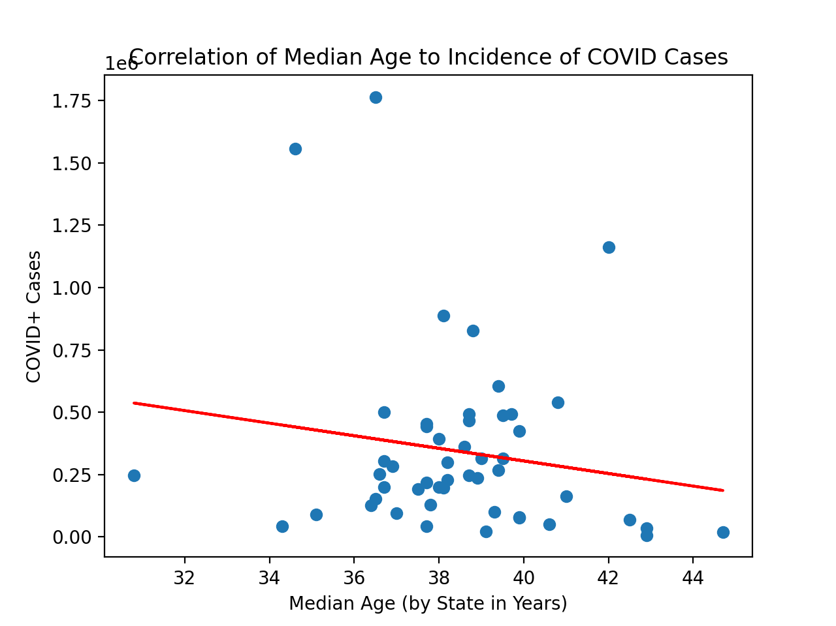
Analysis: COVID v. Median Age
Notes:
Aki

Slide 15
Conclusions

Slide 16
Conclusions
Test Results
Test | Correlation | P-Value
Population Density vs Positive Cases | 0.16 | 0.273316
Median Household Income vs Positive Cases | 0.04 | 0.786089
Median Age vs Positive Cases | -0.17 | 0.250596
Why would this be the case…
Notes:
Dan

Slide 17
Conclusions
What conclusions can be drawn from the test results?
Very small correlations
Statewide metrics may not capture the whole story
The more local, the better
Many other factors come into play
State restrictions and regulations
How could our study have been improved?
Focusing on a smaller area, state or even city
Seeing how the data evolves over time
Notes:
Dan

Slide 18
Post Mortem
Additional Questions
Within each state, how are COVID cases distributed?
How do national/state COVID cases fall across other demographic data points (e.g. race/ethnicity)?
When grouped by socioeconomic indicators, how do COVID infections compare to the % of the actual population nationally? Per State?
Challenges
The volume of data available is massive
Format of available data either too granular or too macro to answer above remaining questions
Notes:
Kieran

Slide 19

Questions?

