Slide 1
A Program for Elsie, a 4-bit Computer
Or, Your Code Really Looks Like This

Slide 2
What is a computer program?

Slide 3
What is a computer program?
It’s a set of computer instructions that accomplish a task

Slide 4
What is Elsie?

Slide 5
Elsie is a tiny computer with a 4-bit bus

Slide 6
Elsie can:
Move a number from memory into Register A (where math can happen)

Slide 7
Elsie can:
Move a number from memory into the A register (where math can happen)
Add a number to Register A

Slide 8
Elsie can:
Move a number from memory into the A register (where math can happen)
Add a number to the A register
Move the result back into memory

Slide 9
Elsie, like all digital computers, only understands ones and zeros

Slide 10
Elsie is really, really simple
but

Slide 11
All our computers work very much like Elsie

Slide 12
So writing a program for Elsie shows us what programs really look like and how they run.

Slide 13
What does a program for Elsie look like?

Slide 14
# this is a line comment
# (first thing’s first!)

Slide 15
# these are the only instructions # Elsie knows
load # move data value into regA
add # add data value to regA
store # store contents of regA
goto # this one we skip for now

Slide 16
# this program adds 1 + 2 and # stores the result in # memory location 10
load 1
add 2
sto 10

Slide 17
How does Elsie know what to do?

Slide 18
When Elsie powers up, the hardware starts reading 4 binary bits (a nybble) at a time.

Slide 19
Where do these nybbles come from?

Slide 20
Elsie has an Instruction Pointer, a register that knows where the next instruction is.

Slide 21
Let’s have a look at Elsie

Slide 22
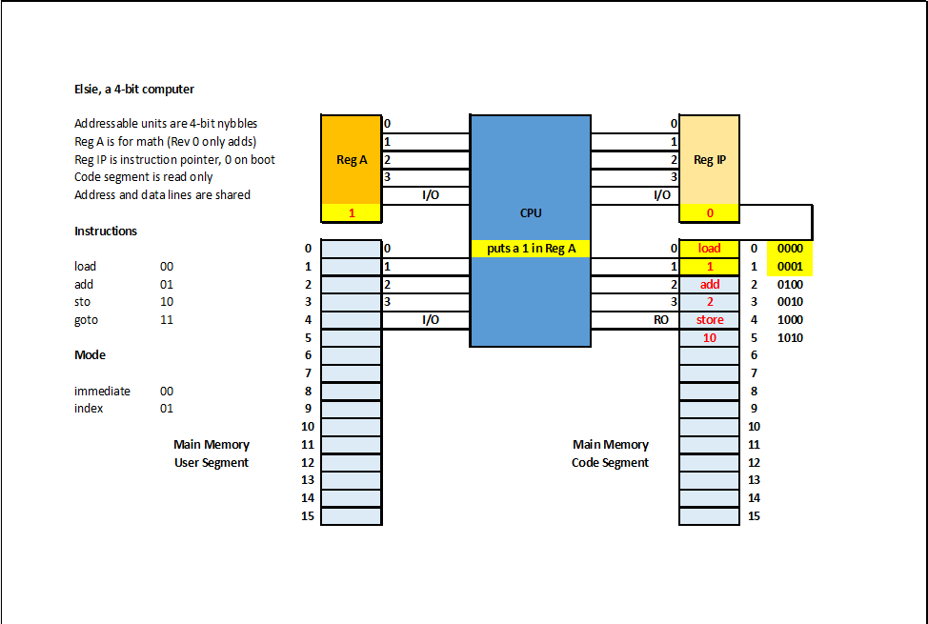

Slide 23
Back to the 4-bit nybbles Elsie’s been reading all this time

Slide 24
Elsie’s hardware endlessly feeds the CPU 4-bit nybbles in pairs

Slide 25
The first nybble is the instruction. The second nybble is data for that instruction to use.

Slide 26
Elsie’s hardware
fetches a 4-bit instruction nybble,

Slide 27
Elsie’s hardware
fetches a 4-bit instruction nybble,
fetches a 4-bit data nybble,

Slide 28
Elsie’s hardware
fetches a 4-bit instruction nybble,
fetches a 4-bit data nybble,
executes the instruction using the data, and

Slide 29
Elsie’s hardware
fetches a 4-bit opcode nybble,
fetches a 4-bit data nybble,
executes the instruction using the data, and
repeats as long as power is on.

Slide 30
On Elsie, each instruction has a 2-bit ID called an opcode:
load = 00
add = 01
sto = 10
goto = 11

Slide 31
Each 4-bit instruction nybble also contains a 2-bit mode that we skip for now
opcode | mode (always 00 for now)

Slide 32
Back to our program..

Slide 33
# this program adds 1 + 2 and # stores the result in # memory location 10
load 1
add 2
sto 10

Slide 34
# this program is # much easier to read # with line comments!
load 1 # put a 1 in register A
add 2 # add 2 to register A
sto 10 # store the result

Slide 35
But Elsie only knows ones and zeros so we must translate

Slide 36
We know the 2-bit opcode for each instruction, and

Slide 37
We know the data for each instruction.

Slide 38
To Elsie, our program looks like this
load 1 0000 0001
add 2 0100 0010
sto 10 1000 1010

Slide 39
(This translation to ones and zeros is what compilers do.)

Slide 40
Elsie’s CPU is wired to execute each instruction.

Slide 42
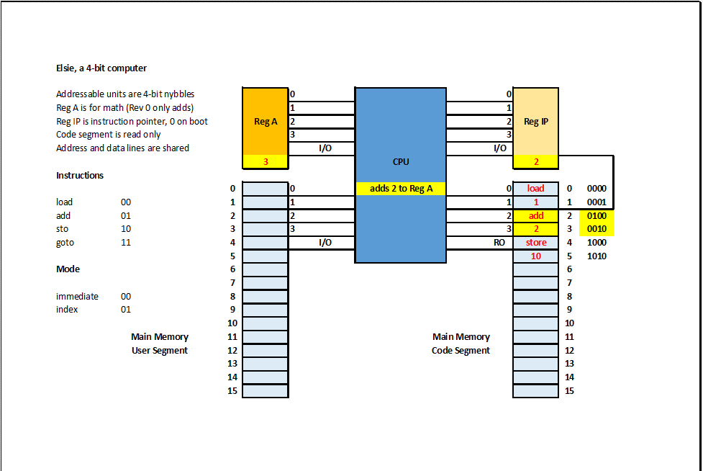

Slide 43
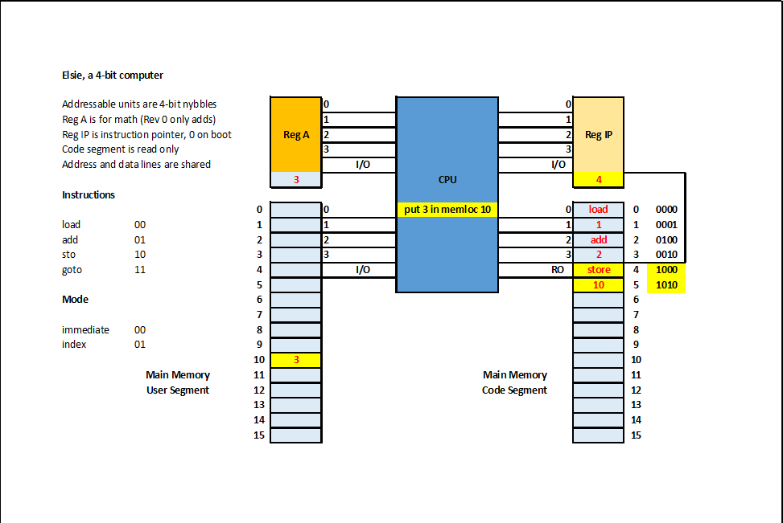

Slide 44
What do real computer instructions look like?

Slide 45
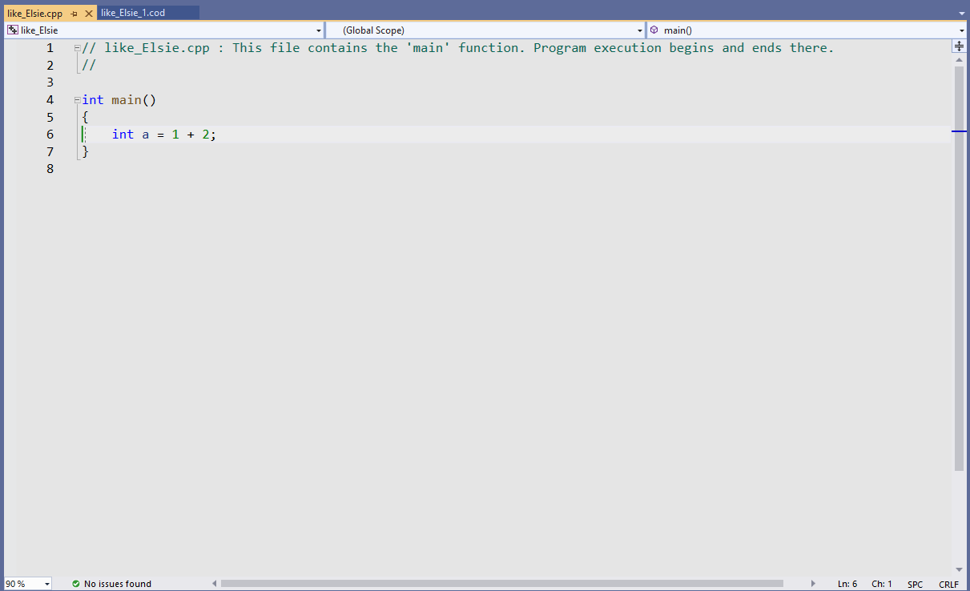
A similar program in C++:

Slide 46
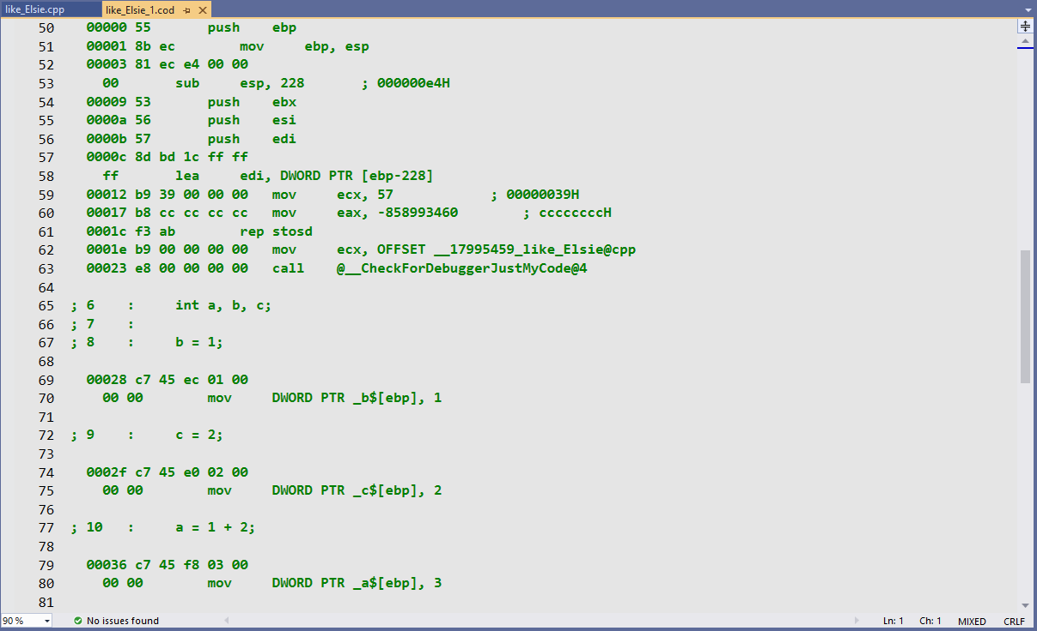
Now the real computer instructions:

Slide 47
Not too different from Elsie’s code, eh?
load 1 0000 0001
add 2 0100 0010
sto 10 1000 1010

