Slide 1
virgl_gpu_3d

Slide 2
Content
1.how qemu support gpu 3d-accelerate
2.how mesa and virglrender work
3.virglrender 3d-accelerate protocol
4.fuzzing virglrender and bug list
5.qemu escape exploit virglrenderer

Slide 3
qemu and gpu

Slide 4
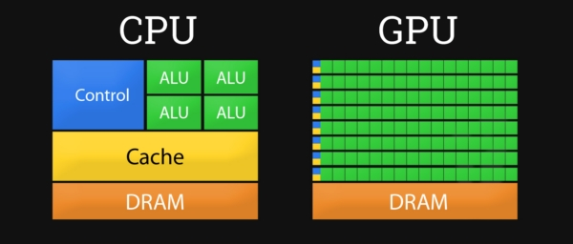
cpu or gpu
CPU is good at processing logical operations
GPU is good at handling parallel operations
3D rendering actually requires a lot of parallel operations
Reference from: https://tproger.ru/articles/cpu-and-gpu/

Slide 5
qemu gpu arch
GPU needs to rely on hardware real-time computing, and the method of using simulation execution has a large performance loss.
solution:
1.host using graphics library to process gpu render
2.qemu gpu passthrougth

Slide 6
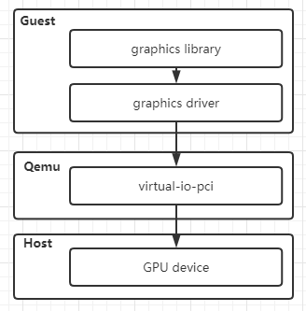
qemu gpu passthrougth
Guest GPU render access pci device of qemu
Qemu will redirect data to host GPU device

Slide 7
qemu vGPU for mesa and virgl
Guest GPU render access pci device of qemu
Qemu using host graphics library to render vGPU request
Reference from: https://tproger.ru/articles/cpu-and-gpu/

Slide 8
mesa and virglrender work

Slide 9
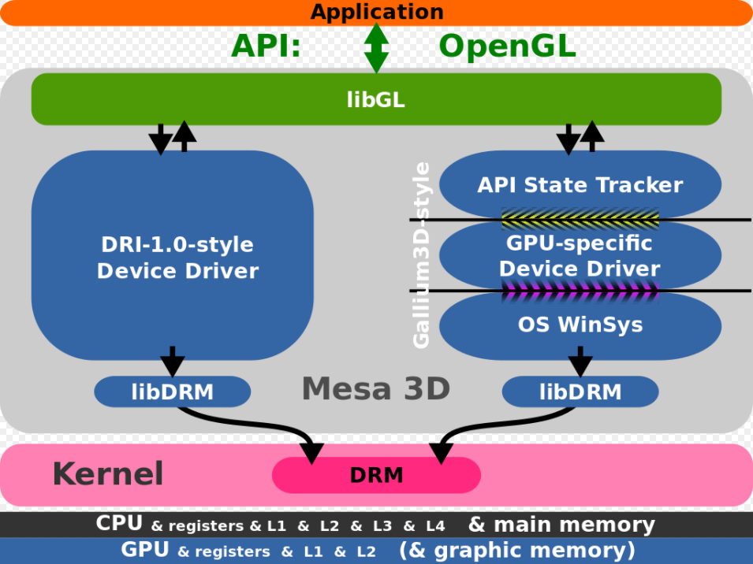
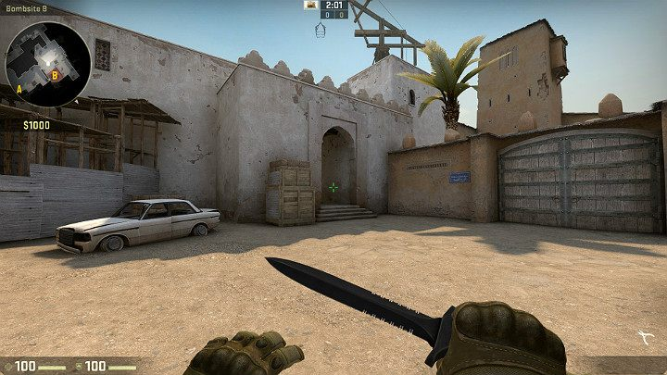
what is mesa
Mesa is OpenGL 3D Graphics Library
Mesa support virutal-gpu
Reference from: https://en.wikipedia.org/wiki/Mesa_3D#/media/File:Gallium3D_vs_DRI_graphics_driver_model.svg

Slide 10
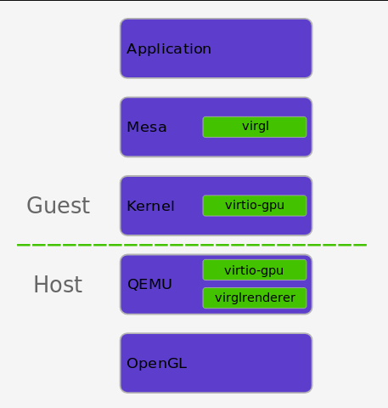
mesa and virgl arch
Guest Application => Chrome(canvas)
Guest Graphics Library => Mesa
Guest Graphics Driver => Mesa(inside)
Host Qemu Emu Device => virtio-gpu
Host Qemu Render => virglrenderer
Host Graphics Library => OpenGL/D3D
Reference from: https://www.collabora.com/news-and-blog/blog/2018/02/12/virtualizing-gpu-access/

Slide 11
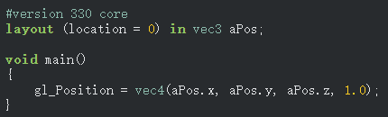
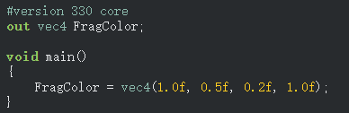
OpenGL example:render shader
1.Vertex Shader
2.Fragment Shader
Reference from: https://learnopengl.com/Getting-started/Hello-Triangle

Slide 12

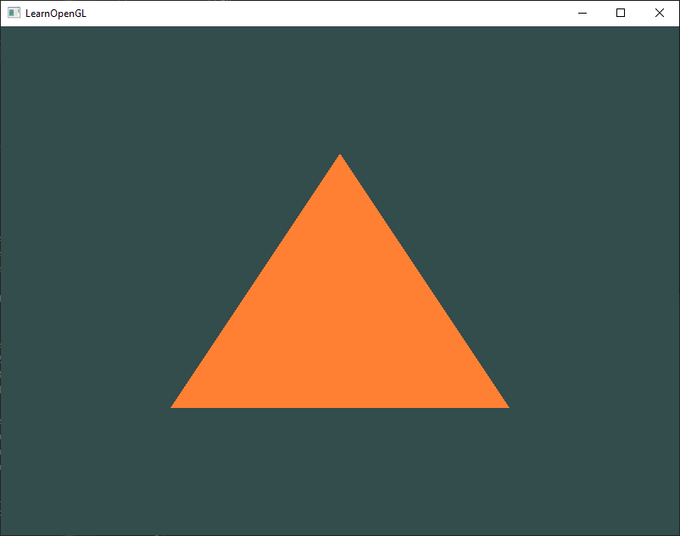
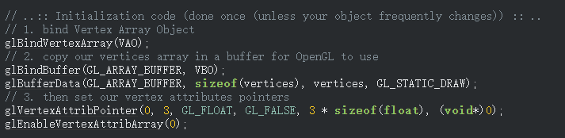

OpenGL example:render shader
3.Run it with OpenGL
Reference from: https://learnopengl.com/Getting-started/Hello-Triangle

Slide 13
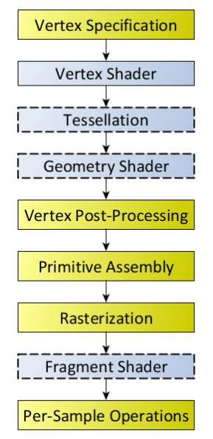
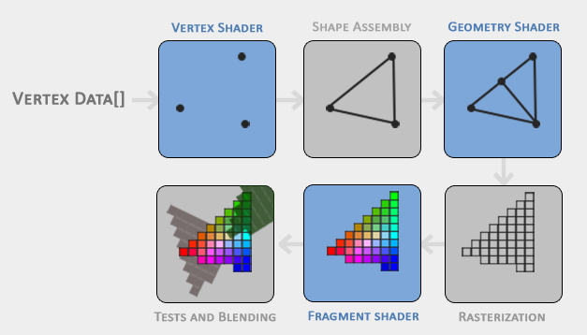
gpu render process
Reference from: https://www.khronos.org/opengl/wiki/Rendering_Pipeline_Overview
https://learnopengl.com/Getting-started/Hello-Triangle

Slide 14
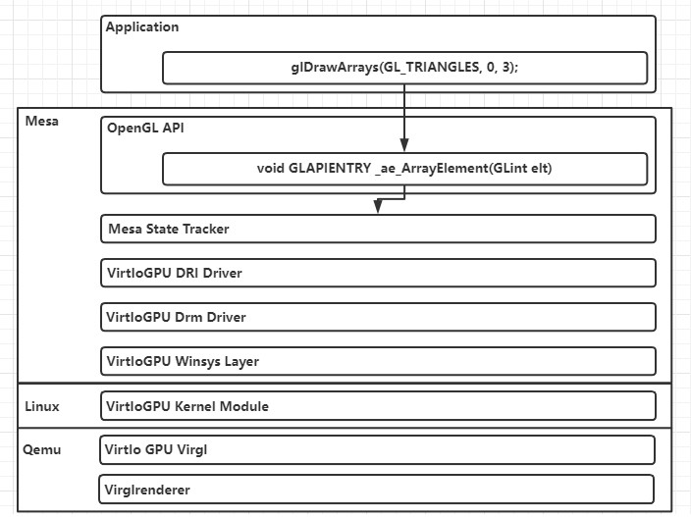
how virglrendender process gpu render
Data Transe

Slide 15
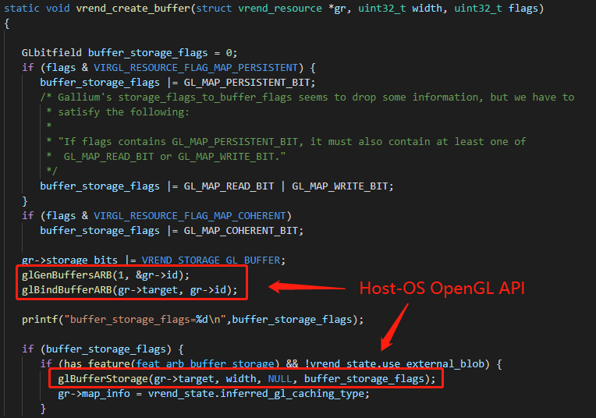
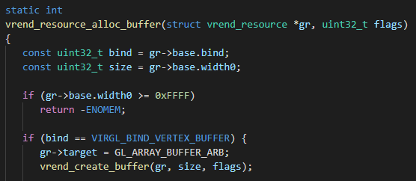
how virglrendender process gpu render
Create Resource Buffer

Slide 16
virgl render process and 3d-accelerate protocol

Slide 17
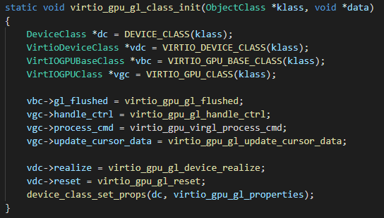
qemu pci and virgl 3d-protocol
Qemu Virtio GPU Init()
Create Message Queue
Create Message Handle

Slide 18
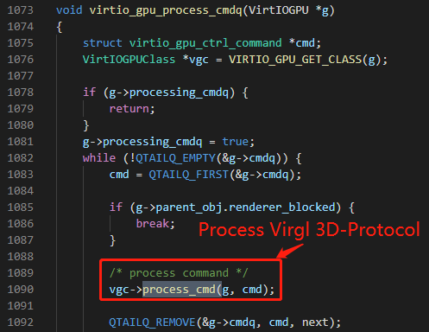
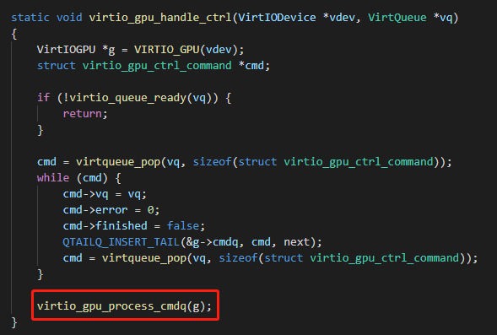
qemu pci and virgl 3d-protocol
Process Render Request from Message Queue

Slide 19
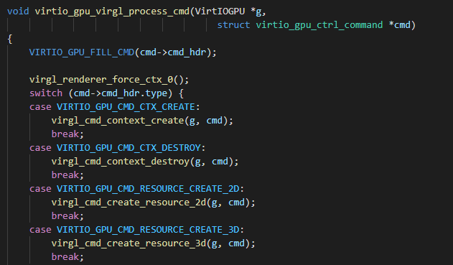
qemu pci and virgl 3d-protocol
Process GPU PCI Command

Slide 20

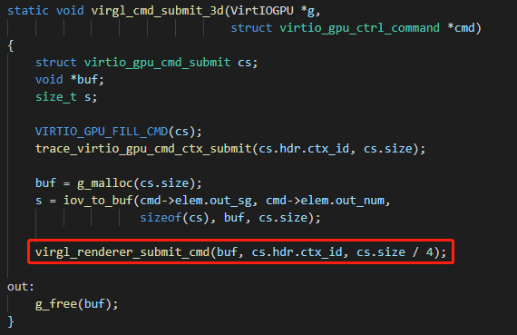
qemu pci and virgl 3d-protocol
PCI Command VIRTIO_GPU_CMD_SUBMIT_3D will Process 3D-Protocol
Code in Qemu

Slide 21
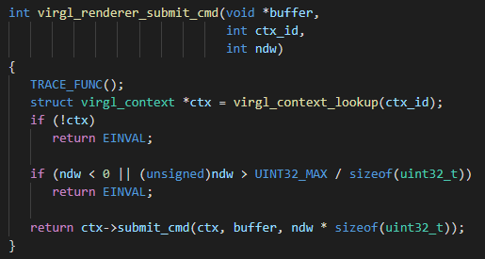
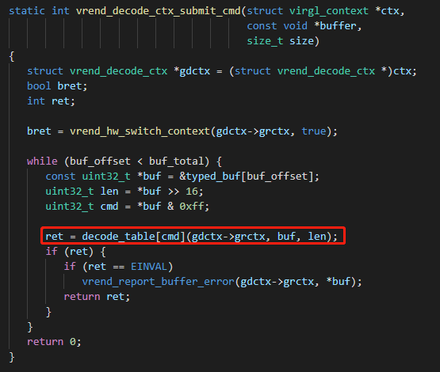
qemu pci and virgl 3d-protocol
virgl_renderer_submit_cmd will process all 3d-protocol command
Code in Virglrenderer

Slide 22
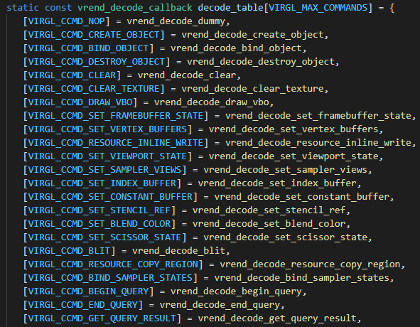
qemu pci and virgl 3d-protocol
3d-protocol commands and process recall function
the role of the 3d protocol is to let the physical machine handle the rendering request of the virtual machine
Code in Virglrenderer

Slide 23

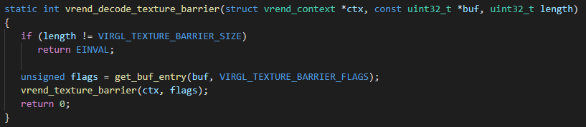
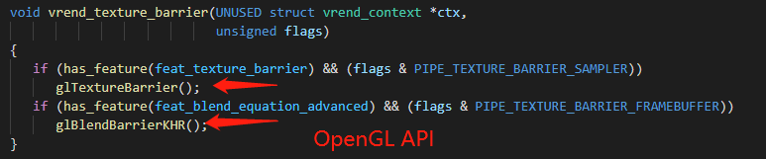
qemu pci and virgl 3d-protocol
virglrender call opengl api for process virtual machine render request

Slide 24
virglrenderer 3d-accelerate protocol
1.详细说说这些代码实现(qemu-pci是怎么样处理请求的)
2.virglrenderer支持哪些接口,攻击面怎么样:
接口请处理,TSGI Shader处理等等

Slide 25
virglrenderer 3d-accelerate protocol example get memory
1.简单源码分析一通
2.举例这里有个简单的空指针bug
3.来一个触发

Slide 26
virglrenderer 3d-accelerate protocol Process TGSI Shader
1.简单源码分析一通
2.就够了。。。。

Slide 27
fuzzing virglrender and bug list

Slide 28
how fuzzing virglrender
1.简单说说这个fuzz的场景
2.libFuzzer怎么样构造fuzz entry
3.fuzz entry的一些构造思路

Slide 29
bug example1 -- xxx

Slide 30
bug example 可利用

Slide 31
qemu escape exploit virglrenderer

Slide 32
qemu escape exploit virglrenderer

Slide 33
qemu escape exploit virglrenderer

