Slide 1
Research Data Management

Slide 2
Why do we meet?
EPFL and funding agencies require a better way to deal with research data.
Plenty of information in https://researchdata.epfl.ch

Slide 3
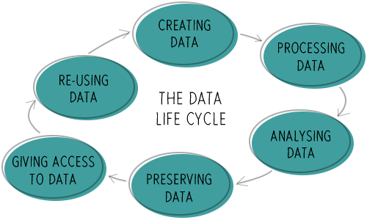
What is RDM?

Slide 4
What is RDM?
Research part: creating, processing analyzing data.
Data management: storing, documenting, sharing, reusing data.

Slide 5
What is wrong?
We loose time: many calculations could be avoided.
Data exists but:
  We don’t have access to it.
  We don’t know enough about it.
  We don’t have the tools to treat it (proprietary format).
  ...
Other people cannot reproduce the research we publish.
  Computational details section is not enough.
  Input geometries, all input parameters, software version…
...

Slide 6
What should we do?
  Use open source software and format.
  Describe extensively your data (metadata). It is never enough!
  Publish your data.
  Write data management plan (DMP) for each project.

Slide 7
Data should be FAIR
Findable
Accessible
Interoperable
Re-Usable
https://www.force11.org/group/fairgroup/fairprinciples

Slide 8
Open Source
Software:
  If you write code or scripts: Learn git; make your source code opensource. People will cite you, they will use your code and improve it.
  Funding agencies start to require the usage of opensource software.
  It is just better for everyone!
Format:
  Data set: CSV, HDF5…
  Code: plain text format (try using open source languages, e.g. Python instead of Matlab)
  Images: .tif .png .svg
  Movies: .mp4 .mj2 .avi .mkv
  Text: .pdf .txt .odt .tex .md… (Do NOT use Apple or Windows format!)
From the List of EPFL Recommended File Formats: https://researchdata.epfl.ch/

Slide 9
Metadata
Good file organization and naming conventions.
Add README files to describe the content of each folder.
Guide to “README” style metadata: https://data.research.cornell.edu/content/readme
To go further:
  Use tools like HDF5 format.
  Or AiiDA: “ Infrastructure to manage, preserve, and disseminate the simulations, data, and workflows of modern-day computational science.” Developped at EPFL.

Slide 10
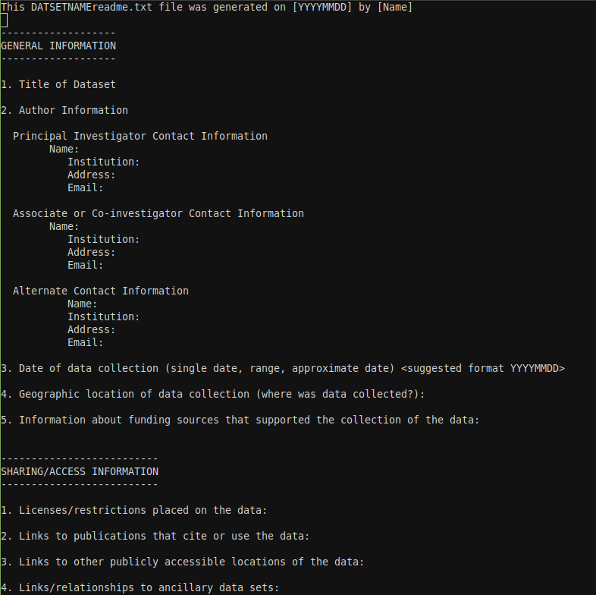
Readme template

Slide 11
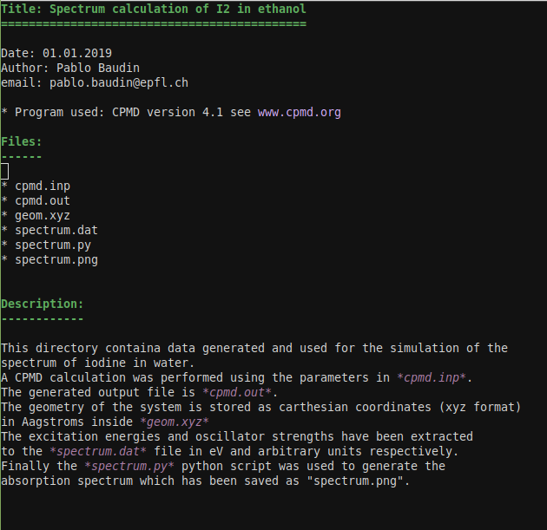
Readme example

Slide 12
Publish your data
Make it open: “If other people can’t reproduce it, it’s not science…”
Give a DOI to your data.
Data repositories: Zenodo (a free and open digital archive built by CERN)
Data journals:
  Journal of Physical and Chemical Research Data (AIP)
  Scientifc Data (Springer Nature Group)
  Data in Brief (Elsevier)
Others will use my data and publish before me!
  The goal is to produce the best possible science as a community, not for personal glory.
  Most of the time you will just be helping yourself…
  They will have to cite your work!

Slide 13
Data Management Plan
The DMP describes:
  Strategies to:
    Create, store, share, maintain, archive and preserve data throughout their life cycle.
  Which data are going to be produced.
  How each type of data will be:
    Organized, classified, archived, shared, distributed, secured, preserved.
Why a DMP?
  Plan: future needs (hardware, software, HR, …)
  Science: better research reproductibility
  Data reuse: better use of public funds
  Transparency: public funded research available
  Openness: social impact of your research
  Visibility: citations, collabor., career
  Compliancy ...
Copy from a presentation of the EPFL Research Data Library Team.

Slide 14
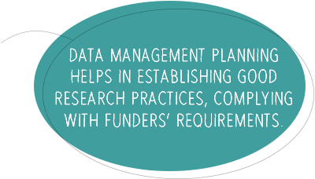
Data Management Plan
There are lots of guidelines and tools on how to write DMP.
Sometimes we have to fulfill requirements from funding agencies.
The DMP is a document that should be updated along with the the projects (we cannot know everything in advance).

Slide 15
Summary
Use OpenSource as much as possible!
Organize your data:
  Meaningful file hierarchy.
  Meaningful naming conventions.
  OpenSource format (plain text, .odt, hdf5...)
  Add metadata (even just README files)!
Publish your data!
Start writing DMP for all your projects (even incomplete) and update it regularly.
Should we agree on a general format for REAMDE files and DMP?

