Slide 1

Group Presentation
TEAM MEMBERS
BIPLOVE LAMICHHANE (20027829)
SAMRAT BOGATI (20024257)
PRATIMA KANDEL (20027628)
TUTOR
Dr. MOHAMMAD NAJI

Slide 2
Agenda
PROJECT OVERVIEW - 3
PROJECT WORKFLOW - 4
TECHNOLOGIES - 5
CLOUD TECHNOLOGIES - 6
RESULTS AND FUTURE WORK - 7
CONCLUSION - 8

Slide 3
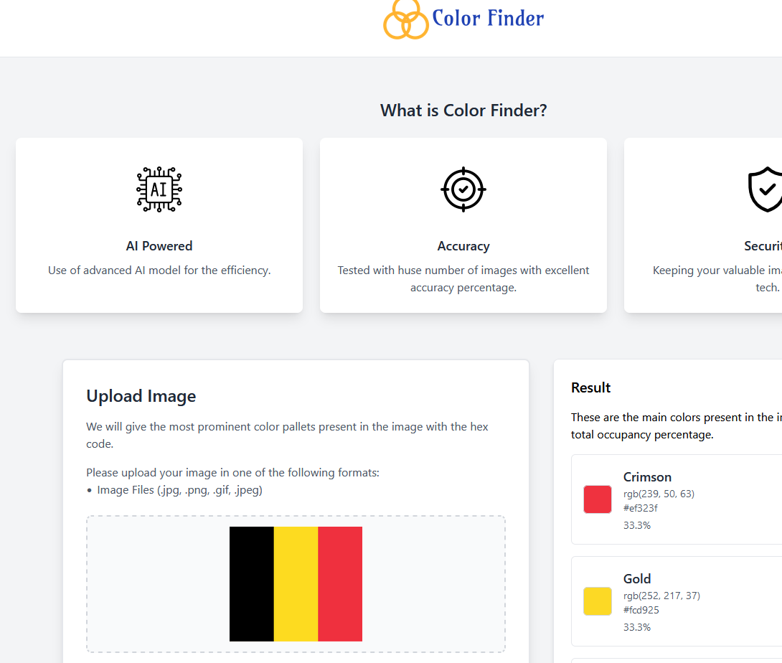
PROJECT OVERVIEW
Build a web app that analyzes uploaded images to detect prominent colors.
Provide the detected colors with hex codes and percentage of occupancy.
User can upload the image from any device as the server is hosted in the cloud.
Available at: https://colorfinder.tech/

Slide 4
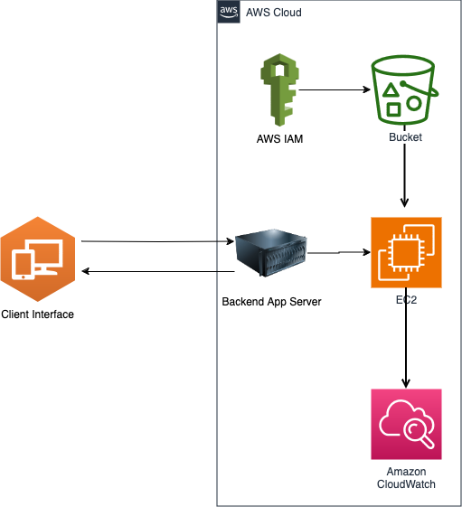
PROJECT WORKFLOW
User uploads image through web interface.
Image is stored securely in AWS S3 bucket.
Web app retrieves the image and processes it.
Color detection is done by using K-Means clustering.
Detected colors, hex codes and percentages are shown.

Slide 5

TECHNOLOGIES
AWS EC2 Services
Flask App – App Server
Nginx– Web Server
K Means Algorithm – Image Processing
HTML , CSS, JS – Frontend Interface

Slide 6

CLOUD TECHNOLOGIES
AWS EC2
Iaas Platform
Hosting App, Scalable And Reliable.
AWS S3
Paas Platform
Storing Images, Secure And Cost-efficient.
Overall Cost
Free For 750 Hours Of T2 Micro EC2 Instance.
Free Until 5gb Of Storage On S3.

Slide 7
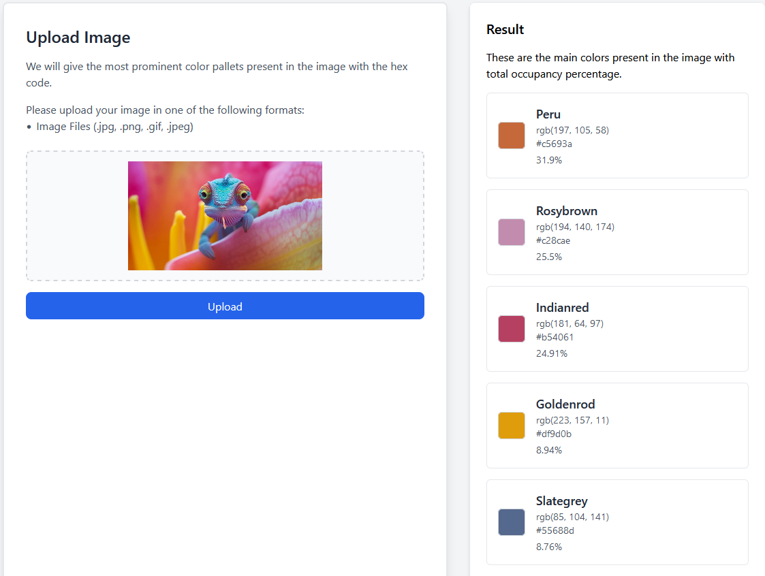
RESULTS AND FUTURE WORKS
RESULTS
Analysed Data Is Shown In Results Section
Hex Code, Color Percentages
Future work
Advanced Algorithm
User Authentication
Batch Processing
Api Integration
Color Editing Option

Slide 8
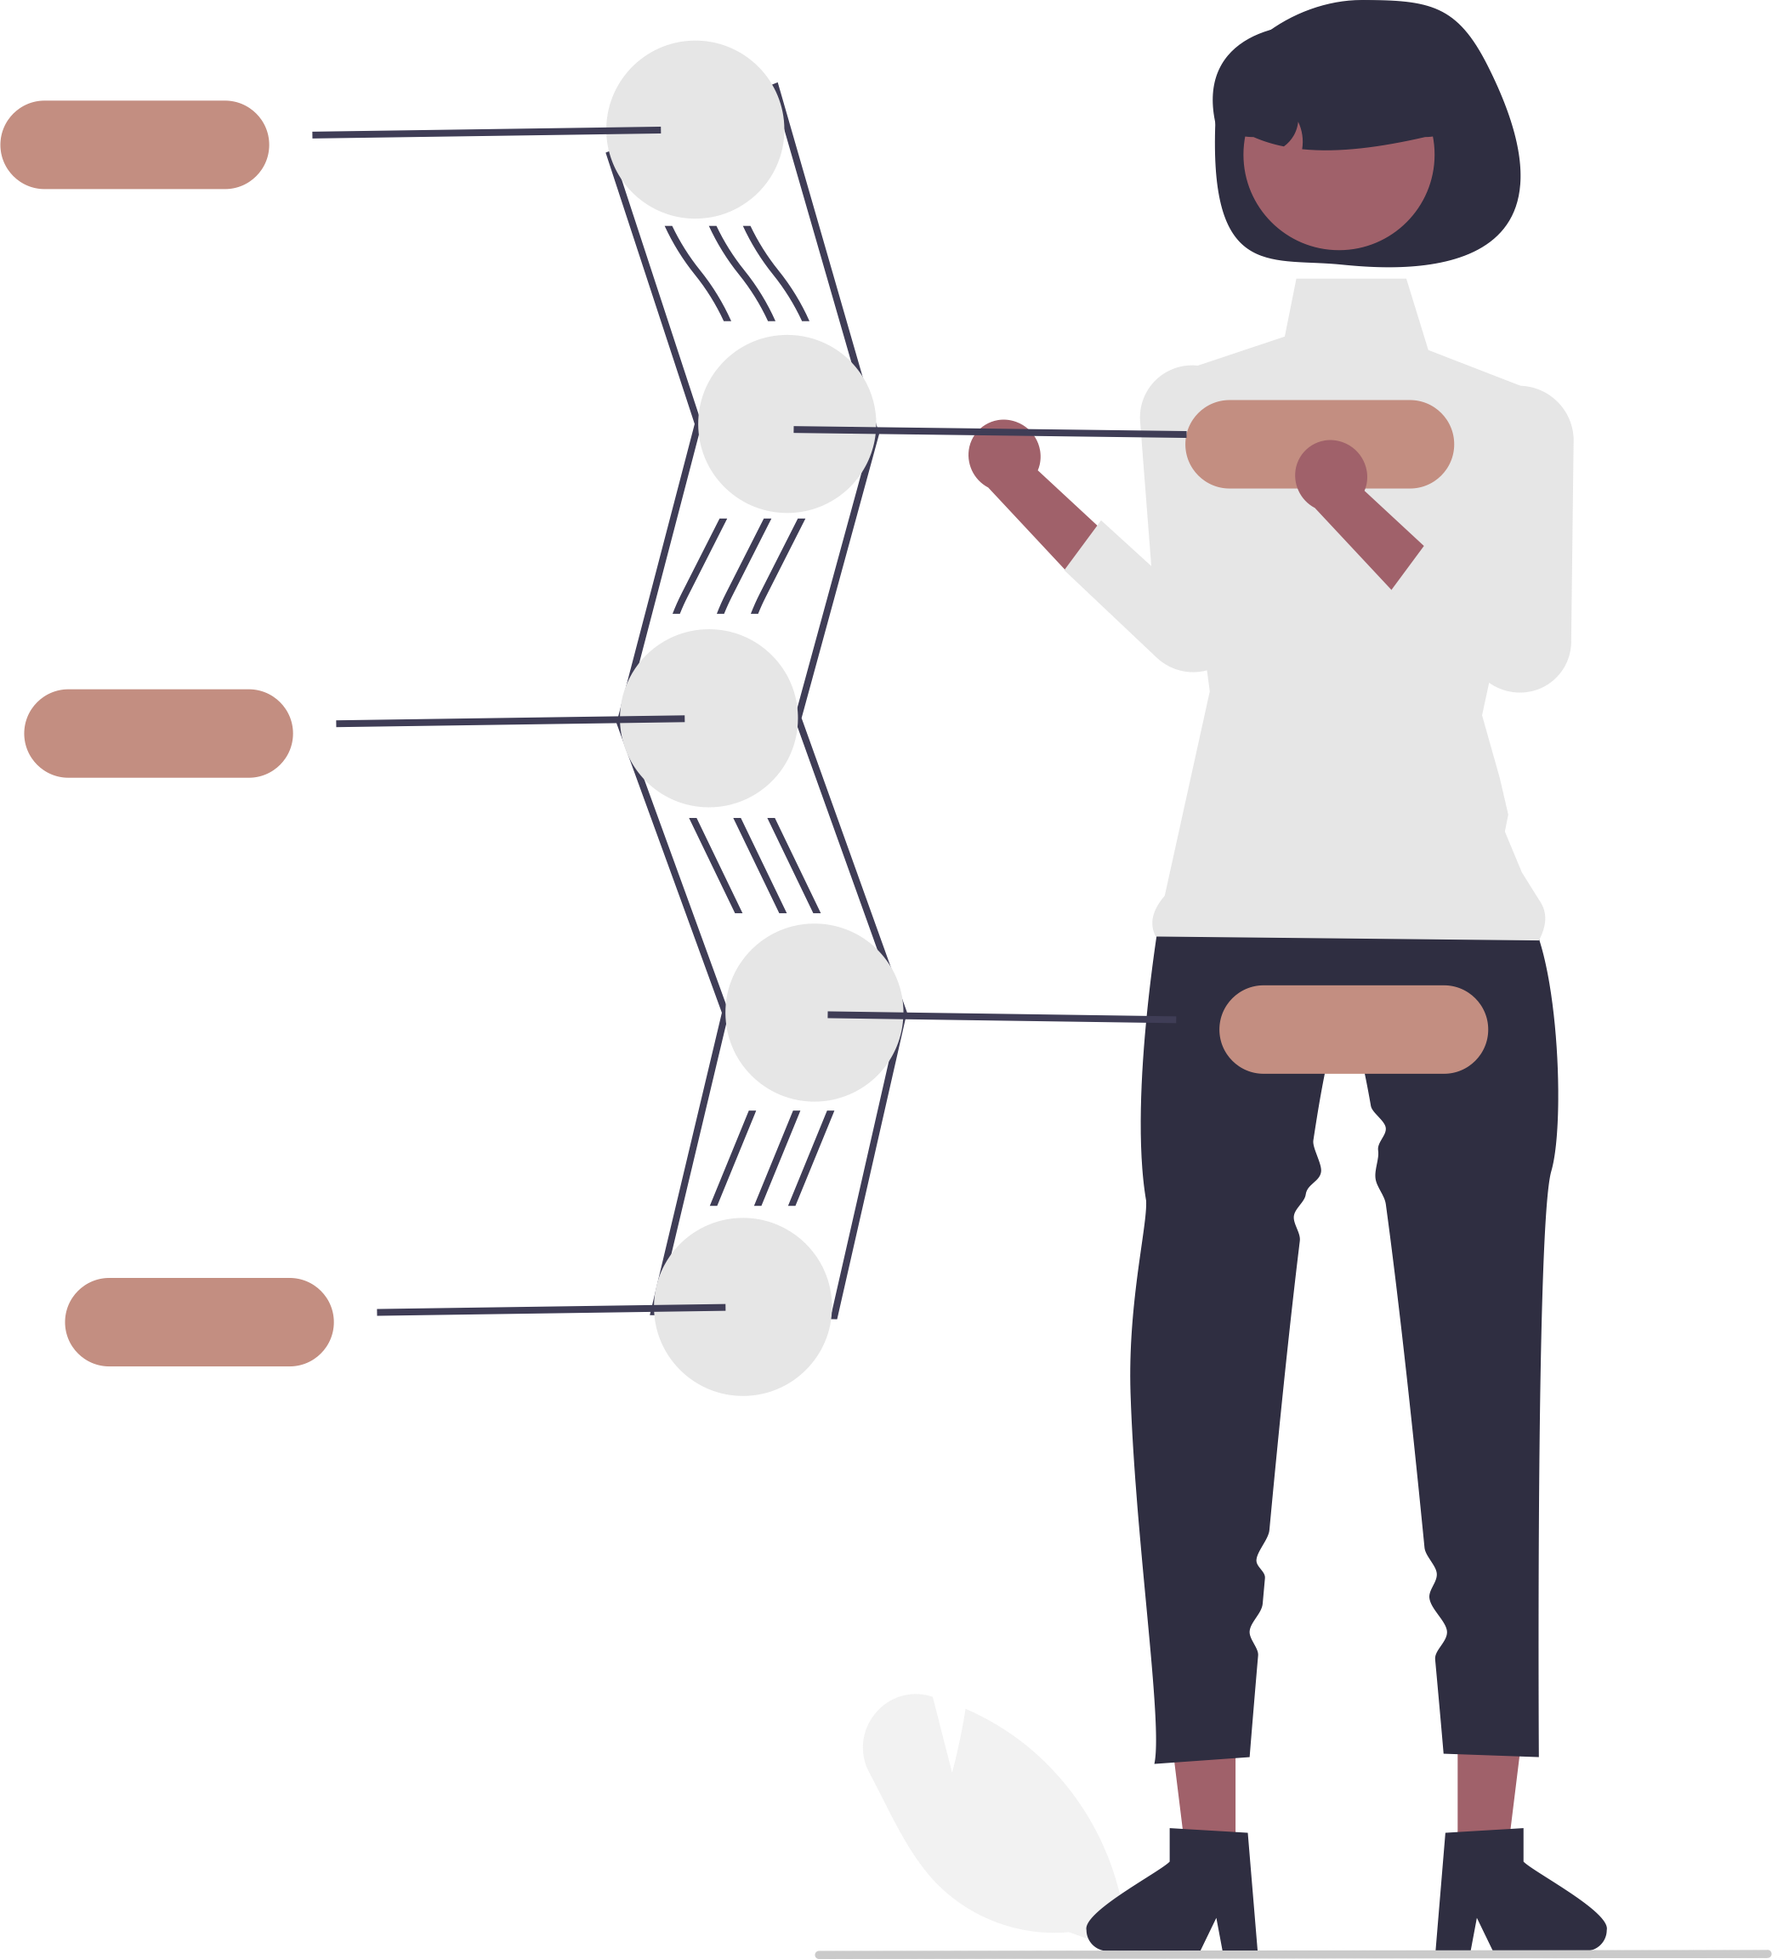
CONCLUSION
Overall Project Success In Delivering A User-friendly Image Analysis App.
Cloud Infrastructure (Aws Ec2, S3) Ensured Scalability And Performance.
Achieved Cost-efficient Cloud Resource Utilization While Meeting User Needs.

Slide 9
THANK YOU
BIPLOVE
SAMRAT
PRATIMA
GROUP 07

