Slide 1

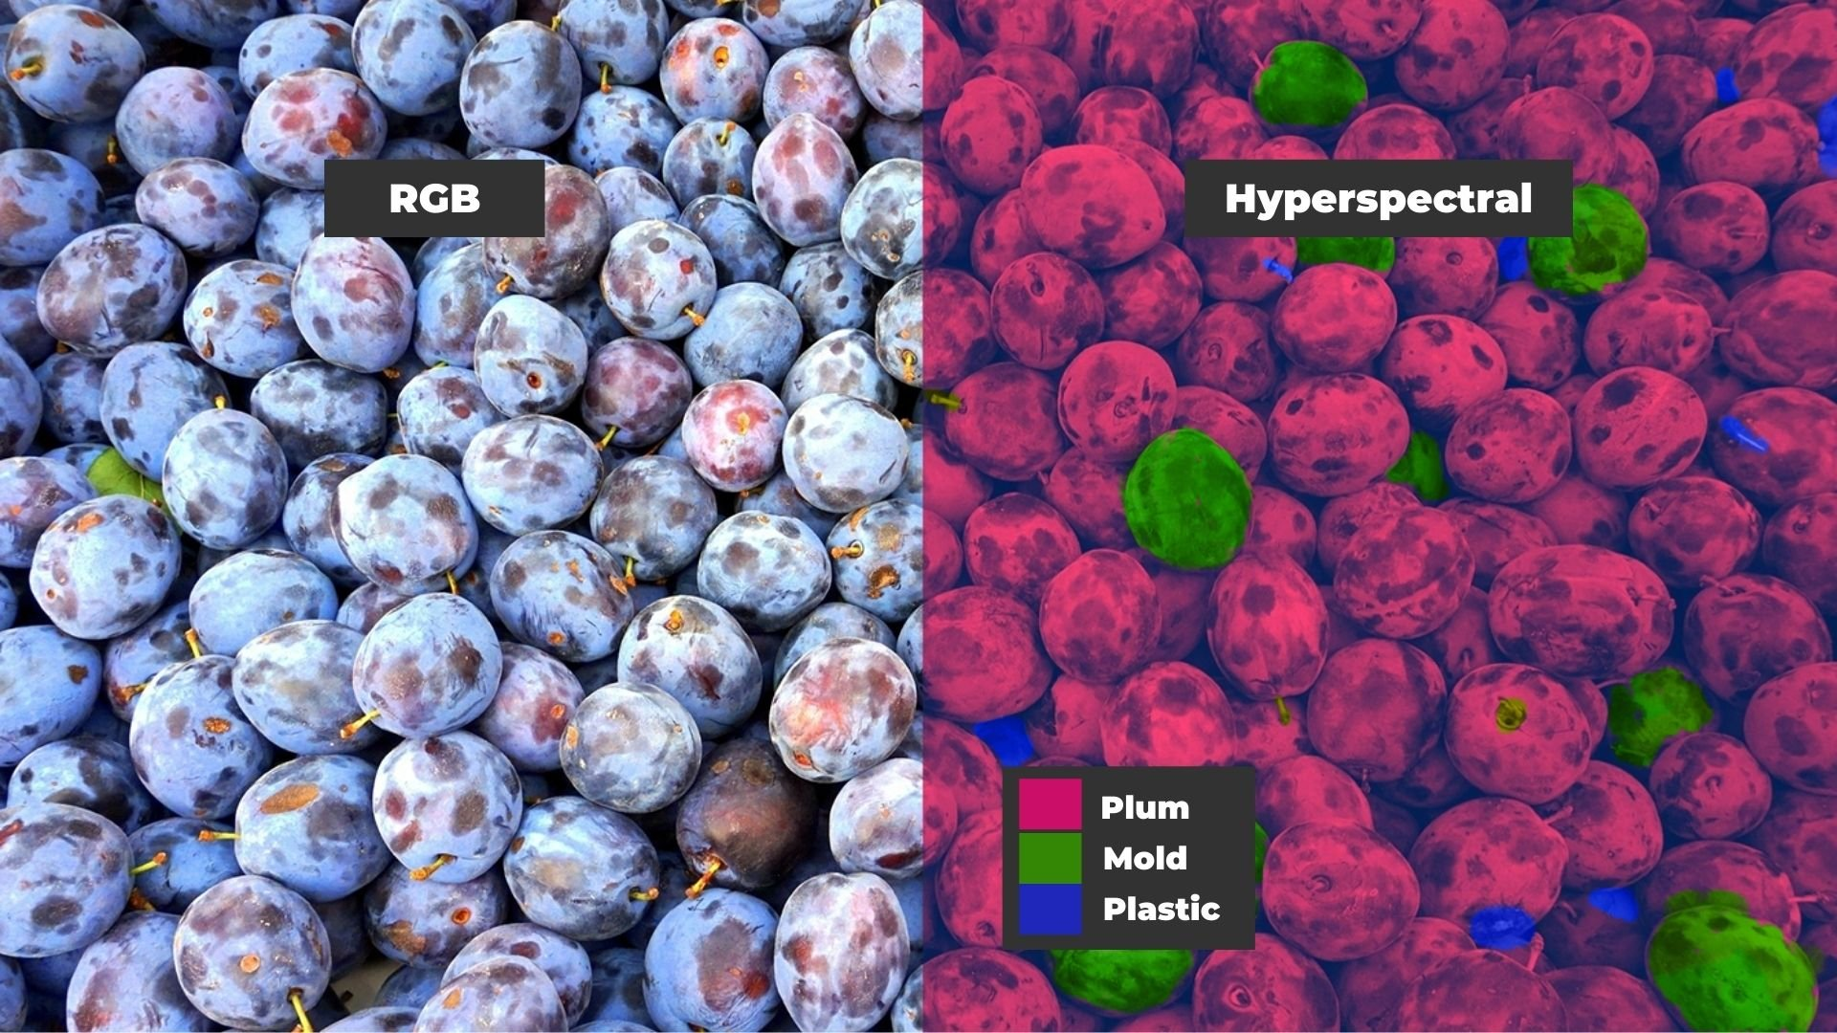
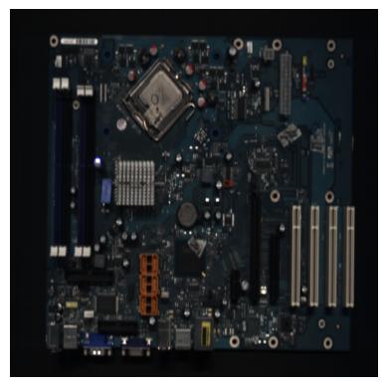
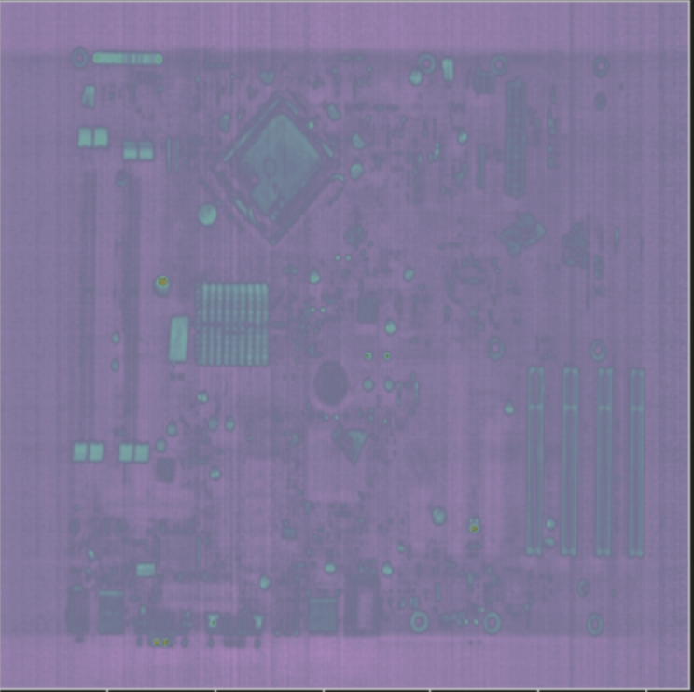
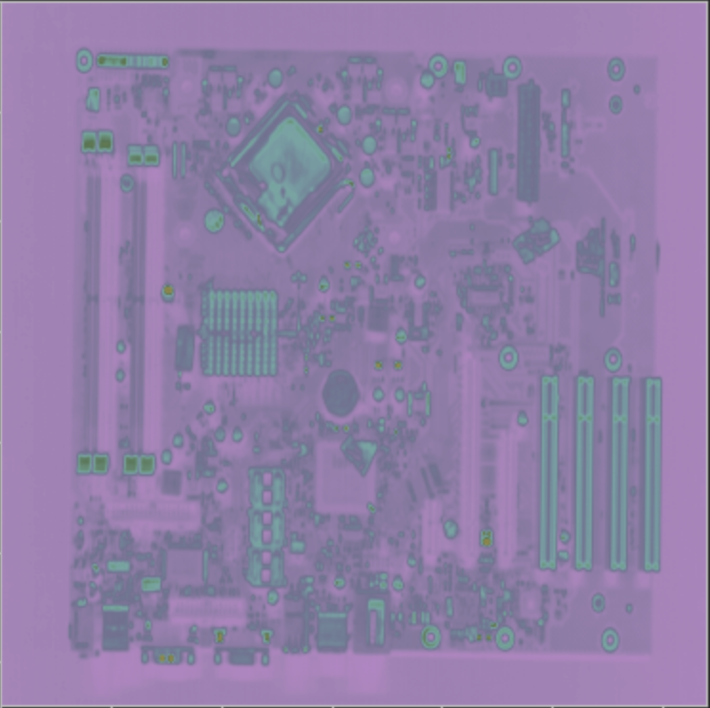
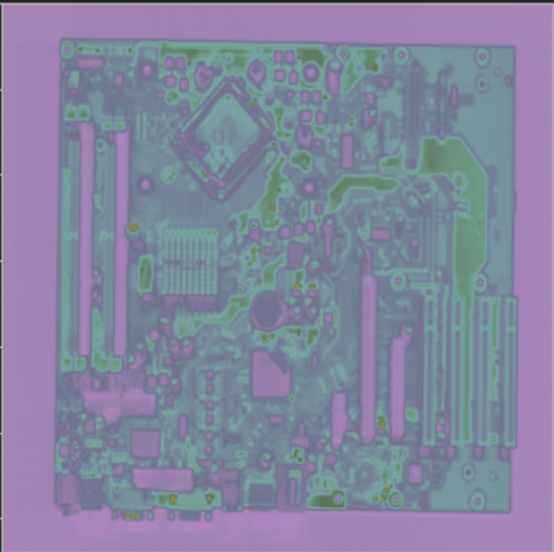
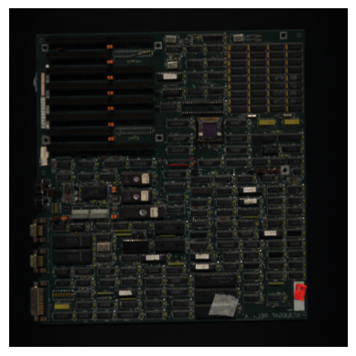
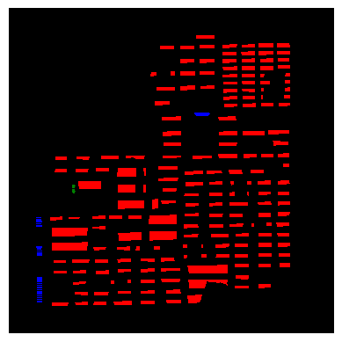
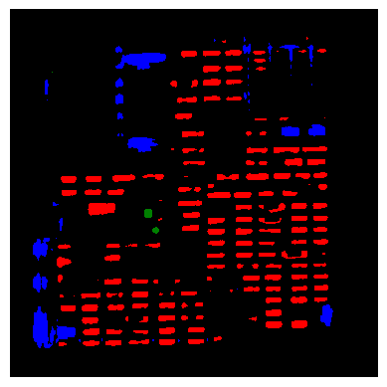
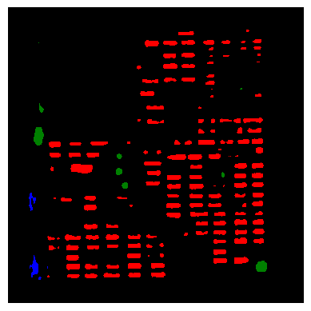
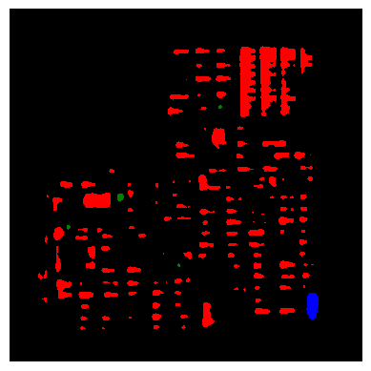
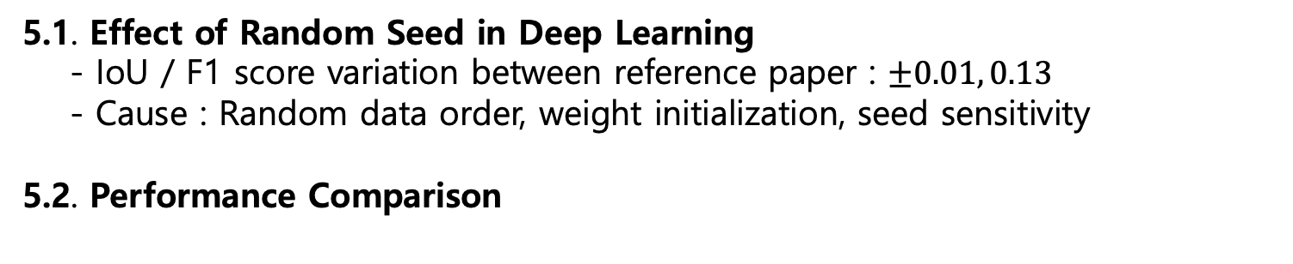
Enhancing PCB Recycling Efficiency through Spectrum Channel Reduction Blocks in HSI
ChanKeun-Lee Instructed by Prof. YoungKeun-Kim
School of Mechanical and Control Engineering, Handong Global University
Personal Contact: (Mobile) 010-2802-4257 (e-mail) 21900575@handong.ac.kr
1. Introduction
4. Model Experiment
1.1 Problem Statement
Printed Circuit Boards(PCBs) contains valuable metals.
Efficient segmentation of components (e.g., ICs, capacitors, connectors) is critical for automated recycling. -> RGB 한계로 HSI로 한다
키워드 : PCB recycling, HSI, Spectrum channel reduction block
1.2 HSI(Hyperspectral Imaging)
Traditional RGB imaging lacks the ability to differentiate visually similar parts
HSI captures rich spectral signatures, enabling better material discrimination.
> This offers a non-destructive and contactless method for analyzing and classifying ->구조
+카메라 설명, 실험 환경(논문 참고)
PCB components, preserving reusability and structural integrity
1.3 Proposed Approach
(214 채널에 적합한 Unet model 구조)
Introduce end-to-end segmentation models that use (1) reduce spectral dimensionality while
(2) preserving segmentation accuracy -> 성능 개선했다
4.1 PCB segmentation result
F1Score, IoU 간단한 의미설명
The resized HSI images (640x640x214) were used to train the models under each input strategy, and their segmentation performance was subsequently evaluated.
ㅁ
Table 1. F1 Score Comparison across PCB Component Classes
Metric | Base Architecture | Spectrum Channel Reduction Block | Others | IC | Capacitor | Connectors
F1 Score | U-net | PCA | 0.95 | 0.27 | 0.23 | 0.05
 |  | None | 0.95 | 0.75 | 0.57 | 0.31
 |  | Ours | 0.96 | 0.67 | 0.58 | 0.46
 | Attention U-net | PCA | 0.94 | 0.25 | 0.23 | 0.10
 |  | None | 0.97 | 0.71 | 0.65 | 0.66
 |  | Ours | 0.96 | 0.70 | 0.36 | 0.54
 | ResUnet | PCA | 0.94 | 0.14 | 0.16 | 0.02
 |  | None | 0.96 | 0.74 | 0.53 | 0.51
 |  | Ours | 0.97 | 0.72 | 0.56 | 0.71
Table 2. IoU Comparison across PCB Component Classes
Metric | Model | Pre Process layer | Others | IC | Capacitor | Connectors
IoU | Unet | PCA | 0.95 | 0.27 | 0.23 | 0.05
 |  | None | 0.91 | 0.60 | 0.40 | 0.18
 |  | 1x1 Conv | 0.93 | 0.51 | 0.41 | 0.30
 | Attention Unet | PCA | 0.90 | 0.14 | 0.13 | 0.05
 |  | None | 0.95 | 0.56 | 0.49 | 0.49
 |  | 1x1 Conv | 0.93 | 0.54 | 0.22 | 0.37
 | ResUnet | PCA | 0.90 | 0.07 | 0.08 | 0.01
 |  | None | 0.94 | 0.59 | 0.36 | 0.34
 |  | 1x1 Conv | 0.94 | 0.56 | 0.39 | 0.55
Figure 1. RGB Image and HSI Comparison
2. HSI Dataset
2.1 PCB-Vision dataset
53 PCB samples 224-band HSI
- Train(126), val(3), test(30)
3 labeled classes : IC, Capacitor, Connector
2.2 Preprocessing
Background(뭘) masking using PCB masks
상세히 시각회 필요
Spectral normalization (white/dark reference)
2.3 Evaluation Metric(삭제)
IoU(spatial prediction quality)
F1 Score(balance between precision and recall)
이미지별 스펙트럼 명시
이미지 Tensor 로 표현해서
5. Discussion
5.1. Effect of Random Seed in Deep Learning - IoU / F1 score variation between reference paper : $±0.01, 0.13$
- Cause : Random data order, weight initialization, seed sensitivity
5.2. Performance Comparison
Table 3. Model Performance Comparison
Comparison | Key Insight
PCA vs 1x1 Conv | 1x1 Conv > PCA in accuracy(non-linear mapping preserves spectra data)
No Preprocess layer vs 1x1 Conv | Input channel size significantly impacted speed and maintain accuracy
…
…
Figure 2. Visualized PCB-Vision dataset
3. PCB Segmentation Model
Original Image
Ground Truth Mask
Attention-Unet Applied Result
(Preprocess layer : None, 1x1 conv, PCA)
In this project, we compare model outputs by applying three different input strategies to the same dataset. The baseline models used in prior studies include U-Net, ResU-Net, and Attention U-Net.(bock input data 표시그림)
Figure 4. Attention-Unet Model Applied Result
3
64
128
64
4
Model | Pre Process layer | Flops(G) | Params(M)
Unet | PCA | 342.34 | 31.04
 | None | 392.12 | 31.16
 | 1x1 Conv | 353.93 | 31.07
Attention Unet | PCA | 416.97 | 34.88
 | None | 466.76 | 35.0
 | 1x1 Conv | 428.57 | 34.91
ResUnet | PCA | 506.47 | 13.04
 | None | 606.03 | 13.29
 | 1x1 Conv | 518.06 | 13.07
640x640
640x640
128
128
640x640
640x640
640x640
128
320x320
320x320
128
320x320
256
256
256
256
160x160
512
160x160
512
160x160
160x160
80x80
40x40
80x80
Copy and crop
1024
Max pool 2x2
Table 4. Gflops and Params Comparison across Models
Conv 3x3, ReLU
Up-conv 2x2
Figure 3. Structure of U-net
conv 1x1
6. Conclusion
(Baseline model #1) U-net with Full Spectrum Input
The hyperspectral input 224 is directly applied to U-Net
1.기존연구에서 뭘 개선했는가
2. % 숫자로 표현
3. Further work
Contribution
Three input strategies were evaluated for PCB hyperspectral segmentation:
PCA-based,
full-channel,
and 1×1 convolutional reduction.
- 1x1 convolution model achieves highest efficiency compared to parameter/GFLOPs
(Baseline model #2) PCA + U-net
The hyperspectral input 224 is reduced to 3 channels using PCA
(Proposed Model) U-Net + Spectrum channel reduction block
The hyperspectral input 224 is reduced to 128 channels then to 3 using 1x1 CONV layers

