Slide 1
A.
B.
Notes:
Figure 1.

Slide 2
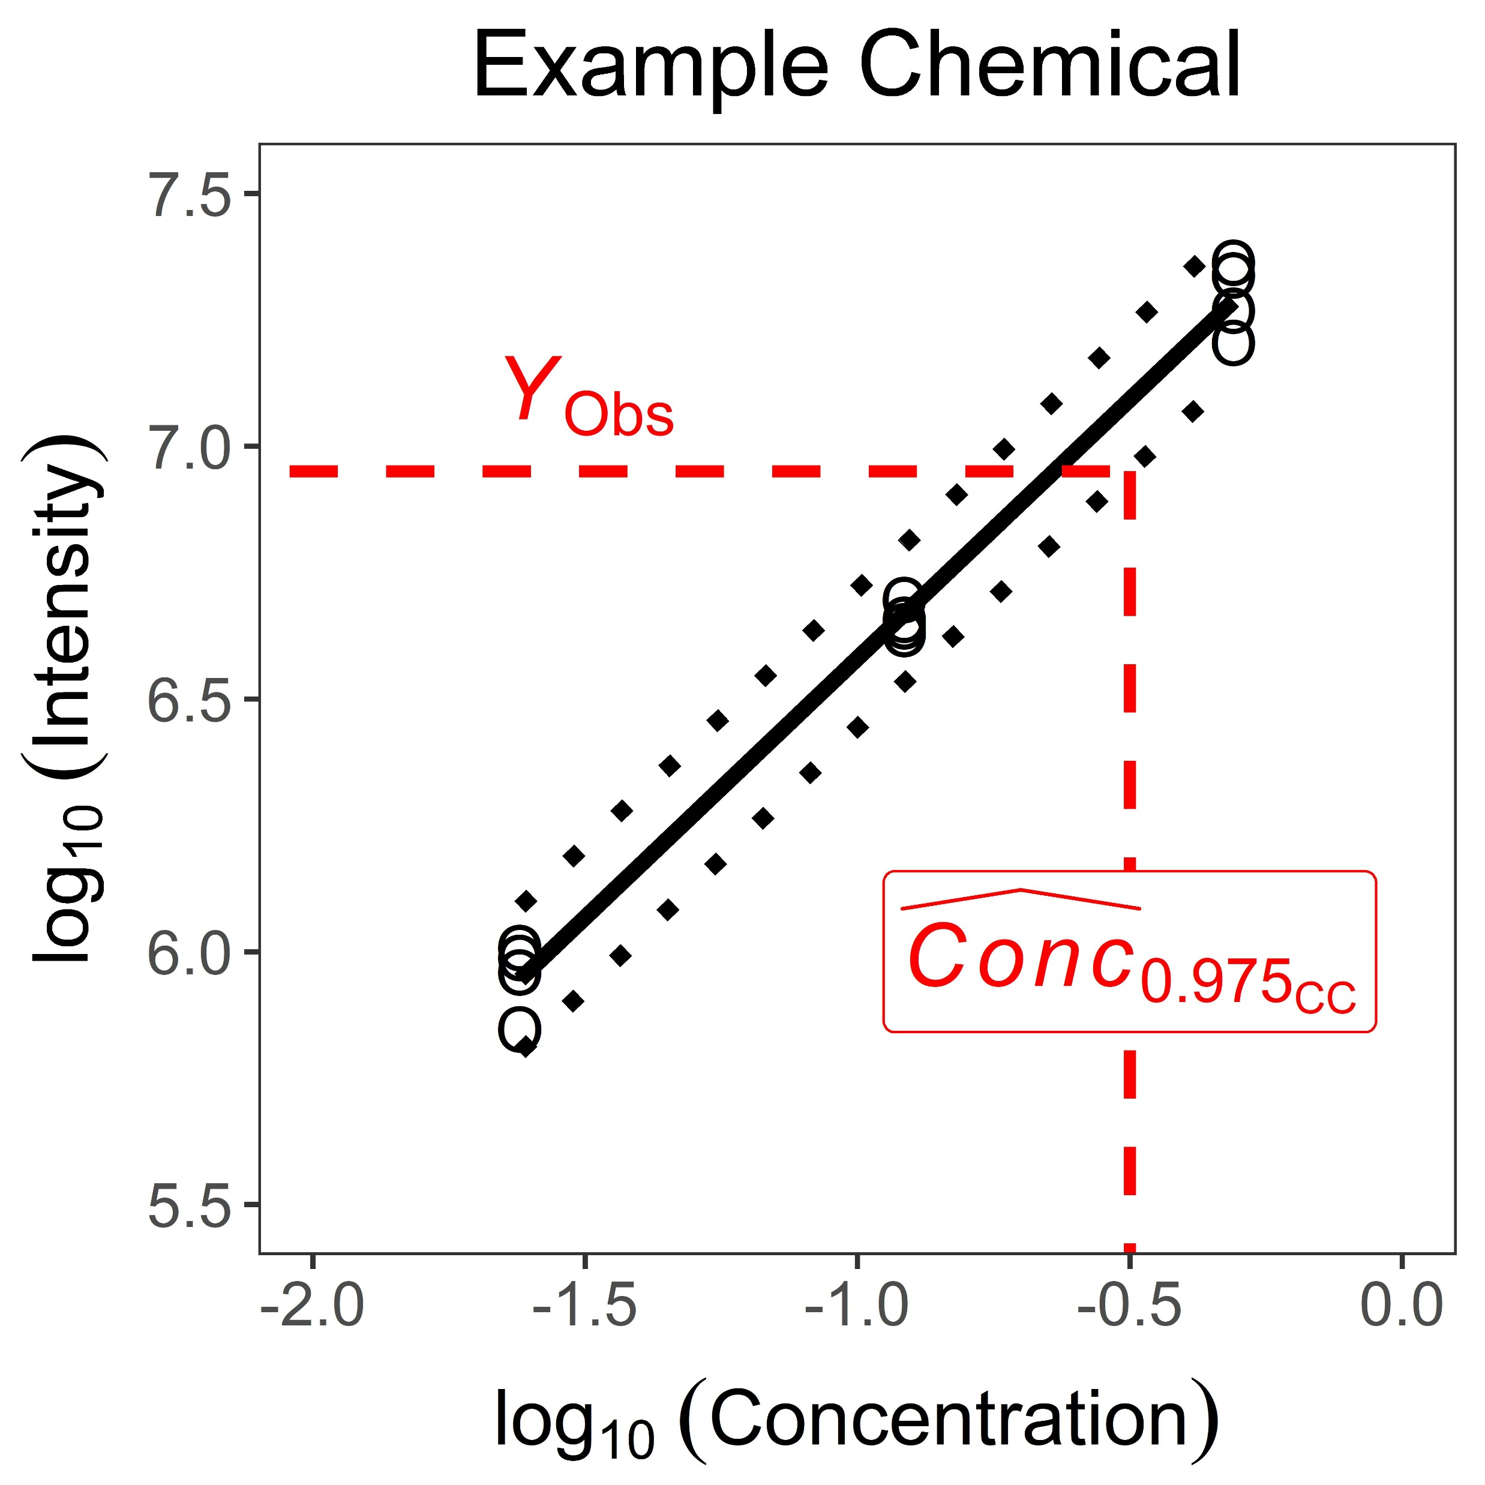
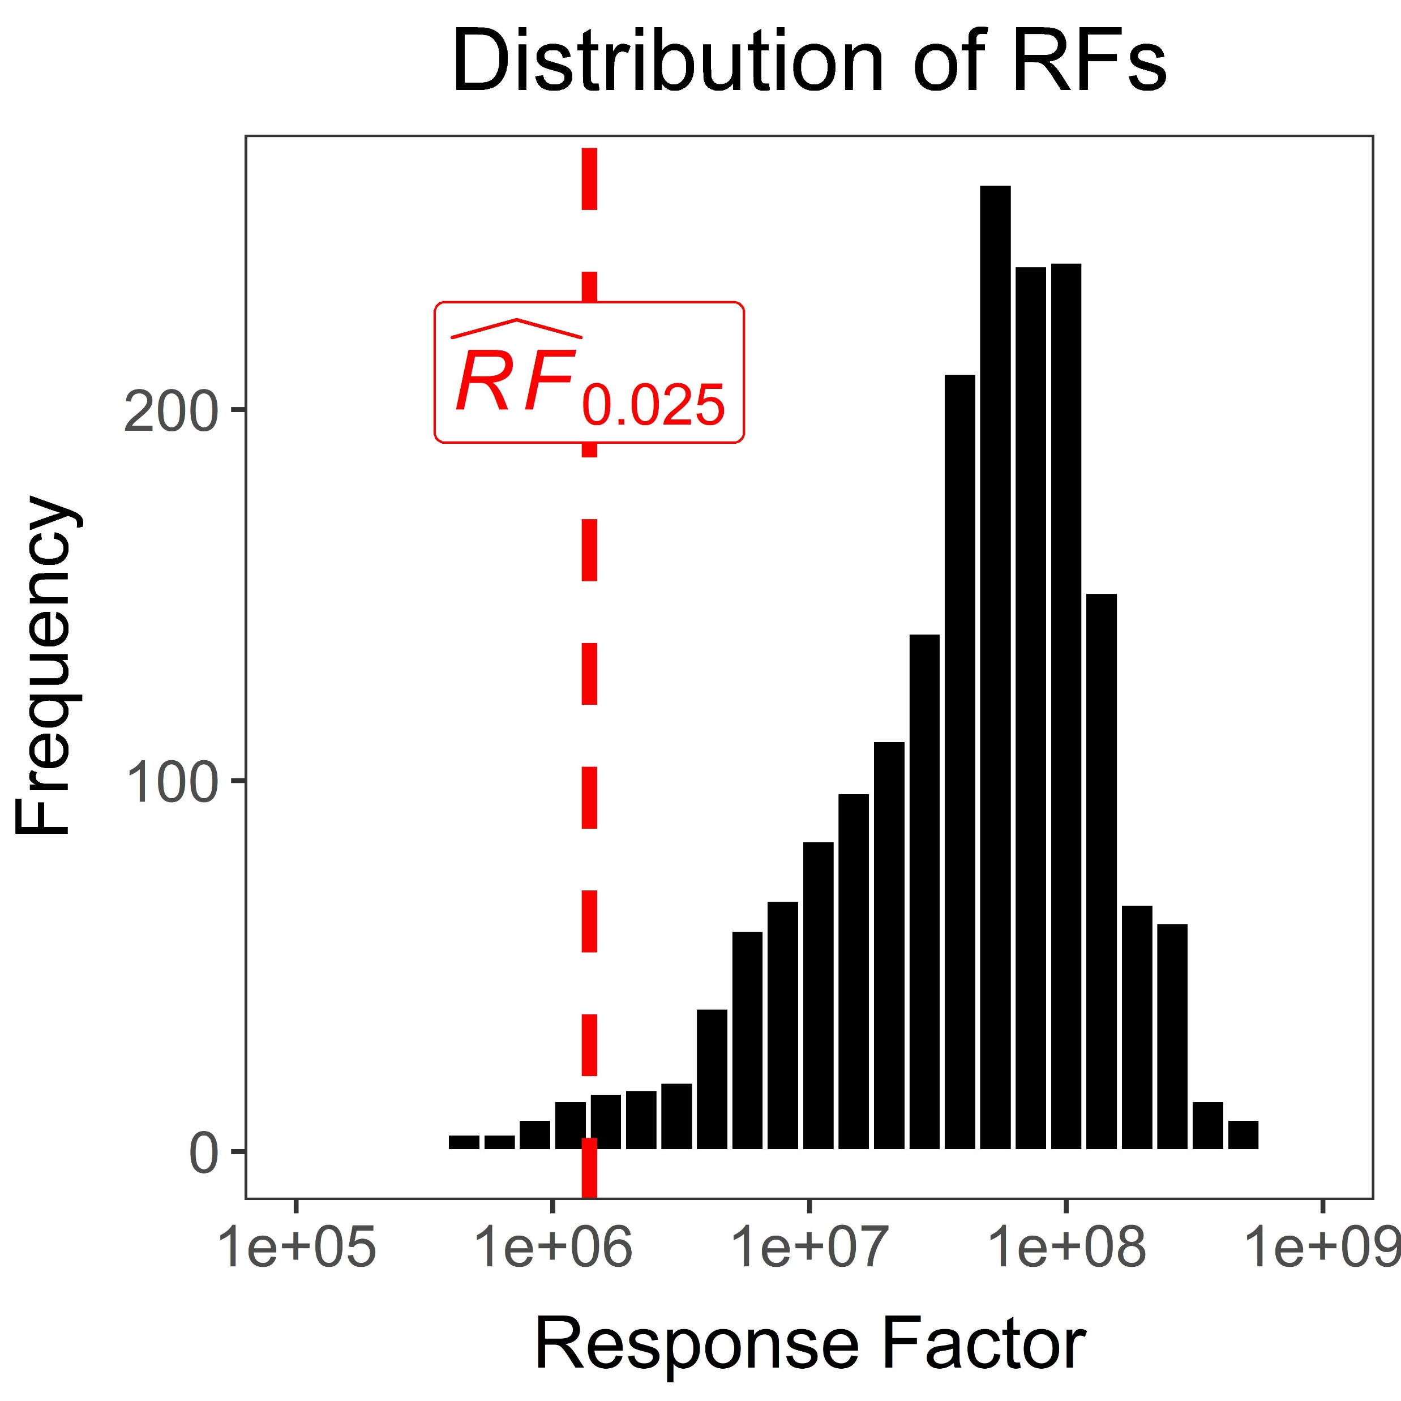
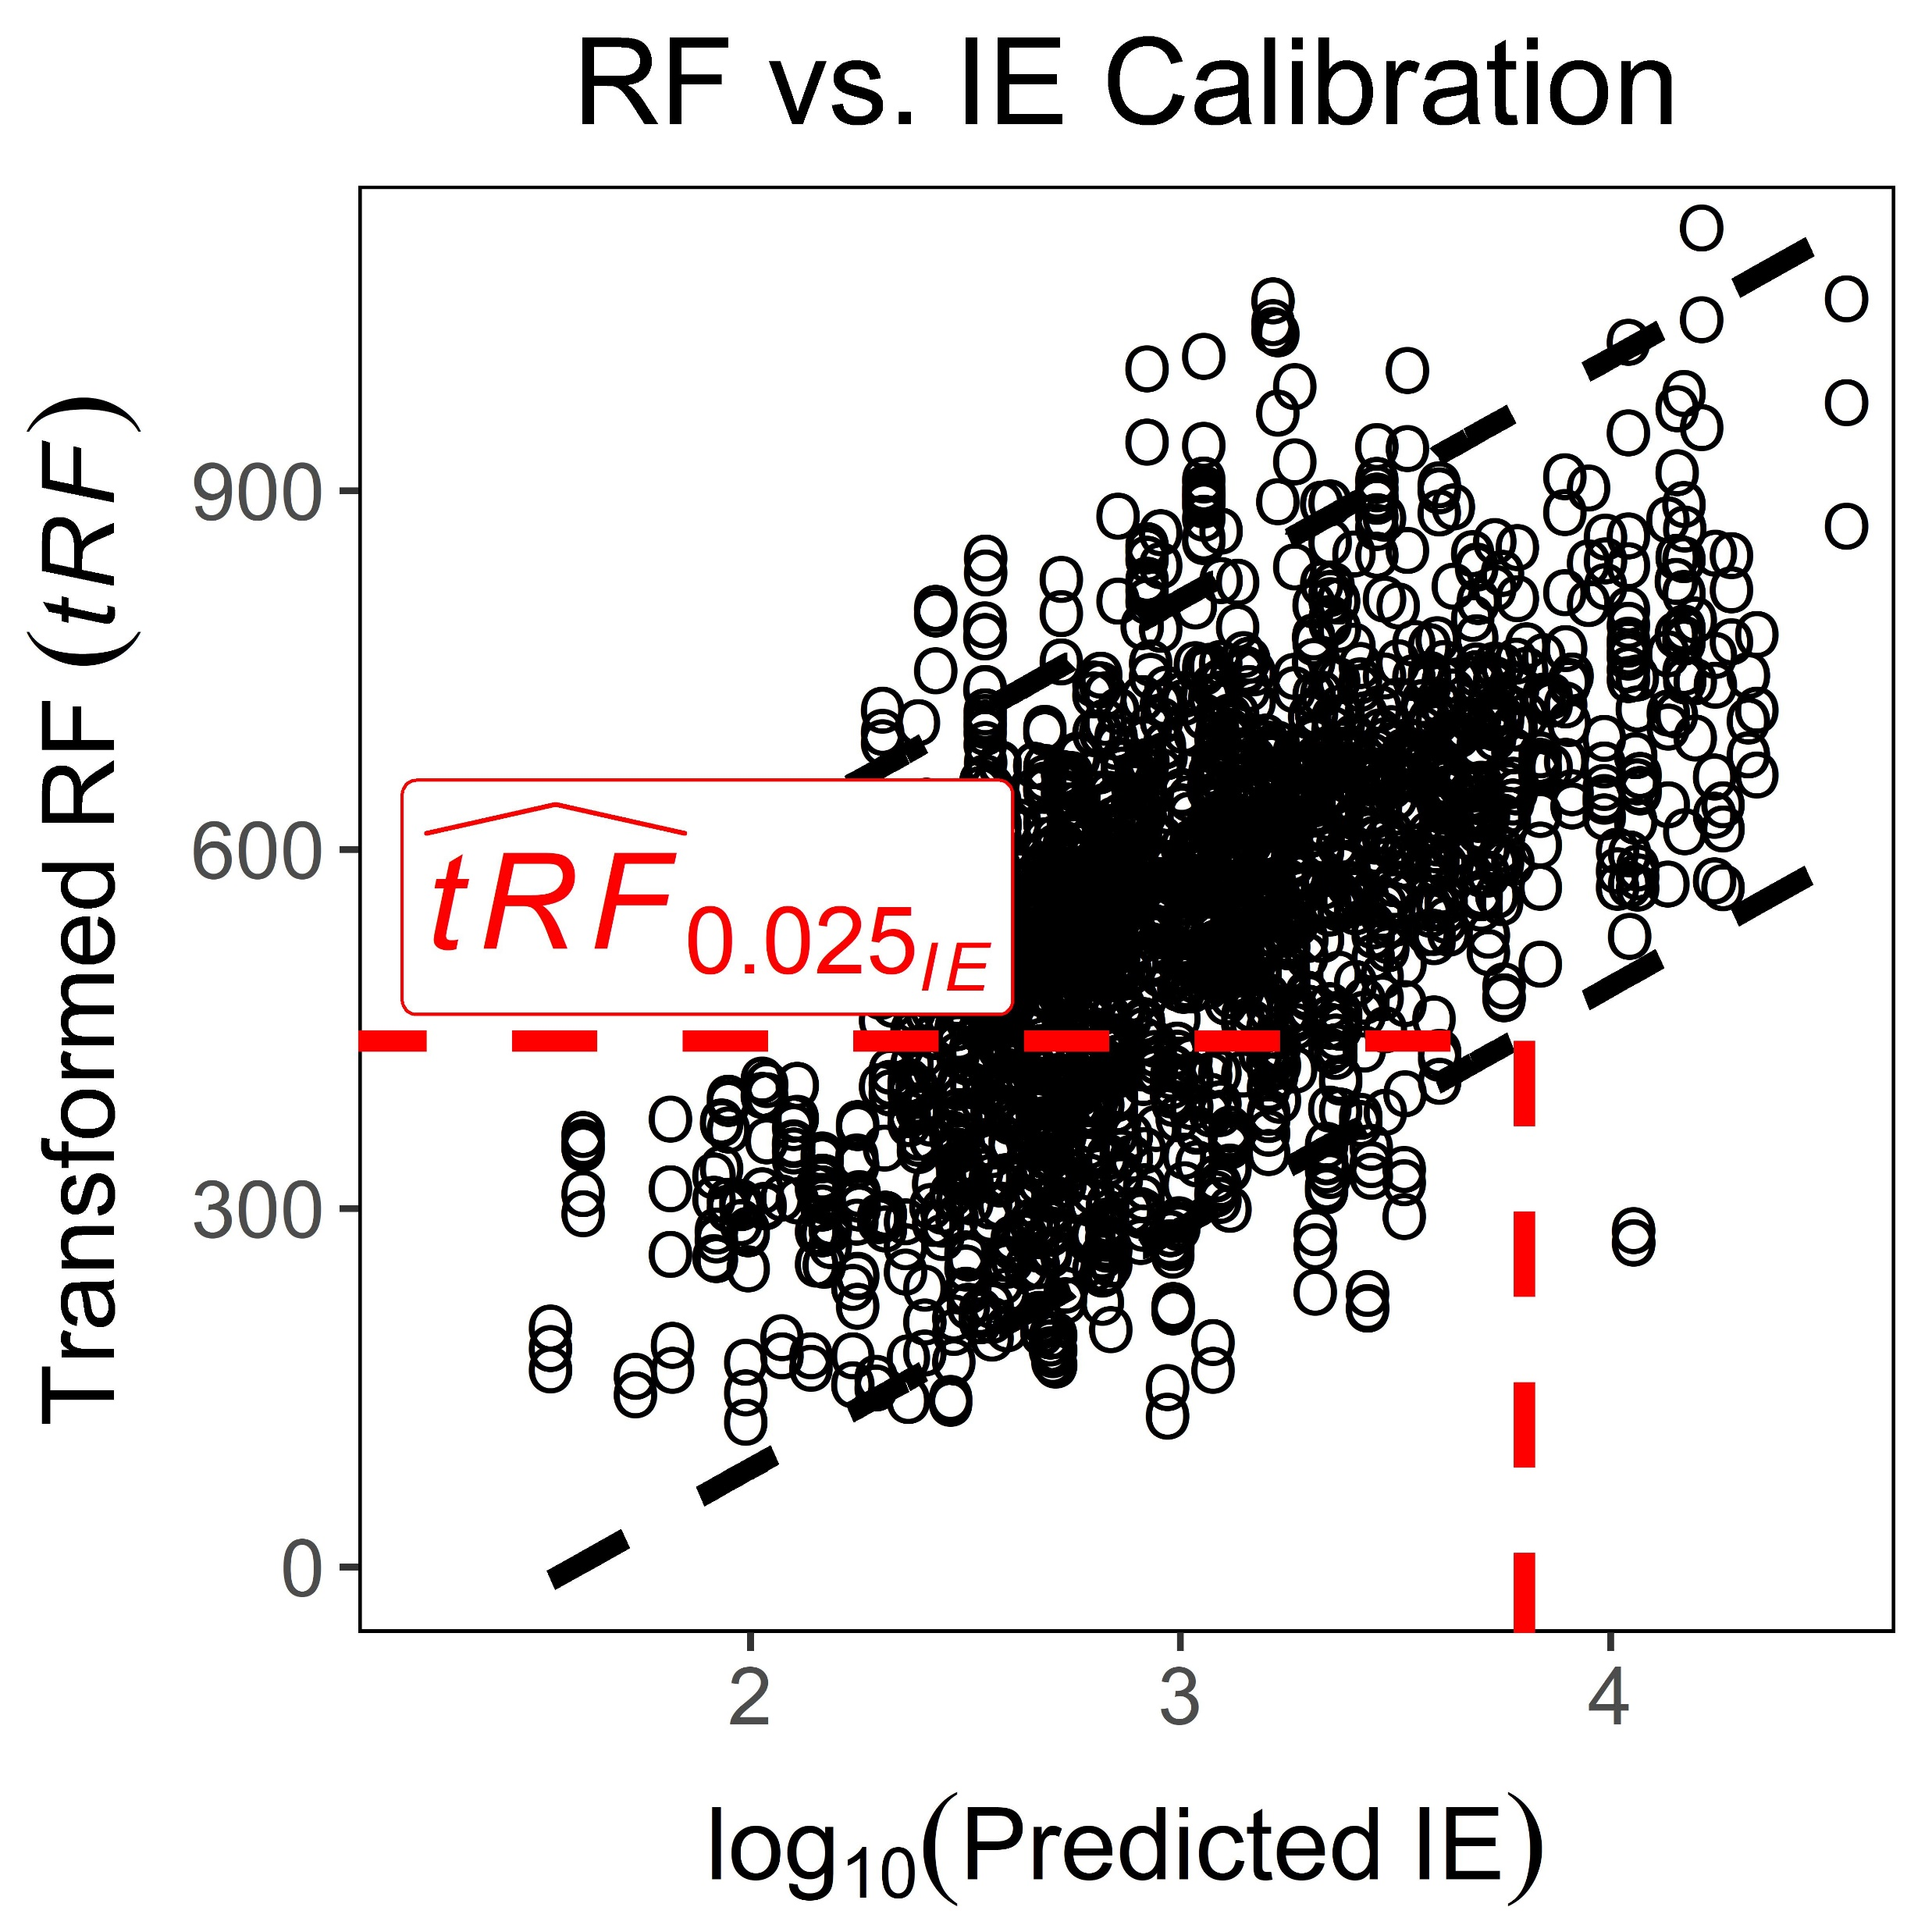

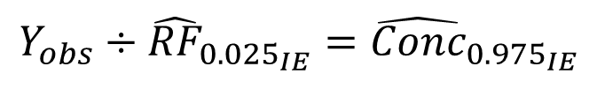
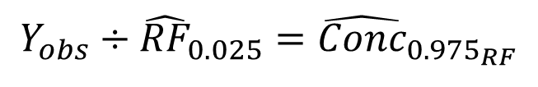
Substances Spiked in ENTACT Mixtures (n = 1269)
Inverse Prediction Using Calibration Curves (CC)
Correctly Identified Chemicals
(n = 530 [+]; 237 [-])
Subset with Repeat Measures
(n = 73 [+]; 10 [-])
Given Y_{obs}
$${\hat{Conc}}_{{0.975}_{CC}}$$
Inverse Prediction Using a Bounded Response Factor (RF)
Given Y_{obs}
$$Y_{obs}÷{\hat{RF}}_{0.025}={\hat{Conc}}_{{0.975}_{RF}}$$
Inverse Prediction Using Ionization Efficiency (IE) Estimation
Given Y_{obs} and Predicted IE
$$Y_{obs}÷{\hat{RF}}_{{0.025}_{IE}}={\hat{Conc}}_{{0.975}_{IE}}$$
Notes:
Figure 2.

Slide 3
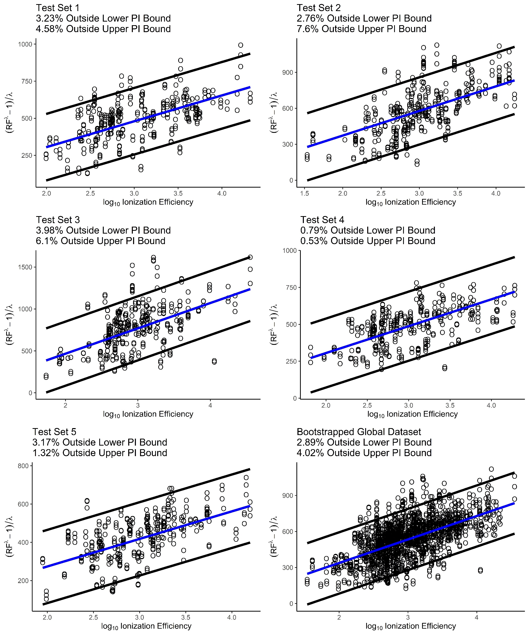
Notes:
Figure 3.

Slide 4
Notes:
Figure 4.

