Slide 1
CS3210 Tutorial 3
Memory Consistency and CUDA Programming
Notes:
Connect to xlog, cd lab3/
Connect to xlog, cd tut3/
CUDA occupancy calculator website

Slide 2
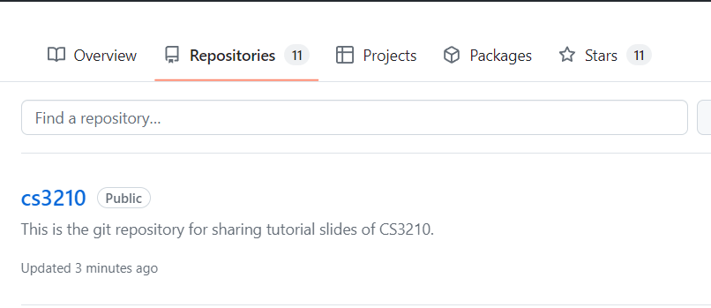
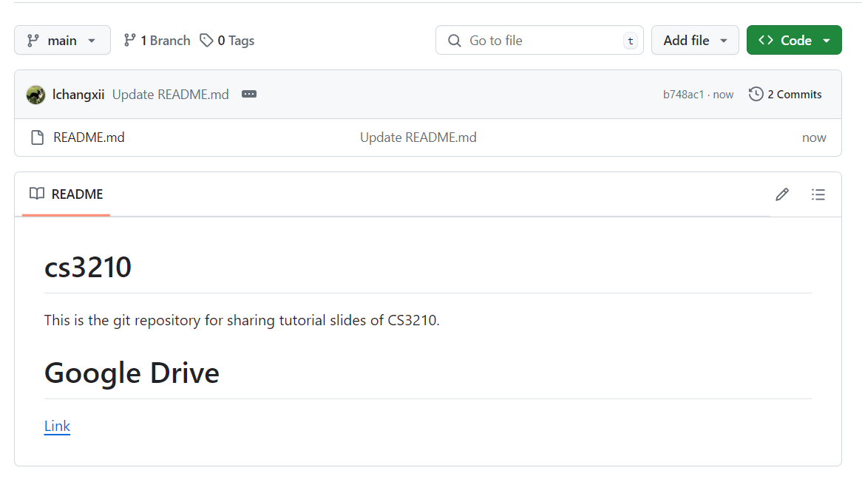
Questions and Slides Sharing
Slides
Github and Google Drive after every session.
https://github.com/lchangxii/cs3210
You can find the Link in the README if preferring Google Drive

Slide 3
Recap: Cache Coherence & Consistency

Slide 4
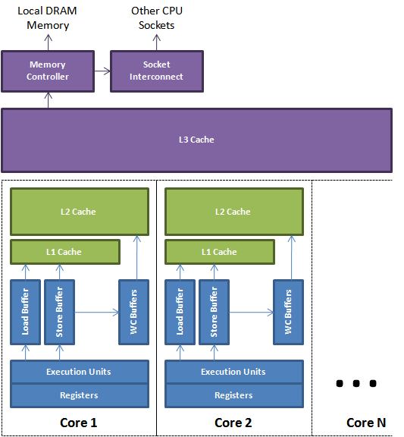
Coherence & Consistency
Complex behavior: 2 issues
Coherence: how cores agree on what is at a single memory location
Consistency: how cores agree on the order of memory operations to different memory locations

Slide 5
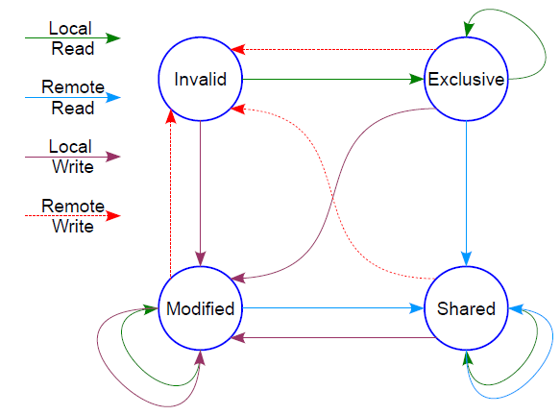
Coherence vs Consistency
Coherence
Core 1
Core 2
Core 3
X = 3
read X → r
X = r + 1
read X
t
Usually: hardware has a cache coherence protocol.
Guarantees:
Write Propagation: changes in one cache are propagated to the rest, eventually
Tx Serialization: everyone sees changes in the same order
How does hardware make sure Core 3 reads x = 4?
We always assume that coherence is preserved! Insanity, otherwise.

Slide 6
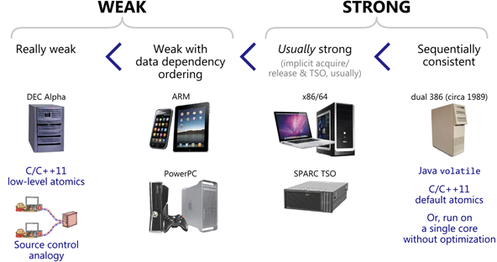
Coherence vs Consistency
Consistency
Core 1
Core 2
X = 3
print X
Y = 5
print Y
t
What guarantees does hardware give us about the result of these assembly instructions?
Each ISA (architecture) specifies exactly what we can expect!

Slide 7
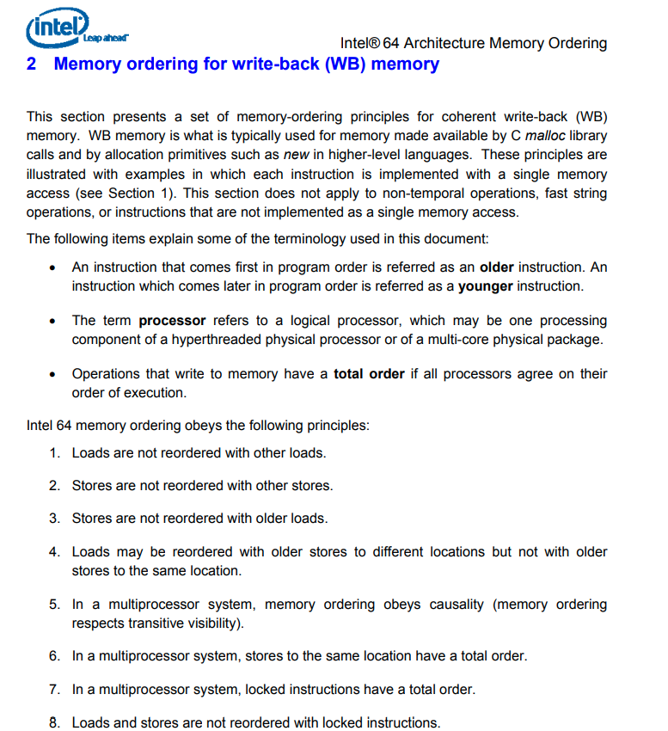
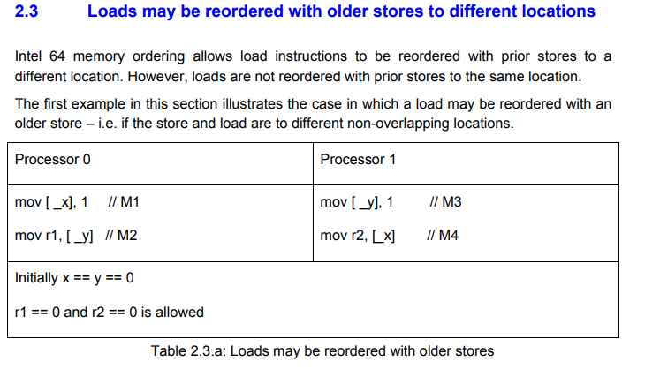
ISA specification of memory order
Note for (e.g.) CS3211: we are talking about hardware level ordering in CS3210!
i.e., what happens to assembly instructions, not high level languages like C++ with complex compilers
Notes:
https://www.cs.cmu.edu/~410-f10/doc/Intel_Reordering_318147.pdf

Slide 8
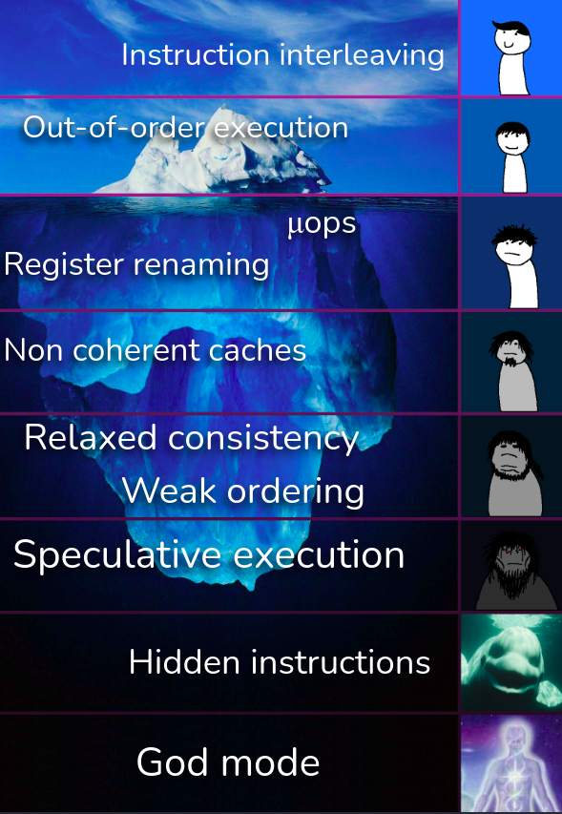
The Processor Black Magic Iceberg

Slide 9
Why does the hardware do these memory tricks?
Hardware-level stuff takes shortcuts to go fast while staying correct.
The best developers understand & exploit this to keep programs fast.

Slide 10
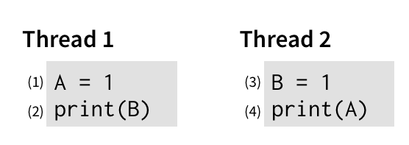
Why Relax our Memory Consistency?
Motivation: is sequential consistency the most sensible memory model?
Write: 2x slower than read
Write:
2x slower than read
Single Core’s view: why should “unrelated” writes prevent reads?
Ref: https://www.cs.utexas.edu/~bornholt/post/memory-models.html

Slide 11
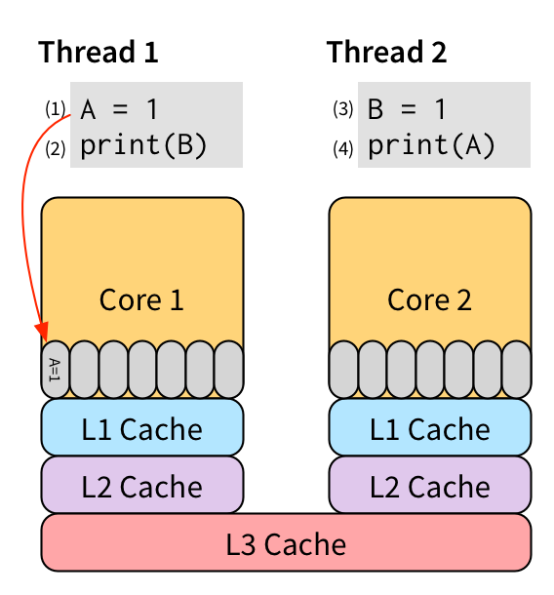
Implementation: Hardware store buffers
Relaxing W → R order
Put writes into a store buffer and let them execute later (when necessary)
Unrelated reads (no data dependencies) from the same processor can continue!
Ref: https://www.cs.utexas.edu/~bornholt/post/memory-models.html

Slide 12
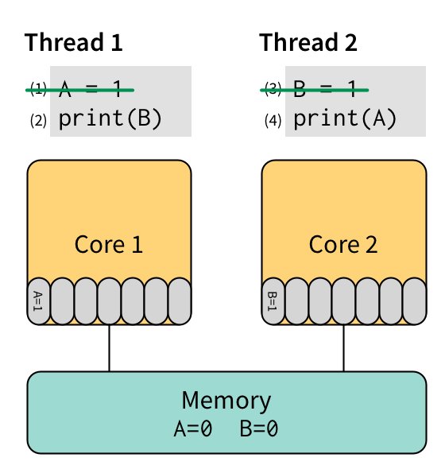
Considerations with W → R relaxation
Now print(A) and print(B) may print 0 even though they are “after” the write instructions
However, this might make your program much faster!
Ref: https://www.cs.utexas.edu/~bornholt/post/memory-models.html

Slide 13
Understanding Relaxation
E.g., if W(rite) → R(ead) relaxation
Find W before Rs (can be multiple Rs)
Must be simple W/R, not control instructions like while(...) etc
Check if there are data dependencies
R → W || W → W || W → R
If no dependencies, the W can go after any of the Rs
X = 5
print Y
print Z
Can
become
print Y
print Y
print Z
X = 5
X = 5
print Z

Slide 14
Understanding Relaxation: Not-Possible Case
E.g., if W → R relaxation
Find W before Rs (can be multiple Rs)
Must be simple W/R, not control instructions like while(...) etc
Check if there are data dependencies
R → W || W → W || W → R
If no dependencies, the W can go after any of the Rs
X = 5
print X
print Z

Slide 15
Understanding Relaxation: Not-Possible Case
E.g., if W → R relaxation
Find W before Rs (can be multiple Rs)
Must be simple W/R, not control instructions like while(...) etc
Check if there are data dependencies
R → W || W → W || W → R
If no dependencies, the W can go after any of the Rs
X = 5
while(Y == 0);
print Z

Slide 16
Memory Models in CS3210
Property | Sequential Consistency (SC) | Relaxed Consistency: Total Store Ordering (TSO) | Relaxed Consistency: Processor Consistency (PC) | Relaxed Consistency: Partial Store Ordering (PSO)
Respects data dependencies within the same core (e.g., don’t touch: x = 5, read x) | Yes
Preserves R → R and R → W order | Yes
Preserves W → R | Yes | No | No | No
Preserves W → W | Yes | Yes | Yes | No
All processors must be able to see same value before a read completes? (Write Atomicity) | Yes | Yes | No | Yes

Slide 17
Agenda
Tutorial: Memory Consistency
Tutorial: CUDA thought process

Slide 18
Question 1: Sequential Consistency

Slide 19
Question 1a: Sequential Consistency
P1
P2
P3
X = 1
while(Y==0);
Z = 2
Y = 1
while(Z==0);
X = 3
while(T==0);
T = X
while(T==0);
print A
A = X
print B
B = X
Initial question: given sequential consistency, what values are guaranteed to be the same at the end of all instructions? [p]

Slide 20
Question 1a: Sequential Consistency
P1
P2
P3
X = 1
while(Y==0);
Z = 2
Y = 1
while(Z==0);
X = 3
while(T==0);
T = X
while(T==0);
print A
A = X
print B
B = X
We can draw the write->read dependencies (thicker lines = while)

Slide 21
Question 1a: Sequential Consistency
P1
P2
P3
X = 1
while(Y==0);
Z = 2
Y = 1
while(Z==0);
X = 3
while(T==0);
T = X
while(T==0);
print A
A = X
print B
B = X
What values are guaranteed to be the same at the end?
Y = 1 must be true - no other writes to Y
Z = 2 must be true, no other writes to Z
The unknowns are: A, B, T, X

Slide 22
Question 1a: Sequential Consistency
P1
P2
P3
X = 1
while(Y==0);
Z = 2
Y = 1
while(Z==0);
X = 3
while(T==0);
T = X
while(T==0);
print A
A = X
print B
B = X
What values can A, B, T, X have after all operations have completed?
What matters: when does X = 3 happen wrt (T, A, B = X)?
How many unique output combinations are there? [p]

Slide 23
Question 1a: Sequential Consistency
P1
P2
P3
X = 1
{T, A, B} = 1
X = 3
X = 1 already done
{T, A, B} = 3
T = X
{T} = 1 {A, B} = 3
A = X
{T, A} = 1 {B} = 3
B = X
{T, A, B} = 1
What values can A, B, T, X have after all operations have completed?
The only relevant interleaving is (T,A,B = X) and (X = 3)
5 possible positions for X = 3 (note: X=3 can run before X=1)
X = 1 ⇒ {T, A, B} = 1 || {X, T, A, B} = 3 || X = 3, T = 1, {A, B} = 3 || X = 3, {T, A} = 1, B = 3 || X = 3, {T, A, B} = 1

Slide 24
Question 1b: Sequential Consistency
P1
P2
P3
X = 1
while(Y==0);
Z = 2
Y = 1
while(Z==0);
X = 3
while(T==0);
T = X
while(T==0);
print A
A = X
print B
B = X
How can we print A, B, as different values? [np]
X = 1 … ⇒ A = X ⇒ print A ⇒ X = 3 ⇒ B = X ⇒ print B

Slide 25
Question 1c: Sequential Consistency
P1
P2
P3
X = 1
while(Y==0);
Z = 2
Y = 1
while(Z==0);
X = 3
while(T==0);
T = X
while(T==0);
print A
A = X
print B
B = X
How can we change this to print the same value for A, B? [np]

Slide 26
Question 1c: Sequential Consistency
P1
P2
P3
X = 1
while(Y==0);
X = 3
Y = 1
while(Z==0);
Z = 2
while(T==0);
T = X
while(T==0);
print A
A = X
print B
B = X
How can we change this to print the same value for A, B? [np]
Swap Z = 2, X = 3 (X = 3 must happen before T, A, B sets to X)

Slide 27
Question 1c: Sequential Consistency
P1
P2
P3
X = 1
while(Y==0);
X = 3
Y = 1
while(Z==0);
Z = 2
while(T==0);
A = X
while(T==0);
print A
B = X
print B
T = X
How can we change this to print the same value for A, B? [np]
Swap Z = 2, X = 3 (X = 3 must happen before T, A, B setting)
Put T = X after setting A, B (set A, B first then release the prints)
Will print (A,B = 1) or (A,B = 3) ⇒ can you see why?

Slide 28
Question 1d: Fails under TSO/PC/PSO?
P1
P2
P3
X = 1
while(Y==0);
X = 3
Y = 1
while(Z==0);
Z = 2
while(T==0);
A = X
while(T==0);
print A
B = X
print B
T = X
Will we still print the same A, B under TSO/PC/PSO? [p]

Slide 29
Question 1d: Fails under TSO/PC/PSO?
P1
P2
P3
X = 1
while(Y==0);
X = 3
Y = 1
while(Z==0);
Z = 2
while(T==0);
A = X
while(T==0);
print A
B = X
print B
T = X
Will we still print the same A, B under TSO/PC/PSO?
TSO: Relax W → R on same processor if no data dependencies
Still OK: there are no W -> R instructions to reorder here!
Control/cmp instructions don’t count here

Slide 30
Question 1d: Fails under TSO/PC/PSO?
P1
P2
P3
X = 1
while(Y==0);
X = 3
Y = 1
while(Z==0);
Z = 2
while(T==0);
A = X
while(T==0);
print A
B = X
print B
T = X
Will we still print the same A, B under TSO/PC/PSO?
PC: Relax W → R on same processor, processors see writes at diff times
Still OK: there are no W -> R instructions to reorder here!
Control/cmp instructions don’t count here

Slide 31
Question 1d: Fails under TSO/PC/PSO?
P1
P2
P3
X = 1
while(Y==0);
X = 3
Y = 1
while(Z==0);
Z = 2
while(T==0);
A = X
while(T==0);
print A
B = X
print B
T = X
Will we still print the same A, B under TSO/PC/PSO?
PSO: Relax W → R, W->W on same processor if no dependencies
Fails! PSO can reorder this code back to our original code
Remember: we only swapped write orders (e.g., X=3, Z=2)

Slide 32
Question 2: Relaxed Consistency

Slide 33
Q2: Relaxed Consistency
P1
P2
P3
X = 5
while(X==0);
while(Y==0);
Y = 2
Y = 6
Z = 5
print Y
print Z
print X
We observed prints of X = 5, Y = 2, Z = 0
Under which relaxed consistency models is this valid? [p]

Slide 34
Q2: Relaxed Consistency
P1
P2
P3
X = 5
while(X==0);
while(Y==0);
Y = 2
Y = 6
Z = 5
print Y
print Z
print X
We observed prints of X = 5, Y = 2, Z = 0
Under which relaxed consistency models is this valid? [p]
Tactic: try from most strict model first: sequential consistency
Totally possible: P1 runs entirely, then P2, then P3
Therefore if possible under SC, possible under all others!

Slide 35
Q2: Relaxed Consistency
P1
P2
P3
X = 5
while(X==0);
while(Y==0);
Y = 2
Y = 6
Z = 5
print Y
print Z
print X
We observed prints of X = 0, Y = 2, Z = 5
Under which relaxed consistency models is this valid? [p]

Slide 36
Q2: Relaxed Consistency
P1
P2
P3
X = 5
while(X==0);
while(Y==0);
Y = 2
Y = 6
Z = 5
print Y
print Z
print X
We observed prints of X = 0, Y = 2, Z = 5
Under which relaxed consistency models is this valid? [p]
Idea: try to find invariants that must be broken.
print X = 0 ⇒ while(Y == 0) triggered ⇒ Y != 0
Contradiction! Y != 0 ⇒ X != 0 if SC
So this cannot be sequential consistency or TSO
Not TSO: this is not explained by W → R swapping

Slide 37
Q2: Relaxed Consistency
P1
P2
P3
X = 5
while(X==0);
while(Y==0);
Y = 2
Y = 6
Z = 5
print Y
print Z
print X
We observed prints of X = 0, Y = 2, Z = 5
What about PC?
Can: X = 5 reaches P2 but not P3 yet (no write atomicity)
What about PSO?
Can: W ← → W was swapped (Y = 2 before X = 5)

Slide 38

Why does this matter?
Most other courses (e.g. CS2106) assume sequential consistency for multithreaded programs.
In reality, most architectures (ARM, X86/64 included) do not implement sequential consistency.
If you don't know about consistency models, low-level code might have issues/be slow & you don't know why.
If you do know about consistency models, your code can be super-fast and correct.

Slide 39
Question 3: Matrix-Vector Mul on GPU (Finals)

Slide 40
Q3: Matrix-Vector Mul on GPU (Finals)
Is the CUDA memory model shared/distributed/both? [p]

Slide 41
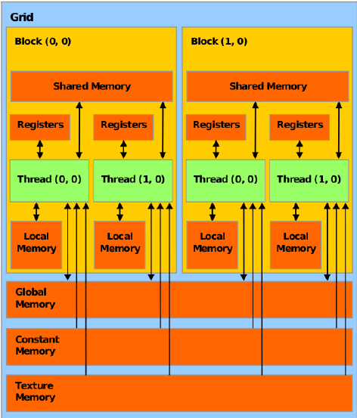
Q3: Matrix-Vector Mul on GPU (Finals)
Is the CUDA memory model shared/distributed/both? [p]
Both: distributed+shared
“shared memory” is private to the block and must be explicitly
copied
Also: host vs device memory

Slide 42
Q3: Matrix-Vector Mul on GPU (Finals)
A kernel uses 64 registers
Each block uses 512 threads
GPU device has 1024x64 registers total, Compute Capability 6.x
GPU has only 1 SM (Streaming Multiprocessor)
How many resident blocks / warps on the SM? [p]

Slide 43
Q3: Matrix-Vector Mul on GPU (Finals)
A kernel uses 64 registers
Each block uses 512 threads
GPU device has 1024x64 registers total, Compute Capability 6.x
GPU has only 1 SM
How many resident blocks / warps on the SM?
# of registers required per block:
(512 threads) x (64 registers for each thread to run)
Total number of resident blocks:
(1024x64) total no. of registers in SM / (512x64) registers per block
2 blocks
2 blocks x (512 / 32 warps per block) = 32 warps

Slide 44
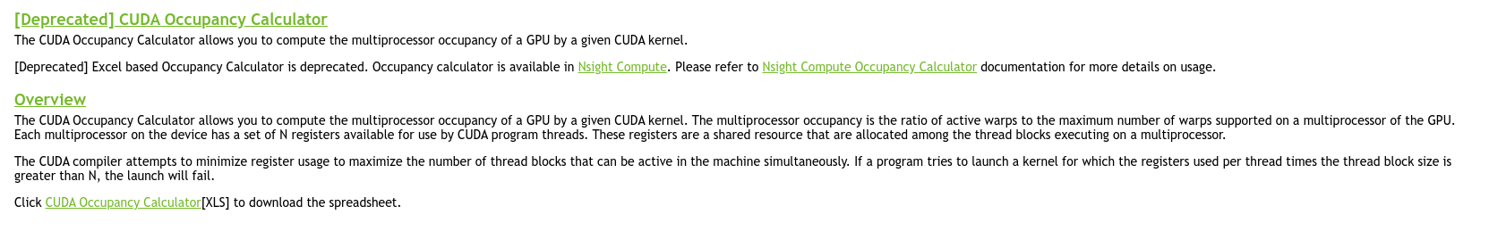
Real World: CUDA Occupancy Calculator
Excel version is deprecated (NVIDIA wants you to use their Nsight Compute program), but still useful to see!
Using an online version for ease: https://xmartlabs.github.io/cuda-calculator/
Compute Capability 6.x
64 registers per thread
512 threads per block
Notes:
https://xmartlabs.github.io/cuda-calculator/

Slide 45
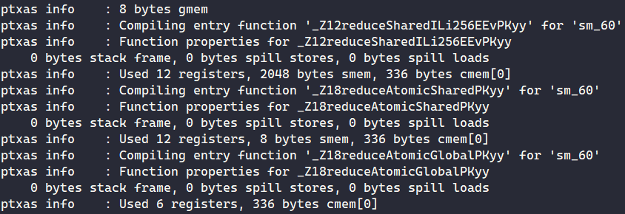
But how do we know about register/shared mem usage?
nvcc --ptxas-options=-v <Your Code>.cu
We can see
#register user per kernel
shared memory (smem) use per kernel
constant memory (cmem) use per kernel
Now we can put that info into the Occupancy Calculator!
Just take note Occupancy is not the only thing that matters for performance (more on that later).

Slide 46
Q3: Matrix-Vector Mul on GPU (Finals)
Implementing matrix-vector multiplication
Really a lot of ways to do this!

Slide 47
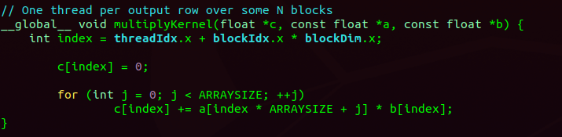
Q3: Matrix-Vector Mul on GPU (Finals)
Most simple version
Each CUDA thread handles 1 row of the output matrix c
All threads read from global memory (matrix a, vector b)
and write back to global memory (vector c)
./matrix-vector-mul-simple
Any suggestions for improvement?
Notes:
srun -G titanrtx /usr/local/cuda/bin/nvcc -o matrix-vector-mul-simple --std=c++17 -arch sm_70 ./matrix-vector-mul.cu

Slide 48
Q3: Matrix-Vector Mul on GPU (Finals)
Most simple version
Each CUDA thread handles 1 row of the output matrix c
All threads read from global memory (matrix a, vector b)
and write back to global memory (vector c)
Any suggestions for improvement?
Answer is always: understand problem size, profile first, then see: nvprof ./matrix-vector-mul-simple

Slide 49
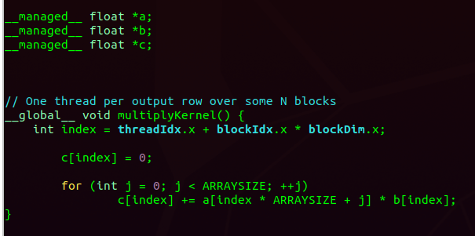
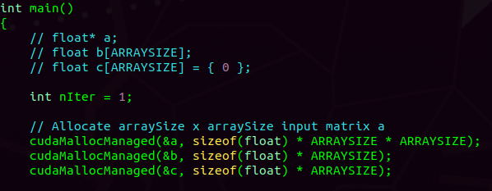
Q3: Matrix-Vector Mul on GPU (Finals)
Could try to cudaMallocManaged and let CUDA figure out how/when to copy the matrices?
nvprof ./matrix-vector-mul-managed
Interesting! Sometimes letting CUDA bring the pages of memory into the GPU on-demand can be better (overlap computation and memory)
Notes:
srun -G titanrtx /usr/local/cuda/bin/nvcc -o matrix-vector-mul-managed --std=c++17 -arch sm_70 ./matrix-vector-mul-managed.cu

Slide 50
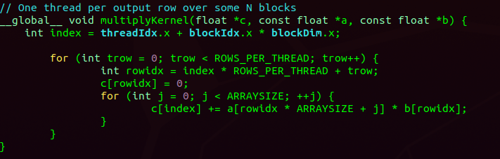
Q3: Matrix-Vector Mul on GPU (Finals)
What if one thread handles multiple rows? (e.g., 32 per thread)
nvprof ./matrix-vector-mul-multirow
Bad idea… spending a lot of time multiplying
Notes:
srun -G titanrtx /usr/local/cuda/bin/nvcc -o matrix-vector-mul-multirow --std=c++17 -arch sm_70 ./matrix-vector-mul-multirow.cu

Slide 51
What if the data is too large to fit into shared memory?
Any ideas?
We can split the multiplication into multiple iterations (multiple calls to the kernel)
Each call to the kernel copies a subset of the data to shared memory
Note: this is really what happens in AI stuff on the GPU - many datasets cannot fit into GPU memory!

Slide 52
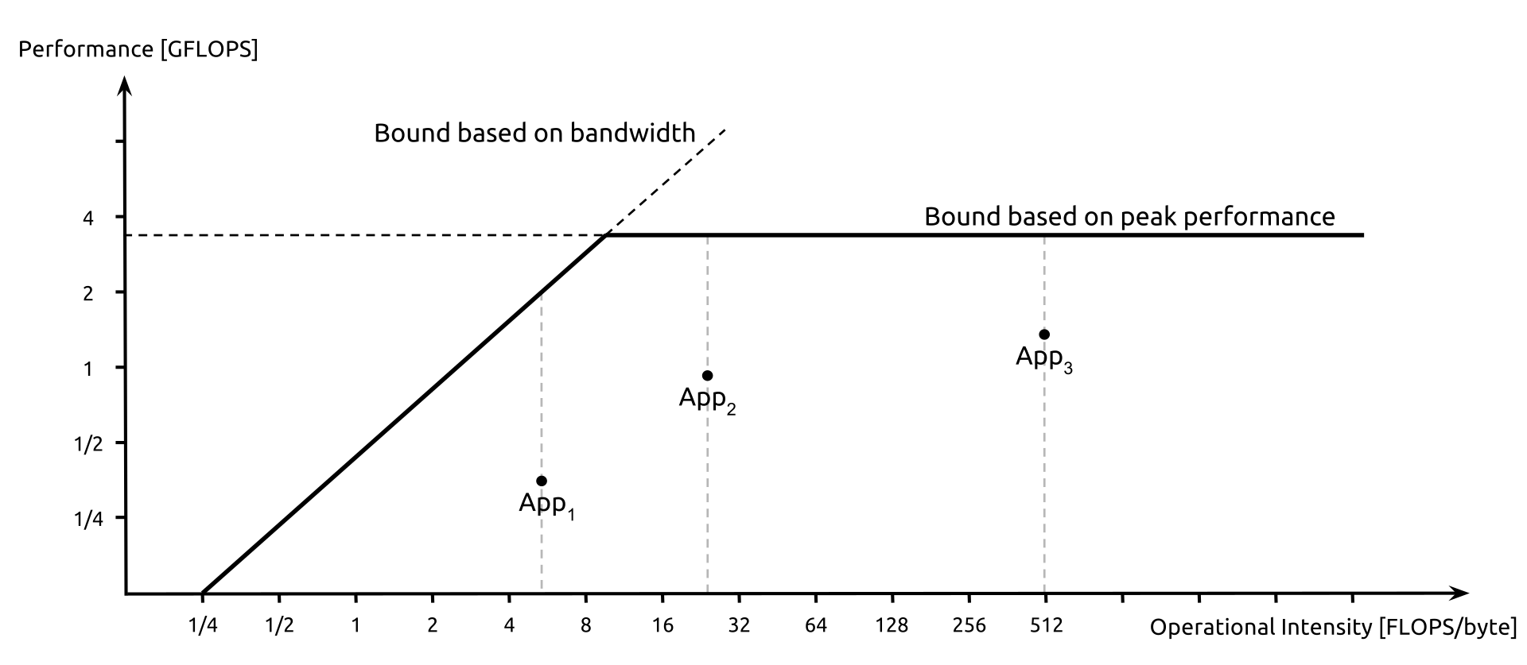
Optional: Is it a good implementation?
Roofline model to see if achieving memory bandwidth bottleneck or GFLOPS bottleneck
Source: [1]
[1]. https://en.wikipedia.org/wiki/Roofline_model

Slide 53
Optional: How to fastly using GPU to accelerate your applications?
Use NVIDIA library
// cuBLAS call for matrix-vector multiplication (SGEMV for single-precision) cublasSgemv(handle, CUBLAS_OP_N, M, N, &alpha, d_A, M, d_x, 1, &beta, d_y, 1);
Source: [1]
[1]. https://docs.nvidia.com/cuda/cublas/

Slide 54

Attendance
link

