Slide 1
CS3210 Tutorial 2
Programming Models and Performance of Parallel Systems
Slides inspired from Sriram
Notes:
cd lab2/
vim mm-omp.cpp
cd t2/
https://www.agner.org/optimize/instruction_tables.pdf

Slide 2
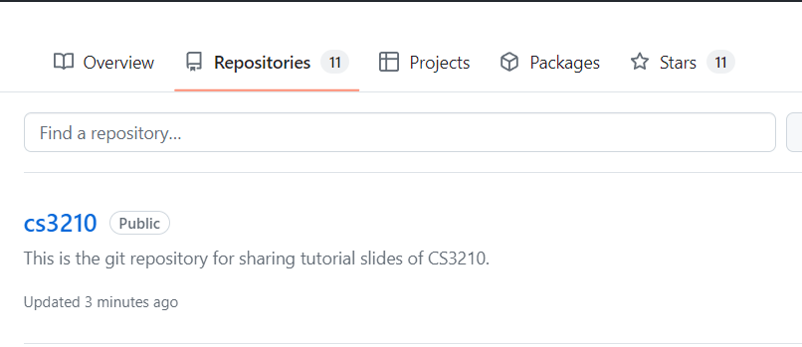
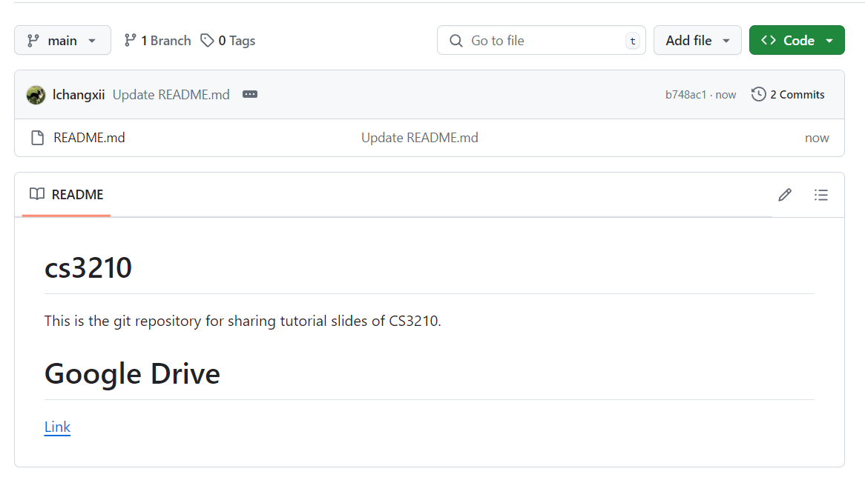
Questions and Slides Sharing
Slides
Github and Google Drive after every session.
https://github.com/lchangxii/cs3210
You can find the Link in the README if preferring Google Drive

Slide 3
Question 1: Task Parallelism

Slide 4
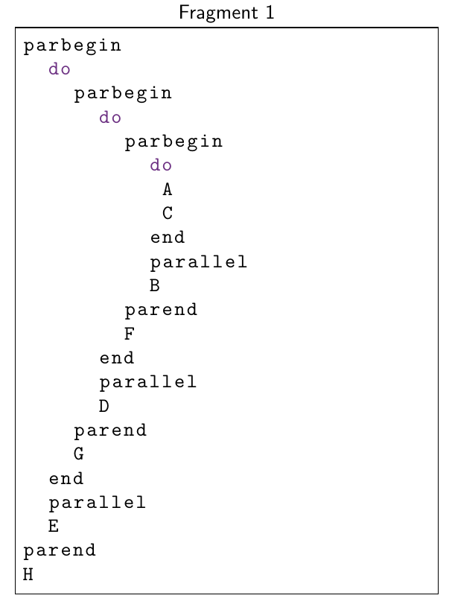
Question 1 (a): Task Dependence Graphs
Rules
X Y → X and Y are sequentially executed
Y depends on X
X
parallel Y → X and Y are executed in parallel
X and Y are independent
parend
→ all tasks must complete before moving on

Slide 5
Question 1 (a): Task Dependence Graphs
Let’s find the dependencies!
A
C
B
F
D
E
G
H

Slide 6
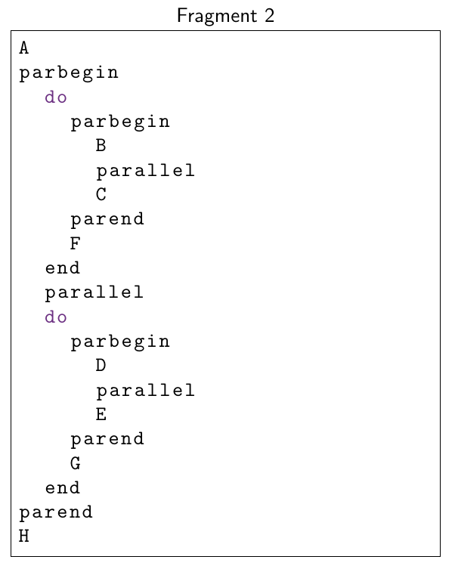
Question 1 (a): Task Dependence Graphs
Fragment 2 Dependencies:
A
B
C
D
E
F
G
H

Slide 7
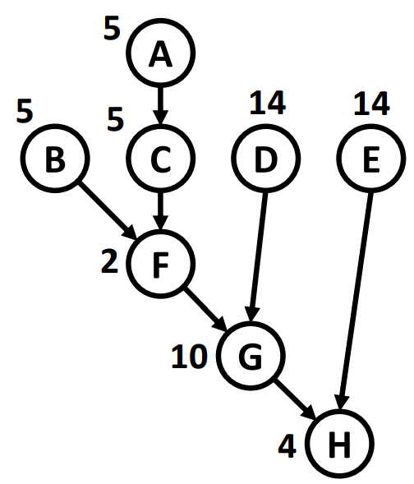
Q1 (b): Amount of Concurrency
Plot the concurrency for Fragment 1

Slide 8
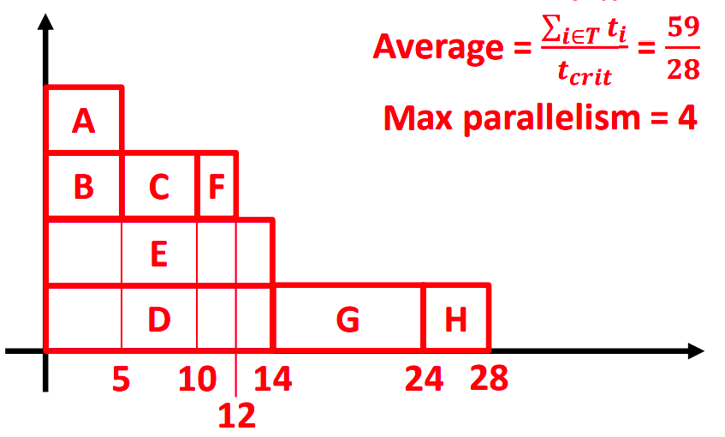
Q1 (b): Amount of Concurrency
Plot the concurrency for Fragment 1
Can you determine the critical path length? i.e. Minimum execution time given sufficient processes for max parallelism
Can you then determine the average concurrency?

Slide 9
Q1 (b): Amount of Concurrency
Critical path length? 28
Average Concurrency? → Sum of work / Critical path length = 59/28 = 2.10
Max Concurrency? 4
28

Slide 10
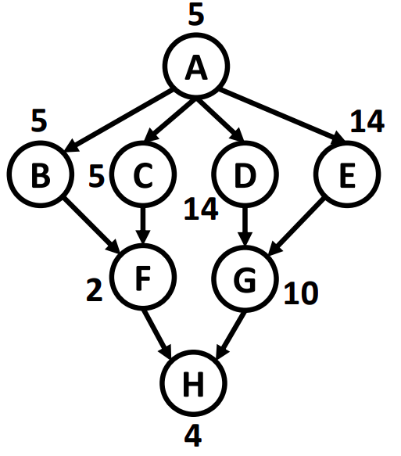
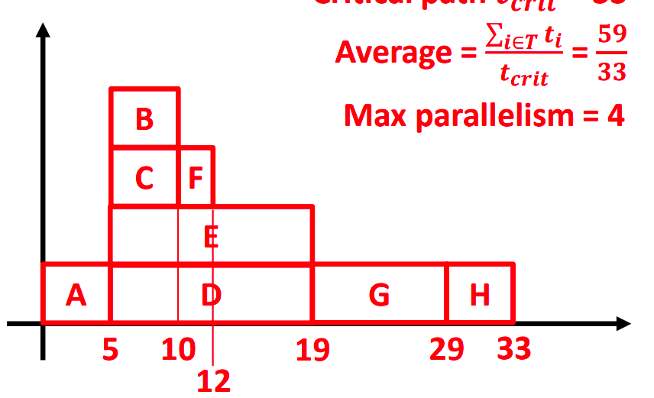
Q1 (b): Amount of Concurrency
Critical path length?
Average Concurrency?
Max Concurrency?

Slide 11
Q1 (b): Amount of Concurrency
Critical path length? 33
Average Concurrency? → Sum of work / Critical path length = 59/33 = 1.78
Max Concurrency? 4

Slide 12
Q1 (c): Speedup
What is the speedup of this program given infinite resources?

Slide 13
Q1 (c): Speedup
What is the speedup of this program given infinite resources?
Sequential implementation = 59 units
Parallel: finishes in 28 time units
Length of the critical path!!
Speedup = 59/28 = 2.10
(== avg deg of concurrency)

Slide 14
Q1 (c): Speedup
What is the speedup of this program given infinite resources?
Sequential implementation = 59 units
Parallel: finishes in 33 time units
Length of the critical path!!
Speedup is 59/33 = 1.78 == its avg deg of concurrency

Slide 15
Q1 (d): Speedup
What if we have only 2 processing units? What is the speedup?

Slide 16
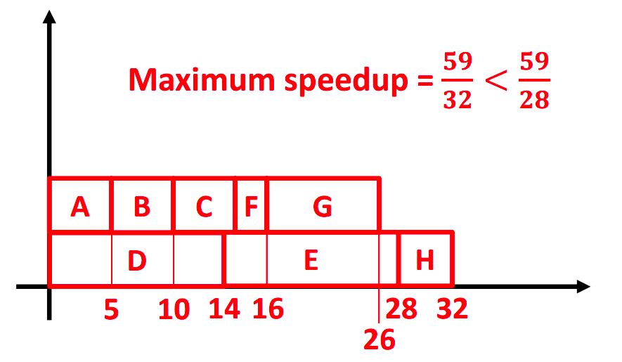
Q1 (d): Speedup
What if we have only 2 processing units? What is the speedup?
Have to draw it out, no easy solution
(Identical-machines scheduling problem)

Slide 17
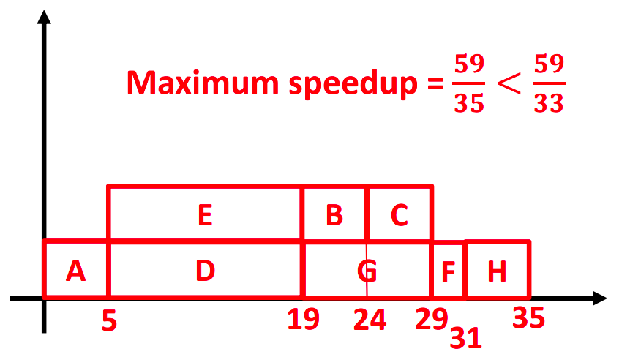
Q1 (d): Speedup
What if we have only 2 processing units? What is the speedup?
Have to draw it out, no easy solution

Slide 18
Why does this question matter?
Helping you to understand how to design your own parallel programs!
Your program is only as strong as its weakest link!
Parallel tasks should be as independent as possible
They should have the shortest critical path possible (dependency chain should be minimized)

Slide 19
Question 2: User CPU Time

Slide 20
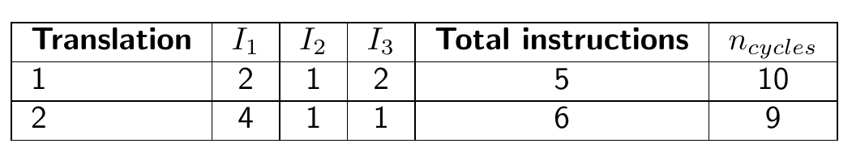
Question 2: Cycles Per Instruction
Cycles per instruction (CPI) for each instr: I₁ = 1, I₂ = 2, I₃ = 3
What is the average CPI for the translation of both programs?

Slide 21
Question 2: Cycles Per Instruction
Cycles per instruction (CPI) for each instr: I₁ = 1, I₂ = 2, I₃ = 3
What is the average CPI for the translation of both programs?
number of cycles / number of instructions
1st program: 10 / 5 = 2.0 (10 = 2*1 + 1*2 + 2*3)
2nd program: 9 / 6 = 1.5

Slide 22
Why does this question matter?
Not all instructions are created equal!
i.e., number of instructions is not a good comparative metric for time taken
Notes:
Gcc -O0 -fno-tree-vectorize -mno-sse -mno-avx
For intmul and floatmul
Look at the massive difference!
See the XMM registers and SSE/AVX used automatically

Slide 23

Information of the Instructions
https://www.agner.org/optimize/instruction_tables.pdf

Slide 24
Question 3: MIPS

Slide 25
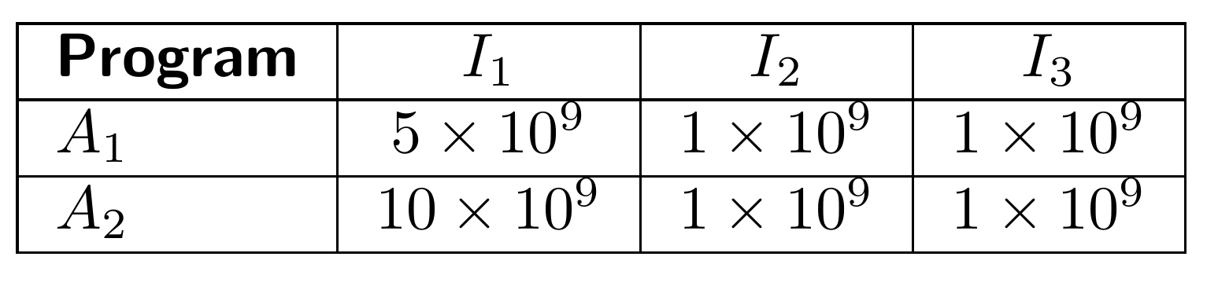
Question 3: MIPS
Cycles per instructions (CPI) for each instr: I₁ = 1, I₂ = 2, I₃ = 3
2 GHz (2 x 10⁹) clock rate
Different composition of instructions in each program

Slide 26
Question 3: MIPS
Cycles per instructions (CPI) for each instr: I₁ = 1 | I₂ = 2 | I₃ = 3
2 GHz (2 x 10⁹) clock rate
How long does each program take?
Time for A₁ = (Cycles / Clock speed) = (5 + (1 x 2) + (1 x 3)) x 10⁹ / (2 x 10⁹) = 5s
Time for A₂ = (Cycles / Clock speed) = (10 + (1 x 2) + (1 x 3)) x 10⁹ / (2 x 10⁹) = 7.5s
What is the MIPS for each program?
MIPS for A₁ = (MillionInstrs / Time) = ((5 + 1 + 1) x 10⁹ / 10⁶) / 5 = 1400 MIPS
MIPS for A₂ = (MillionInstrs / Time) = ((10 + 1 + 1) x 10⁹ / 10⁶) / 7.5 = 1600 MIPS
What can we conclude?

Slide 27
“MIPS is like a real estate agent determining how much a building is worth by measuring the weight of a rubber chicken.” (Brendan, StackOverflow)

Slide 28
Question 4: Speedup

Slide 29

Question 4: Speedup
For these questions: we could use the laws directly
But in this tutorial: let’s understand what we’re doing from first principles!
Each instruction takes 2 cycles on a 1 GHz processor

Slide 30
Question 4: Speedup
For N = 100, what is the speedup for 10 and 100 processors?
Total number of cycles if no parallelism: (N + N²) x 2 cycles/instr. = (100 + 100²) x 2
Each instruction takes 2 cycles on a 1 GHz (10⁹ Hz) processor

Slide 31
Question 4: Speedup
For N = 100, what is the speedup for 10 and 100 processors?
Strategy (using basic logic): find sequential time, find parallel times
Sequential time: ((100 + 100²) x 2) / 10⁹ = 20200 ns
Sequential instructions time + parallel instructions time (non-sped-up)
Par time (p=10): ((100 + 100²/10) x 2) / 10⁹ = 2200 ns (9.18x speedup)
Par time (p=100): ((100 + 100²/100) x 2) / 10⁹ = 400 ns (50.6x speedup)
If we have infinite resources, the parallel section can be approximated to 0 instructions running serially
Par time (p=∞): ((100 + 0) x 2) / 10⁹ = 200 ns (101x speedup)
Each instruction takes 2 cycles on a 1 GHz processor

Slide 32
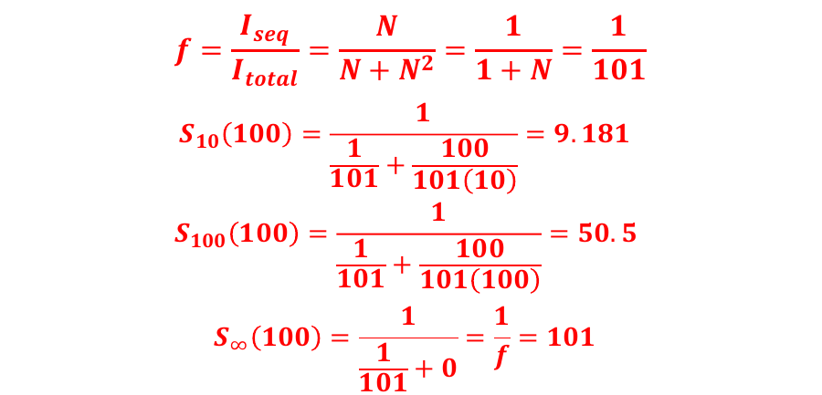
Question 4: Speedup
Note: this identical from direct application of Amhdal’s law, but the basics are simpler to understand for now!
Recap:
f = ratio of sequential execution time to total execution time
S₁₀ = Speedup achievable with 10 processors
Each instruction takes 2 cycles on a 1 GHz processor

Slide 33
Question 4: Speedup
Fixed time: N that can be solved with 10/100 processors?
Sequential time (p=1): ((100 + 100²) x 2) / 10⁹ = 20200 ns
For 10 processors, find N:
((N + N²/10) x 2) / 10⁹ = 20200 ns ⇒ N = 312
“Gustafson speedup”: (Sequential time for N = 312 / Parallel time for N = 312)
For 100 processors, find N:
((N + N²/100) x 2) / 10⁹ = 20200 ns, ⇒ N = 956
Each instruction takes 2 cycles on a 1 GHz processor

Slide 34
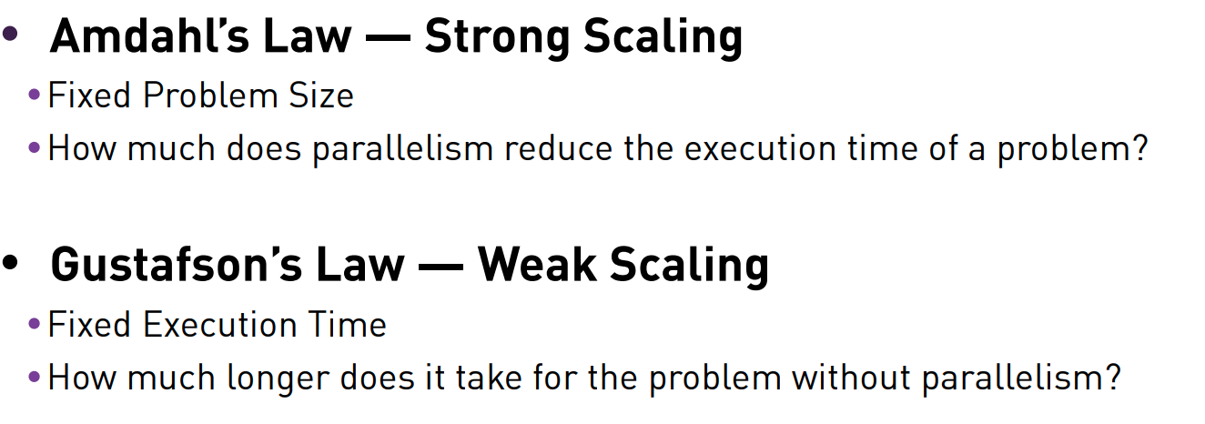
Why does this question matter?
If you have a fixed-sized problem to solve OR you have a constant sequential fraction with increasing problem size
Amdahl’s law applies: speedup limited by the sequential fraction
If you have a problem size that can be varied AND your sequential fraction does not scale as much with the problem
Gustafson’s law applies: you can solve larger problems with more speedup!

Slide 35
Question 5: Parallel Programming Models

Slide 36
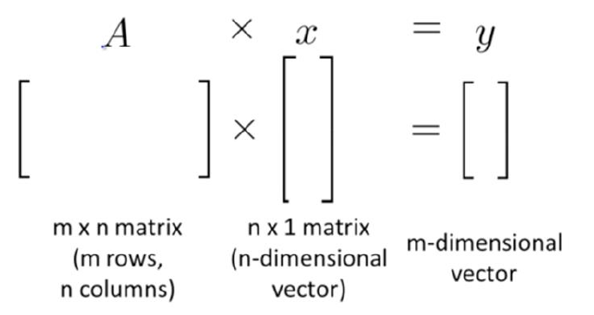
Question 5: Parallel Programming Models
Data or task parallelism? [p]

Slide 37
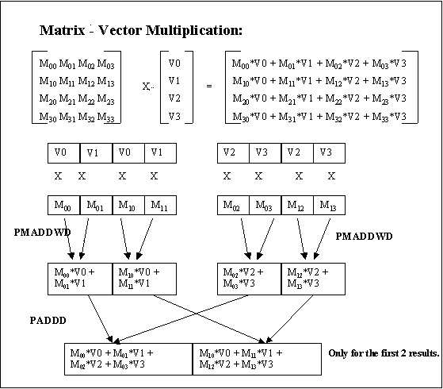
Question 5: Parallel Programming Models
Data parallelism
We want to use SIMD (Flynn’s Taxonomy) for this!
Yes, MIMD is superset of SIMD
Teaching point here is the idea of SIMD instructions
Notes:
https://stackoverflow.com/questions/31076430/vec4-x-mat4x4-product-using-simd-and-improvements

Slide 38
Question 5: Parallel Programming Models
What kind of parallel programming pattern (disregarding SIMD) would be best for this? [p]
Notes:
https://stackoverflow.com/questions/31076430/vec4-x-mat4x4-product-using-simd-and-improvements

Slide 39
Question 5: Parallel Programming Models
What kind of parallel programming pattern would be best for this? [p]
Fork-join / Parbegin-parend
We don’t need the complexity of fork-join - leads to very spaghetti code
Parbegin/end is arguable since that is literally OpenMP
Master-worker
Best here: we want relatively simple and homogeneous (same amount of work) worker threads, and a master thread to organize them
Task pool
Not as good as master-worker here: tasks are usually for heterogenous tasks or those that finish at very different times
Pipelining: better for task parallelism, this is data parallel, single task type
Producer-consumer: does not fit into this model as nothing is “produced”
Notes:
https://stackoverflow.com/questions/31076430/vec4-x-mat4x4-product-using-simd-and-improvements

Slide 40
Why does this question matter?
Thinking of the right pattern allows you to use the right tools
Non-data-parallel-like problems: don’t use GPU computation
Parbegin/end: good for OpenMP
Many more!

Slide 41
Question 6: 2020 Midterms Q1

Slide 42

Question 6: 2020 Midterms Q1
You are parallelizing a backend web server
It runs on a shared memory machine
Discuss about
task vs data parallelism
what pattern to use
Request for each client run in this order
read
socket
process
write

Slide 43
Question 6: 2020 Midterms Q1
What kind of parallelism? [Task/Data parallelism]
read
socket
process
write
Assume that read/write/process time is all very similar

Slide 44
Question 6: 2020 Midterms Q1
What kind of parallelism?
Task parallelism: each stage is a task
Data parallelism may be accepted if request = task AND requests assumed to arrive at same time
What pattern to use?
read
socket
process
write
Assume that read/write/process time is all very similar

Slide 45
Question 6: 2020 Midterms Q1
What kind of parallelism?
Task parallelism: each stage is a task
Data parallelism may be accepted if request = task AND requests assumed to arrive at same time
What pattern to use?
Best: pipelining - best in cases where each stage takes similar time
read
socket
process
write
Assume that read/write/process time is all very similar

Slide 46
Question 6: 2020 Midterms Q1
What kind of parallelism?
read
socket
process
write
Assume that read/write >> compute time

Slide 47
Question 6: 2020 Midterms Q1
What kind of parallelism?
Task parallelism: each stage is a task
What pattern to use?
Producer-consumer: producer reads from socket and processes, consumer writes back to the socket, #producers == #consumers
No pipelining: the stages are uneven!
read
socket
process
write
Assume that read/write >> compute time

Slide 48
Question 6: 2020 Midterms Q1
Similar to previous part: except for producer/consumer, we need more producers than consumers
read
socket
process
write
Assume that compute time >> read/write

Slide 49
Question 6: 2020 Midterms Q1
Assume task parallelism
What pattern do we use?
Task pool is perfect here: pool of tasks are ready for jobs and are assigned as necessary
If distributed memory: same answers, but need explicit communication.
rEaD
socket
proCesS
wRiTe
What if we don’t know how long anything takes? Or heavily varies?

Slide 50
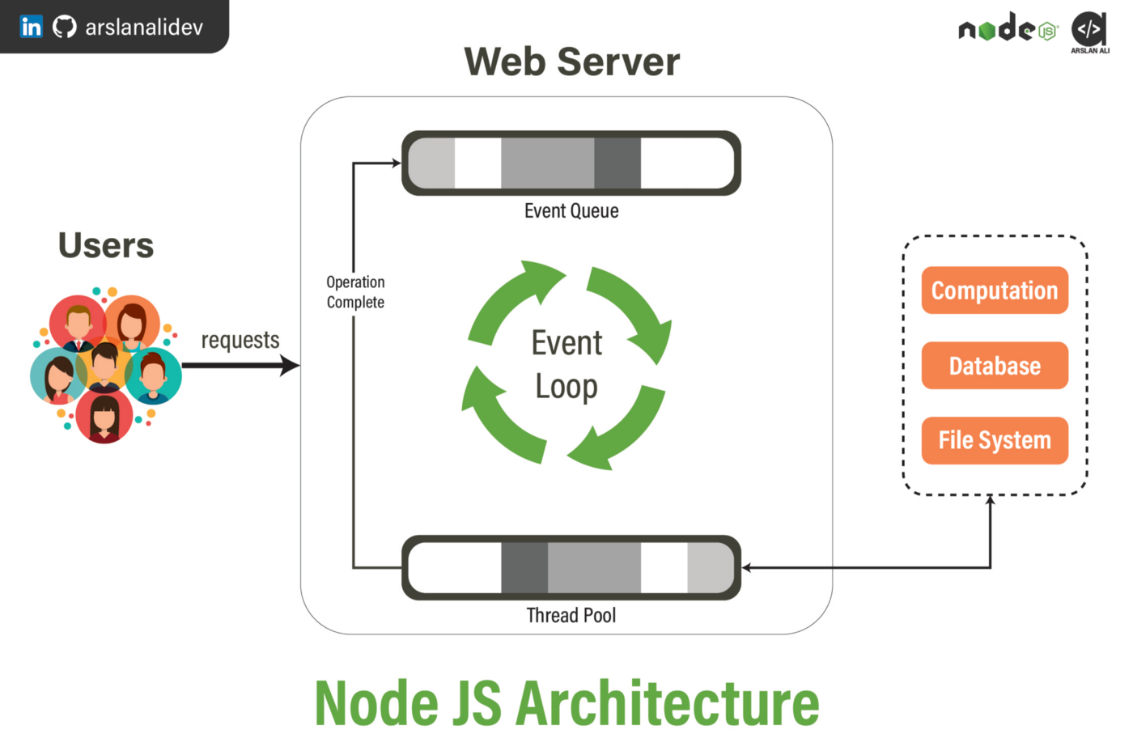
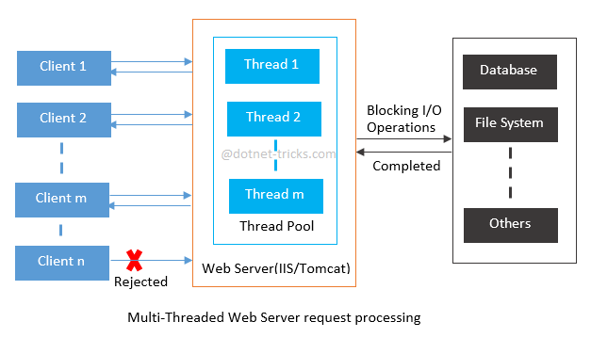
Why does this question matter?
Affects your entire system architecture and downstream programming patterns!

Slide 51

Attendance
link

Slide 52
Thanks
Email: changxi_liu@nus.edu.sg

