Slide 1
CS3210 Tutorial 4
Quiz 1/2 Review + GPU tidbits

Slide 2

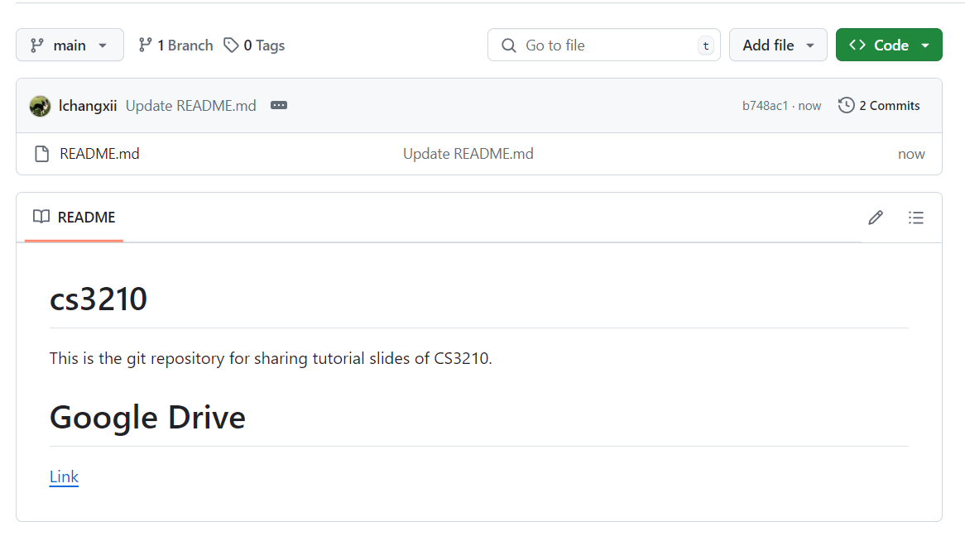
Questions and Slides Sharing
Slides
Github and Google Drive after every session.
https://github.com/lchangxii/cs3210
You can find the Link in the README if preferring Google Drive

Slide 3
Quiz 1

Slide 4
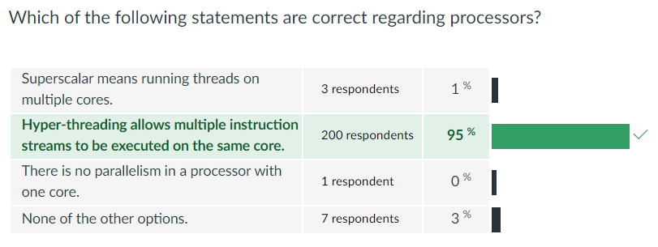

Slide 5
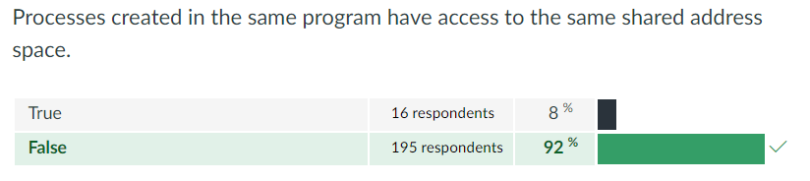

Slide 6
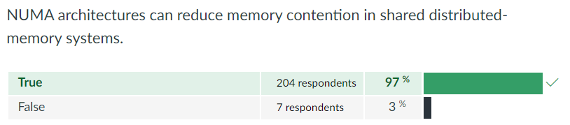

Slide 7
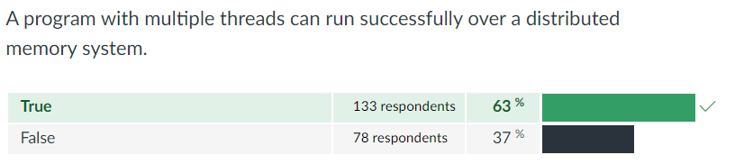

Slide 8
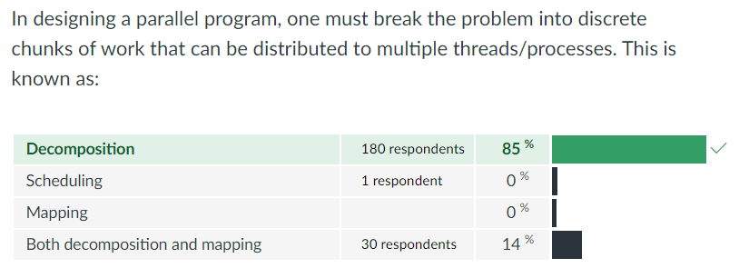

Slide 9
Quiz 2

Slide 10
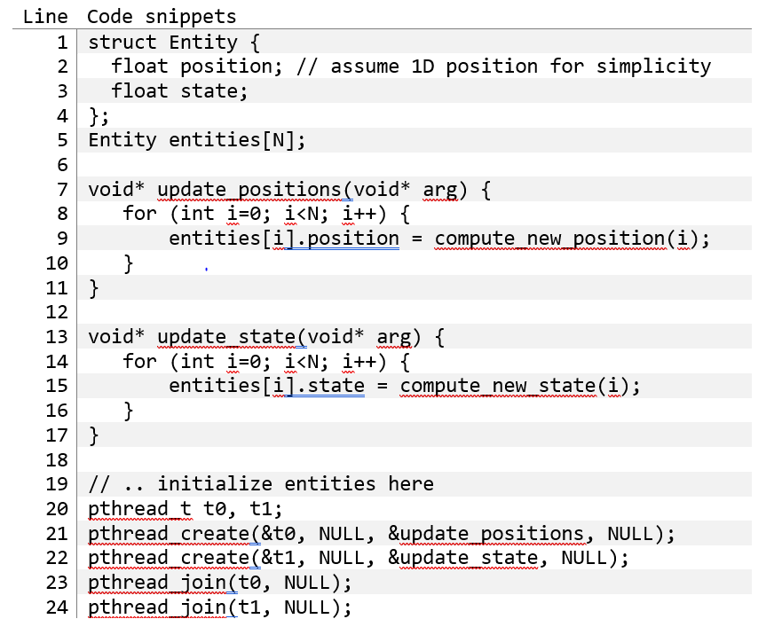
Quiz 2
Understanding the problem
Two threads, both updating values within an array of structs
One changes the position variable, one changes the state variable, for each struct

Slide 11
Quiz 2
Why don’t we get 2x speedup?
Classic false sharing
Both threads (if running at the same rate) are writing to the same entity
That’s OK, but position and state are part of the same cache line!!

Slide 12
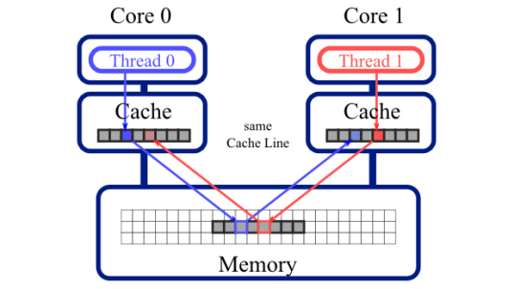
False Sharing
Two cores update different data that happens to be part of the same cache line!
Due to cache coherence, the data must be written back to memory and written to the other core’s cache, even if not strictly needed!
Notes:
https://haryachyy.wordpress.com/2018/06/19/learning-dpdk-avoid-false-sharing/

Slide 13
Quiz 2
How to solve (at least 3 ideas)?
Have two separate arrays:
float position[N]
float state[N]

Slide 14
Quiz 2
How to solve (at least 3 ideas)?
Have two separate arrays:
float position[N]
float state[N]
Have padding between position and state to put them in diff cache lines
E.g., add a field like char pad[PAD_BYTES]
One loop iterates from 0 -> N and the other goes from say, 100 -> wraparound -> 0

Slide 15
Quiz 2
How to solve (at least 3 ideas)?
Have two separate arrays:
float position[N]
float state[N]
Have padding between position and state to put them in diff cache lines
E.g., add a field like char pad[PAD_BYTES]
One loop iterates from 0 -> N and the other goes from say, 100 -> wraparound -> 0

Slide 16
Additional question 1
Relaxed consistency models address the concern that software complexity is increased by the need for unnecessary synchronization.

Slide 17
Additional question 1
Relaxed consistency models address the concern that software complexity is increased by the need for unnecessary synchronization.
False: relaxed consistency does not address software complexity
It’s a way to increase performance

Slide 18
Additional question 2
Cache coherence is the property that multiple caches contain the same set of items. Is this statement true or false?

Slide 19
Additional question 2
Cache coherence is the property that multiple caches contain the same set of items. Is this statement true or false?
False: Caches do not have to contain the same set of items
We just need to make sure that the specific cache lines that is being accessed by multiple processors is in sync

Slide 20
Matrix Multiplication in OpenMP and CUDA
We discussed the matrix multiplication problem in many contexts in this course.
Assume you are required to implement two programs, one in OpenMP and another one is CUDA that do matrix multiplication for two large square matrices. The matrices are stored in two files and they do not fit in memory (i.e. both the host memory and the device memory are unable to store the entirety of a single matrix). The result is computed and stored in a file.
Assume that the computers (machines) used for all questions below have similar performance to the computers you used to do your assignments.

Slide 21
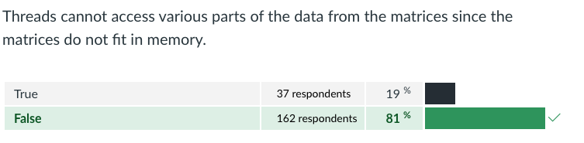
If you try to run a classic matrix multiplication implementation in OpenMP (like the one we used in Lab 2), you will experience some issues. Are the following statements true or false?

Slide 22
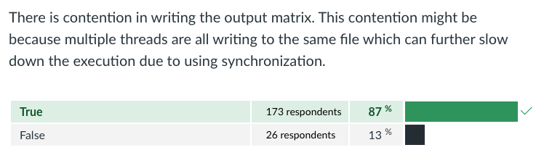
If you try to run a classic matrix multiplication implementation in OpenMP (like the one we used in Lab 2), you will experience some issues. Are the following statements true or false?

Slide 23
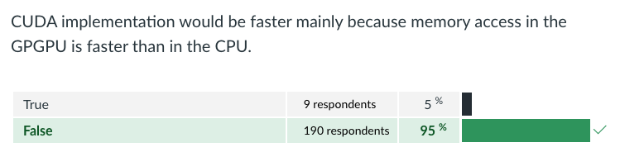
Which of the two matrix multiplication classic implementations (OpenMP and CUDA) do you expect to have better performance (i.e. smaller execution time) in the scenario provided above and why?
Are the following statements true or false?

Slide 24
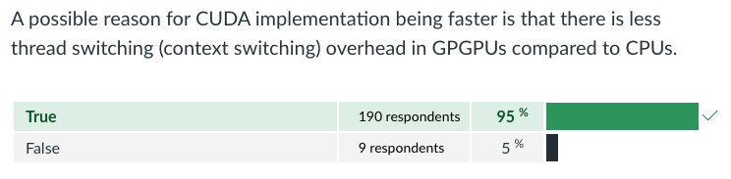
Which of the two matrix multiplication classic implementations (OpenMP and CUDA) do you expect to have better performance (i.e. smaller execution time) in the scenario provided above and why?
Are the following statements true or false?

Slide 25
Lab 3: GPU Sum

Slide 26
Lab3: GPU Sum - methods to make fast
Atomic add:
all threads atomically add to a global variable
Notes:
t3-demo

Slide 27
Lab3: GPU Sum - methods to make fast
Atomic add:
all threads atomically add to a global variable
Atomic shared
threads add to block-shared variable
then finally to global variable
Notes:
t3-demo

Slide 28
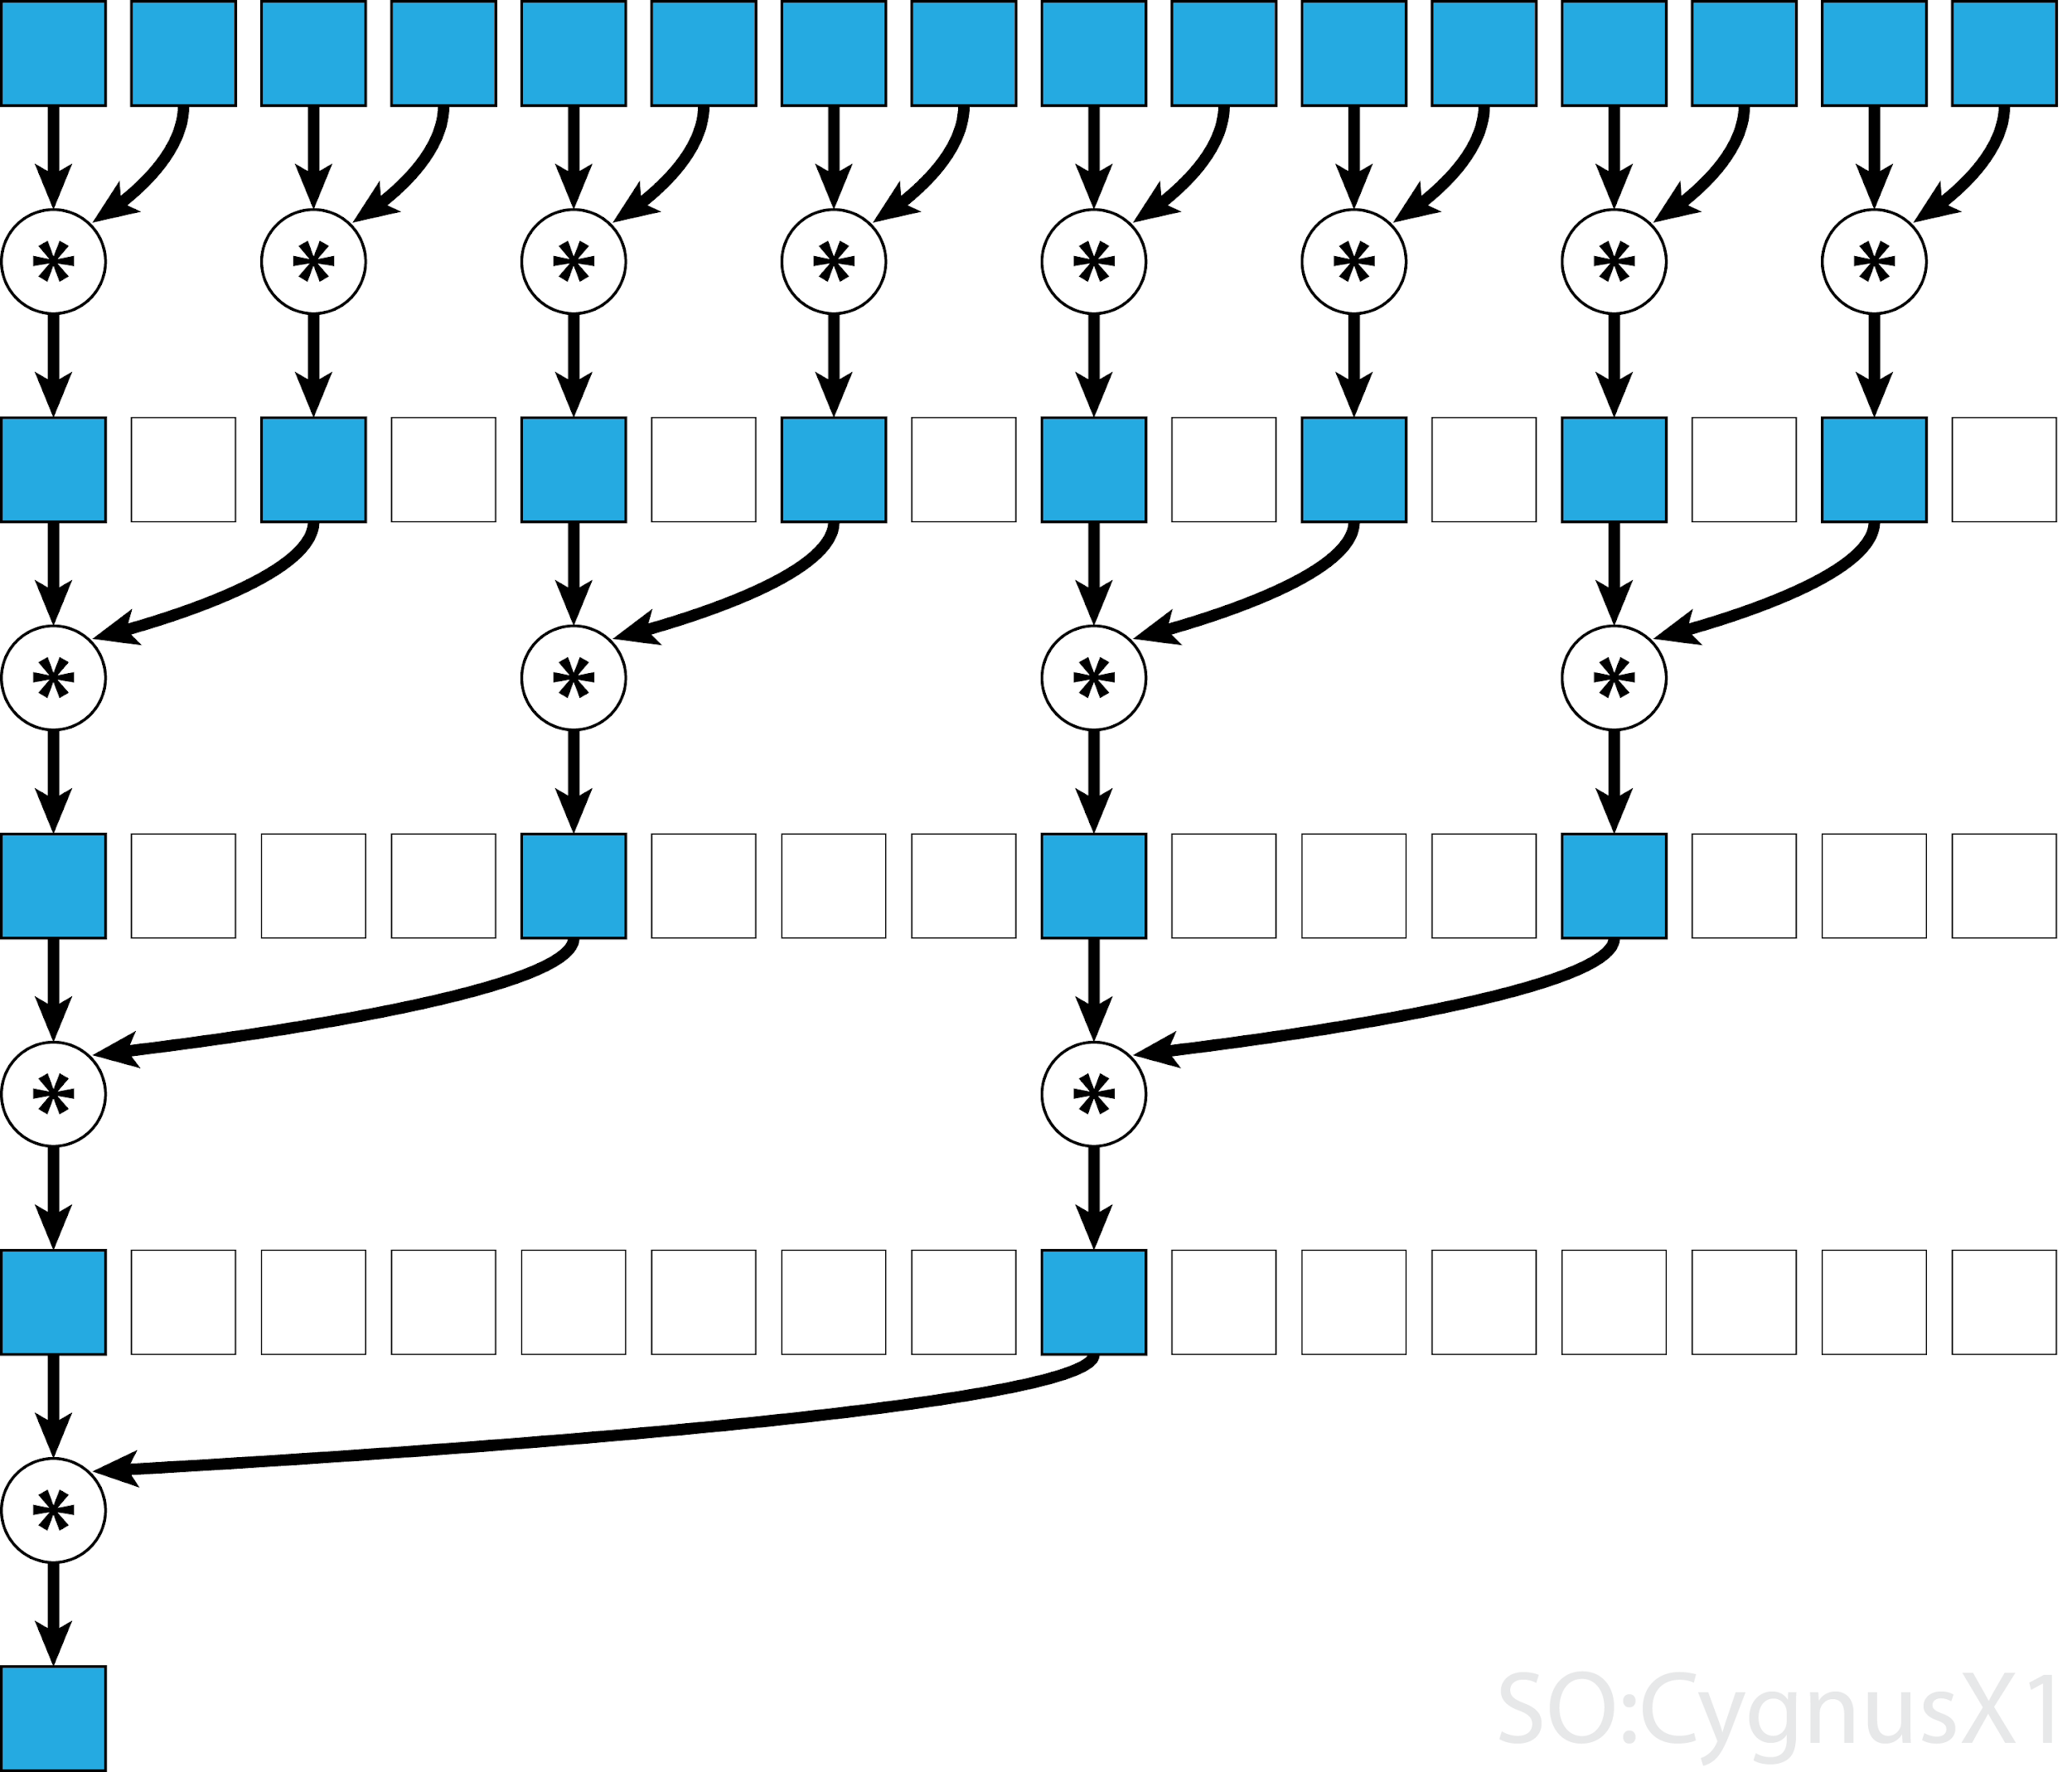
Lab3: GPU Sum - methods to make fast
Atomic add:
all threads atomically add to a global variable
Atomic shared
threads add to block-shared variable
then finally to global variable
Reduce shared
Threads combine values in a block-shared array
Each step, half the threads from prev step are involved
One last atomic add at the end
Notes:
t3-demo

Slide 29
Bitonic Sort in CUDA

Slide 30
Bitonic Sort
Great algorithm for massively parallel sorting
Relies on merging bitonic sequences: a series of numbers that are
Increasing for the first half
Decreasing for the second half
O(n log²n) ⇒ serially less efficient, but massively parallel

Slide 31
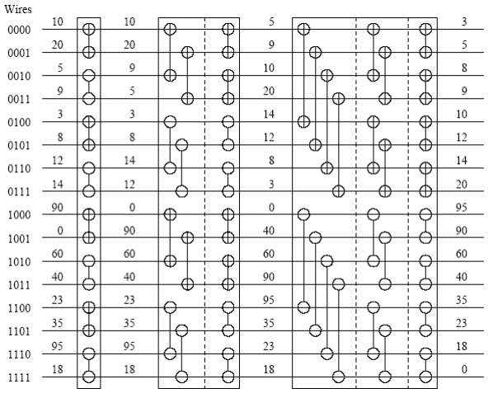
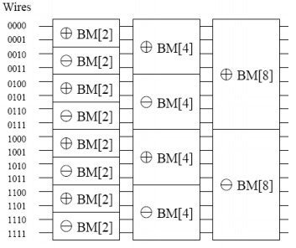
CUDA?
Why is this parallelizable, and ideal for CUDA?
Input
Output
Notes:
https://people.cs.rutgers.edu/~venugopa/parallel_summer2012/bitonic_overview.html

Slide 32
CUDA?
descending order
We have the same number of ‘threads’ (N/2) doing the same number of comparisons in each step!
ascending order
Notes:
https://people.cs.rutgers.edu/~venugopa/parallel_summer2012/bitonic_overview.html

Slide 33
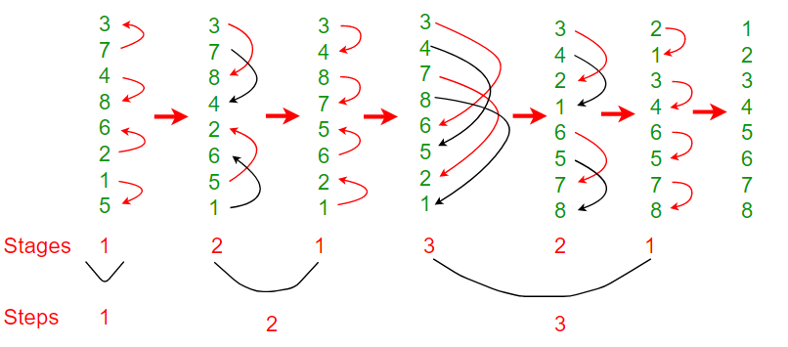
More intuition
Observe: 4 comparisons in each “step”, N / 2, same each time
Completely independent data in each step

Slide 34
More intuition
Observe: 4 comparisons in each “step”, N / 2, same each time
Completely independent data in each step

Slide 35
More intuition
Observe: 4 comparisons in each “step”, N / 2, same each time
Completely independent data in each step

Slide 36
More intuition
Observe: 4 comparisons in each “step”, N / 2, same each time
Completely independent data in each step

Slide 37
More intuition
Observe: 4 comparisons in each “step”, N / 2, same each time
Completely independent data in each step

Slide 38
More intuition
Observe: 4 comparisons in each “step”, N / 2, same each time
Completely independent data in each step

Slide 39
More intuition
Observe: 4 comparisons in each “step”, N / 2, same each time
Completely independent data in each step

Slide 40
More intuition
Observe: 4 comparisons in each “step”, N / 2, same each time
Completely independent data in each step

Slide 41
Compared to MergeSort
Why might Bitonic sort be preferred compared to Mergesort for parallel implementations?
Limited parallelism: only two tasks created per step, need to synchronize before each merge
Total task number changes at each state
Task granularity can be too small at the end
Merge is not parallelized
Temporary arrays have to be synchronized correctly

Slide 42

Attendance
link

