Slide 1
CS3210 Lab 4
MPI

Slide 2
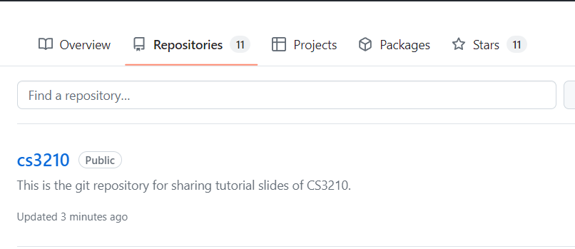
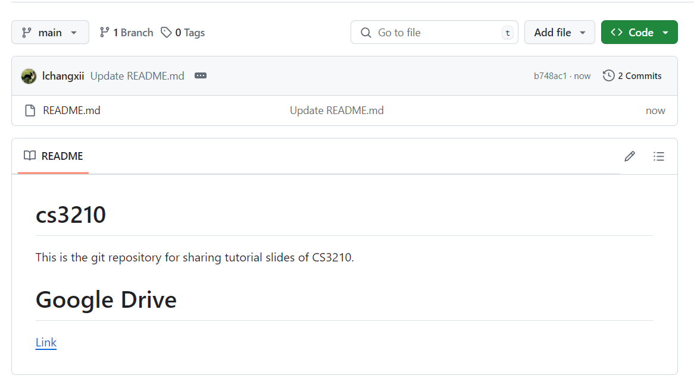
Questions and Slides Sharing
Slides
Github and Google Drive after every session.
https://github.com/lchangxii/cs3210
You can find the Link in the README if preferring Google Drive

Slide 3
Your progress through CS3210 :)
Part 1: OpenMP
Making single-node CPU programs faster
Complex tasks that are relatively less parallelizable (10s of tasks)
Part 2: CUDA
Making single-node GPU-able programs faster
Simpler tasks that are relatively more parallelizable (millions of tasks even)
Part 3: MPI
Making multi-node programs faster
Large, mixed workloads (slow communication between nodes is worth it due to size / parallelizability of work)
You are here!

Slide 4
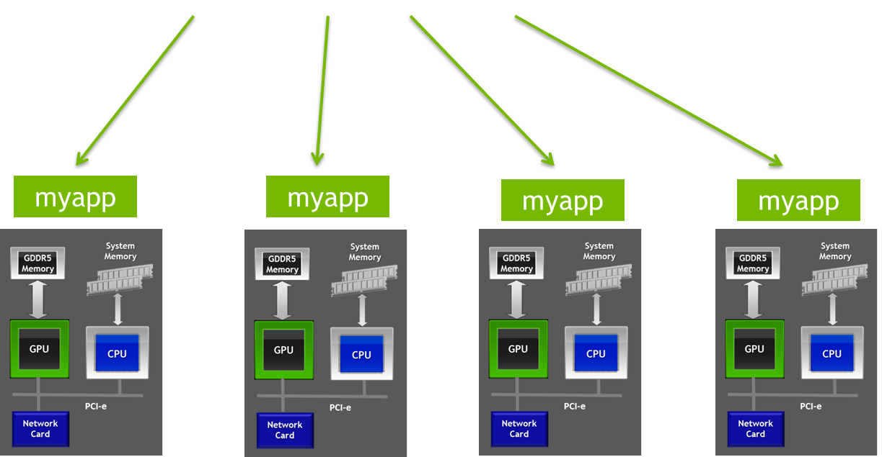
These are not mutually exclusive!
MPI distributes processes to nodes (note: can have > 1 process per node!)
mpirun -H … -np 4 ./myapp <args>
OpenMP
CUDA

Slide 5
Some naming confusion
OpenMP != MPI != OpenMPI
 | OpenMP | MPI | OpenMPI
Shared or distributed memory? | Shared | Distributed | Distributed
Just the standard, or actual implementation? | Implementation | Just a standard | Implementation of MPI standard
Another MPI implementation : MPICH

Slide 6
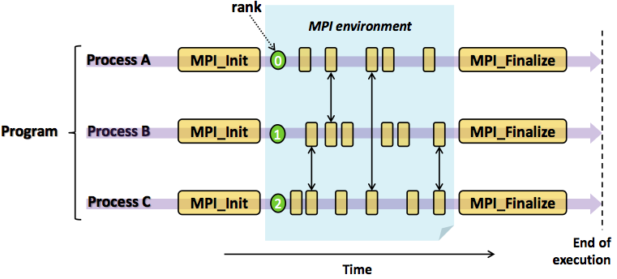
MPI Program Lifecycle

Slide 7
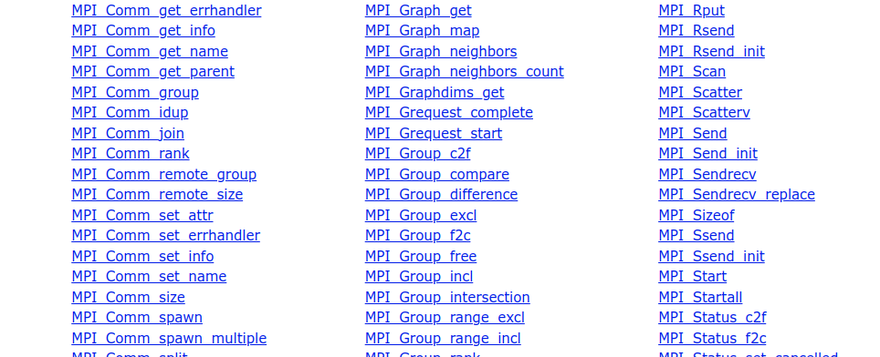
MPI is all about communicating
If independent processes: we could just do srun/sbatch over many nodes
Communicating is hard: therefore “Message Passing Interface”

Slide 8
Slurm + MPI

Slide 9
Using Slurm to run MPI programs!
vim hello.cpp
mpic++ -o hello hello.cpp
salloc -n 192 -N 12 mpirun./hello
salloc -n 500 -N 12 --overcommit mpirun ./hello
sacct
Notes:
Showing the sheer number of tasks we can run

Slide 10
MultiNode Slurm Scheduling/Accounting
Priority-based scheduling
Based on job age / your priority / how “large” your job is
There are limits for:
MaxNodesPerJob: 5
MaxJobs: 1 [max running jobs]
Max time per job: 3 min
Etc (these can/will be adjusted)
Lots of people sharing few nodes, so use only what you need!

Slide 11
Important paradigm things in MPI
int rank, size;
char hostname[256];
MPI_Init(&argc, &argv);
MPI_Comm_rank(MPI_COMM_WORLD, &rank);
MPI_Comm_size(MPI_COMM_WORLD, &size);
Why don’t I need to synchronize rank and size?
This is a distributed memory programming model!
The processes are running in independent memory spaces!

Slide 12
Important paradigm things in MPI
Do MPI programs spawn the processes upon calling MPI_Init()?
No! The necessary processes are spawned by executing mpirun.
MPI_Init() only sets up the communication channels between the different processes.
Take note: anything done before MPI_Init() & after MPI_Finalize() is considered undefined behaviour in a MPI program.
Ref: https://www.mpich.org/static/docs/v3.3/www3/MPI_Finalize.html

Slide 13
Today’s Lab

Slide 14
Lab 4: MPI
ex1/2: Running MPI programs locally, “manual” MPI distribution
ex3: Running across many nodes with Slurm
ex4: Mapping and binding MPI processes
ex5/6/7: Blocking MPI communication
ex8: Non-blocking MPI communication
ex9/10/11 (for submission!): MPI performance comparison

Slide 15
For MPI…
…we're back to using soctf again! Please do not do your lab on xlogin!
Add the following line to your .bashrc if there is any problems
export OMPI_MCA_btl_tcp_if_include=172.26.187.34/23

Slide 16
ex2: ssh-copy-id failure
If this fails, you don't have an ssh key on the node
Run first: ssh-keygen -t rsa on your login soctf node
Then, follow the instructions (or just hit Enter 3 times if you're lazy to read)
Skip this exercise if you still run into errors, ex2 is just letting you feel the pain of running mpirun without salloc :(

Slide 17
Why do we do this?
ssh-copy-id
allowing you to log in via SSH without needing to enter a password.
MPI
rely on SSH to launch processes on remote nodes in a multi-node cluster.
This allows MPI to start parallel jobs across multiple machines without requiring manual password entry for each node.

Slide 18
Differences between MPI Sends/Recvs

Slide 19
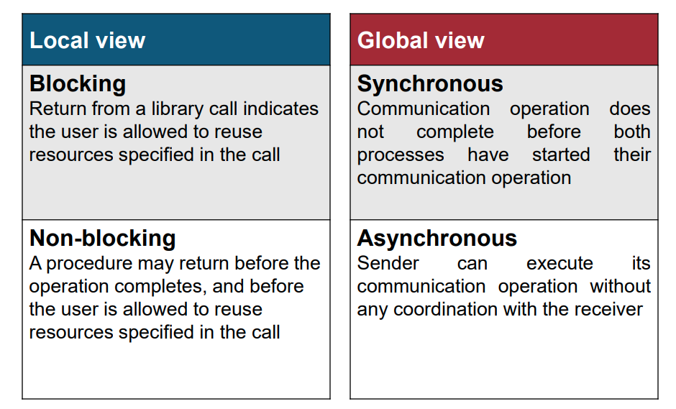
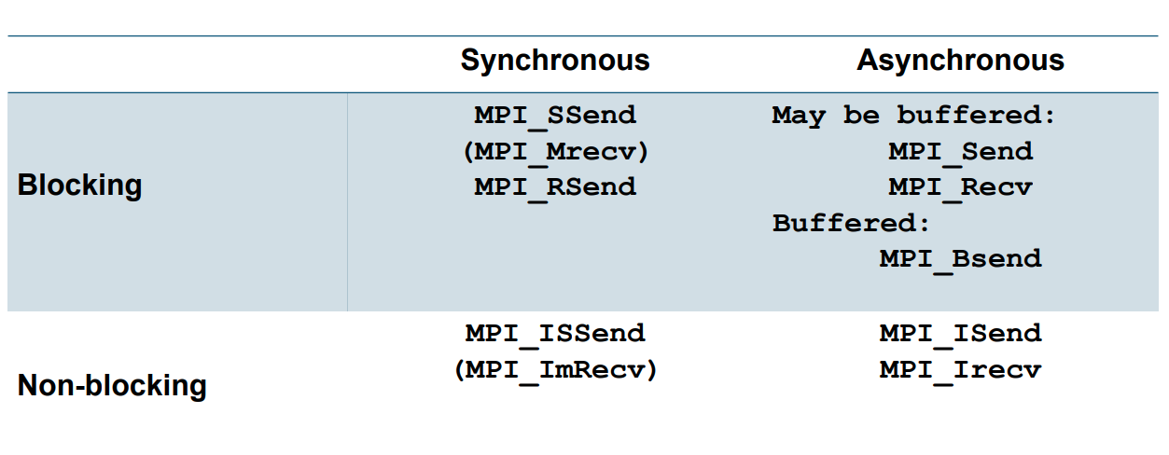
Overview

Slide 20
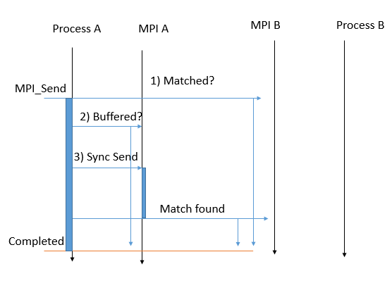
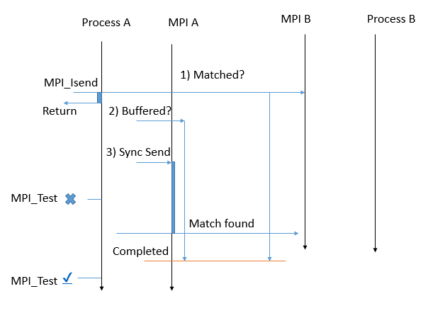
MPI Send/Recv/all variants
MPI_Send
MPI_ISend
https://iamsorush.com/posts/mpi-send-types/

Slide 21
Difference between MPI_Send & MPI_SSend?
If both of them are blocking anyways, what's the difference?

Slide 22
Difference between MPI_Send & MPI_SSend?
If both of them are blocking anyways, what's the difference?
There's a difference between when they will return control flow to the application!
MPI_Send will return to the application when the input buffer is ready for reuse.
MPI_SSend will return when input buffer (i.e. the buffer defined in application that holds the data to be sent) is ready for reuse AND receiver started receiving the data.

Slide 23
MPI_Send's behaviour
The only guarantee is that it will always returns when programmer-defined application-side input buffer is ready to be reused.
Can exhibit different behaviours depending on the size of the message, the availability of system buffers, the specific implementation of MPI, and the network hardware.
[Similar to Bsend] Input data can be buffered into MPI's system buffer if it can fit. MPI_Send will then return afterwards, & does not necessarily require a matching receive.
[Similar to Ssend] Input data is too large to fit into MPI's system buffer - A matching receive is required in this case to send the data over so that the programmer-defined buffer can be reused (and thus allowing MPI_Send to return).

Slide 24
mpirun: Mapping and Binding
Crucial for performance!
Notes:
https://nekodaemon.com/2021/02/05/Understanding-MPI-map-by-and-bind-to-option/

Slide 25
How to understand map/bind behavior?
Slot: the smallest unit an MPI process can get allocated to
#slots determined by
Slurm (or whatever “batch system” is used), or
#physical processor cores on the node OR
if --use-hwthread-cpus specified, use #logical cores
Default: MPI allows 1 process per slot unless you say --overcommit
mpirun ./hello
mpirun --use-hwthread-cpus ./hello
salloc -p xs-4114 mpirun ./hello
Notes:
There’s a difference between running mpirun directly on soctf-pdc-001 and running on same hw type via salloc
Salloc indicates that there are 20 CPUs available, but when running directly, mpirun uses the no. of physical cores first
We need to add oversubscribe to mpirun for the last one

Slide 26
How to understand map/bind behavior?
Processing element (PE) - can be used later for map/bind
By default, a physical core
If --use-hwthreads-cpus, then it’s a logical core
Mapping: deciding which processes run on which node
{slot, hwthread, core, L1cache, L2cache, L3cache, socket, numa, board, node, sequential, distance, ppr}
Binding: constraining a process to specific CPUs
If there is an “object-specific” mapping, binding usually automatically set to match it
salloc -p xs-4114 --nodes 1 --ntasks 4 mpirun --report-bindings --map-by slot:pe=1 ./hello
salloc -p xs-4114 --nodes 1 --ntasks 4 mpirun --report-bindings --map-by slot:pe=2 ./hello
salloc -p xs-4114 --nodes 1 --ntasks 4 mpirun --report-bindings --map-by core:pe=2 ./hello
Notes:
There’s a difference between running mpirun directly on soctf-pdc-001 and running on same hw type via salloc
Salloc indicates that there are 20 CPUs available, but when running directly, mpirun uses the no. of physical cores first
Last one: conflict, we want to map each one to a core, but we ask for multiple cores (PEs) per process

Slide 27
More on mapping and binding
Let’s try to figure out more worked examples
salloc -p dxs-4114 --nodes 1 --ntasks 20 mpirun --report-bindings --map-by socket --bind-to core ./hello
Mapped to each socket in round-robin fashion, each proc bound to a core
salloc -p dxs-4114 --nodes 1 --ntasks 10 mpirun --report-bindings --map-by socket:pe=2 --bind-to core ./hello
Mapped to each socket in round-robin fashion, each proc bound to 2 cores

Slide 28
More on mapping and binding
salloc -p i7-7700 --nodes 2 --ntasks 6 bash -c 'mpirun --map-by core --bind-to hwthread --report-bindings ./hello 2>&1 | sort'
salloc -p i7-7700 --nodes 2 --ntasks 6 bash -c 'mpirun --map-by hwthread --bind-to hwthread --report-bindings ./hello 2>&1 | sort'
Mapping applies round-robin, across cores or hwthreads in this case, then we bind specifically to a hwthread each time

Slide 29

Attendance
link

