Slide 1
CS3210 Lab 2
Parallel Programming with OpenMP & Performance Instrumentation
Slides inspired by Sriram's slides

Slide 2
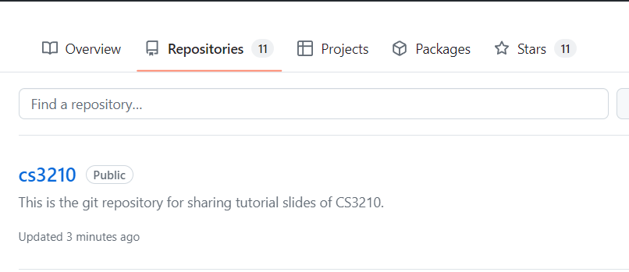
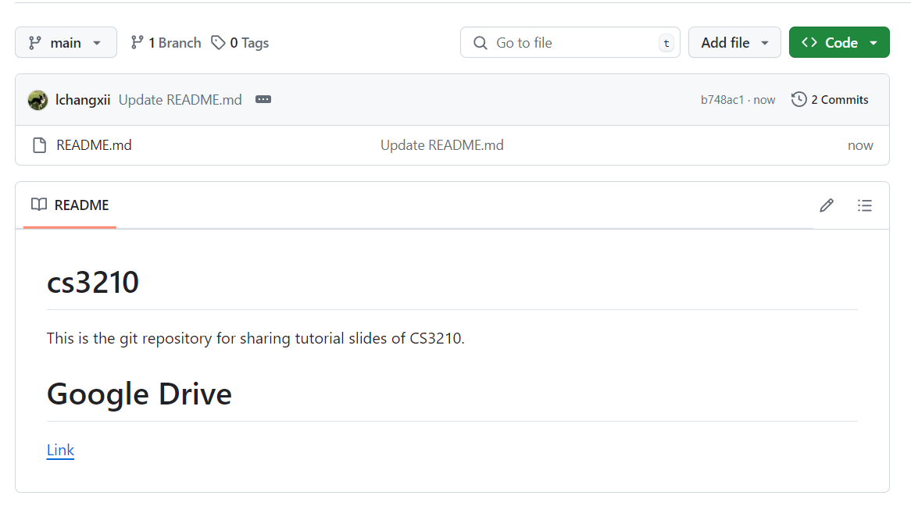
Questions and Slides Sharing
Slides
Github and Google Drive after every session.
https://github.com/lchangxii/cs3210
You can find the Link in the README if preferring Google Drive

Slide 3
Lab 1 marking feedback
Most of you got the exercises correct :)
For those who made mistakes, don't worry about it, there are chances for catch-ups later.
Do check your comments annotated in your PDFs (when the grades & comments are published).
Read and try to answer all questions

Slide 4
The quick crash-course on how to write assignment reports that you never had
Content of this section is derived from Theodore

Slide 5
"How to write report"
Understand the skills we are trying to teach
Start with benchmarking ==> Getting aggregated results ==> Having a hypothesis on results ==> Testing the given hypothesis ==> Improving your code ==> Back to benchmarking

Slide 6
"How to write report"
Understand the skills we are trying to teach
Start with benchmarking ==> Getting aggregated results ==> Having a hypothesis on results ==> Testing the given hypothesis ==> Improving your code ==> Back to benchmarking
Lab 1

Slide 7
"How to write report"
Understand the skills we are trying to teach
Start with benchmarking ==> Getting aggregated results ==> Having a hypothesis on results ==> Testing the given hypothesis ==> Improving your code ==> Back to benchmarking
This is the basis of your performance analysis.
Use whichever tools you want to use that might help – be it time, perf, hyperfine, etc.
In this step, we need to get raw data. Might or might not necessarily need to see individual data points in the final report
Put raw data in appendix
Put in a easily-digestible form

Slide 8
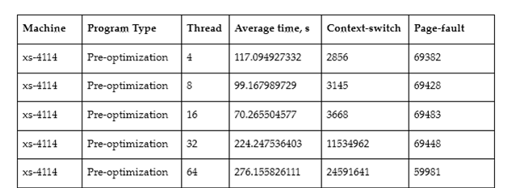
"How to write report"
Understand the skills we are trying to teach
Start with benchmarking ==> Getting aggregated results ==> Having a hypothesis on results ==> Testing the given hypothesis ==> Improving your code ==> Back to benchmarking
Example data taken from Theo's A1 in 2022, results averaged from 10 runs.

Slide 9
"How to write report"
Understand the skills we are trying to teach
Start with benchmarking ==> Getting aggregated results ==> Having a hypothesis on results ==> Testing the given hypothesis ==> Improving your code ==> Back to benchmarking
This is the part where you show the results of the data in an aggregated manner.
The laziest is to put screenshots of perf/time/whatever in your report
Please don't :((((
Use graphs to your advantage here.
Usually you want to see trends; how does your program benchmark…
across different machines?
across different input sizes?
across different algorithms?
Note:
Don't worry about advanced statistical methods in this module. (This is not CS5239)

Slide 10
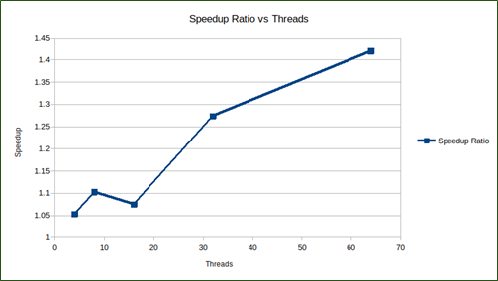
"How to write report"
Understand the skills we are trying to teach
Start with benchmarking ==> Getting aggregated results ==> Having a hypothesis on results ==> Testing the given hypothesis ==> Improving your code ==> Back to benchmarking
Graph from previous data
Note: this graph is alright, but there are still quite some improvements which can be made:
Error bars / standard deviation
Scale of axis; log scale might be better for x-axis

Slide 11
"How to write report"
Understand the skills we are trying to teach
Start with benchmarking ==> Getting aggregated results ==> Having a hypothesis on results ==> Testing the given hypothesis ==> Improving your code ==> Back to benchmarking
Make it clear that you're putting forth your hypothesis
Hypothesis needs to be plausible!
Make sure you remove common issues before you even get to this point
sleep, print statements, etc.

Slide 12
"How to write report"
Understand the skills we are trying to teach
Start with benchmarking ==> Getting aggregated results ==> Having a hypothesis on results ==> Testing the given hypothesis ==> Improving your code ==> Back to benchmarking
A good hypothesis doesn't come out of thin air, but backed up by data
Common points: perf, flamegraphs

Slide 13
"How to write report"
Understand the skills we are trying to teach
Start with benchmarking ==> Getting aggregated results ==> Having a hypothesis on results ==> Testing the given hypothesis ==> Improving your code ==> Back to benchmarking
Excerpt from Theo's prev A1 submission
In every single test on the Xeon machine, with an increasing number of threads, there is a speedup - up until a certain point where it suddenly has a large slowdown.
This might happen due to contention on the processing unit which happening due to having too many threads.
Figure A6 sheds some insight into this - once the number of threads is larger than 16, there is a huge increase in the number of context-switches, which is a good indicator of contention and would incur a large penalty in time taken.

Slide 14
"How to write report"
Understand the skills we are trying to teach
Start with benchmarking ==> Getting aggregated results ==> Having a hypothesis on results ==> Testing the given hypothesis ==> Improving your code ==> Back to benchmarking
This goes hand-in-hand with the previous point; if you suspect that something is causing your code to be slow, change it (if possible)
Now you have a new version of code that performs better :)
Unlocks a new benchmarking data point
Also unlocks comparison across versions

Slide 15
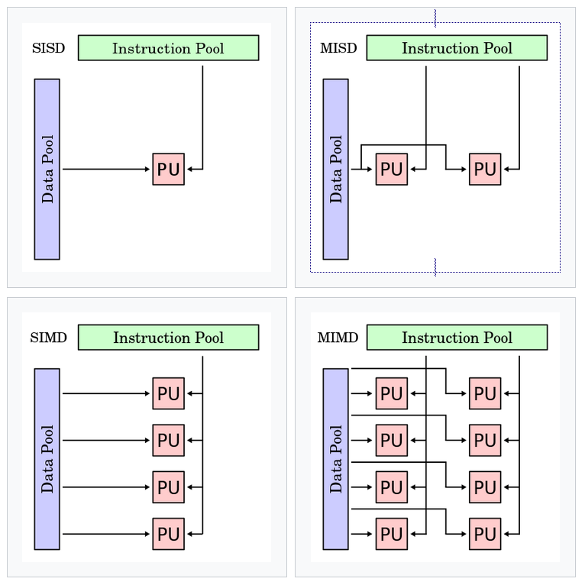
Revisit: Flynn's Taxonomy
Single core processor with pipelining?
A: SISD: Because there's only a single stream of instructions being executed at any given point of time.

Slide 16
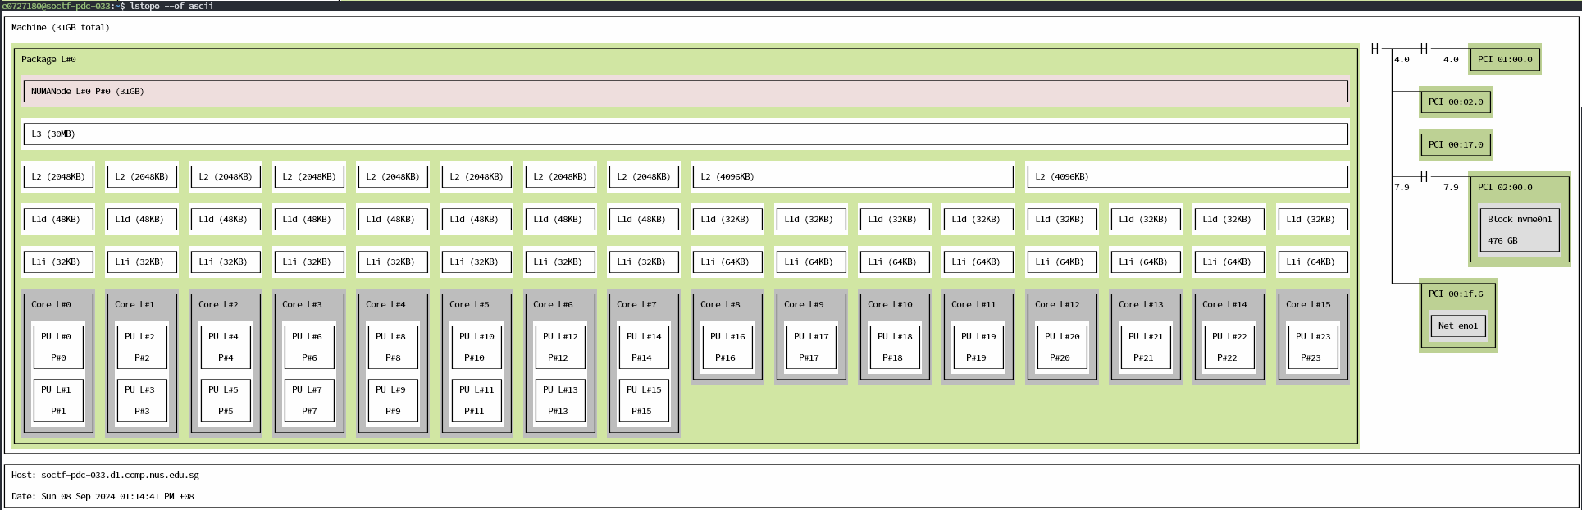
Revisit: lstopo on a heterogeneous processor (i7-13700)
Recall: i7-13700 has 8x P-cores and 8x E-cores

Slide 17
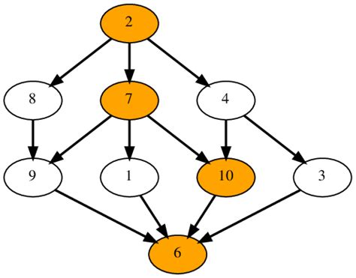
Recapping the past week
Parallel Programming Models I (Lec 4 & Lab 2)
Data vs Task Parallelism
Coordination models
Shared address space
Data parallel
Message passing
Task Dependence Graphs
Foster's Design Methodology
Partitioning ⬇️ Communication ⬇️ Agglomeration ⬇️ Mapping
Parallel Patterns
Fork-join
Parbegin-Parend
SIMD/SPMD
Master-Worker
Task Pools
Producer-Consumer
Pipelining

Slide 18
Focus: OpenMP
What kind of parallel pattern does OpenMP usually use?
Parbegin-Parend (Mainly what you, as a programmer, will do in your code)

Slide 19
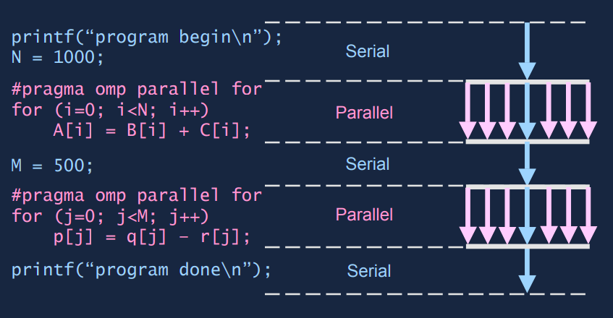
Focus: OpenMP

Slide 20
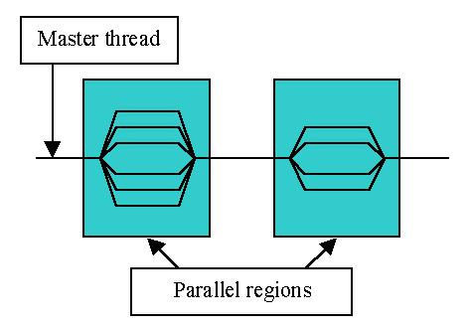
What is OpenMP?
Compiler directives that help you parallelize parts of your code easily!
usage: Add "#pragma omp …" lines above your parallelizable code.

Slide 21
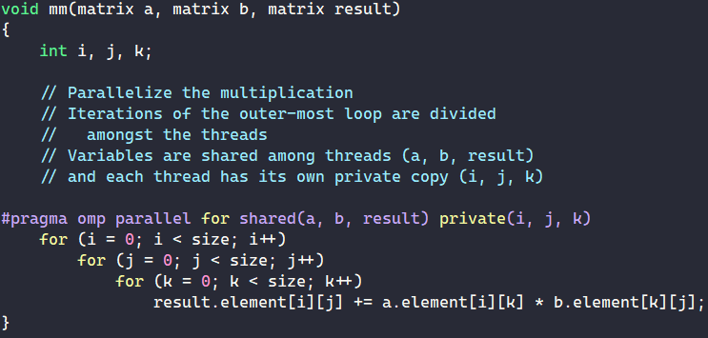
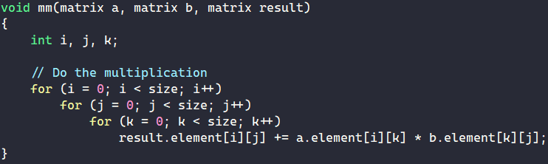
What is OpenMP?
Main usage: Parallelize for loops!
Use #pragma omp to tell the compiler to generate parallel code for the code block below.
All threads will wait for each other before continuing (implicit barrier).
Sequential (mm-seq.cpp)
OpenMP (mm-omp.cpp)

Slide 22
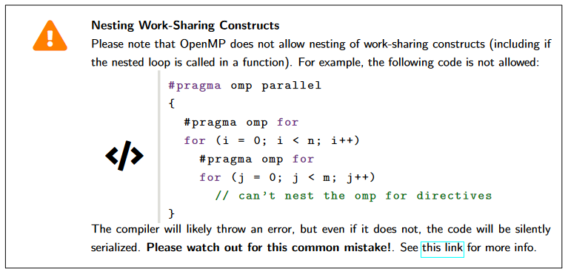
Warning against OpenMP Nesting
OpenMP Nesting is disabled by default.
Notes:
Works if OMP_NESTED environment flag is enabled, but we will not enable the flag when we test code. Use `collapse(2)` instead.

Slide 23
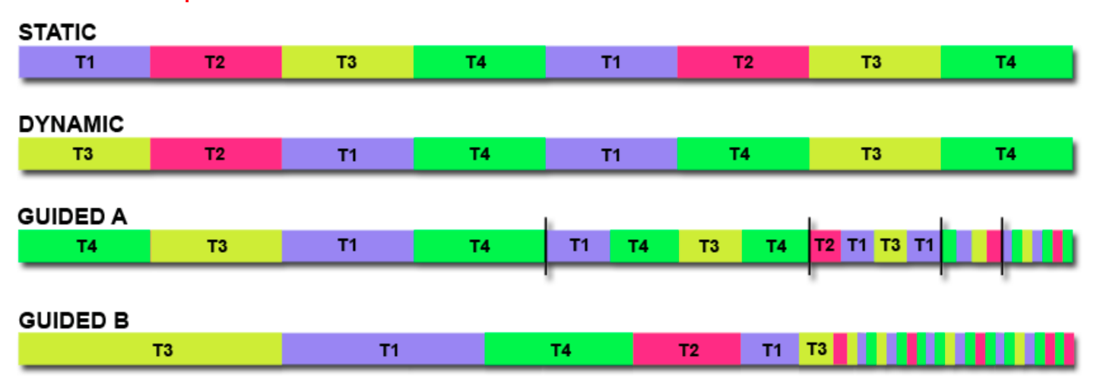
Focus: OpenMP
We can control how loop iterations are given to threads.
Static: each thread gets a fixed part of the array, fixed size (least overhead)
Dynamic: threads get a fixed size chunk when idle (for unpredictable work times)

Slide 24
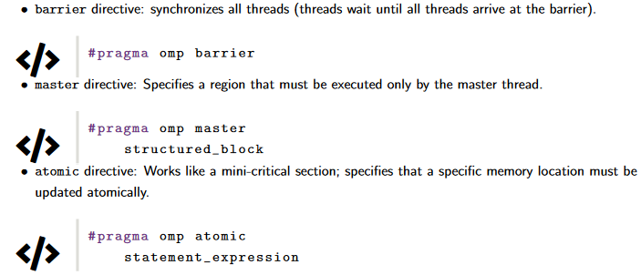
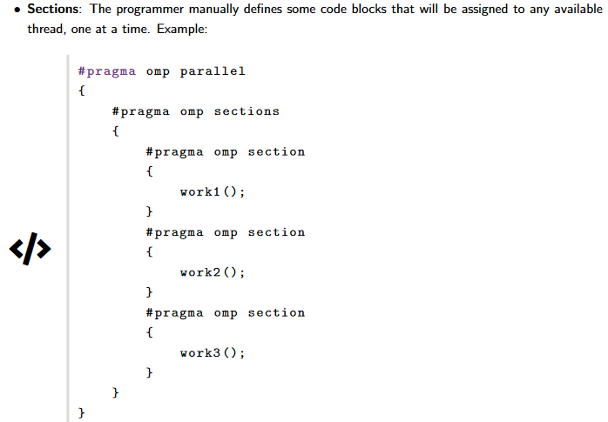
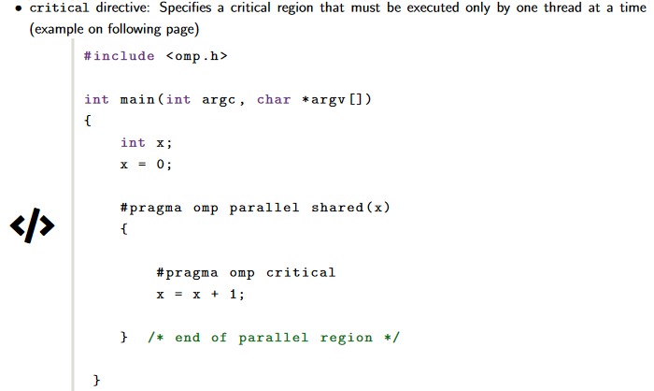
Focus: OpenMP
Useful constructs for your exploration here & in Assignment 1:

Slide 25
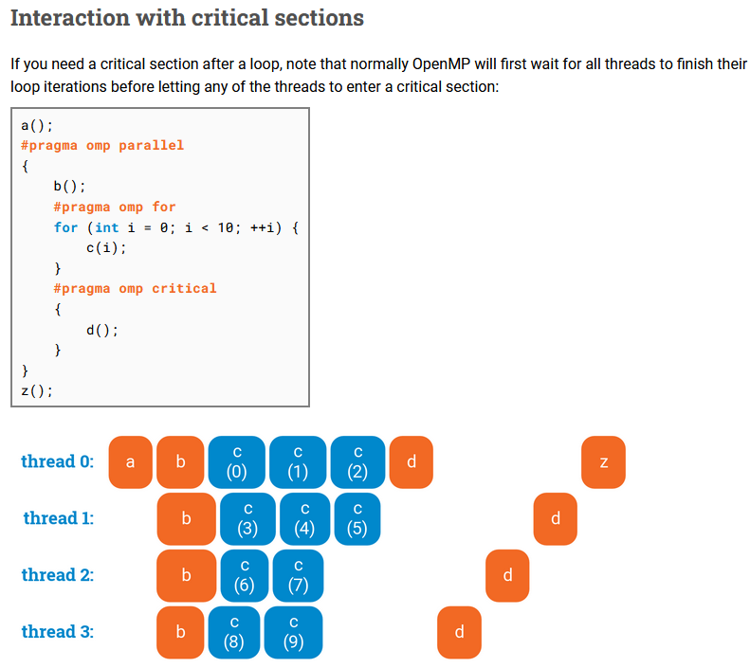
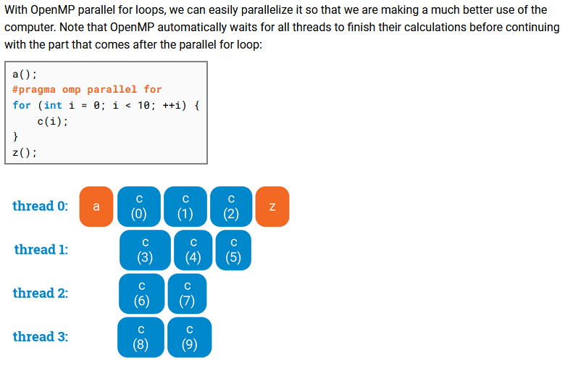
Very cool visual guide!
https://ppc.cs.aalto.fi/ch3/

Slide 26
perf

Slide 27
What is perf?
Unified interface to collect performance statistics from Linux from 2 sources:
Hardware counters (from performance measurement unit [PMU])
e.g. cache misses, branch misses, instructions, …
Software counters (provided by Linux kernel)
e.g. page faults, cpu-migrations, …

Slide 28
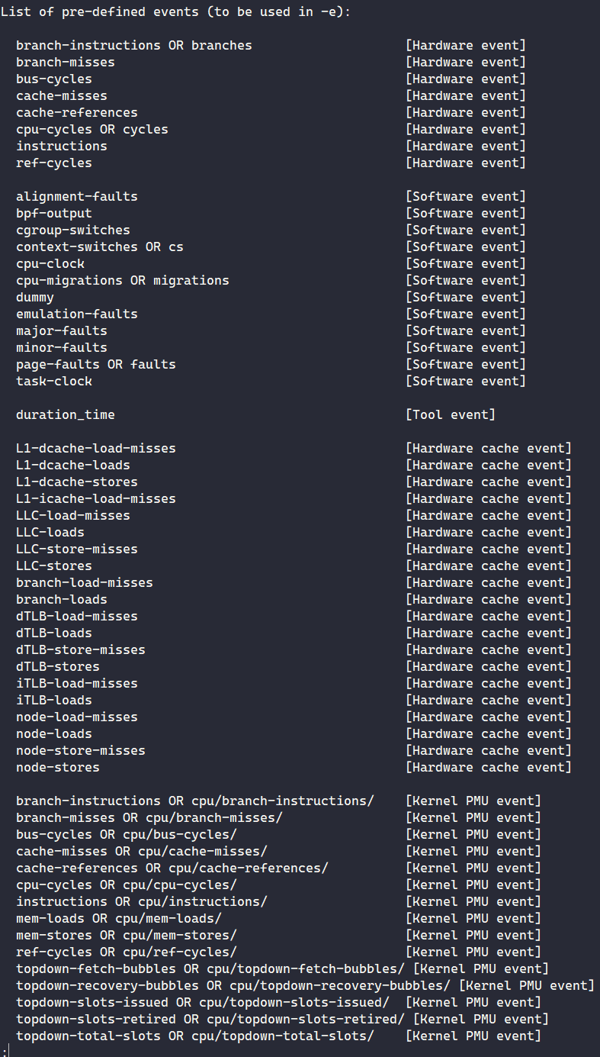
perf events
Get list of events that perf can measure via perf list
Differs for Linux kernels + Hardware types
Example usage: perf stat -- ls

Slide 29
Live Demo: Tut 1's pthread_addsub results recap
4C/8T i7-7700 CPU @ 3.60GHz*: 4.266s
8C/8T i7-9700 CPU @ 3.00GHz*: 4.7163s
10C/20T Xeon Silver 4114 @ 2.20GHz*: 6.0608s
8C/16T Xeon W-2245 @ 3.90GHz*: 4.8317s
16C/24T i7-13700 @ 2.10GHz* (P-core), 1.50GHz* (E-core): 1.4197s
For me: cd ~/tut1 tail -n +1 i7-7700.out i7-9700.out xs4114.out xw2245.out i7-13700.out
Why does is i7-7700 faster than i7-9700 & Xeon 4114? Why is i7-13700 the fastest here?
*Base clock speed, different from tutorial 1 slides
Rebenched w/ perf instead of hyperfine.

Slide 30
Live Demo: Tut 1's pthread_addsub results
Commands to replicate my results:
hx pthread_addsub.cpp
g++ -o pthread_addsub pthread_addsub.cpp
srun -p i7-7700 perf stat -r 3 ./pthread_addsub > /dev/null 2> i7-7700.out
srun -p i7-9700 perf stat -r 3 ./pthread_addsub > /dev/null 2> i7-9700.out
srun -p xs-4114 perf stat -r 3 ./pthread_addsub > /dev/null 2> xs4114.out
srun -p xw-2245 perf stat -r 3 ./pthread_addsub > /dev/null 2> xw2245.out
srun -p i7-13700 perf stat -r 3 ./pthread_addsub > /dev/null 2> i7-13700.out
Notes:
EASTER EGG HERE: If you are reading this and wondering why we pipe the output of pthread_addsub to /dev/null instead of removing the printf statements from code, it is because removing printf statements causes a slowdown. I'm still not too sure why, Peigeng suggested it may be due to this: https://stackoverflow.com/questions/42358211/adding-a-print-statement-speeds-up-code-by-an-order-of-magnitude (TLDR weird Intel AVX behaviour) but I still couldn't get rid of the slowdown despite following the suggestions in the answer.

Slide 31
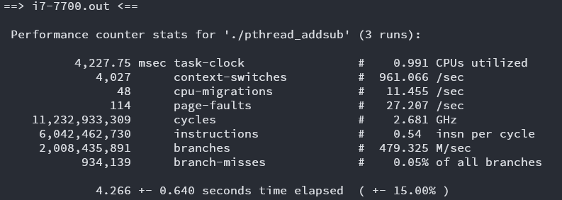
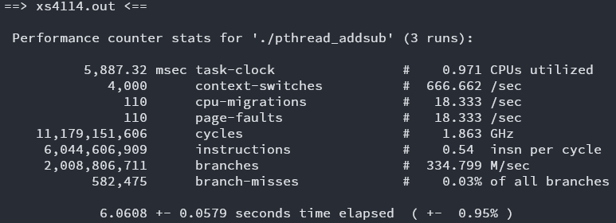
Live Demo: Tut 1's pthread_addsub results
No speed-up despite using multiple threads :( On average only 1 core is fully utilized
note: "CPUs" here refers to processing cores
i7-7700 @ 3.60Ghz
xs-4114 @ 2.20GHz
i7-7700 wins due to higher clock speed (& thus having higher single-threaded performance)

Slide 32
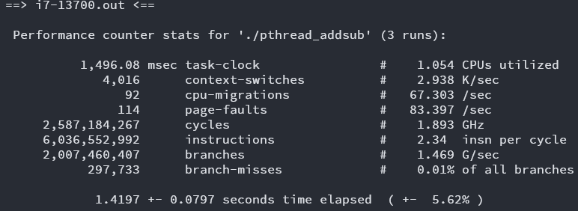
Live Demo: Tut 1's pthread_addsub results
i7-7700
i7-13700
i7-13700 wins due to its superior IPC & branch prediction! (despite having slower average clock speed)

Slide 33
Today's Problem: Matrix Multiplication
Can you see how it can be parallelized?

Slide 34
Getting started
wget the lab from pdc (link in PDF)
Please use srun or sbatch to run your programs from Ex3 and onwards.

Slide 35
Lab time!
Ex1 + Ex2: Matrix Mult w/ OpenMP
Ex3: System differences w/ OpenMP
Ex4: Static vs Dynamic schedules
Ex5: OpenMP sections
Ex6: Synchronization in OpenMP
Ex7: Profiling w/ perf
Ex8 + Ex9: perf w/ Slurm
Ex10: IPC & MFLOPS vs no. of threads
Ex11: Matrix Mult optimization
Ex12: Benchmarking Ex11
Quick taste of OpenMP
OpenMP exercises
perf exercises
(Some tidbits provided later)
For submission
Notes:
Demo ex9 at the end

Slide 36
perf subsampling
Notes:
INCLUDES HINTS FOR EX10

Slide 37
Live Demo: perf -M vs perf -e
perf -M
perf stat -M GFLOPs python3 -c 'print(2.0 / 5.0)'
srun -- hostname; perf stat -M GFLOPs python3 -c 'print(2.0 / 5.0)'
Run multiple times
perf -e
perf stat -e fp_arith_inst_retired.scalar_double python3 -c 'print(2.0 / 5.0)'
srun -- hostname; perf stat -e fp_arith_inst_retired.scalar_double python3 -c 'print(2.0 / 5.0)'
Run multiple times
What is causing this inconsistency?

Slide 38
Live Demo: perf -M vs perf -e
What if we try replicating perf -M with perf -e?
perf stat -e fp_arith_inst_retired.scalar_single,fp_arith_inst_retired.scalar_double,fp_arith_inst_retired.128b_packed_double,fp_arith_inst_retired.128b_packed_single,fp_arith_inst_retired.256b_packed_double python3 -c 'print(2.0 / 5.0)'
What happens?

Slide 39
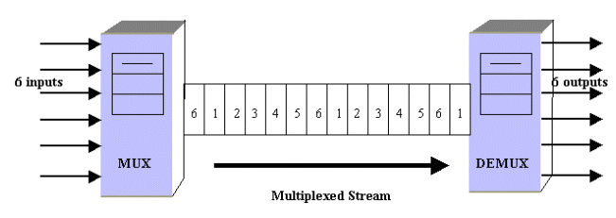
Live Demo: perf -M vs perf -e
If there are not enough hardware counters: perf multiplexes the events (i.e. subsampling) and estimates the counts based on execution time!

Slide 40
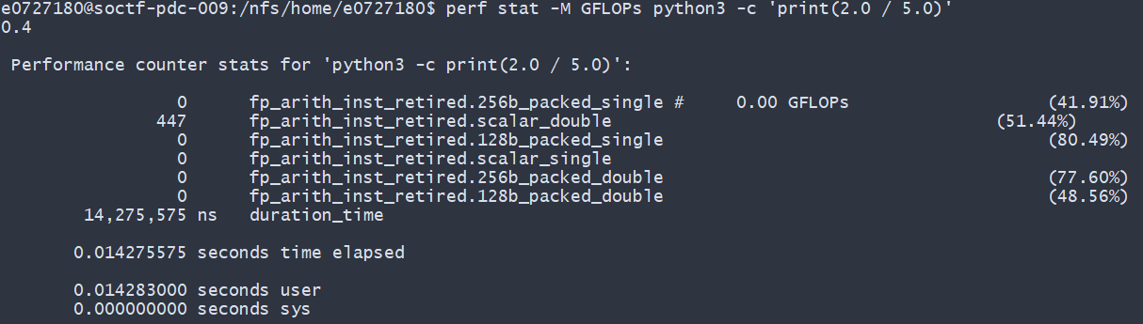
% sign in perf readings
Usually means that the reading is subsampled.
Signifies % of time spent measuring the specific event.
https://stackoverflow.com/questions/33679408/perf-what-do-n-percent-records-mean-in-perf-stat-output

Slide 41
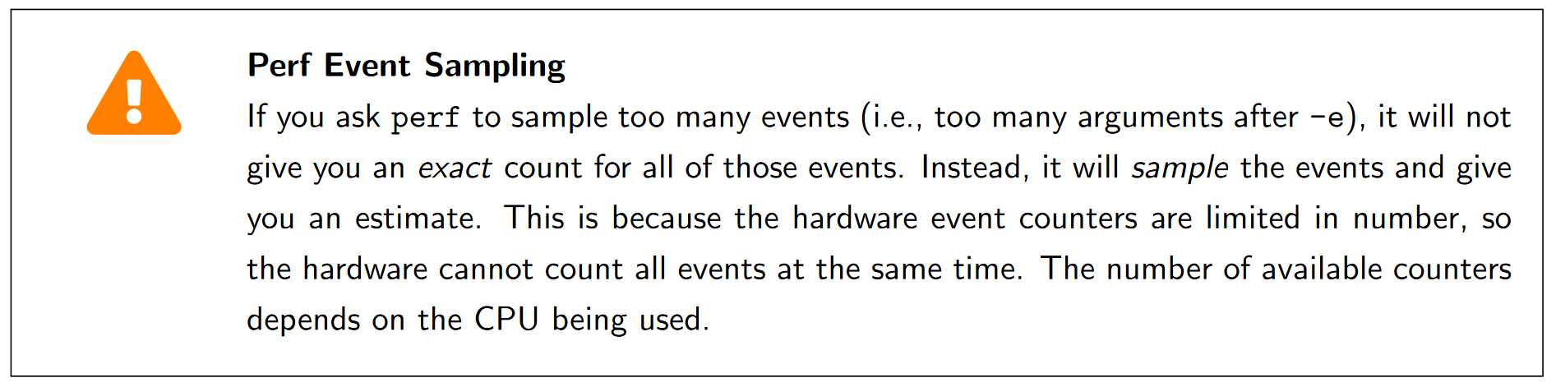
perf subsampling
Basically a warning to prevent what happened in the previous slides

Slide 42
Disclaimers for Ex 11: Optimizing matrix multiplication
We are not concerned about total correctness.
The values for the matrices are generated randomly.
There is NO NEED to transpose the matrices! (you can assume a matrix is already transposed)
There are multiple solutions possible.
As long as the order of access fulfills the criteria of row-wise access.

Slide 43
Summary
OpenMP
perf usage
Using Slurm with OpenMP and perf

Slide 44

Attendance
link

Slide 45
See you next week!
Email: changxi_liu@nus.edu.sg

