Slide 1
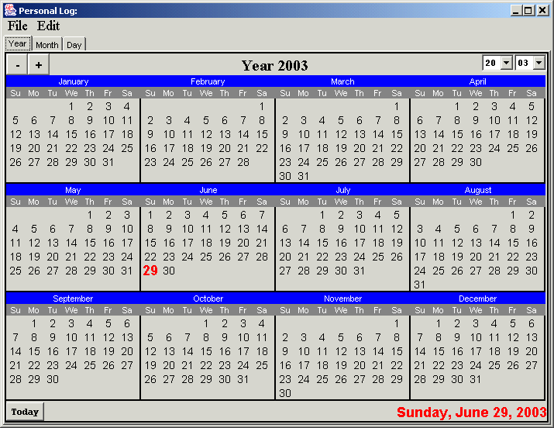
The Log application – initial interface

Slide 2
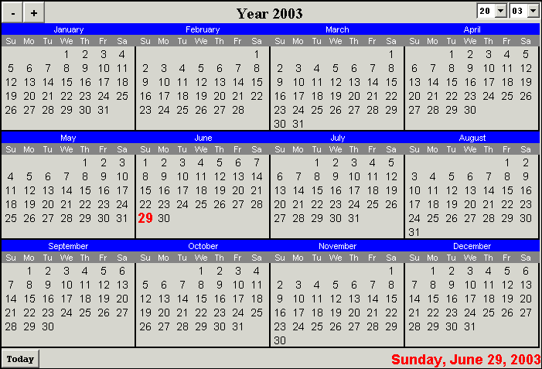
YearView Class

Slide 3
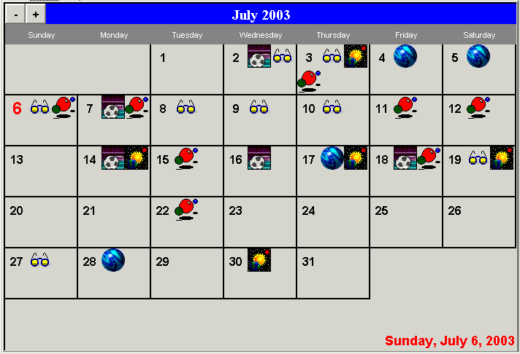
MonthView Class

Slide 4
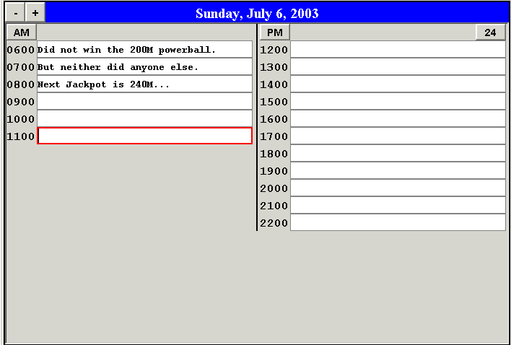
DayView Class

Slide 5
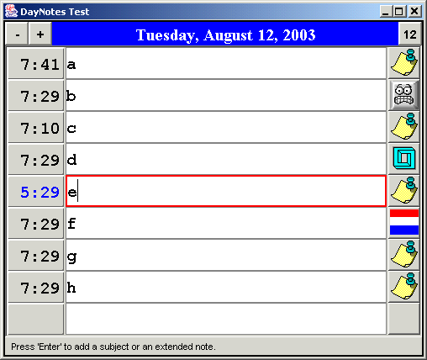
DayNotes Class

Slide 6
Happiness
As in ‘Life, liberty, and the pursuit of’. The reason it is stated as a pursuit rather than simply having or achieving, is that happiness is a state of mind that you can have (or not) in your journey through life. It cannot be a goal in itself because as a state of mind, what you need to sustain it is always changing, along with everything else in your life.
In this pursuit, you need goals. Strangely, happiness most often occurs as you see that you are making progress in your goals, not only in their final achievement.

Slide 7
Goal
A goal is something you want. It can involve possession of material items or a specific achievement and is usually something that you believe you need to become (or stay) ‘happy’. A goal should have an associated plan for how it can be achieved.
Examples of goals:
  Get a new car, TV, home
  Earn a degree or get a job
  An athletic accomplishment
  Financial independence

Slide 8
To Do List
A ‘To Do’ list is of course a list of ‘to do’ items. A todo item is a task that you have assigned to yourself. Actually, someone else could have assigned it, but enthusiastically or not, you have accepted the task and intend to accomplish it. You do not have to have each item written down to have a list; many people just keep them in their head. Reasons to keep a written list (either on paper or electronically) could be if there are many tasks on your list or if there are complications such as prerequisites or deadlines. A ‘written’ list may make it easier to organize the tasks and better visualize any potential interactions or dependencies. A simple example is the order of: going to the gym, going for gas, and then picking up your family member from their activity on your way home. The considerations are: how far can you drive on the gas you have, when does the event end, how long is your workout, and others. Most people automatically sort these things out in their mind without any problem but again, if the list becomes too long, writing it down can help.

Slide 9
Plans
A plan is the methodology (including a timetable) of how you intend to achieve the goal. A ‘To Do’ list is NOT a plan; it is a necessary component of a plan but it can also be a distraction. If you are familiar with the expression, “can’t see the forest for the trees” then the items on your list can be thought of as trees; your goal is the forest, and your plan is the steps you need to take to get you there.

Slide 10
Goal Evolution
Goals should be reevaluated regularly because accomplishment of any given goal will not necessarily move you closer to happiness. This can be true after other changes in your life have made the goal unnecessary or even inappropriate for you, and because many people are just plain wrong in the first place, about what will make them happy. For these people, rather than happiness, their goals are taking them somewhere else entirely.
The reevaluation should start with your idea of what is needed for your own happiness, then factoring in any progress (forward or reverse) or changes in your life since the last examination, add new goals as identified and remove those that are now inappropriate or accomplished, as well as updating the associated plans.

Slide 11
The Long View
Goal reevaluation could involve a slight alteration of the goal but it could also mean dropping it altogether. If the goal is truly no longer right for you then you will not be a ‘quitter’ and you should be able to make a compelling case to those who care about you and most importantly, yourself. However, in these cases you need to be very careful to consider the long view. If you are an unhappy student and are struggling through classes that you need for your future, of course dropping out will give you a fleeting relief, but the future is still coming and it will not stop for you. Understand that yes, you may have a torturous time ahead of you right now, but you should weigh that against the quality of your life after five years and beyond.

Slide 12
Event
An event is something that happens. You can participate in it, observe it, or simply note it for historical purposes. An event always has a given place and time but these may not always be known. Events can be prerequisites or deadlines for a Todo List item.
Examples:
  A meeting
  A movie or play
  A volcano eruption
  A murder

Slide 13
Upcoming Events vs. Todo Items
Take care to distinguish between todo items and upcoming events. An upcoming event does not depend on your actions; it will occur in any case. For example, at a conference next week you have agreed to give a presentation. Your presentation will not happen without you and so it really belongs on your todo list, whereas the conference itself can be an upcoming event. Only after you have given your presentation does it become a Past Event (possibly recorded in your Day Notes) and can be removed from your todo list.
Of course there is an important relationship between your todo item and the upcoming event. This relationship (in this case a coordination) can be captured within the todo item so that it is clear why you must wait until next week before you can accomplish it.

Slide 14
Prerequisite
A prerequisite is something that needs to happen before your ‘real’ goal can be achieved. It can range anywhere from being a trivial task to being a huge production. More than one of your goals may have the exact same prerequisite. Accomplishing it can be a major milestone or a goal in itself. If not accomplished, it becomes a roadblock.
Examples:
  Getting a degree
  Getting organized
  Cleaning the (attic, garage, shed)
  Survival

Slide 15
Survival
The last ‘prerequisite’ example needs a few more words. Survival is a prerequisite to every goal you will ever have. It needn’t sound so dramatic but it is important. If you are spending so much time and effort on this that you cannot make progress on any of your goals, then you need to make a change.
Examples:
  Food
  Shelter
  Paying the bills
  Vehicle maintenance

Slide 16

Waiting
If achieving a goal or prerequisite is simply a matter of time then that may be ok but time is a valuable resource that should not just be ‘killed’ – if you are waiting for something before you feel your life can progress, then find some intermediate goal that CAN be accomplished during this waiting period; do NOT simply blame a lack of progress on the calendar.
Example:
  You’ve got big plans for your tax refund. It will arrive ‘any day now’.
  Whenever it arrives, the garage still needs cleaning, and it has a better chance of getting done now than it will after you start your new project(s).

Slide 17

Issues
An issue is an unanswered question or an action that has yet to be performed, that is beyond your control. In other words, you are waiting for someone else to provide the information you need or otherwise do what you expect of them. They may give you a date/time when it will be resolved but their time estimate can range from ‘appropriate for the task’ to ‘delaying tactic’. You must weigh their relationship to you and their reliability (if known), to determine where your situation falls in this range, and do not simply accept in every case that your only recourse is to wait.
An issue is a roadblock to a ‘To Do’ list item or an Event.

Slide 18
Roadblocks
A roadblock is anything that keeps you from being able to act on a ‘To Do’ list item, or that is preventing an Event from taking place.
You have four options on how to proceed:
  Wait until it goes away.
  Find a way to make it go away.
  Go around.
  Give up.
Note that option 1 can be the same as option 4, if you do not set your own deadline on how long you’re willing to wait.

Slide 19
Organization
By staying organized, you position yourself to meet all your obligations at the right time, as well as finding the time and other resources needed to fulfill your goals.
A common organizational task is to track and be prepared for time-based Events such as a meeting or a bill due date.

Slide 20
Other
Emotions
Ideas
Entertainment
Todo linkages
deadline
coordination
prereq.

Slide 21
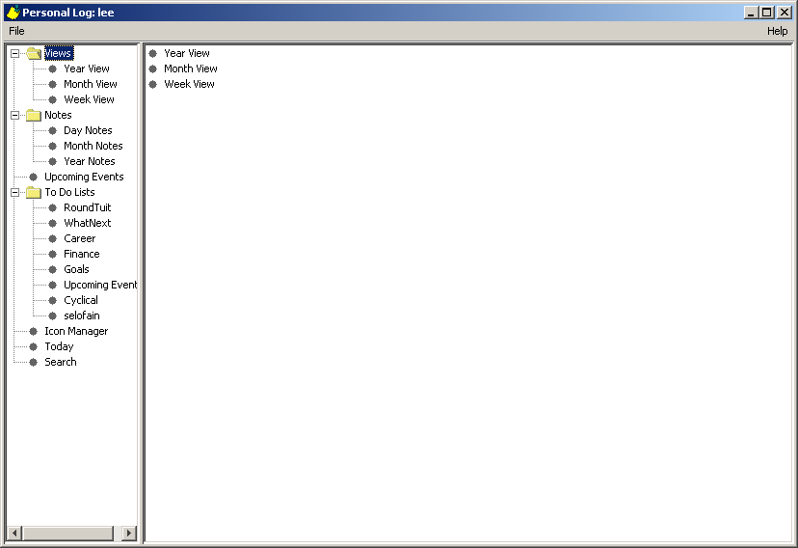

Slide 22
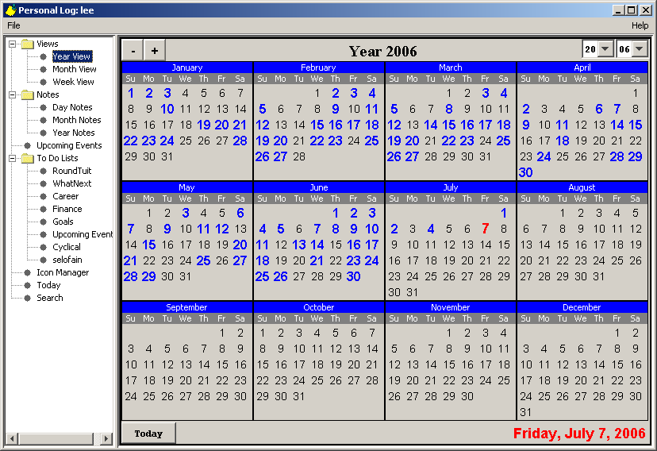

Slide 23
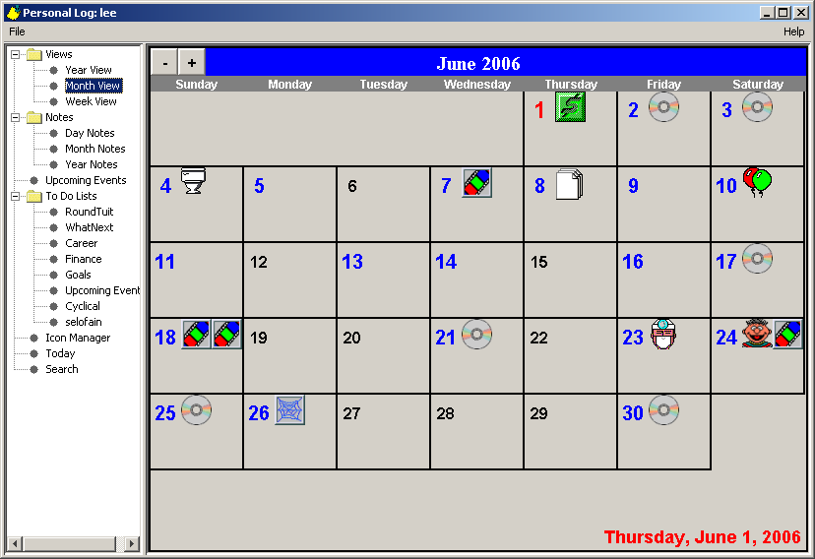

Slide 24
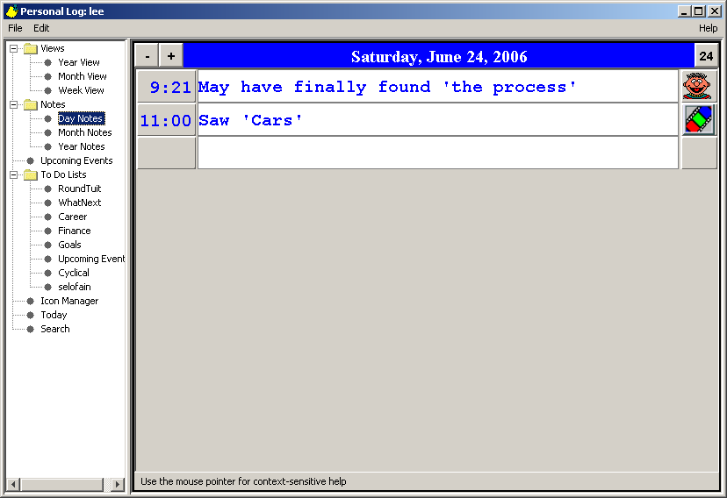

Slide 25
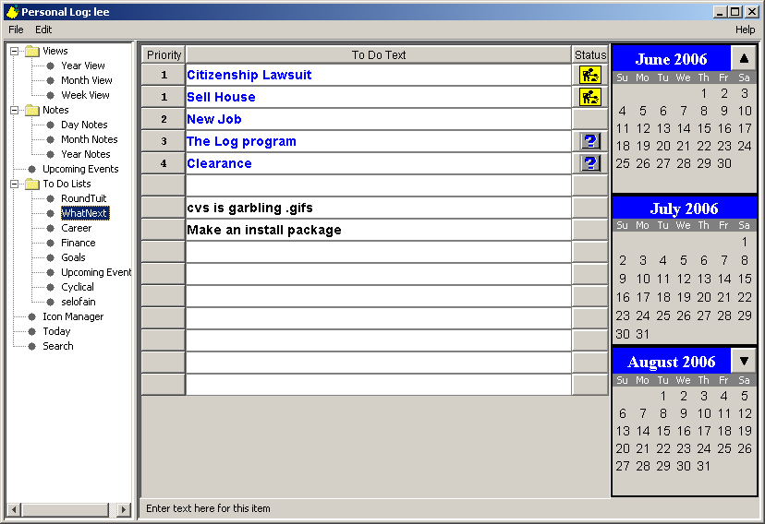

Slide 26
LogEvents
Heading
EventNoteGroup
TMC
LogEvents is a JPanel with a BorderLayout; the three components shown are added directly, and the South and West areas are empty.

Slide 27
Data Structures (5/12/2007)
NoteData
String | strNoteId
String | noteString
String | subjectString
String | extendedNoteString
int | extendedNoteWidthInt
int | extendedNoteHeightInt
Date | dateLastMod
IconNoteData
String | iconFileString
boolean | showIconOnMonthBoolean
SearchResultData
File | fileFoundIn
Date | dateNoteWhen
DayNoteData
Date | timeOfDayDate
EventNoteData
Date | dateEventStart
Date | dateEventEnd
String | strLocation
String | strRecurrence
int | intDatKnown
boolean | blnRetainNote
TodoNoteData
int | intPriority
int | intStatus
Date | dateTodoItem
String | strLinkage
Notes:
MonthNotes and YearNotes do not need to extend NoteData; they can use it as-is. The timeOfDayDate member is granular down to the second but can certainly be used to store a Month or Year value.
As for keeping subjectString in the base class – it is not needed by TodoNoteData, but that is the only user (of 5 at this writing) that does not need it, and in the event that the item is moved to a DayNote, it would be populated at that time. In the meanwhile it will remain null for a TodoNoteData, with no user interface access.
The redesign drops the embedded ‘deadline’ and associated format from a todoItem and reestablishes it in an event that the item may be linked to.
For TodoNoteData, the timeOfDayDate will equate to a ‘status as of’ date.

Slide 28
Component Structures (6/17/2007)
NoteComponent
NoteData | nd
NoteTextField | noteTextField
IconNoteComponent
IconNoteData | myIconNoteData
NoteIcon | noteIcon
SearchResultComponent
SearchResultData | mySearchResultData
FoundInButton | fibTheFoundInButton
LastModLabel | lmlTheLastModLabel
TodoNoteComponent
TodoNoteData | myTodoNoteData
StatusButton | sbTheStatusButton
PriorityButton | pbThePriorityButton
DayNoteComponent
DayNoteData | myDayNoteData
NoteTimeLabel | noteTimeLabel
int | myTimeAmPm
Date | myTime
EventNoteComponent
EventNoteData | myEventNoteData
Notes:
Note that there may be additional members; what is shown here are the graphical controls.

Slide 29
Group Structures (8/18/2007)
TodoNoteGroup
JPanel | heading NORTH
ThreeMonthColumn | tmc EAST
TodoGroupHeader | listHeader
SearchResultGroup
JPanel | heading NORTH
SearchResultHeader | listHeader
EventNoteGroup
EventHeader | theHeader NORTH
ThreeMonthColumn | tmc EAST
String | defaultIconFileString
NoteGroup
JScrollPane | jsp CENTER
JLabel | lblStatusMessage SOUTH
ExtendedNoteComponent | enc
CalendarNoteGroup
Date | choice
SimpleDateFormat | sdf
Date | getChoice()
DayNoteGroup
JPanel | heading NORTH
String | defaultIconFileString
YearNoteGroup
JPanel | heading NORTH
MonthNoteGroup
JPanel | heading NORTH
Notes:
On NoteGroup, the jsp is private but there is a public method whereby a header may be added, and his viewport view is the Panel that contains the group components. Where a ThreeMonthColumn is shown going into the EAST section, it is actually a JPanel with FlowchartLayout, with the tmc inside of that so that the tmc does not get stretched when the center expands.

Slide 30
Data Structures (1/13/2007)
NoteData
String | strNoteId
String | noteString
String | subjectString
String | extendedNoteString
int | extendedNoteWidthInt
int | extendedNoteHeightInt
Date | dateLastMod
IconNoteData
String | iconFileString
boolean | showIconOnMonthBoolean
DayNoteData
Date | timeOfDayDate
EventNoteData
Date | dateEventStart
Date | dateEventEnd
String | strLocation
String | strRecurrence
int | intDatKnown
boolean | blnRetainNote
TodoNoteData
Int | intPriority
Int | intStatus
Date | dateTodoItem
String | strLinkage
Notes:
MonthNotes and YearNotes do not need to extend NoteData; they can use it as-is. The timeOfDayDate member is granular down to the second but can certainly be used to store a Month or Year value.
As for keeping subjectString in the base class – it is not needed by TodoNoteData, but that is the only user (of 5 at this writing) that does not need it, and in the event that the item is moved to a DayNote, it would be populated at that time. In the meanwhile it will remain null for a TodoNoteData, with no user interface access.
The redesign drops the embedded ‘deadline’ and associated format from a todoItem and reestablishes it in an event that the item may be linked to.
For TodoNoteData, the timeOfDayDate will equate to a ‘status as of’ date.

Slide 31
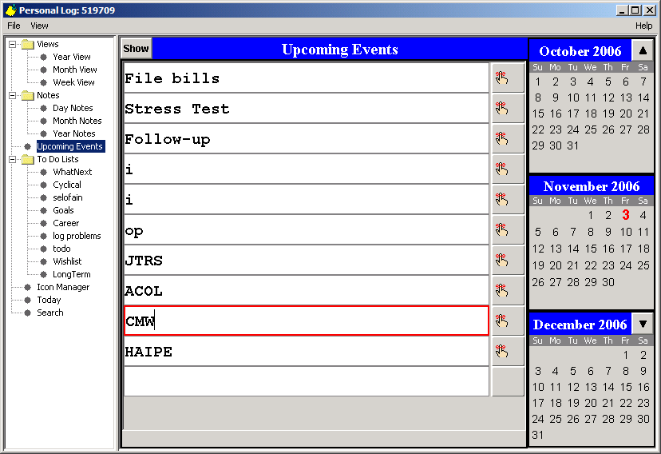

Slide 32
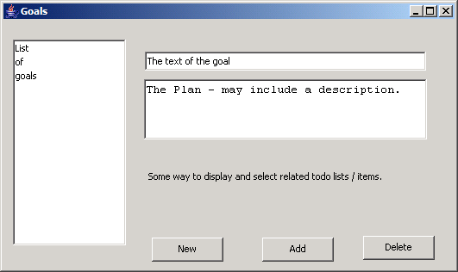
Initial Design for the Goals Dialog

Slide 33
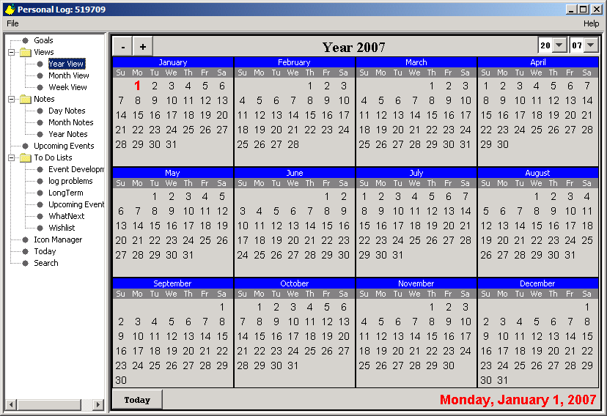

Slide 34
Hypothesis – An unverified explanation of certain facts or observations
Theory – A hypothesis that has been verified.
Decision – An opinion or judgment reached after consideration of one or more factors.
A conclusion is a type of decision.
Note that a decision may not necessarily lead to a plan of action; it may be: ‘do nothing for now’ or ‘wait for more info’.

Slide 35



x
Memory Bank
Version 0.2

