Slide 1
Challenges

Slide 2
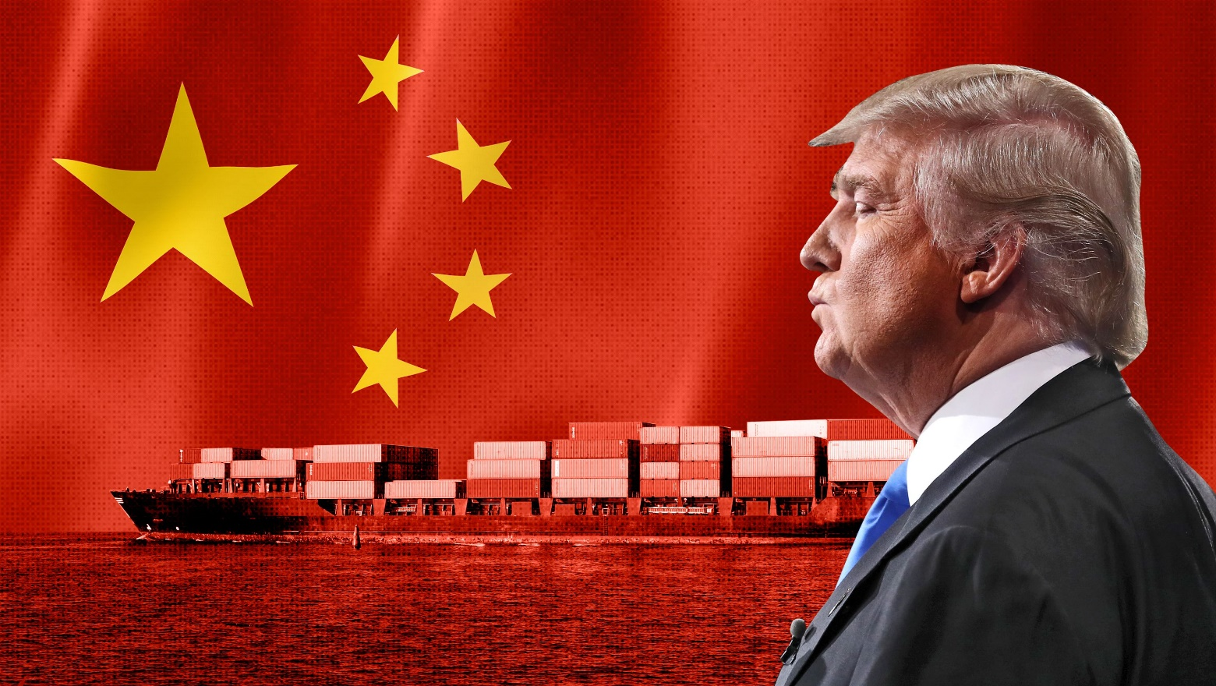

Export Restrictions under Former President Trump:
During Trump’s administration, stricter export controls limited China’s access to U.S. technology, slowing Chinese tech development and prompting a push for domestic innovation.
China’s e-commerce’s intense competition
China’s $2 trillion e-commerce market, led by giants like Alibaba and JD.com, faces intense competition. Price wars and promotions dominate, squeezing profit margins, especially for smaller players.

Slide 3

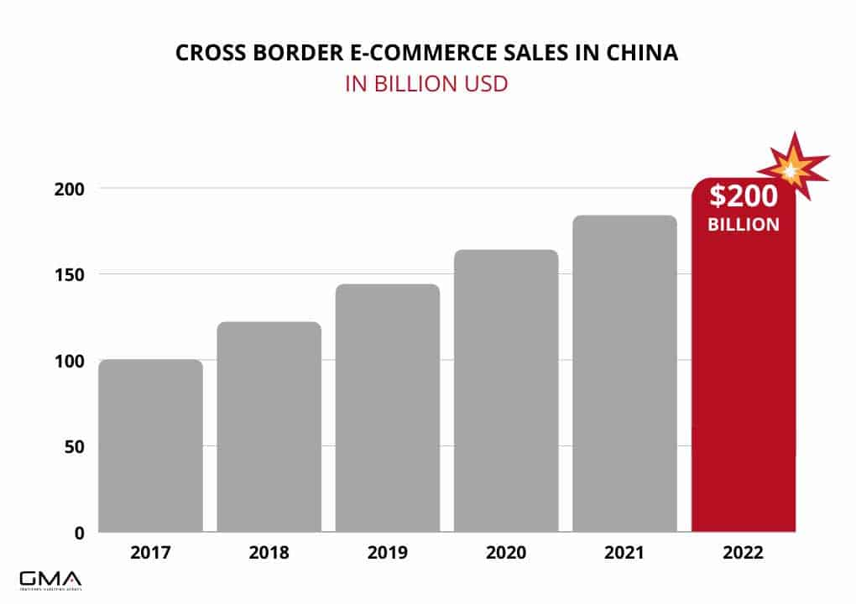
personalized shopping experiences through AI and VR technologies.
cross-border e-commerce

