Slide 1

Final Project SciDB for Clustering Analysis of MovieLens Ratings Data
Liu, Wusuo
Lee, Chia Ying
CSCI E-63 Big Data Analytics
Harvard University Extension School
Prof. Zoran B. Djordjević
@Your Name
1
Notes:
1

Slide 2
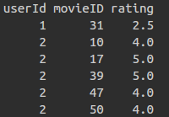
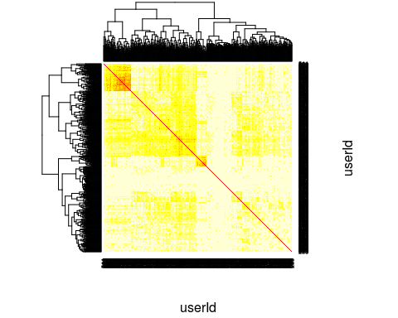
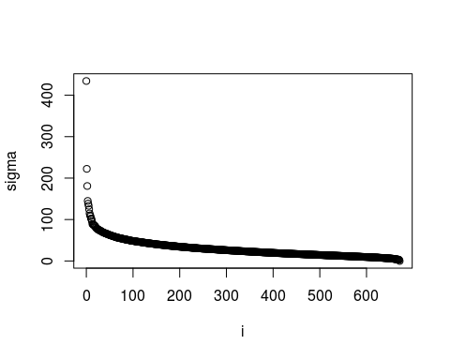
SciDB for Clustering Analysis of MovieLens Ratings Data
Correlation
Matrix
Principle Component Analysis
@Your Name

