Slide 1

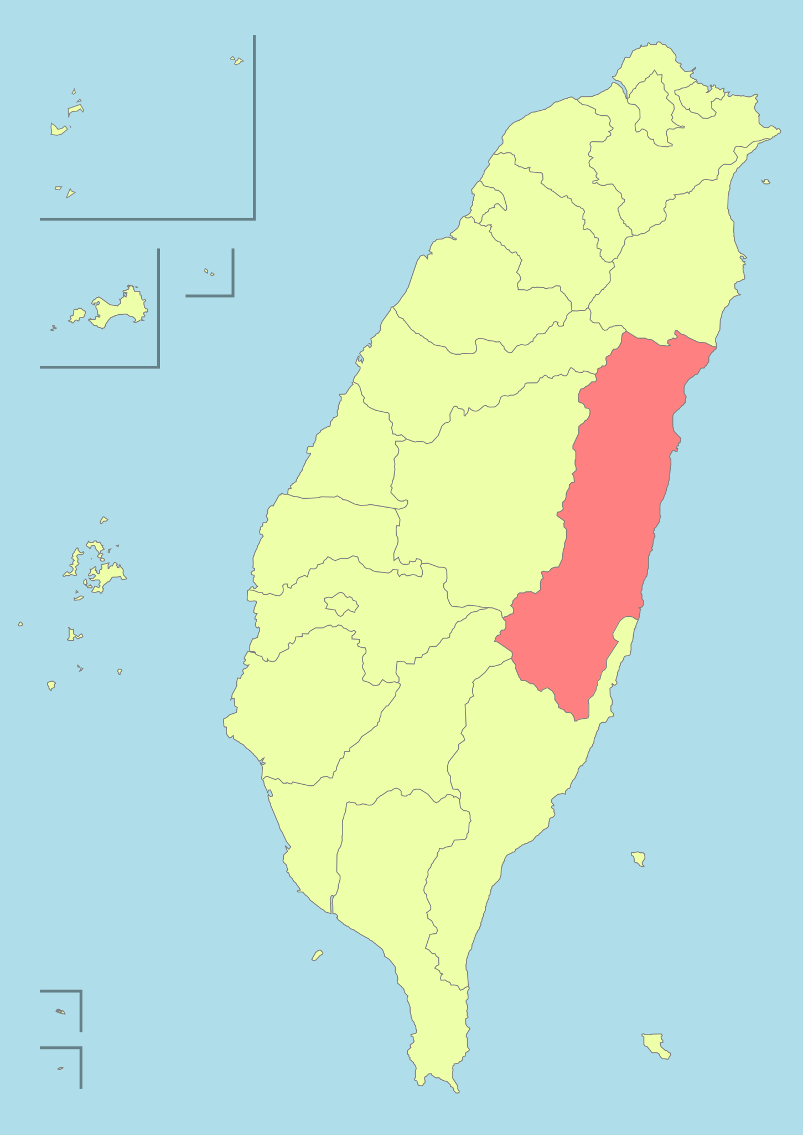
Morphological Analysis of Amis with Python Lonnie Chien, LING 073 Computational Linguistics, Swarthmore College
Background
Python Analyser Architecture
Amis is an Austronesian language with 108,000 speakers located in Hualien County on the east coast of Taiwan.
The status of the language in terms of its transmission to current and future generations is 6b: Threatened.
ISO Code: AMI
Corpuses of the language are written in the latin script, with the vowels a, e, i, u and the consonants c, d, g, h, k, l, m, n, ng, p, r, s, t, v, w, x, y, z, and also utilizes glottal stops.
Used Python to assemble library of morphemes by stripping .lexd entries:
Created data structure organizing Amis text, list of tags, and root of form.
Stored these in a dictionary where key is a category (voice, mood, etc).
Implemented patterns to stitch morphemes and concatenate tags:
ira:ira <pers><sg><p3>: # Possible fix to spelling issue
ira,pers,sg,p3
forms = list of all of the roots
options = list of dictionary keys representing optional categories
for each option:
for each form:
append to forms: copy of the form with options attached
Evaluation
To check coverage over a corpus, each word is stored in a set, and all forms in a dictionary. The program looks up each word in the dictionary.
A running tally of the words in the dictionary is recorded.
The Python analyzer stores whole forms and searches them, so it is O(n) based on the number of words.
Because the Python program stores the entire dictionary of forms for searching, it is memory inefficient and slow.
The Python analyzer stores whole forms and searches them, so it is O(n) based on the number of words it needs to search.

