Slide 1
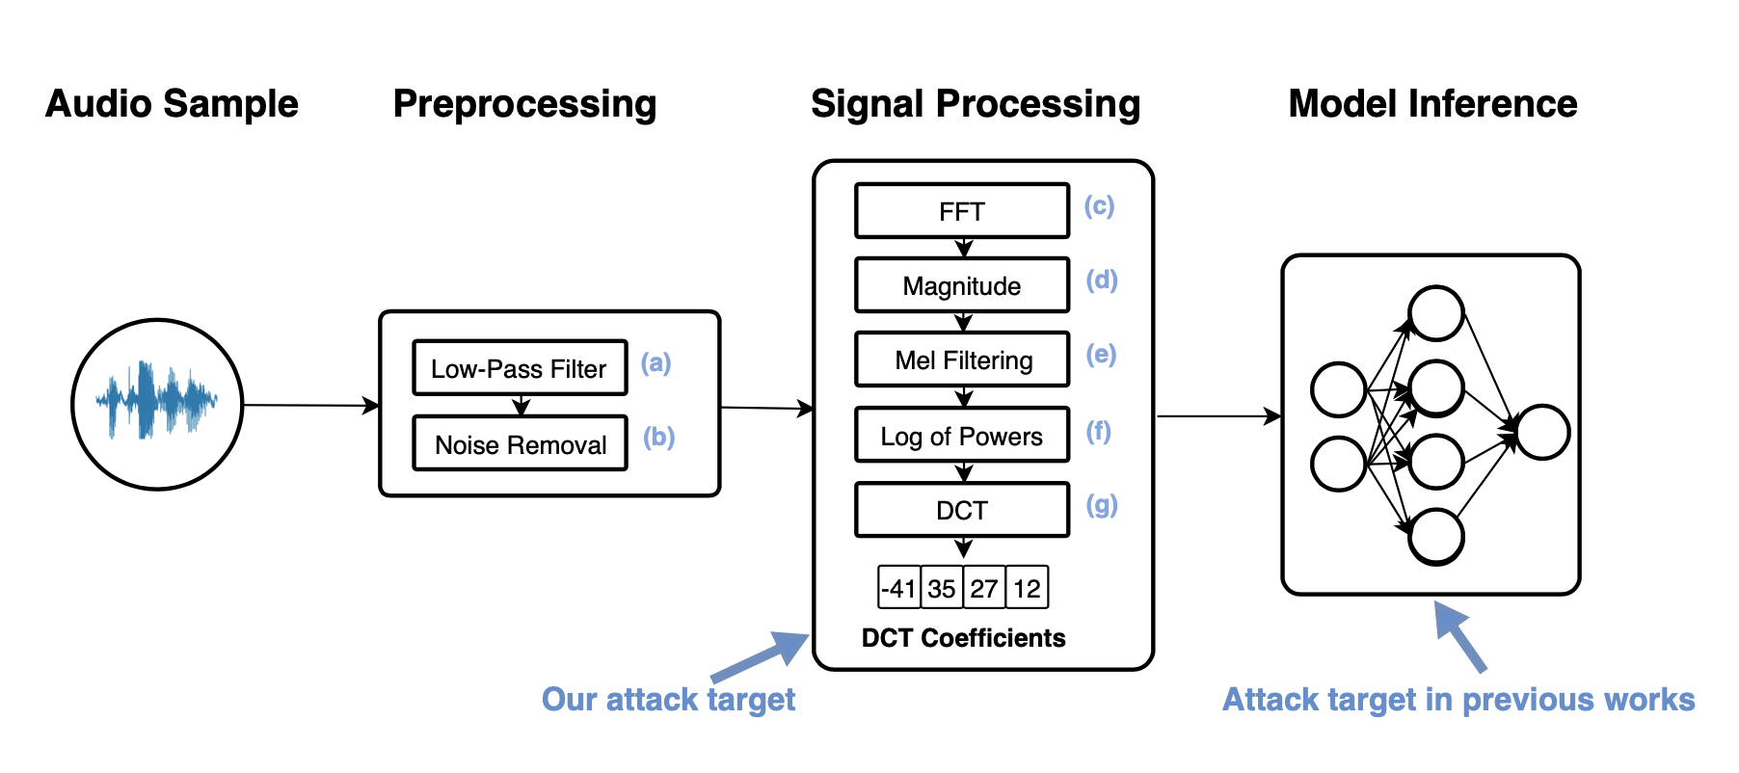
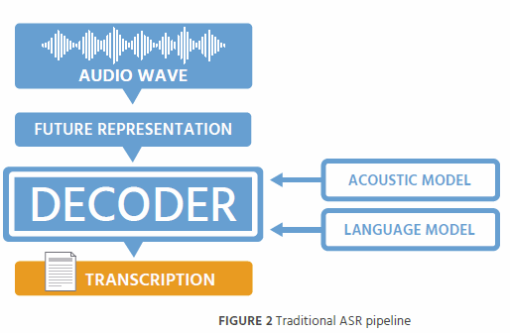
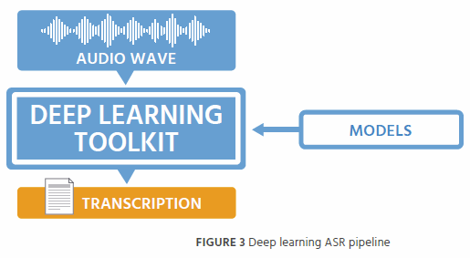
？

Slide 2
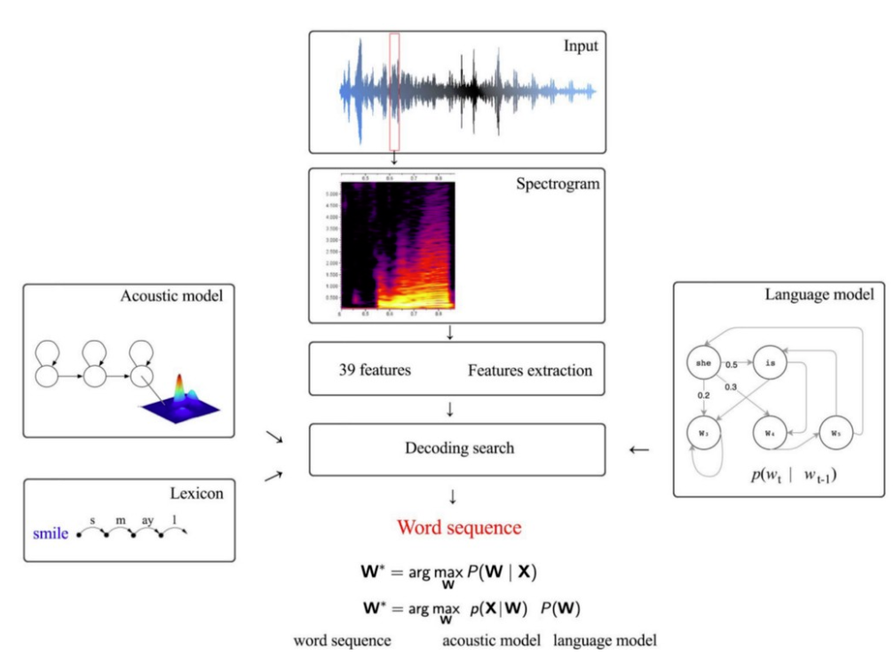

Slide 3
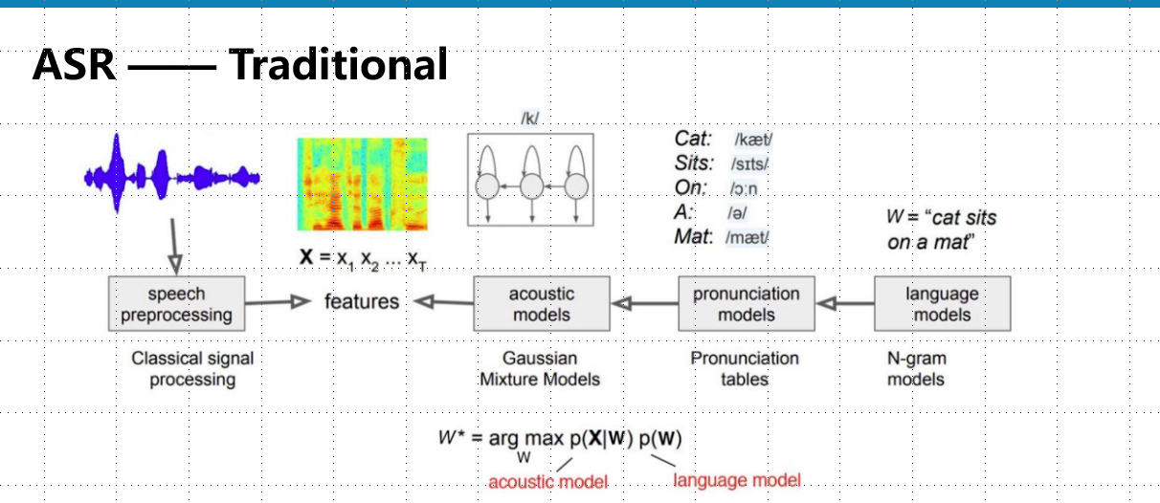

Slide 4
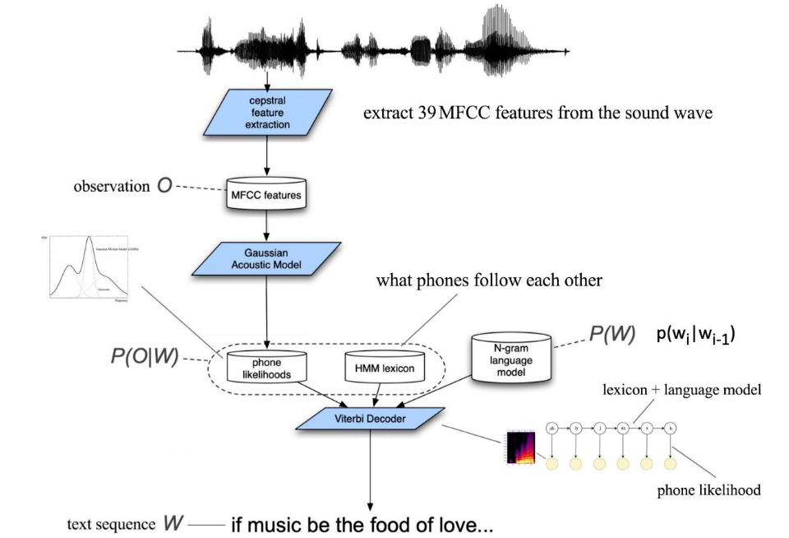

Slide 5
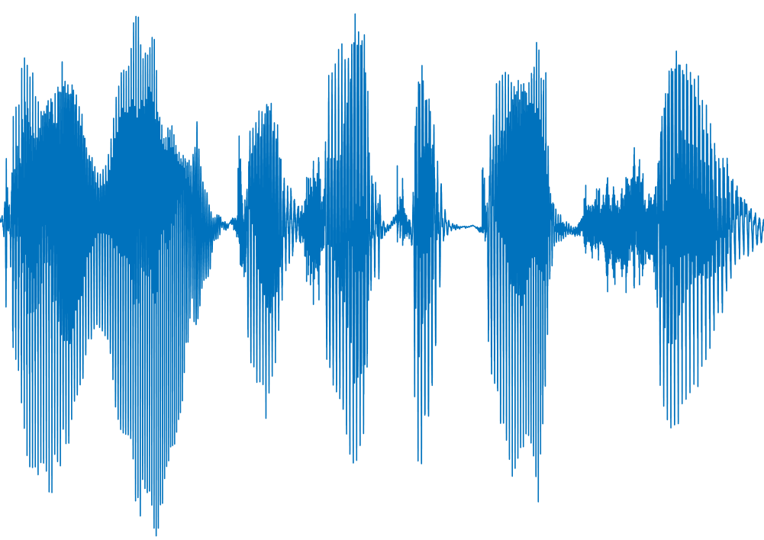
Feature Extraction
Acoustic
model
Language model
Signal
preprocessing
Feature extraction
Acoustic
model
Pronunciation model
Language model
“I want to
take a picture”

Slide 6


Signal
preprocessing
Feature extraction
Acoustic
model
Pronunciation model
Language model
Output
“take a picture”
/teɪk/ → take
/eɪ/ → a
/ˈpɪktʃə(r)/ → picture
1. take a picture
2. take a denture
Origin audio
/t/
Decoding model

Slide 7
Feature Extraction
Acoustic
model
Language model
Pronunciation model
Acoustic model
Signal
preprocessing
Feature extraction
“I want to
take a picture”
Language model
I: /aɪ/
Want: /wɒnt/
To: /tuː/
Take: /teɪk/
A: /eɪ/
Picture: /ˈpɪktʃə(r)/

Slide 8
Acoustic model
Signal
preprocessing
Feature extraction
Pronunciation model
Take: /teɪk/
A: /eɪ/
Picture: /ˈpɪktʃə(r)/
“take a picture”
Language model

