Slide 1
基于音频预处理过程漏洞的
语音识别系统攻击
李超豪 蒋沁宏

Slide 2

Background & Motivation
Feature Extraction
Decoding
Time-scale modification
Filter
SR System
Sound
Preprocessing
Speech recognition (optional)
音频预处理过程

Slide 3
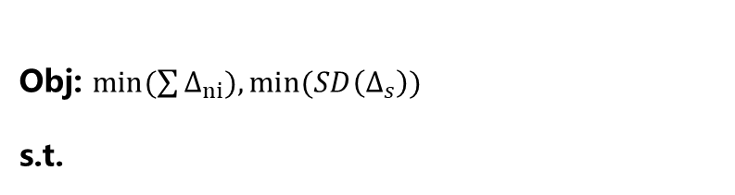

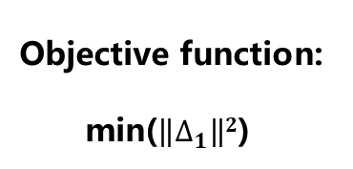








Model
$$∆_{1}=F(∆_{n},∆_{s})$$
$$A=S+ ∆_{1}$$
$$∆_{n}:the vector of enabling control sequece{ (∆}_{n}=[0,1,1,0,1,0])$$
$$TSM\left(A\right)=D$$
$$①$$
$∆_{s}:the vector of speech control sequence$ ${ (∆}_{s}=[1,1.01,1.02,1,0.9,1])$
$$D=T+∆_{2}$$
$$\left\|∆_{2}\right\|∞≤ε$$
$$∆_{n}:the vector of enabling control sequece{ (∆}_{n}=[0,-1,1,0,1,0])$$
$$②$$
区别放缩
Objective function:
min($\left\|∆_{1}\right\|2$)
$∆_{s}:the vector of speech control sequence$ ${ (∆}_{s}=[0,0.01,0.02,0,0.1,0])$
Obj: $min(\sum{∆_{ni}}),min(SD\left(∆_{s}\right))$
s.t.
$$D=T+∆_{2}$$
$$\left\|∆_{2}\right\|∞≤ε$$

Slide 4

Challenges
How to measure the distortion？
The alignment between the audio before and after the time-scale modification.
How to formulate our problem as an optimization problem?
We don’t add new phoneme into the source audio.
It is different from image scaling.

Slide 5




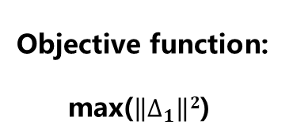


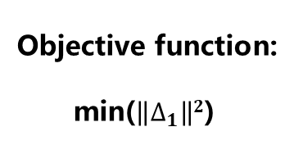






Model
$$∆_{1}=F(∆_{n},∆_{s})$$
强攻击
弱攻击
$$∆_{n}:the vector of TSMed frame$$
$$∆_{s}:the speech sequence of TSMed frame$$
$$A=S+ ∆_{1}$$
$$R=TSM′(T)$$
$$TSM\left(A\right)=D$$
$$A=R+∆_{1}$$
$$D=T+∆_{2}$$
$$TSM\left(A\right)=D$$
$$\left\|∆_{2}\right\|∞≤ε$$
Obj:
s.t.
$$D=T+∆_{2}$$
$$\left\|∆_{2}\right\|∞≤ε$$
Objective function:
min($\left\|∆_{1}\right\|2$)
Objective function:
max($\left\|∆_{1}\right\|2$)

