Slide 1
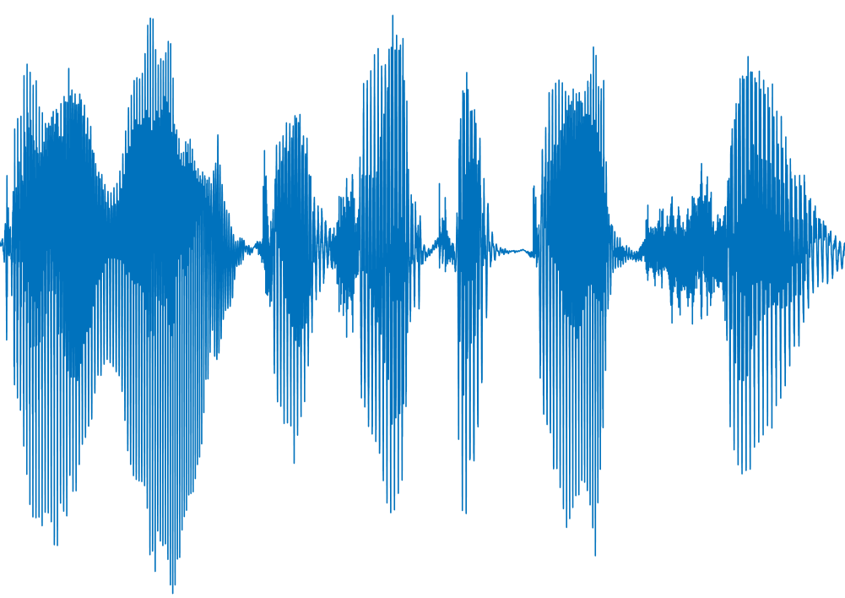
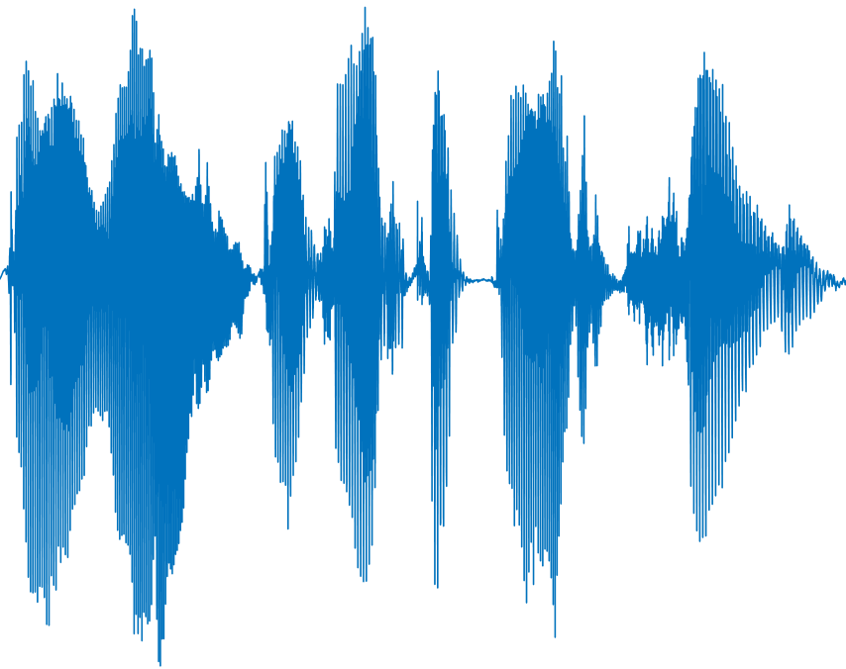
Signal Decomposition
Origin audio
Analysis Frame
Synthesis Frame
Output signal

