Slide 1
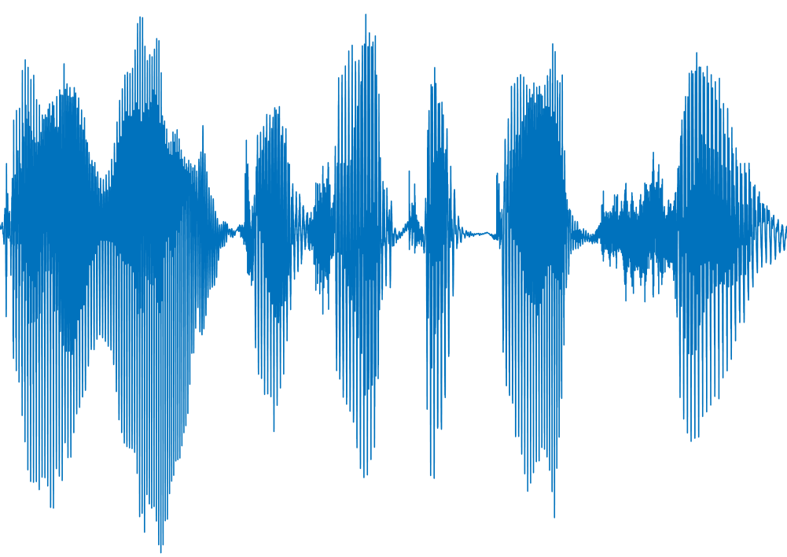
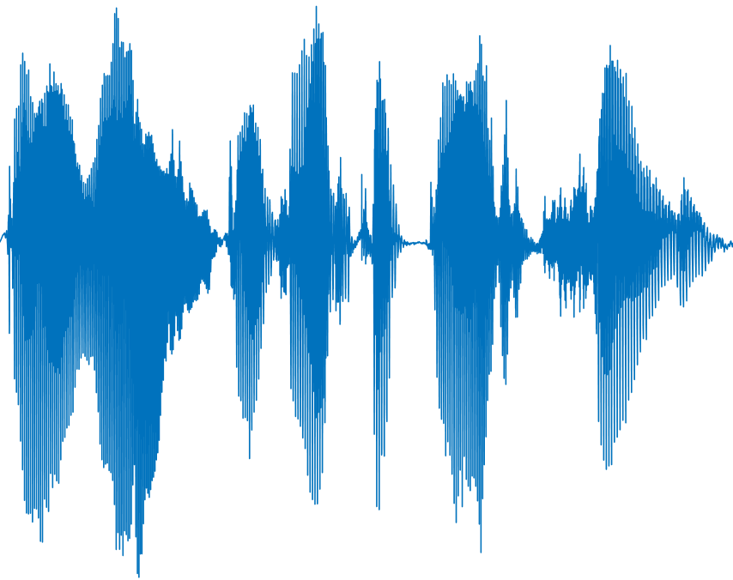
Signal Decomposition
Frame Relocation
Signal Reconstruction
Origin audio
Analysis Frame
Synthesis Frame
Output signal

Slide 2
Signal decomposition
Frame relocation
Signal reconstruction
Origin audio
Analysis frames
Synthesis frames
Output signal

Slide 3
Signal decomposition
Frame relocation & adaption
Signal reconstruction
Origin audio
Analysis frames
Synthesis frames
Output signal
Analysis
hopsize
Synthesis
hopsize

