Slide 1
VAD-based TSM
inner-word phoneme shifting
inter-word connected speech
the minimum pause interval of ASR systems

Slide 2
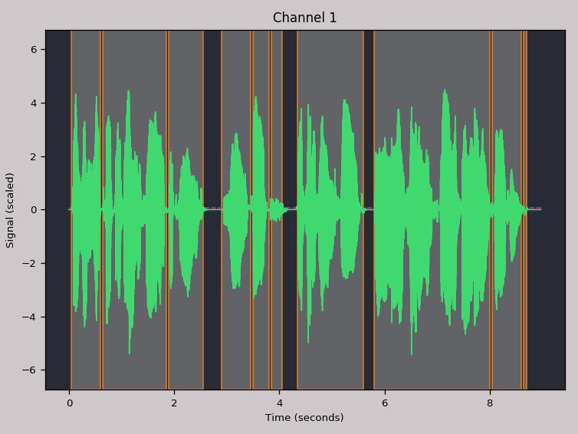
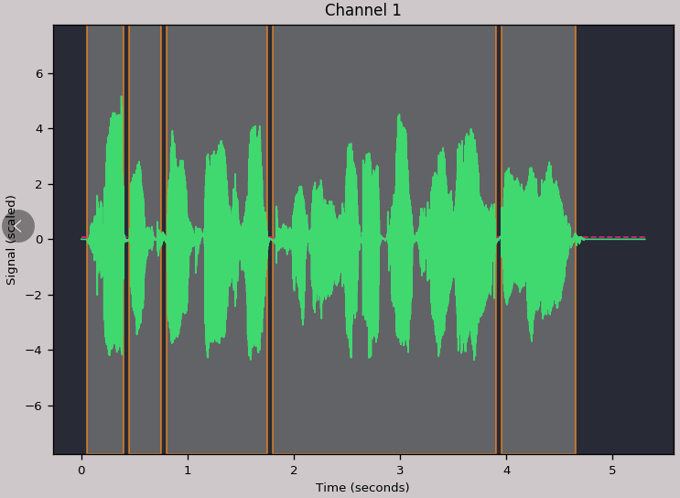
VAD-based TSM
Word
Pause

Slide 3
Experiments
A: Only randomly change the speed of word part
B: Only randomly change the speed of pause part
C: Both change

Slide 4
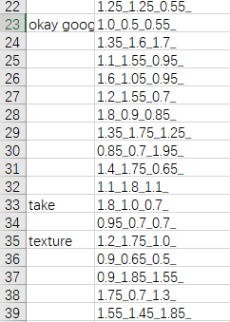
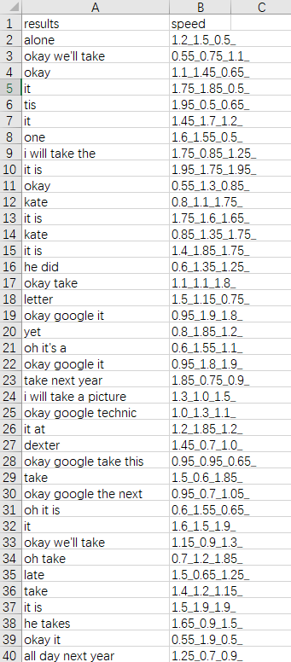
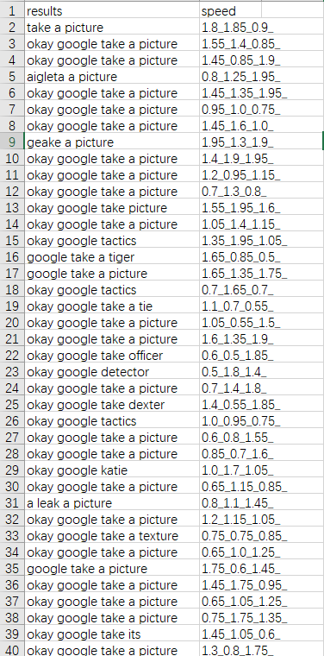
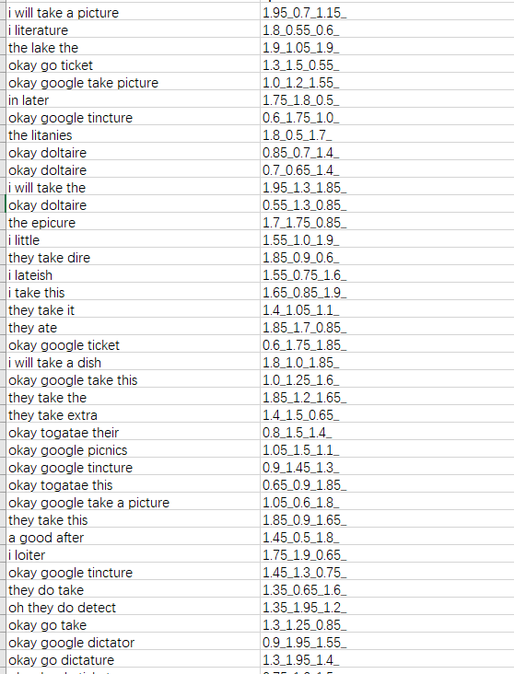
Experiments – A
A: Only randomly change the speed of word part
PV\OLA\WSOLA\FFMPEG

Slide 5
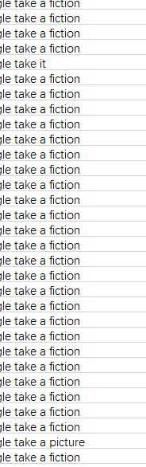
Experiments – B
B: Only randomly change the speed of pause part
okay google take a picture —— google take a fiction， google take a fixture
google take it， google take a victor

Slide 6

Experiments – Example
I finish my work at 6:00 pm —— worth
I like playing football —— life
Okay Google take a picture —— take it
Hundreds of soldiers ate in silence around their campfires. —— one of older date and silent around cities
I wish I had taken better care of myself. —— i will raise health taking that air of myself
Shaw, those twelve beige hooks are joined if I patch a young, gooey mouth. —— she alterin the yearning

Slide 7
Experiments – KDXF
I like playing football-->I love playing football.
基本错误的不多

Slide 8
Result
Word Deletion
可解释性一般（不能完全解释）
基于VAD处理过后可听性增强

