Slide 1
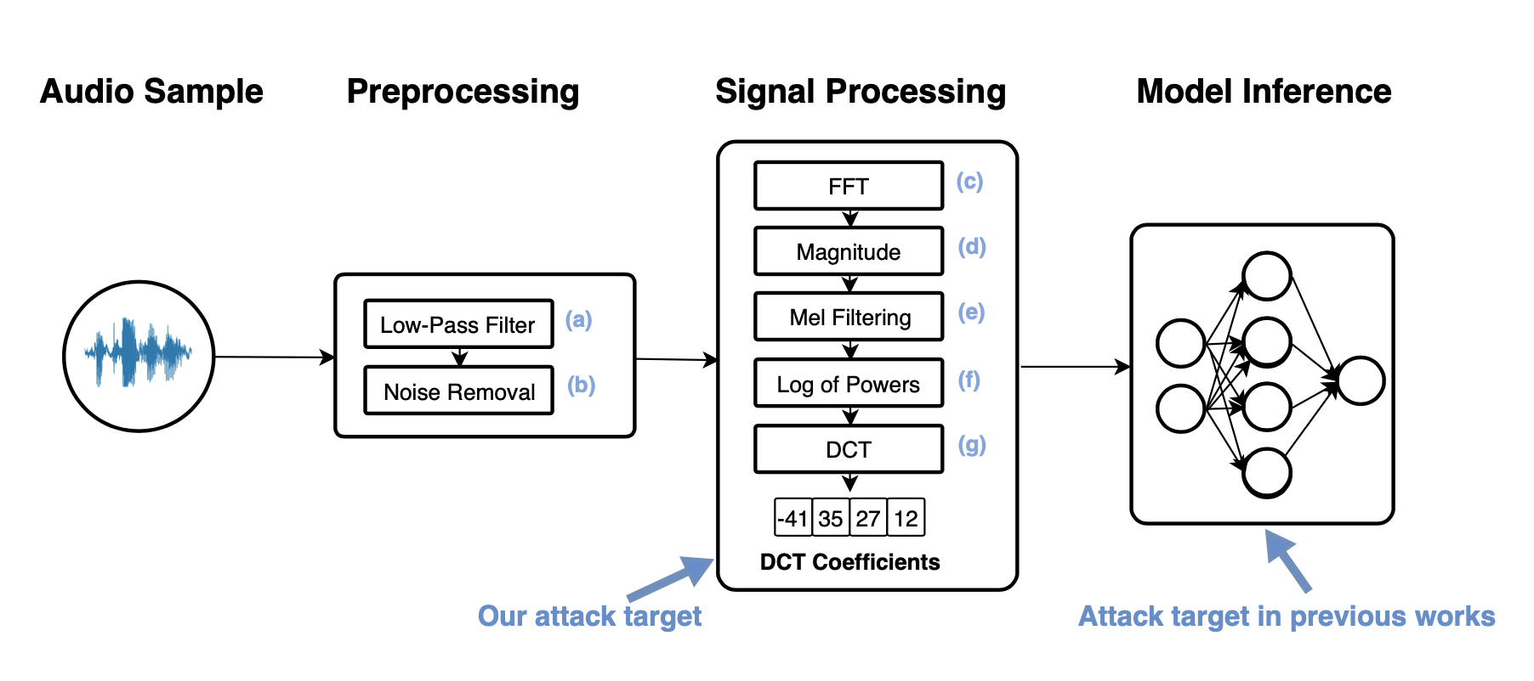
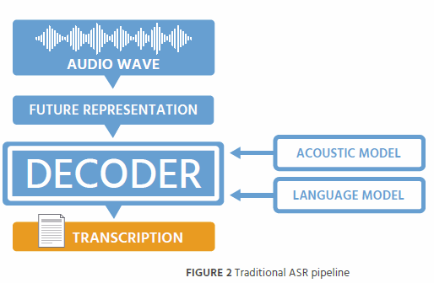
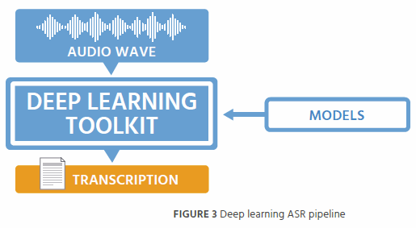
？

Slide 2
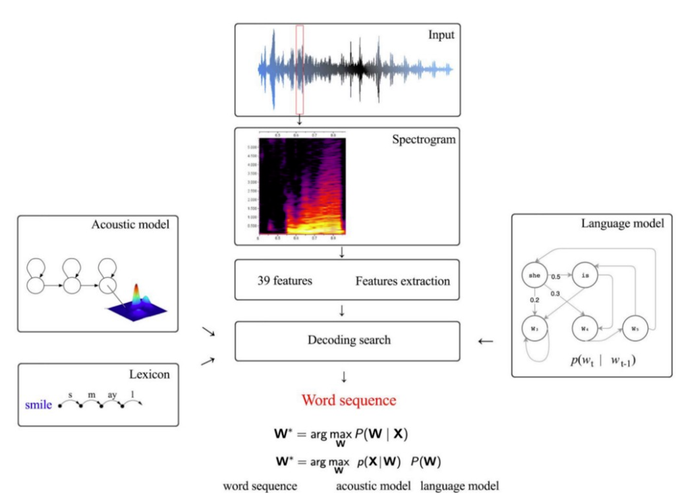

Slide 3
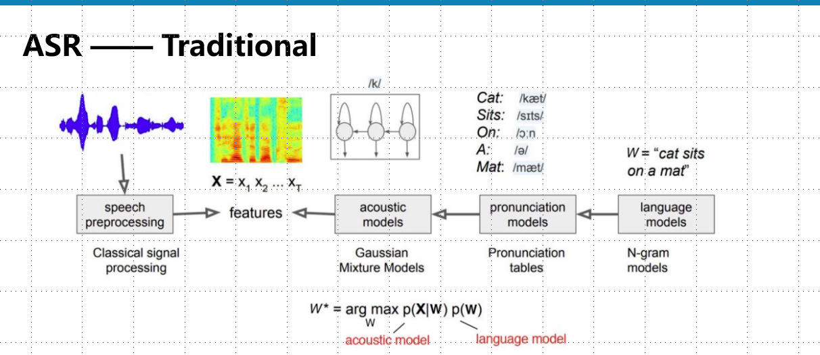

Slide 4
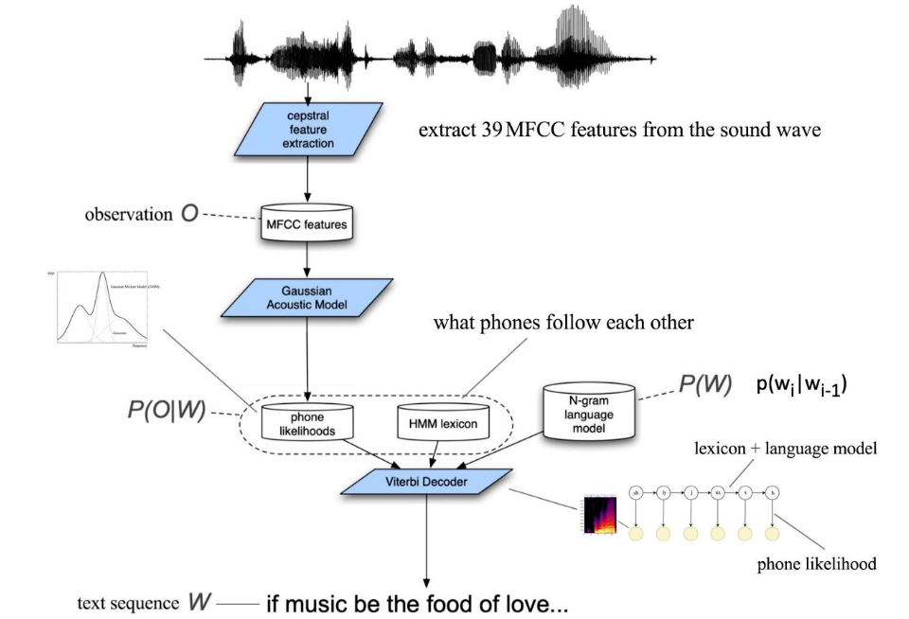

Slide 5
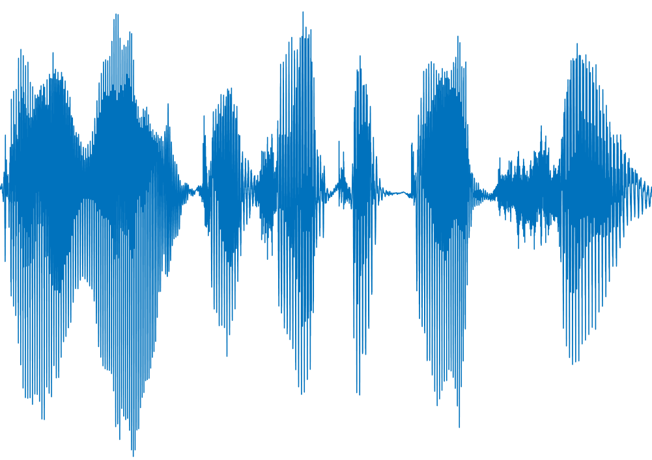
Feature Extraction
Acoustic
model
Language model
Signal
preprocessing
Feature extraction
Acoustic
model
Pronunciation model
Language model
“I want to
take a picture”

Slide 6
Feature Extraction
Acoustic
model
Language model
Pronunciation model
Signal
preprocessing
Feature extraction
“I want to
take a picture”
Acoustic model
Language model

