Slide 1
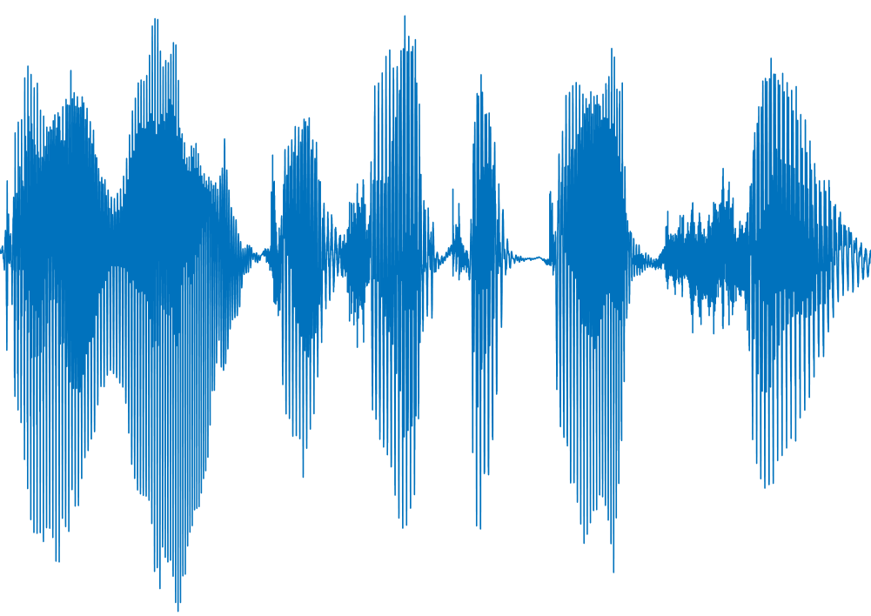
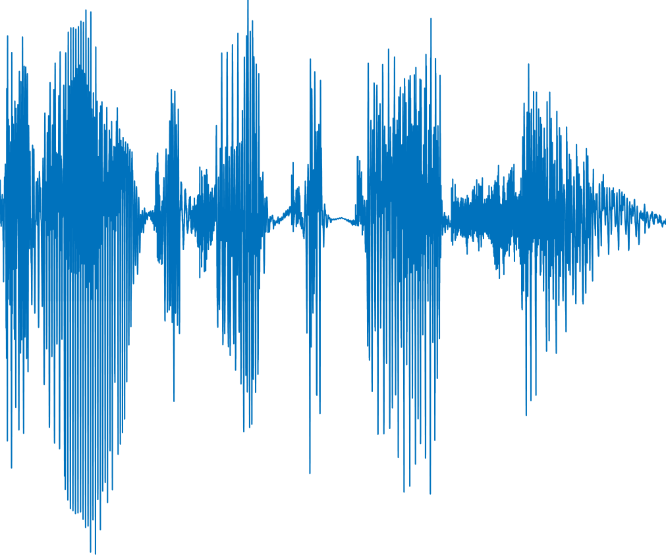
Time-scale Modification (TSM)
Entire TSM
Original Audio
Automatic Speech Recognition System (ASR)
Partial TSM
Targeted Result
What user hears:
“I want to take a picture”
What ASR recognizes:
“wait action”

Slide 2
Time-scale Modification (TSM)
Entire TSM
Original Audio
Automatic Speech Recognition System (ASR)
Targeted Result
Partial TSM
“I want to take a picture”
“wait action”

Slide 3
Phonemic feasibility analysis
GA-based AEs generation
Original Audio
Sound change
model
preliminary
text result
ASR
Partial TSM
ASR
Word construction model
Partial TSM
Targeted result

Slide 4
Phonemic analysis
Audio
Sound change
model
preliminary result
ASR
Word construction model
initial generation
Original audio
Audio segment
Partial TSM
Targeted result
GA-based AEs generation

Slide 5
Phonemic analysis
preliminary
result
Sound change
model
Word construction
model
ASR
initial generation
Original audio
Audio segment
Partial TSM
GA algorithm
T
Targeted result
N
GA-based AEs generation

Slide 6
Phonemic analysis
preliminary
result
Sound change
model
Word construction
model
ASR
initial generation
Original audio
Audio segment
Partial TSM
GA algorithm
T
Targeted result
N
GA-based AEs generation

Slide 7
Phonemic analysis
preliminary
result
Sound change
model
Word construction
model
phoneme
decomposition
ASR
initial generation
AEs
T
Original audio
Audio segment
Partial TSM
GA algorithm
ASR
Targeted result
N
GA-based AEs generation

Slide 8
Phonemic analysis
ASR
preliminary
result
Sound change
model
Word construction
model
phoneme
decomposition
initial generation
Original audio
Audio segment
Partial
TSM
GA algorithm
AEs
ASR
Y
Targeted result
N
GA-based AEs generation

Slide 9
Phonemic feasibility analysis
Targeted result
Sound change
model
Word construction
model
ASR
initial generation
Original audio
Audio segment
Partial
TSM
GA algorithm
AEs
ASR
Y
Targeted result
N
GA-based AEs generation

Slide 10
Targeted text
Original text
Sound change
model
Original audio
Segmentation
Time-scale
Modification
GA Search
AEs
ASR
Y
Targeted result
N
GA-based AEs generation

Slide 11
Sound change model
Original audio
Slicing
Time-scale
modification
GA-based search
Targeted words?
Y
Adversarial
audio
N
GA-based AE generation

