Slide 1
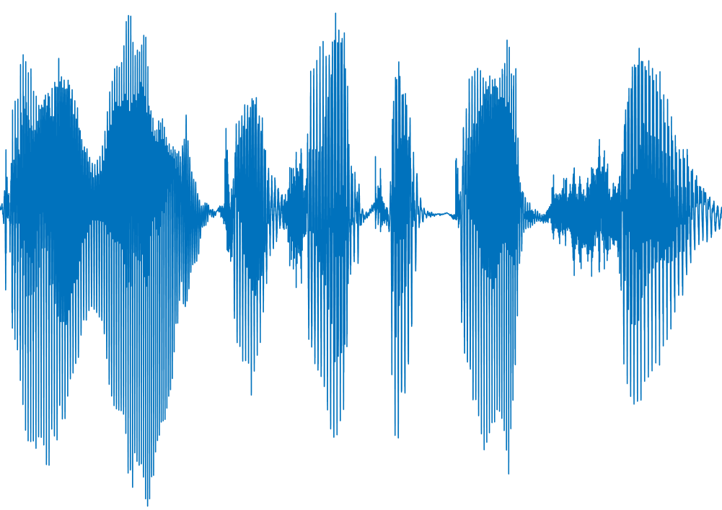
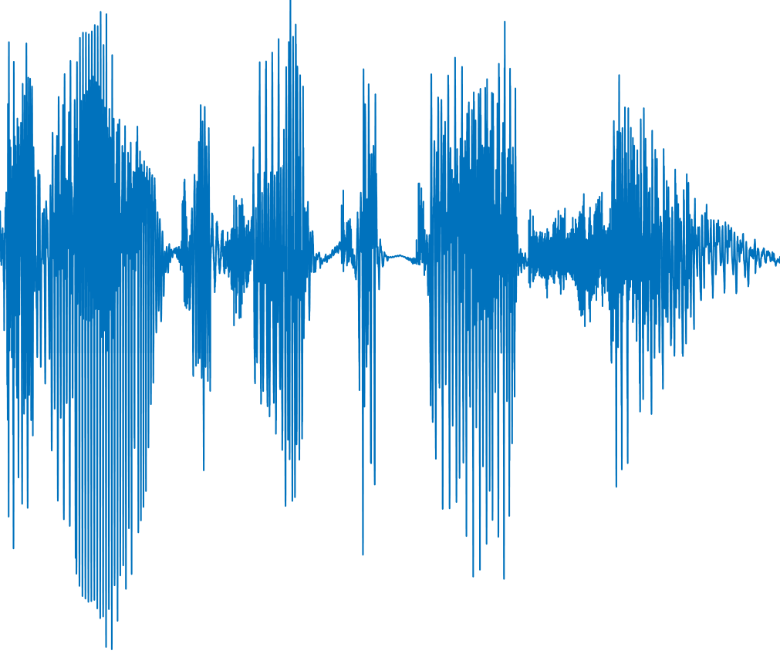
Time-scale Modification (TSM)
Entire TSM
Original Audio
Automatic Speech Recognition System (ASR)
Partial TSM
Targeted Result
What user hears:
“I want to take a picture”
What ASR recognizes:
“wait action”

Slide 2
Time-scale Modification (TSM)
Entire TSM
Original Audio
Automatic Speech Recognition System (ASR)
Targeted Result
Partial TSM
“I want to take a picture”
“wait action”

Slide 3


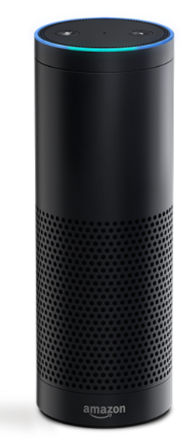

Ok Google, take a picture.
Ok Google, take a picture.
Human
Played in 1.5x speed
Ok Google, Wait action
Machine

