Slide 1
VAD-based TSM
inner-word phoneme shifting
inter-word connected speech
the minimum pause interval of ASR systems
Notes:
Most words are two to three syllables long, giving you the answer that the average person speaks approximately 100 – 130 words per minute. A professional voice over artist usually uses 150 to 160 words per minute. An auctioneer, on the other hand, does a rapid fire 250 to 400 words per minute. Those, however, are exceptions. When you’re just having a chat, you’ll usually speak at a rate of 110 to 130 words per minute.
https://wordcounter.net/blog/2016/06/02/101702_how-fast-average-person-speaks.html
Normally, you speak about 125 words per minute. But you may speak much slower at about 100 wpm if you are giving a slide presentation.
You will find that the rate of speaking in audiobooks is about 150-160 words per minute whereas auctioneers can speak at about 250 wpm. According to the Guinness World Record, the current fastest speaker is Steve Woodmore, who was clocked at a rate of 637 wpm. Caution--slow down a minute to consider what you might do with your speech rate to be more effective.
https://lumen.instructure.com/courses/218897/pages/linkedtext54273?module_item_id=5007143

Slide 2
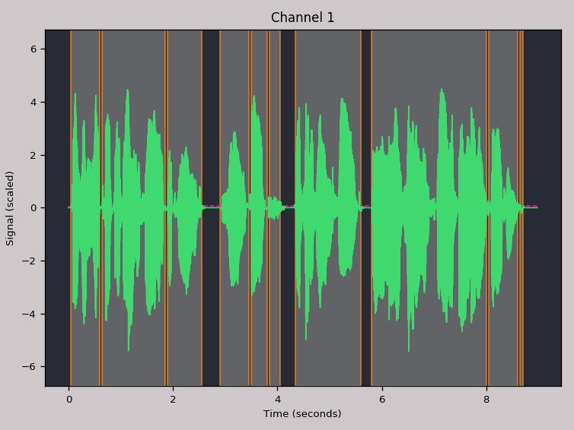
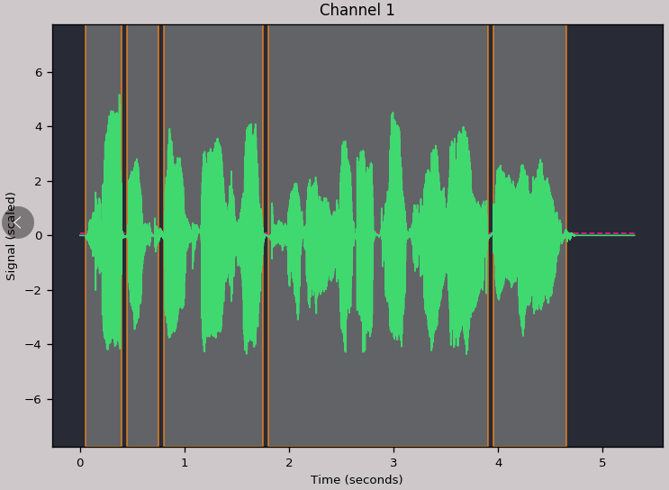
VAD-based TSM
Word
Pause
Notes:
Most words are two to three syllables long, giving you the answer that the average person speaks approximately 100 – 130 words per minute. A professional voice over artist usually uses 150 to 160 words per minute. An auctioneer, on the other hand, does a rapid fire 250 to 400 words per minute. Those, however, are exceptions. When you’re just having a chat, you’ll usually speak at a rate of 110 to 130 words per minute.
https://wordcounter.net/blog/2016/06/02/101702_how-fast-average-person-speaks.html
Normally, you speak about 125 words per minute. But you may speak much slower at about 100 wpm if you are giving a slide presentation.
You will find that the rate of speaking in audiobooks is about 150-160 words per minute whereas auctioneers can speak at about 250 wpm. According to the Guinness World Record, the current fastest speaker is Steve Woodmore, who was clocked at a rate of 637 wpm. Caution--slow down a minute to consider what you might do with your speech rate to be more effective.
https://lumen.instructure.com/courses/218897/pages/linkedtext54273?module_item_id=5007143

Slide 3
Experiments
A: Only randomly change the speed of word part
B: Only randomly change the speed of pause part
C: Both change
Notes:
Most words are two to three syllables long, giving you the answer that the average person speaks approximately 100 – 130 words per minute. A professional voice over artist usually uses 150 to 160 words per minute. An auctioneer, on the other hand, does a rapid fire 250 to 400 words per minute. Those, however, are exceptions. When you’re just having a chat, you’ll usually speak at a rate of 110 to 130 words per minute.
https://wordcounter.net/blog/2016/06/02/101702_how-fast-average-person-speaks.html
Normally, you speak about 125 words per minute. But you may speak much slower at about 100 wpm if you are giving a slide presentation.
You will find that the rate of speaking in audiobooks is about 150-160 words per minute whereas auctioneers can speak at about 250 wpm. According to the Guinness World Record, the current fastest speaker is Steve Woodmore, who was clocked at a rate of 637 wpm. Caution--slow down a minute to consider what you might do with your speech rate to be more effective.
https://lumen.instructure.com/courses/218897/pages/linkedtext54273?module_item_id=5007143

Slide 4
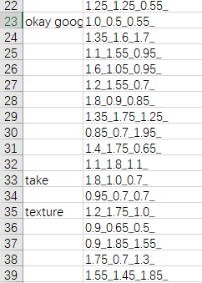
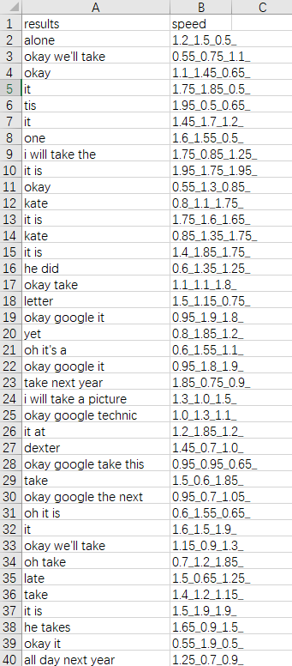
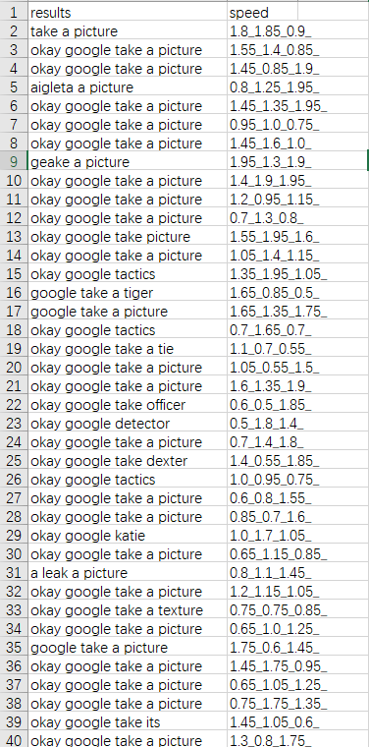
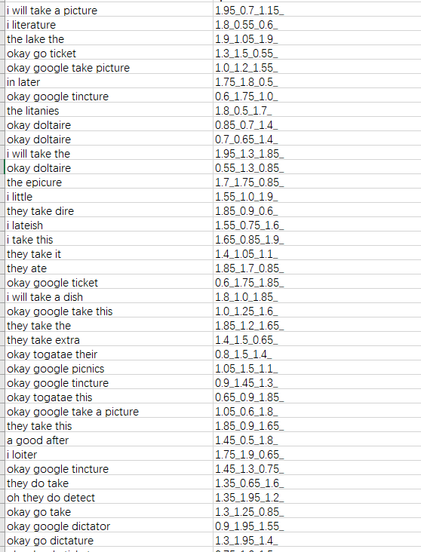
Experiments – A
A: Only randomly change the speed of word part
PV\OLA\WSOLA\FFMPEG

Slide 5
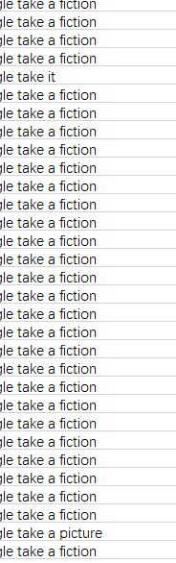
Experiments – B
B: Only randomly change the speed of pause part

Slide 6

Experiments – Example
I finish my work at 6:00 pm —— worth
I like playing football —— life
Okay Google take a picture —— take it

Slide 7
Experiments – KDXF
I like playing football-->I love playing football.
基本错误的不多

Slide 8
Result
Word Deletion
可解释性一般（不能完全解释）
基于VAD处理过后可听性增强

