Slide 1
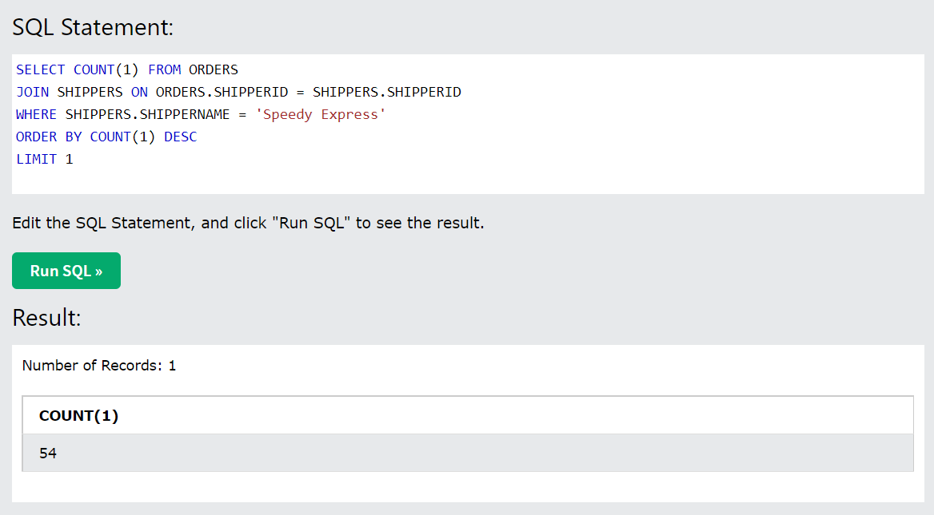
How many orders were shipped by Speedy Express in total?

Slide 2
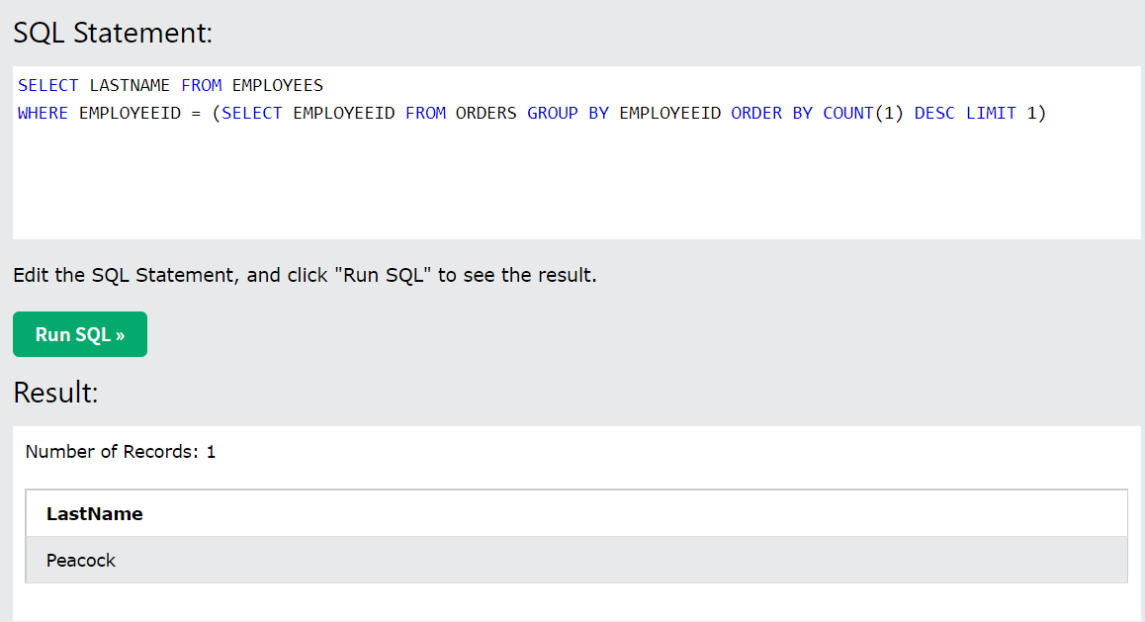
2. What is the last name of the employee with the most orders?

Slide 3
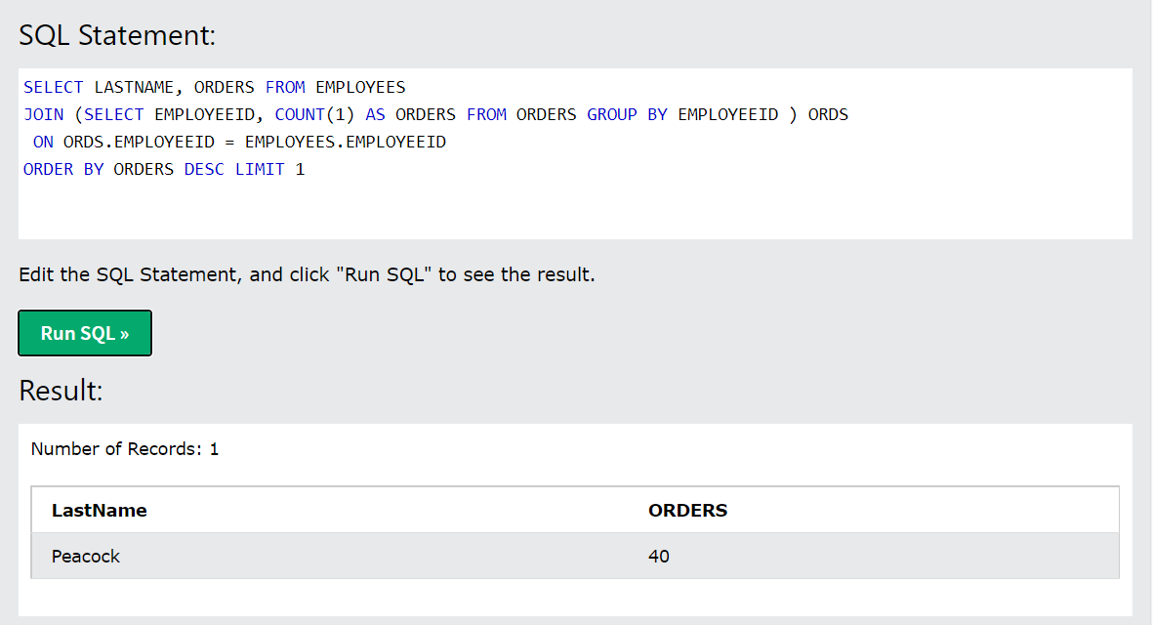
2. What is the last name of the employee with the most orders? (Another version)

Slide 4
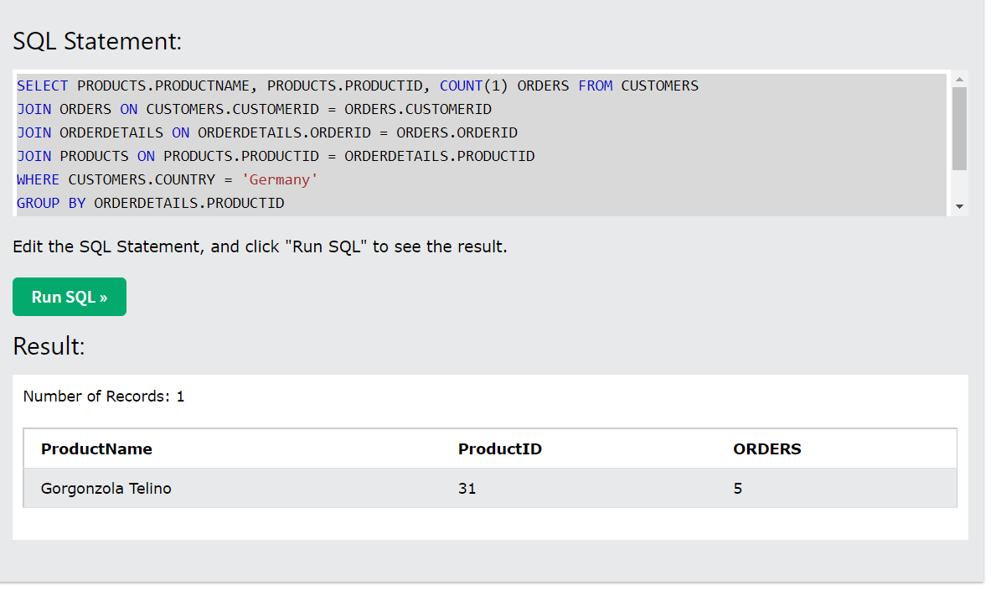
3. What product was ordered the most by customers in Germany?

