Slide 1
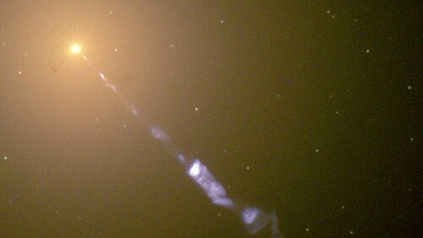
Modelling and Analysis of Multi-Messenger Blazar Spectra
Luke Hyndman – Supervisor: Dr Ankur Sharma
Notes:
Introduction, Ankur’s previous work

Slide 2
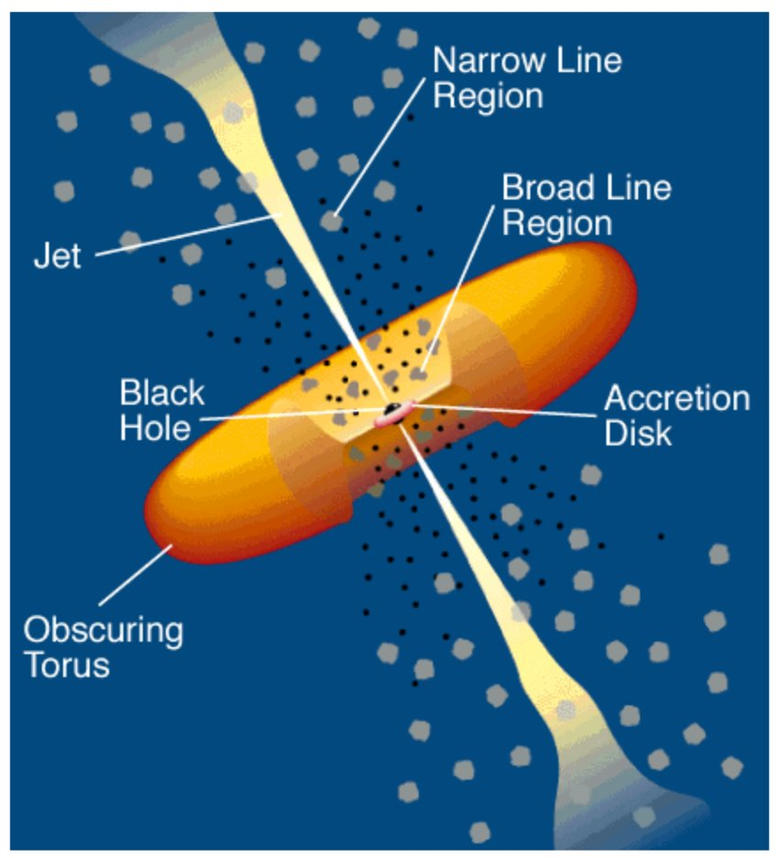
Blazars and Neutrinos
Blazars are a subset of active galactic nuclei (AGN)
Accreting super-massive black holes in other galaxies
Defining characteristic is a relativistic jet of material pointed along our line of sight (toward earth)
EM Spectrum that covers radio to high energy gamma rays
One blazar is a confident (3σ) neutrino source (TXS-0506+056)
We are very interested in finding neutrino sources at high energies
  Difficult as the flux at earth is low, also weakly interacting
Most neutrinos are formed in the jet through hadronic processes.

Slide 3
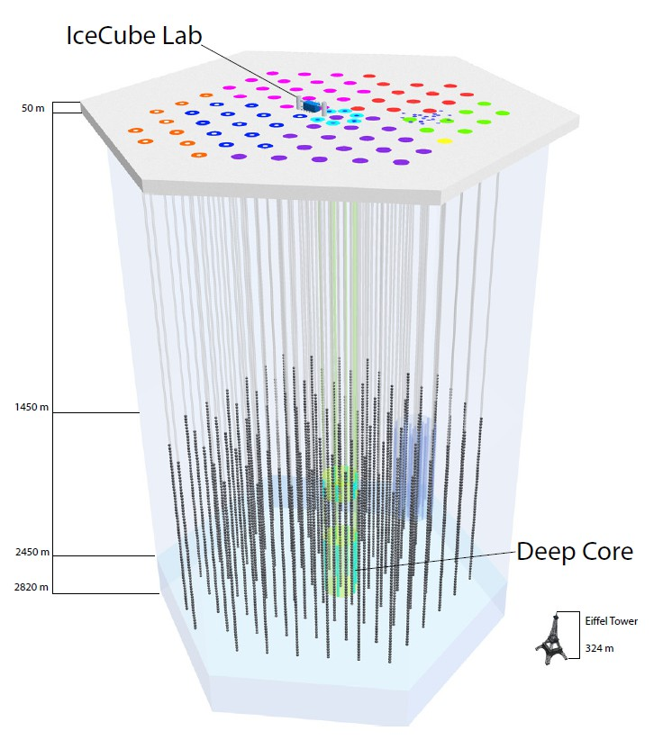
Project Overview
We think that at least some blazars are neutrino sources. (TXS-0506+056)
However, we have few neutrino observations that we can confidently say are connected to blazars.
We do have multiwavelength observations of blazar Spectral Energy Distributions (SEDs)
Given multiwavelength SEDs of blazars, what can we deduce about the blazar?
Use machine learning to attempt recovery of the parameters of the jet environment. (governs neutrino emission)
We will use a simulation engine to build our training set of SEDs. Attempting to cover a large chunk of the parameter space

Slide 4
Why Do This?
When we do catalogue searches for neutrino sources, the number of places we look effects the significance of individual trials.
As we look at more of the sky, the chances that we are seeing a background fluctuation increases.
So, we want to be able to deduce the expected neutrino flux and detectability at earth from a source's photon SED.
This would allow us to minimize the size of our catalogues for searching to just the most promising for neutrino emitters.

Slide 5
High Energy Astro-particle Modelling: AM3
AM³ (Astrophysical Multi-messenger Modelling): approximates the emitting region as a spherical blob moving along the jet axis
Time-dependent, self-consistent solver for the coupled evolution of protons, electrons, photons, pions, muons, and neutrinos in a one-zone model
Tracks the full particle cascade from injection to escape, returning steady-state photon and neutrino SEDs

Slide 6
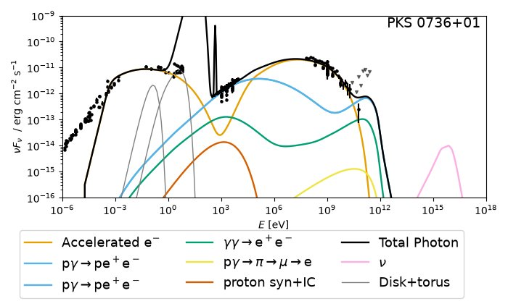

Slide 7
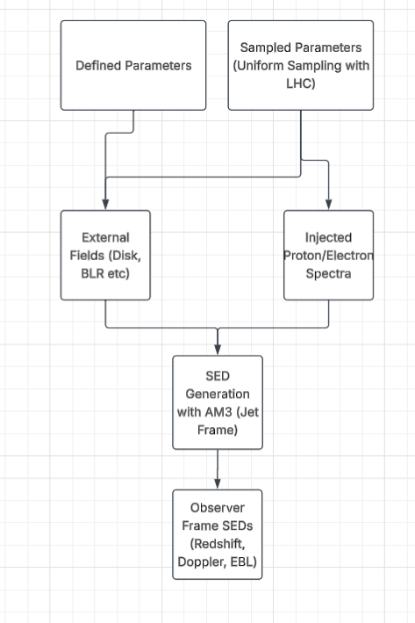
Current SED Generation Pipeline
Notes:
Define SED

Slide 8
Machine Learning Based Regression
Gradient-boosted histogram regression (Scikit-learn)
Attempting to return a parameter from just the SED
3 Cases:
  Photon SED only
  Adding neutrino SEDs as extra features (Not observationally realistic)
  Masking of photon SED (Flux weighted, observationally realistic)

Slide 9
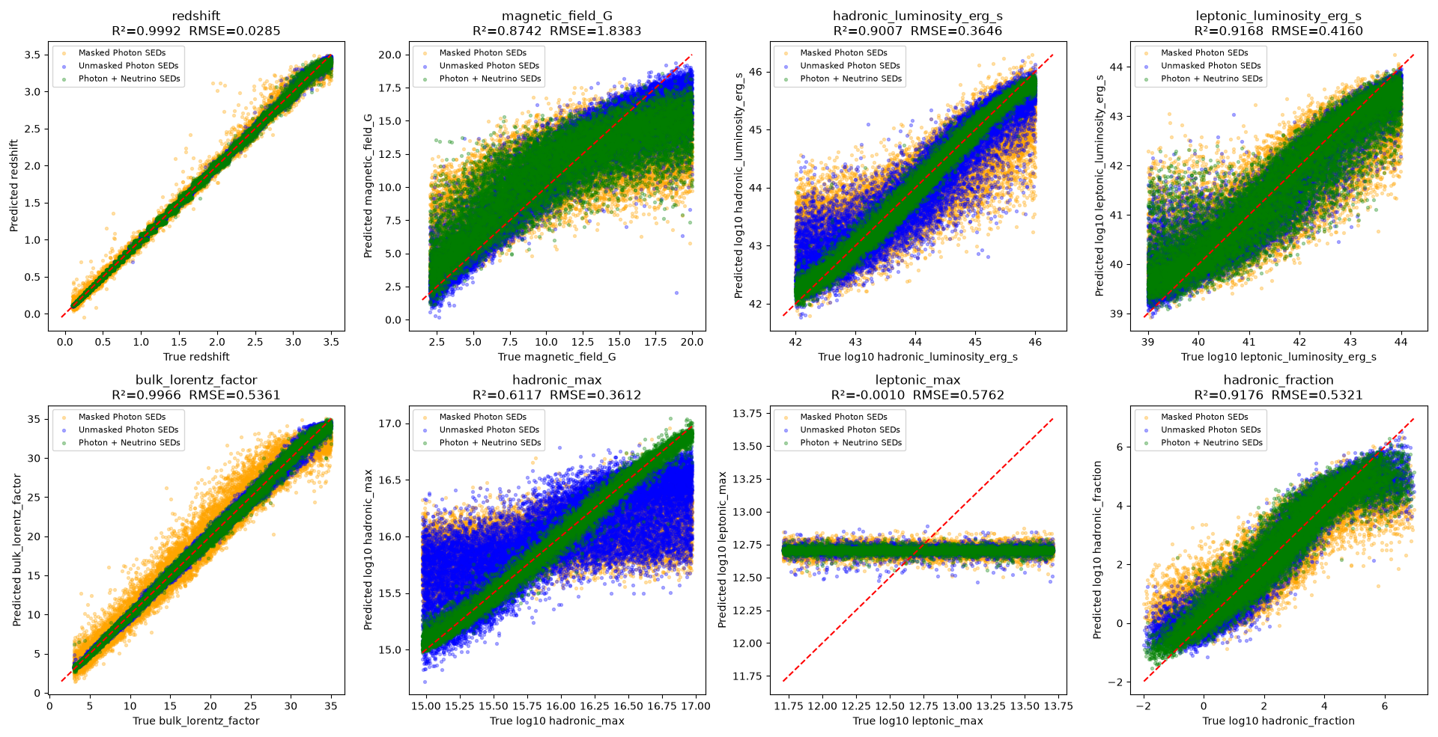
Stacked Regression Results

Slide 10
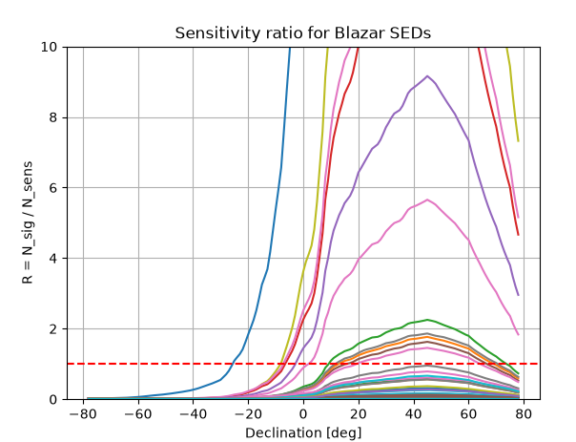

IceCube Detectability (Neutrinos)
Calculate expected signal events for source
Calculate expected events for hypothetical source at sensitivity
Find ratio of events by declination
Notes:
Simplify.

Slide 11
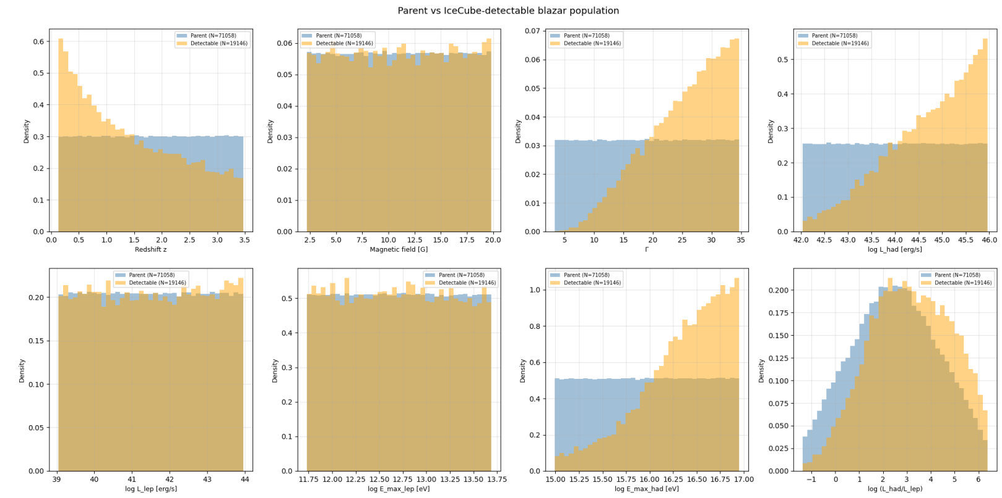

Slide 12
Caveats and Drawbacks
Many simulation assumptions and fixed parameters not yet varied (e.g. black hole mass, disk/torus geometry constants)
  Could be important for delineation of blazar subclasses
Training set is still small relative to the full accessible parameter space ~100k
Sensitivity ratio contains some baked in assumptions about neutrino flux power law that may not hold.
The results presented are very preliminary

Slide 13
Next Steps
Explore other regression models for stronger results, especially for masked and maximum-energy parameters
More rigorous sensitivity and discovery-potential modelling, accounting for non-power-law spectral shapes
Reducing our parameter space and/or implementing correlations between samples.
Semi-Final Goal:
Return neutrino SED (or maybe peak position) from a masked photon SED -> Ideal for real world catalogue search selection.

Slide 14
References
Aartsen et al. 2017, ApJ 835, 45
Abbasi et al. 2026, ApJ 998, 37
Klinger et al. 2024, ApJS 275, 4
Pedregosa et al. 2011, JMLR 12, 2825
Rodrigues et al. 2024, A&A 681, A119
Urry & Padovani 1995, PASP 107, 803
Waxman & Bahcall 1997, PRL 78, 2292
AM3 documentation: am3.readthedocs.io

Slide 15
Questions

Slide 16
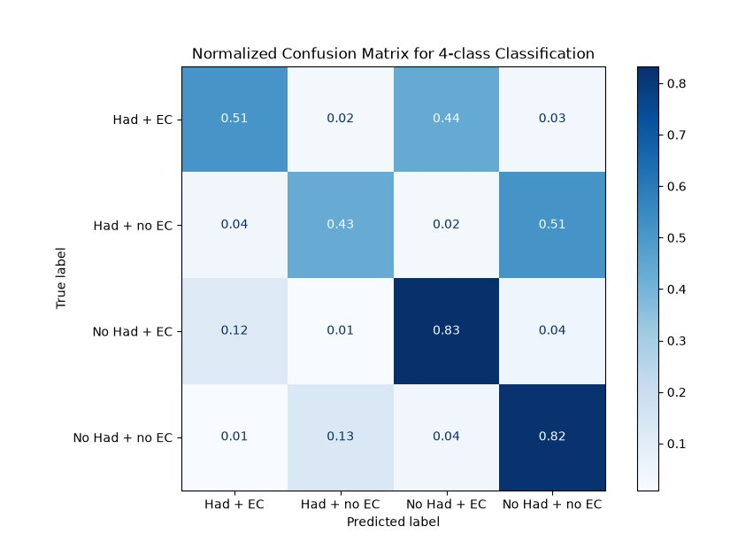
Classification (Backup)
Two independent binary labels: significant hadronic component (yes/no), significant external photon field (yes/no) -> 4 source classes
Same gradient-boosted approach as regression, adapted to 4-class classification..

Slide 17
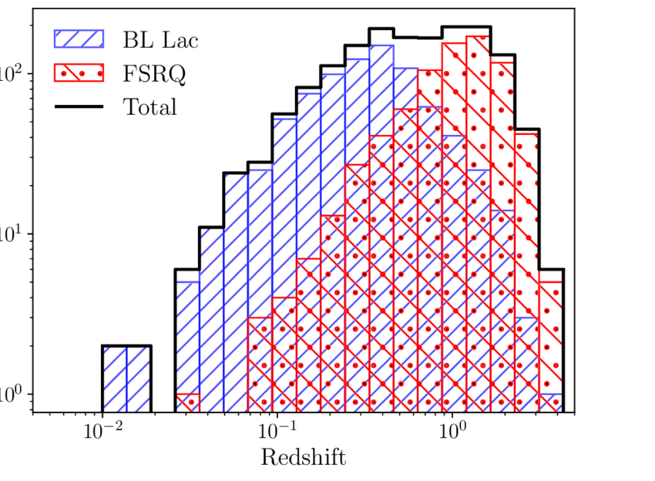
Blazar Subclasses (Backup)
Blazars divide into 2 subclasses:
Flat Spectrum Radio Quasars (FSRQs):
  Generally higher redshifts
  Strong accretion and jet power
  Stronger Emission Lines
BL Lacartae Objects (BL Lacs)
  Lower Redshift
  Weaker accretion
  Little to no emission lines

Slide 18
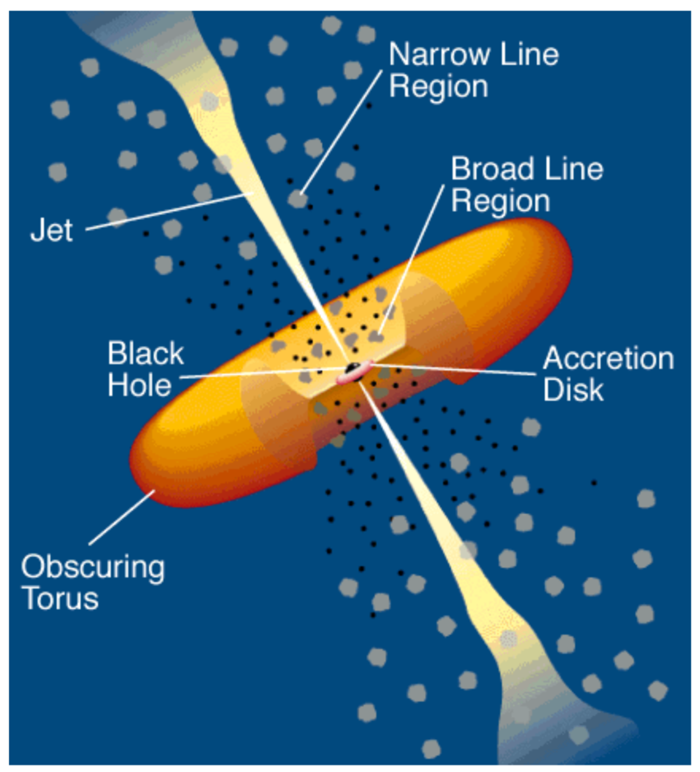
Setting the Stage: Blazars as Multi-Messenger Sources (backup)
There is an isotropic flux of high-energy neutrinos detected at IceCube, origin still unknown
After roughly 15 years of searching, AGN are the strongest candidates: the blazar TXS 0506+056 is one such AGN
TXS 0506+056: neutrino detection coincident with an elevated gamma-ray flare (Fermi-LAT): the first plausible neutrino–blazar association
Notes:
Explain current understanding of neutrino source detection

Slide 19
Blazar Parameters (Backup)
Uniform sampling of our parameter space
Parameter ranges anchored to the fit ranges from Rodrigues et al. (2024): 324 gamma-ray blazars
We avoid sampling parameters that are derivable from others, to preserve physical correlations
Key parameters: redshift, bulk Lorentz factor, magnetic field strength, and the injected hadron/lepton energy distributions
Hadronic and external-photon-field strength sampled as a continuous suppression factor

