Slide 1
current state
state proposal
current state
state proposal
current state
{A}
{A,B,C}
{A,B,C}
{A,B}
{A,B,C}
accepted
rejected

Slide 2
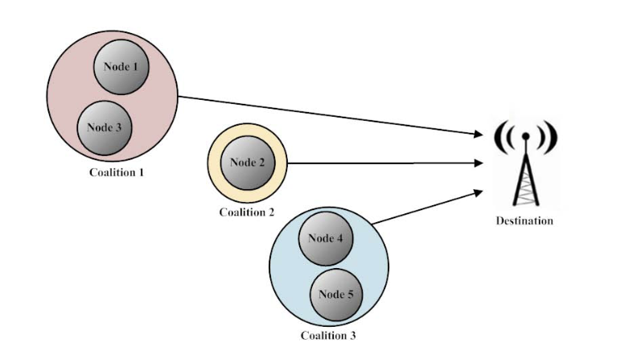
This is an example of a good diagram - for inspiration

Slide 3
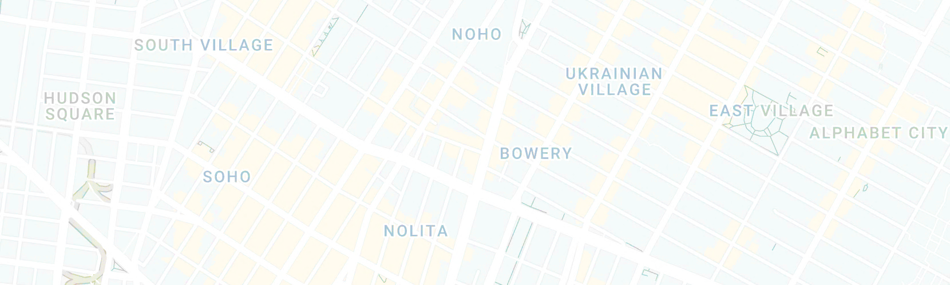










?
?
t₀
……..
t_{n}
Agents are exposed to different coalition configurations and select based on reward maximization

Slide 4
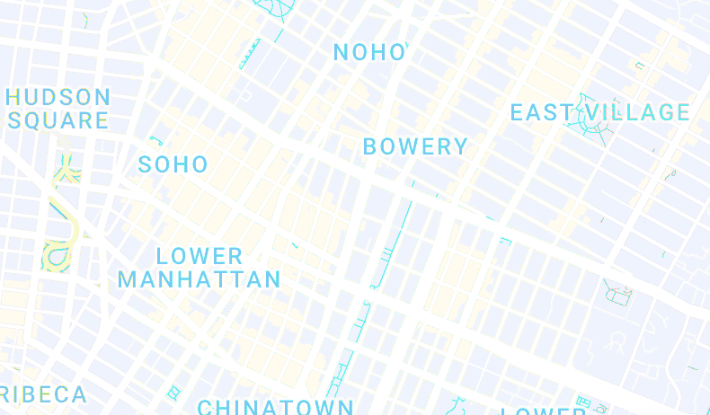



Color retouch of the image: https://www.youtube.com/watch?v=Egfn-Cd2q-M
Around minute 1
Also edges were rounded
coalition 1
updated coalition 1
coalition 2
updated coalition 2
t₀
……..
t_{n}
Coalition structures are set of coalitions that optimize the total travel time. As the number and location of agents change in time, the policy updates the coalitions and a new coalition structure is formed.

Slide 5
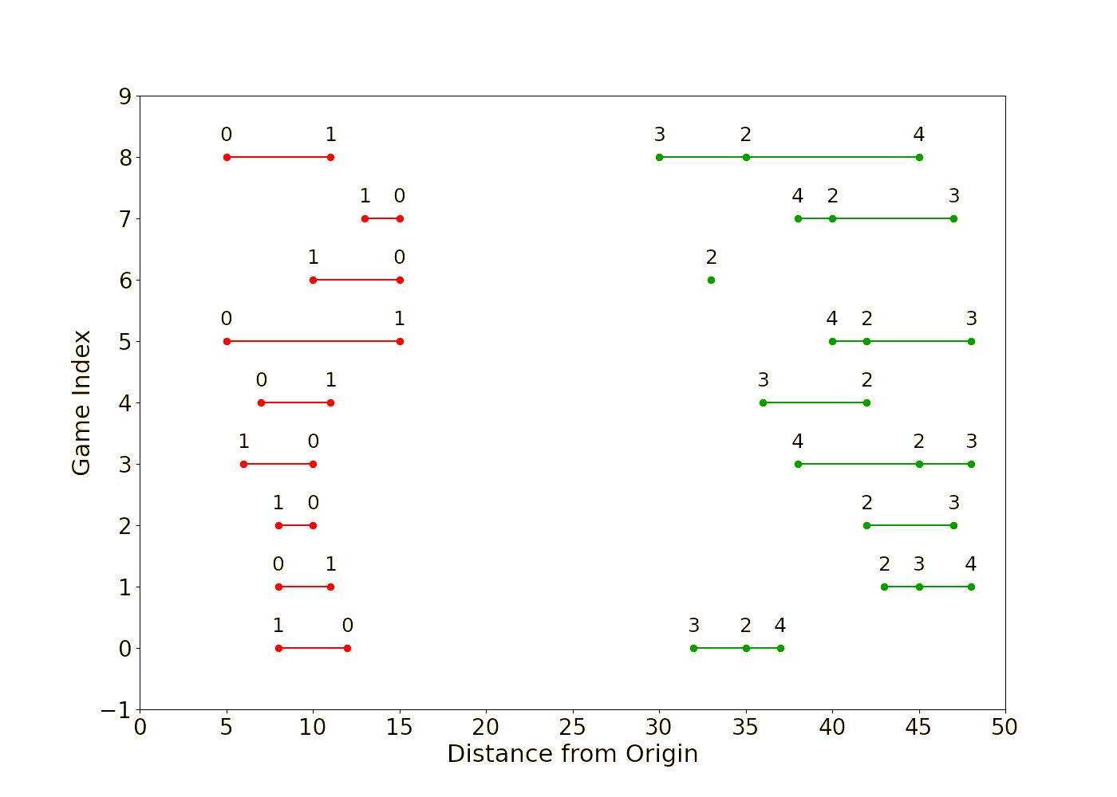

Slide 6
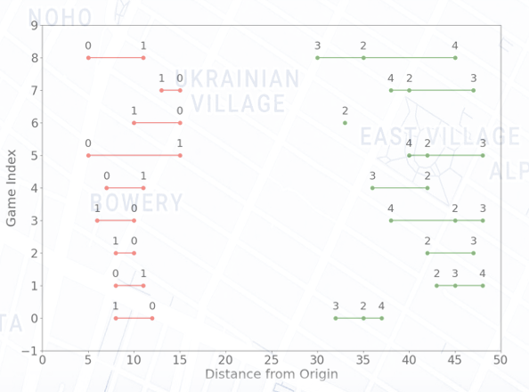

Slide 7
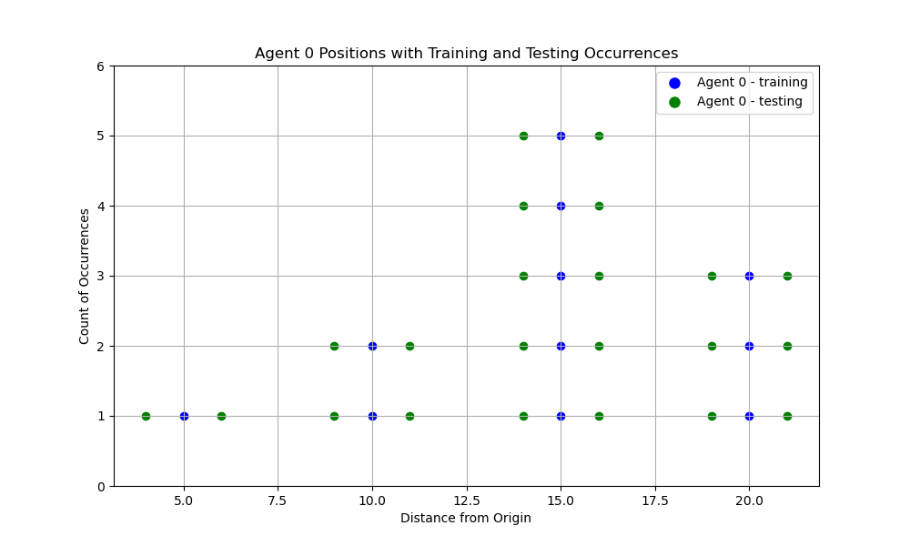
Agent 0 - Positions with Training and Testing Occurrences
Count of Occurrences
Agent’s location

Slide 8
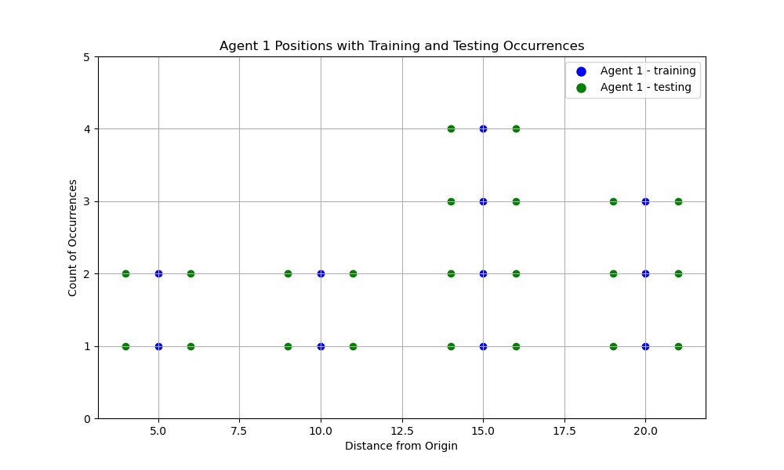
Agent 1 - Positions with Training and Testing Occurrences
Count of Occurrences
Agent’s location

Slide 9
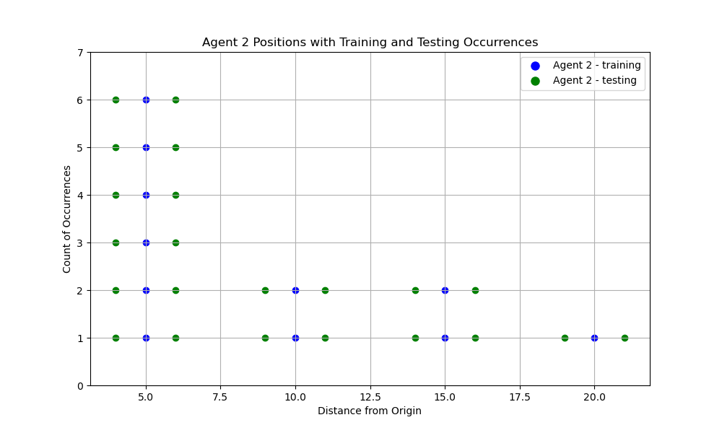
Agent 2 - Positions with Training and Testing Occurrences
Count of Occurrences
Agent’s location

Slide 10
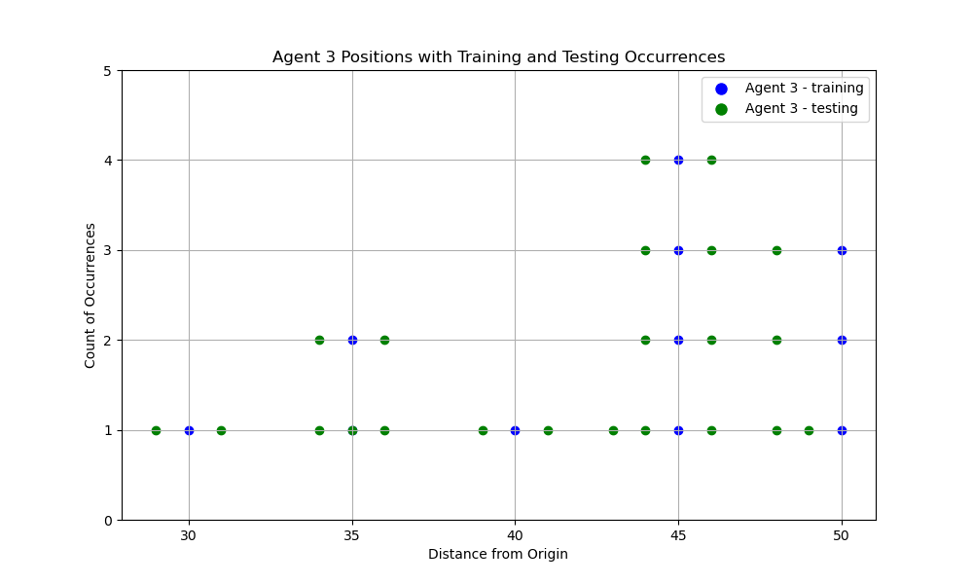
Agent 3 - Positions with Training and Testing Occurrences
Count of Occurrences
Agent’s location

Slide 11
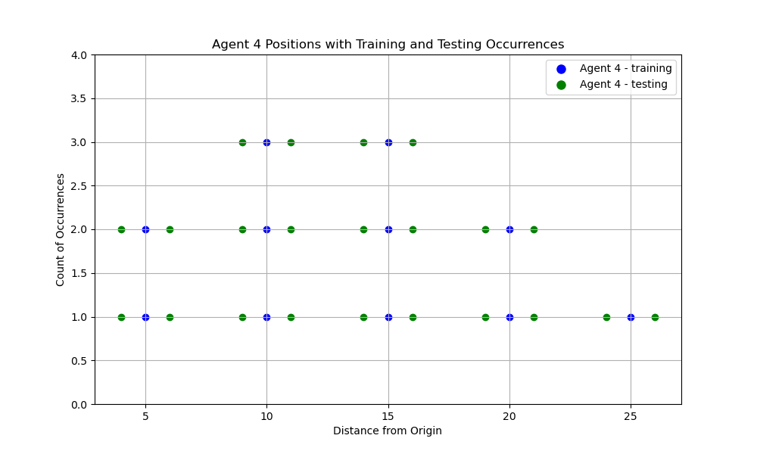
Agent 4 - Positions with Training and Testing Occurrences
Count of Occurrences
Agent’s location

Slide 12
agent state
state proposal
agent state
state proposal
agent state
state
{B}
{A,B,C}
{A,B,C}
{A,B}
{A,B,C}
accepted
rejected
reward
V(A) – V(0)
V(ABC) – V(B)
- V(A,B) + V(ABC)

Slide 13
agent state
state proposal
agent state
state proposal
agent state
state
{C}
{A,B,C}
{A,B,C}
{A,C}
{A,B,C}
accepted
rejected
reward
V(A) – V(0)
V(ABC) – V(C)
- V(A,B) + V(ABC)

Slide 14




Base station with multiple antennas

Slide 15

Base station with multiple antennas

